Slide 1
Biosafety and Biosecurity (Practical)
Safe Sharps Handling
3rd lecture
Ms. Banaz A. Salih

Slide 2
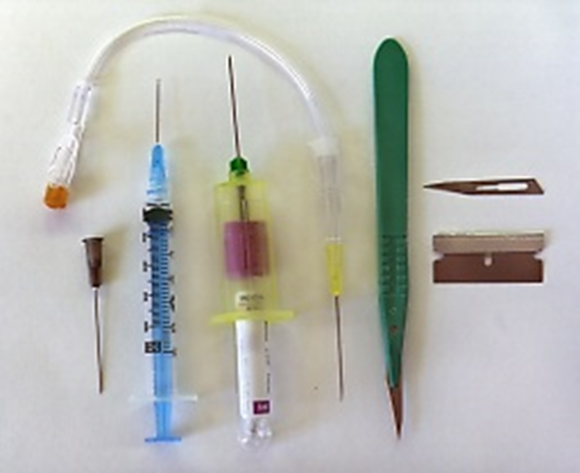
Sharp objects
They include new and used items that cause injuries and infection such as;
Lancets, Suturing needles
Syringe needles, surgical needles (CSF, biopsy)
Cannula, I.V fluid and Blood sets, scalp veins.
Surgical blades, Scalpels.
Glass slides.
Broken glasses ware
Such as ( tubes, pipettes).

Slide 3
Avoid incorrect practices
Don’t use the same syringe for more than one patient, even if the needle was changed
Don’t use the same medication vial for more than one patient, and accessing the vial with a syringe that has already been used to administer medication.
Don’t use a common bag of saline or other IV fluid for more than one patient with a syringe that has already been used to flush a patient’s catheter
Don’t leaving the needle in multi-dose vial

Slide 4
Safe handling practices
Don't break, bend or recap syringes needles.
Don’t remove the needle by hand or use one hand.
Throwing whole syringe is preferred.
Collect in special leak-proof containers.
Never fill the sharp containers (only 2/3).
Don’t let bare needles in vials.
Use needles once (disposable).
Don't use broken glassware and collect separately.
Use new safe designed sharps.

Slide 5
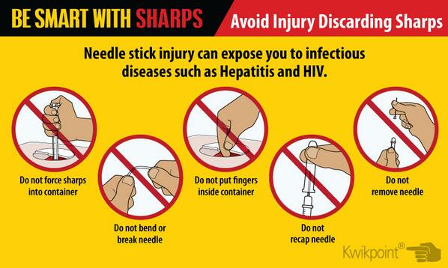
Be care

Slide 6
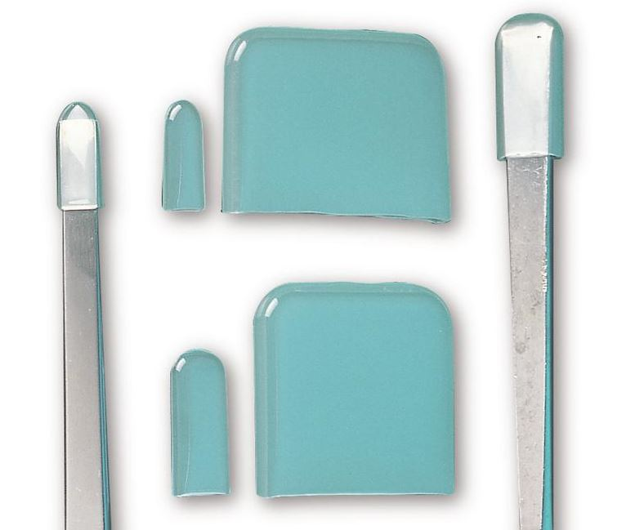

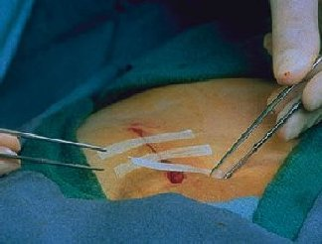
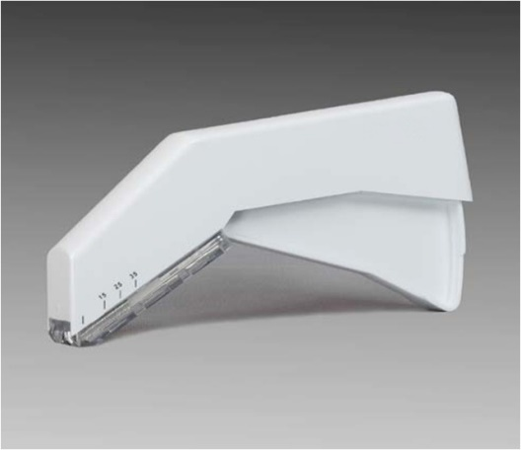
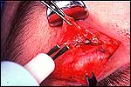
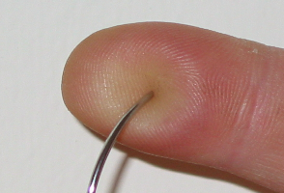
New technology
Blunt suture
Blunt suture needle
Sharp cover
Use cautery
Adhesive strips
Stapling device

Slide 7
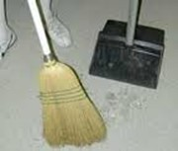
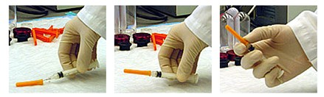
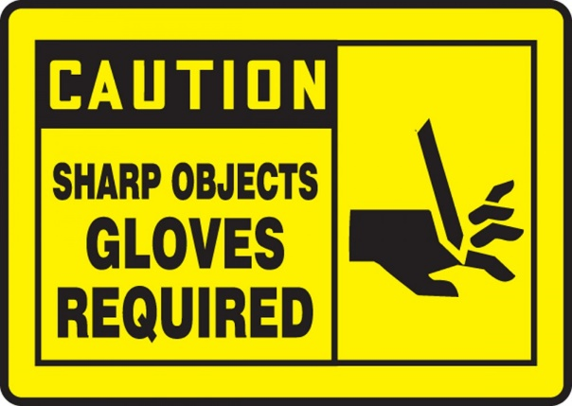
Clean Up and Dispose With Care
How to remove Disposed Sharps in Work Environment
  Insert syringe in to the needle with one hand
  Use mechanical device if you cannot safely pick up sharps by hand
  Wear thick gloves
  Use brush and dust pan
Notes:
If you encounter improperly disposed sharps in the work environment, handle them carefully. Keep your hands behind sharps at all times. Use a mechanical device to pick up sharps if they cannot be handled safely.

Slide 8
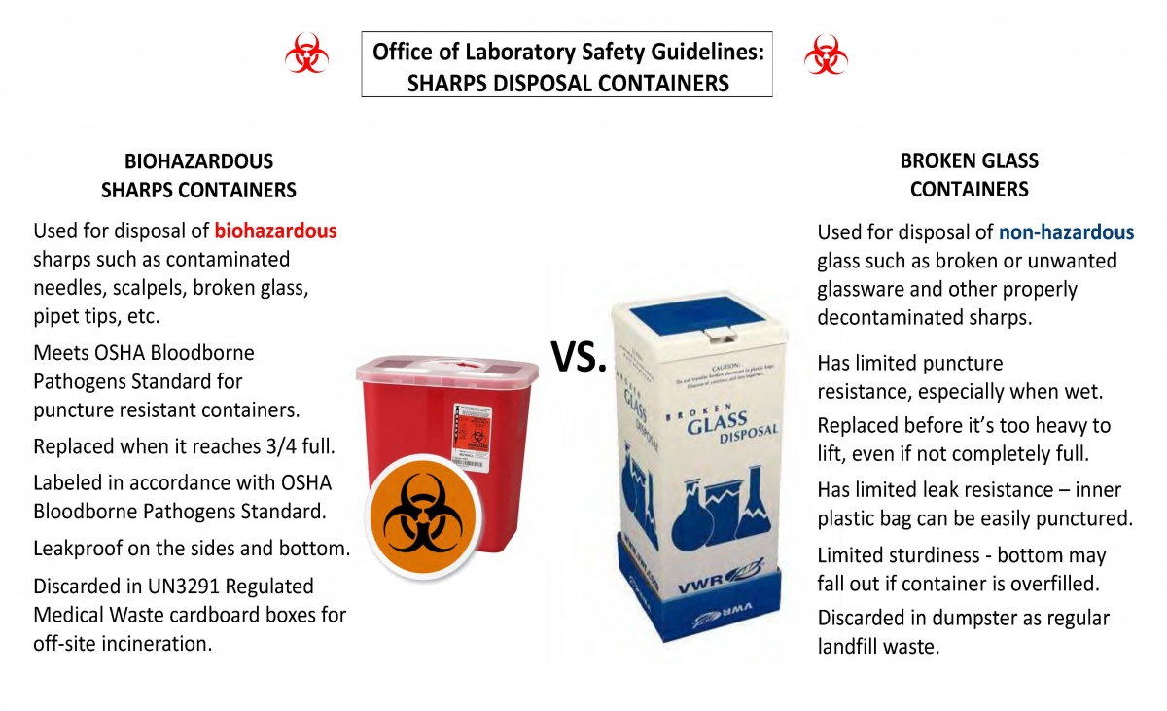

Slide 9
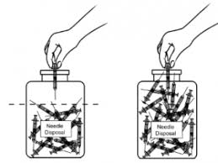
These containers must be:
Plastic or hard water resist paper
Puncture resistant and leak-proof.
  Not re-openable
With or without handle
Color-coded, Yellow or orange with symbol.
With mark of three quarter filling
Place it at the site of use
With bio-hazrad writing.
Automatically closed when ¾ filled

Slide 10
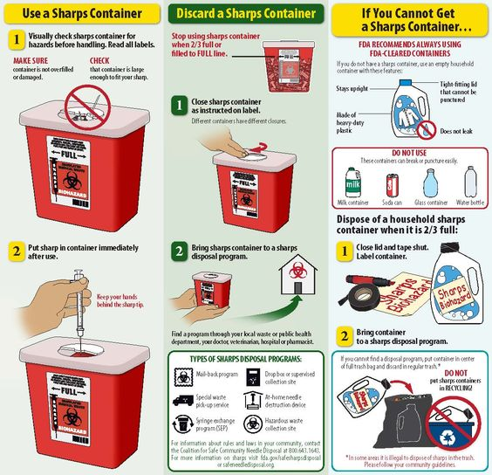

Slide 11
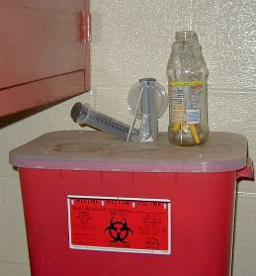
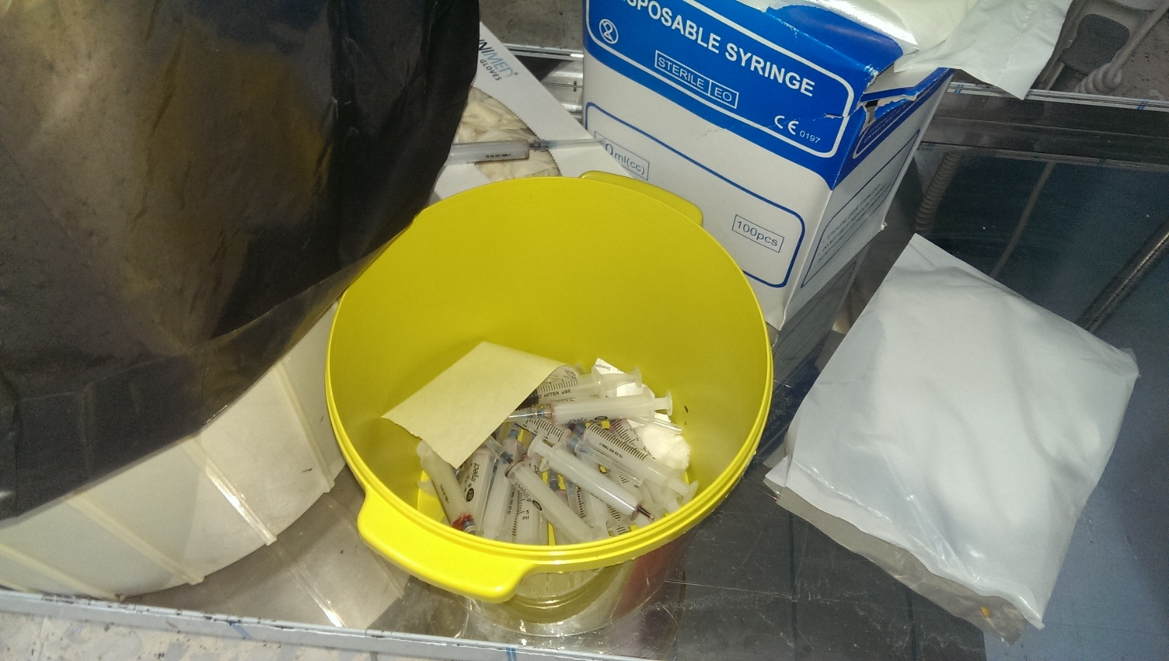
Correct or Not and why?

Slide 12
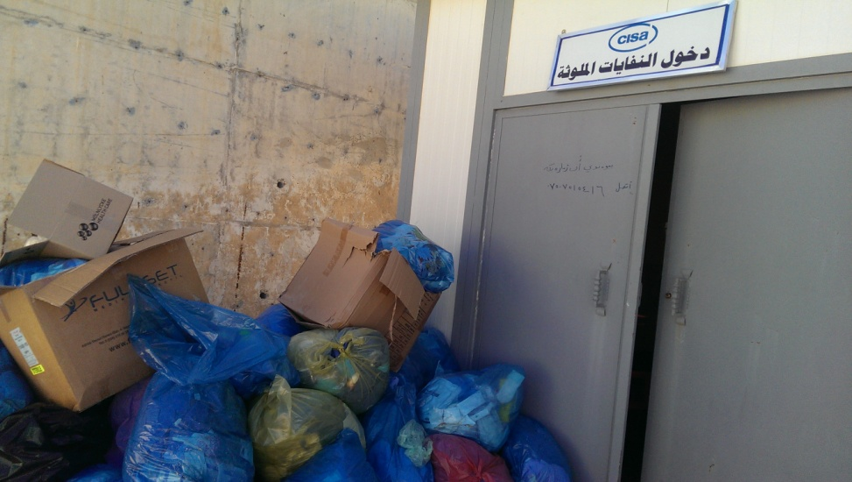
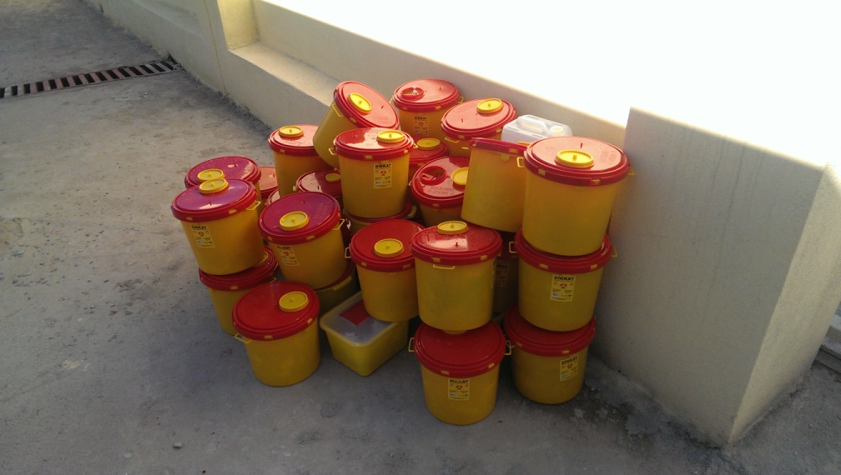
Autoclave shredder unit

Slide 13
Medical waste management techniques
Chemical and pharmaceutical waste | Sharp waste | Pathological waste | Infectious waste | Technique | S.N
Small amounts | Y | Y | Y | Incineration | 1
N | Y | N | Y | Chemical disinfection | 2
N | Y | N | Y | Autoclaving | 3
N | Y | N | Y | Microwaving | 4

Slide 14
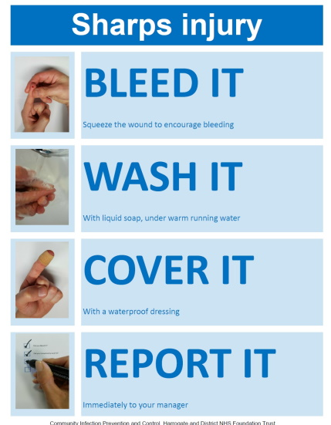
Needle stick injuries safety protocol
Don’t squeeze, suck or rub the wound.
Encourage bleeding by Immediate washing it with soap under running tap water for 30 seconds.
Dry it , apply antiseptic and dressing.
Flush splashes to nose, mouth or skin with water.
Report the incident to your supervisor.
Seek medical treatment within 24 hours.

Slide 15
Needle stick injury care steps
Wound care.
Report the event to the supervisor
Asses the injury by fluid type, needle type, and blood amount.
Asses the patient (source) status for HIV, HCV and HBV.
Asses the person for HIV, HCV and HBV if the of blood source is unknown

Slide 16
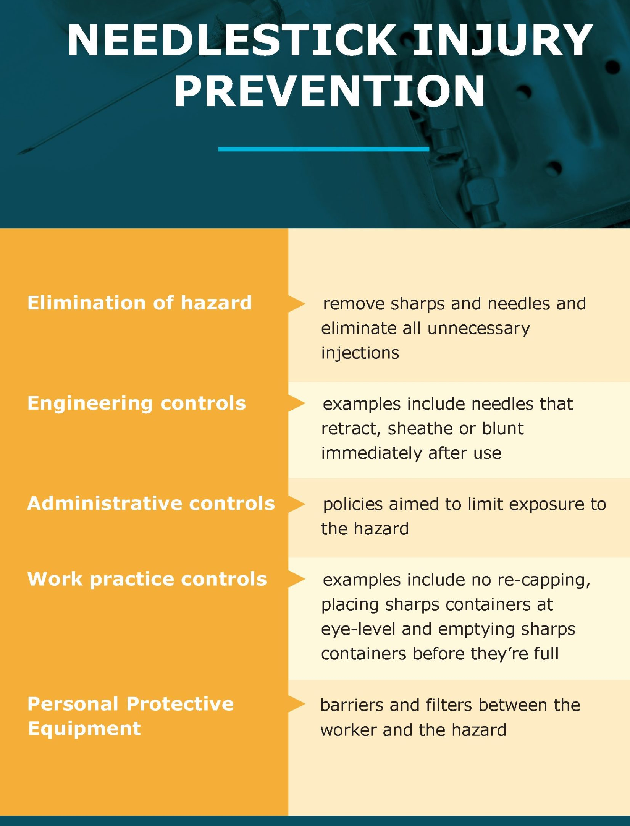
The summery of needle stick prevention

