Slide 1

Biosafety and Biosecurity (Practical)
Personal Protective Equipment (PPEs)
Second lecture
Ms. Banaz A. Salih

Slide 2
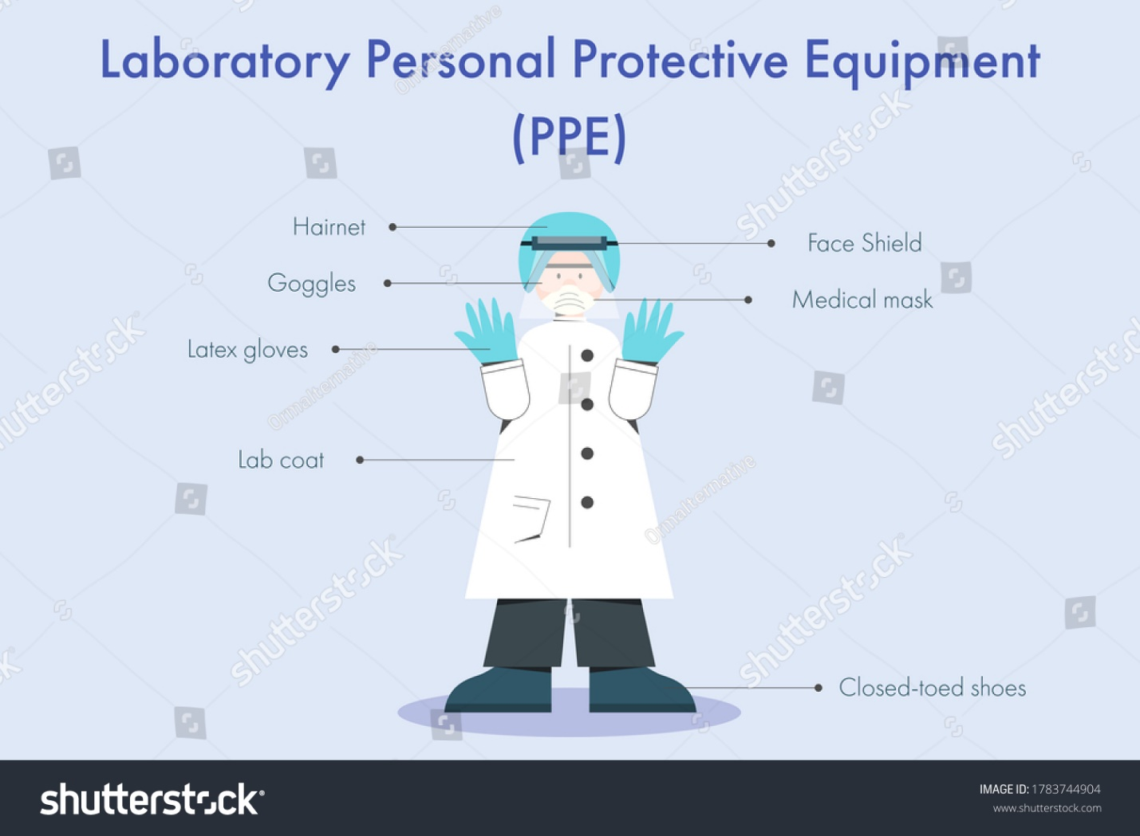

Slide 3
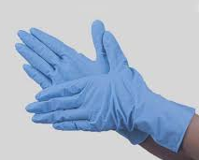
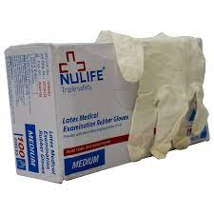
None Surgical Gloves
Examinations gloves and other nonsurgical procedures involving contact with mucous membranes; laboratory procedures
None sterile, Single-use disposable, Natural rubber latex (NRL), Nitrile or Polyvinyl chloride (vinyl), Polyethylene (plastic), Non powdered for PCR
Non-medical nitrile gloves give great comfort and sensitivity. These disposable gloves are exceptionally useful for when frequent glove changing is required, especially for serving food and other sanitation applications

Slide 4
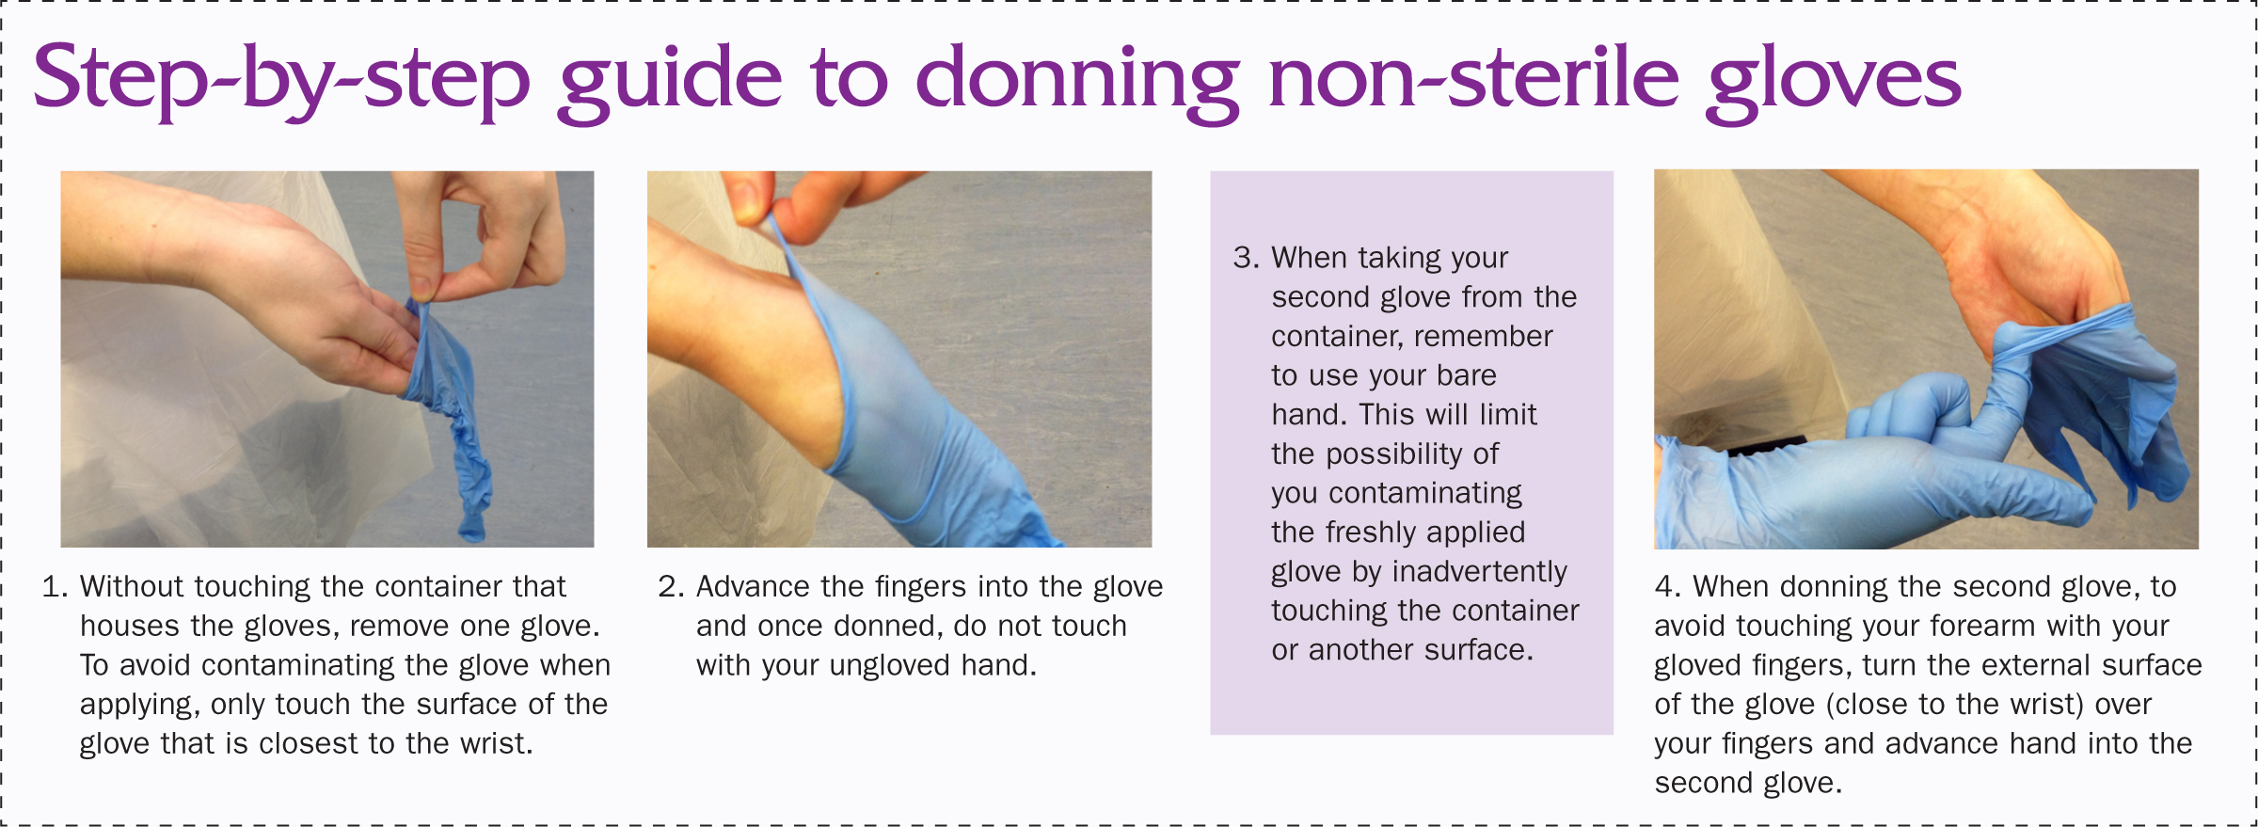
How to put on Non-Surgical Nitrile Gloves:
Thoroughly wash hands, Select the sized of the glove.

Slide 5
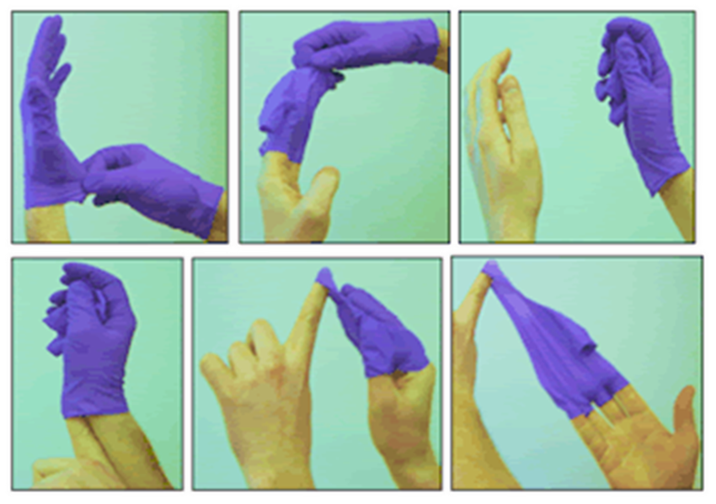
How to remove Non-Surgical Nitrile Glove
Grasp the outside of one glove at the wrist.
Do not touch your bare skin.
Peel the glove away from your body, pulling it inside out.
Hold the glove you just removed in your gloved hand.
Dispose of the gloves safely. Do not reuse the gloves.
Thoroughly wash your hands immediately after removing non-medical gloves.

Slide 6
HOW WE CAN USE GLOVES
Work from “clean to dirty” and Limit “touch contamination”
Don’t touch your face or adjust PPE with gloves
Don’t touch environmental surfaces except as necessary .
Change gloves if torn and when heavily soiled (even during use on the same patient and after use on each patient.
Washing of latex gloves with plain soap, chlorhexidine, or alcohol can cause micropunctures.
Wearing gloves does not replace the need for handwashing.

Slide 7
Gowns
Select appropriate type and size, Opening is in the back, Secure at neck and waist, If gown is too small, use two gowns
It protect skin and clothing from blood or body fluids .
Use a gown for the care of only one patient
Remove gown and perform hand hygiene before leaving .
Visitors wear gowns if they are visiting a patient who is in isolation due to an illness that can be easily spread.

Slide 8
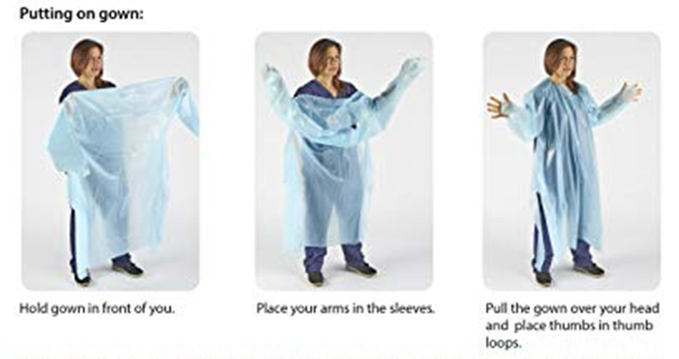
Wearing the gowns

Slide 9
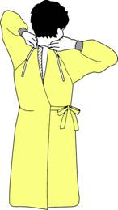
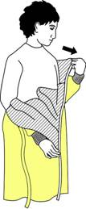
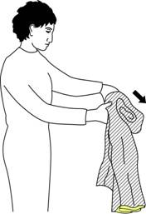
Removing Isolation Gown
Unfasten ties
Peel gown away from neck and shoulder
Turn contaminated outside toward the inside
Fold or roll into a bundle
Discard it with medical waste
Notes:
Unfasten the gown ties with the ungloved hands. Slip hands underneath the gown at the neck and shoulder, peel away from the shoulders. Slip the fingers of one hand under the cuff of the opposite arm. Pull the hand into the sleeve, grasping the gown from inside. Reach across and push the sleeve off the opposite arm. Fold the gown towards the inside and fold or roll into a bundle. (Only the “clean” part of the gown should be visible.) Discard into waste or linen container, as appropriate.

Slide 10
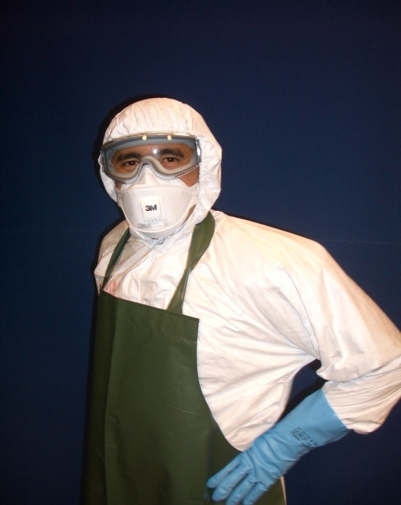
Apron
Apron may be worn
if there is concern over
splash with infectious
body fluids
AND
The coverall/gown is not impermeable
OR
Heavy duty with risk of disrupting the coverall/gown

Slide 11
Face Masks (Face Protection)
Masks – protect nose and mouth
There are several types of masks ,they vary in shape (rectangular, round) and method of securing (elastic, ties)
They do not protect you from airborne transmitted diseases, just droplet transmitted disease. prevent fluid penetration.
Mask and goggles or a face shield are used during patient care activities likely to generate splashes or sprays of blood, body fluids, secretions, or excretions.

Slide 12
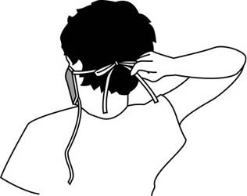
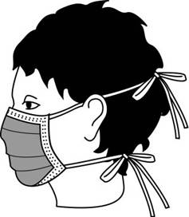
How to Don and doff a Mask
Place over nose, mouth and chin
Fit flexible nose piece over nose bridge
Secure on head with ties or elastic
Adjust to fit
Untie the bottom, then top, tie
Remove from face
Discard

Slide 13
Respiratory Protection
Purpose – protect from inhalation of infectious aerosols (e.g., Mycobacterium tuberculosis)
PPE types for respiratory protection
1. Particulate respirators
2. Half- or full-face elastomeric respirators
3. Powered air purifying respirators (PAPR)

Slide 14
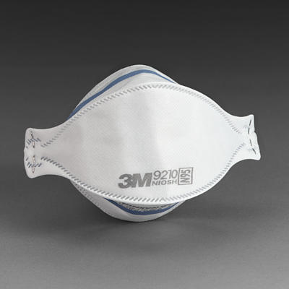
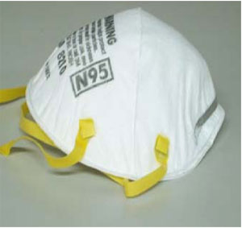

Particulate Respirators
Help prevent inhalation of infected particles
Existence of different models. Do not wear a respirator with an exhalation valve if you have a respiratory infection!
Use correct size, fit over nose and mouth
Main drawbacks:
  Difficult/uncomfortable to use
  Very expensive
  Leak: >15%

Slide 15
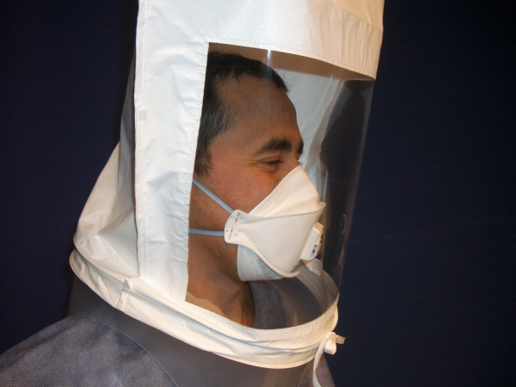
Fit test ≠ Seal check
Seal check
  helps check if the respirator is well adjusted to the face
  should be done before EACH USE
Users should be trained on how to use the respirator
Notes:
Reference: Clayton M & Vaughan N, Ann occup Hyg, Vol 49, No. 7, pp. 545 – 548, 2005
Particulate respirator wearers should be trained how to use the device (e.g. putting on of respirator, avoidance of self-contamination during use and upon removal, and ways to achieve the best seal). The application of fit testing to improve HCWs' ability to comply with adequate use of respirators has been evaluated and has not been shown to be an effective means to improve compliance.
Ref:Hannum D, Cycan K, Jones L, et al. The effect of respirator training on the ability of healthcare workers to pass a qualitative fit test. Infect Control Hosp Epidemiol 1996;17(10):636-40.

Slide 16
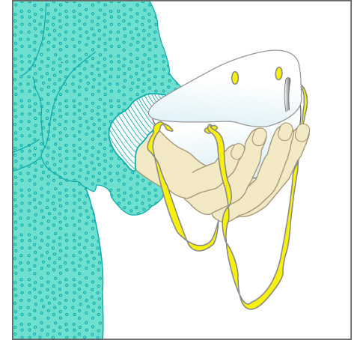
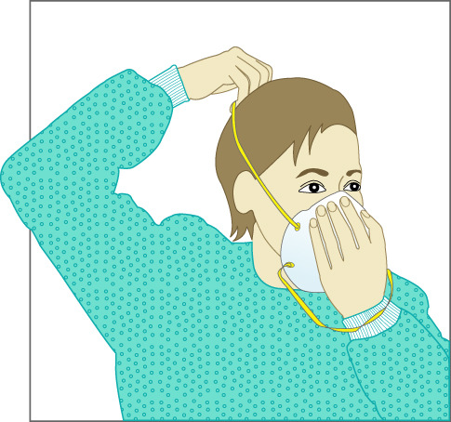
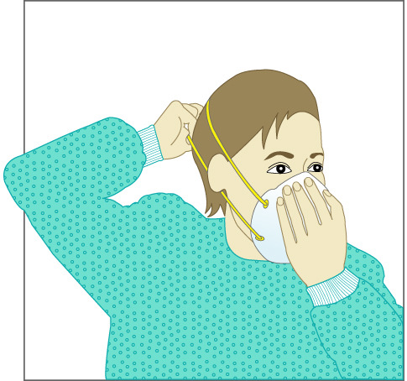
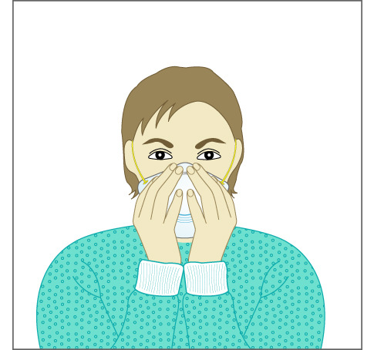
Sequence of a particulate respirator seal check
Cup the respirator in your hand with the nosepiece at your fingertips allowing the headbands to hang freely below your hand
Position the respirator under your chin with the nosepiece up
Pull the top strap over your head resting it high at the back of your head. Pull the bottom strap over your head and position it around the neck below the ears
Cover the front of the respirator with both hands, being careful not to disturb the position of respirator

Slide 17
Sequence of a particulate respirator seal check
Cover the front of the respirator with both hands, being careful not to disturb the position of respirator
Positive seal check
Exhale sharply. A positive pressure inside the respirator = no leakage. If leakage, adjust position and/or tension straps.
Retest the seal and repeat the steps until respirator is sealed properly
Negative seal check
Inhale deeply. If no leakage, negative pressure will make respirator cling to your face
Leakage will result in loss of negative pressure in the respirator due to air entering through gaps in the seal

Slide 18
Taking off PPE
Remove the most contaminated PPE items first.
Hand hygiene must be performed immediately after glove removal
Perform hand hygiene whenever ungloved hands touch contaminated PPE items
The last PPE item to be removed should be the mask or particulate respirator
Discard disposable items in a closed rubbish bin
Put reusable items in a dry closed container

