Slide 1
Biosafety and Biosecurity (Practical)
Hand Hygiene and Care
1st lecture
Ms. Banaz A. Salih

Slide 2
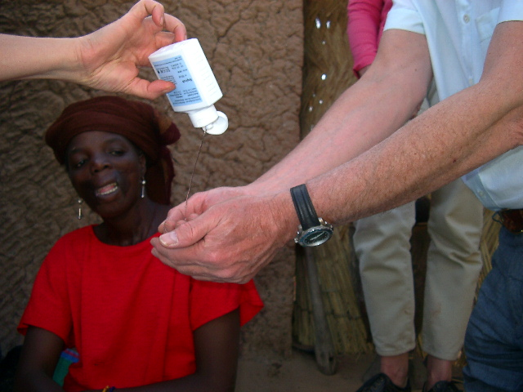
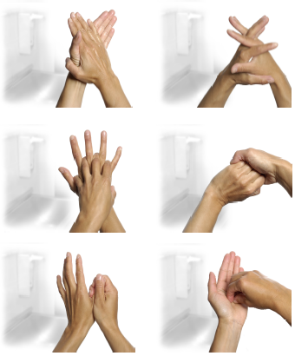
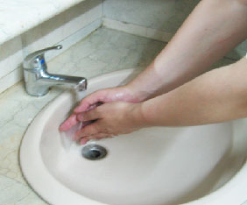
Hand Hygiene
- Clean hands reduce the burden of infection
- Alcohol based hand rubs are the gold standard for hand hygiene in health care (unless hands are visibly soiled).

Slide 3
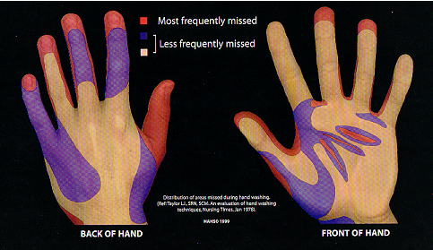
Areas Most Frequently Missed
Hand washing missed areas
HAHS © 1999

Slide 4
Hand Care
Nails, should be cut and short, avoid artificial nails and staining.
Rings should be removed during hand washing
Hand creams to save dryness could be used
Cuts & abrasions should be covered
“Chapping” avoided
Skin Problems should be treated but if large lesions exist avoid working.

Slide 5
Key Times to Wash Hands
Before and after preparing and eating food
Before and after caring for someone at home who is sick with vomiting or diarrhea
Before and after treating a cut or wound
After using the toilet
After changing diapers or cleaning up a child who has used the toilet
After blowing your nose, coughing, or sneezing
After touching an animal, animal feed, or animal waste
After touching garbage

Slide 6
Follow these steps for at least 40-60 seconds
Remove jewelry and watch then Wet your hands with running water (warm or cold), turn off the tap, and apply enough soap.
Lather your hands by rubbing them together with the soap, start from the palm and backs of your hands, between and back of your fingers, big finger and under your nails then wrist.
Scrub your hands for at least 20 seconds.
Rinse your hands well under clean, running water then turn off the tap with dry tissue or your elbow.
Dry your hands with clean towel, disposable tissue or air dry.

Slide 7
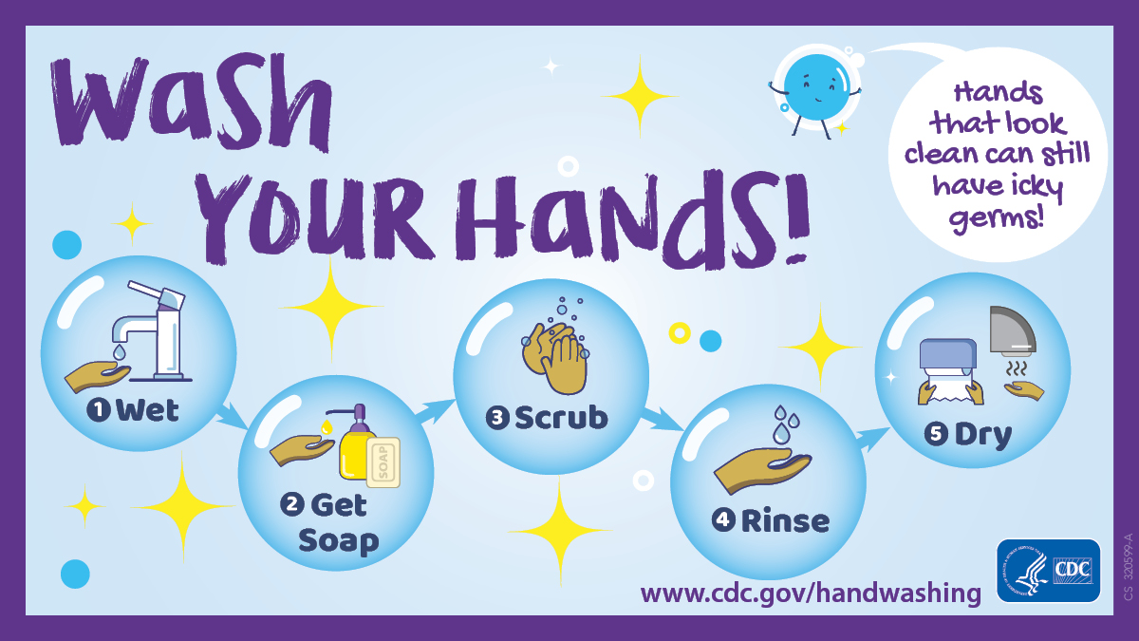
Follow five steps of hand washing

Slide 8
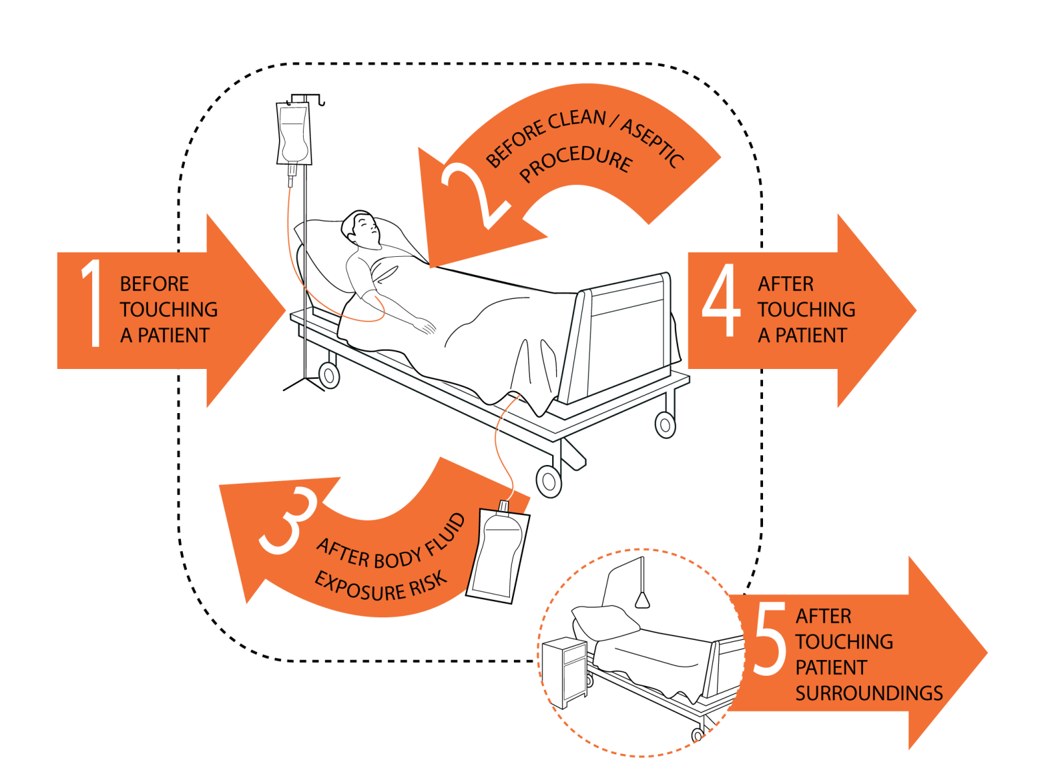
The “My 5 Moments for Hand Hygiene” approach
Before patient contact
Before aseptic task
After body fluid exposure task
After patient contact
After contact with patient surroundings

Slide 9
How to handrub
To effectively reduce the growth of germs on hands, handrubbing must be performed by following all of the illustrated steps.
This takes only 20–30 seconds!

Slide 10

Time constraint = major obstacle for hand hygiene
Adequate hand washing with water and soap requires
40–60 seconds
Average time usually adopted by health-care workers:
<10 seconds
Alcohol-based
Hand rubbing: 20–30 seconds

Slide 11
The effect of water, soap and alcohol
Unwashed
Running water
Soap and water
alcohol and soap

