Slide 1
Environmental Cleaning, sanitization and Disinfection in health facilities
4th Lecturer
Ms. Banaz A. Salih
Notes:
fcyu

Slide 2
Definitions
Environmental Cleaning:
It is the process of mechanical removal (manual or electrical) of surface contaminants such as (dirt, dust, oils, spills ,food particles …etc.) from surfaces by washing, brushing, or wiping the area.
The cleaning mechanically removes 80% of microorganism while doesn’t include killing of them.
Common cleaning products include: Soaps, Detergents, Vacuums, Dusters, Degreasers, Glass Cleaners

Slide 3
Definitions
Sanitizing
Sanitizing means to reduce the number of microorganisms 99.999% in 30 seconds on a surface after it has been cleaned to the level that is deemed safe by the public health standards.
It is an extremely important practice in restaurants, schools, corporate offices, and hospitals often several times a day such as for Cutting Boards, Worktables, Pots and Pans, Serving Utensils, Countertops, Cooking Equipment.

Slide 4
Definition
Disinfection
*Killing of 99.999% of infectious bacteria, viruses, and fungi within a 5-10 minutes period.
*It is recommended to disinfect frequently touched surfaces by Bleach, Alcohol, Chlorine.
*Light Switches, Door Handles, Elevator Buttons, Handrails, Bathroom Surfaces, Faucet Handles, Computer Keyboards and Mice Phones

Slide 5
Aims of environmental cleaning
To remove the pathogen growth sources because they live on dirt
To get rid of bad smell from pathogen growth
To remove environment pollutant
To provide clean healthy environment in health facilities without insects
To ensure provision of healthy services

Slide 6
Cleaning Procedures
The cleaning process is performed through dry vacuuming or wet mopping with *water alone or *with water and liquid soap and or shampoo.
It is essential for cleaning surfaces, walls and floor of health facilities.
and it should be performed in scheduled running.

Slide 7
Components of cleaning program
Cleaning services unit and cleaning officer
Written protocol with annual budget
Written cleaning schedule
Cleaning Supervisors.
Cleaning audits
Well dedicated trained cleaning personnel

Slide 8
Components of cleaning process
Availability of (PPEs) such as special shoes, gloves masks and uniforms
Cleaning supplies such as brooms, brushes, mops, cloth pads
Collecting waste containers such as bins.
Cleaning solutions (liquid soap and shampoo).
Colored waste collections bags .
Monthly reporting

Slide 9
General basics of cleaning
It is more important than sterilization process because it simplify the sterilization process
Floors and surfaces should be cleaned daily before and after work and on need to avoid sticking of dirt spots.
Cleaning of walls and roofs should be performed according to soiling degree or it should be performed weekly

Slide 10
General basics of cleaning
Wet mopping is preferred since dry cleaning produce dust aerosols
Dry cleaning should be able to absorb the dust
Heavy duty gloves should be used during work
The cleaning should be aggressive to remove dirt spots and spots should be removed first
Immediately Attend to Body Fluid Spills

Slide 11
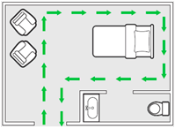
General basics of cleaning
The cleaning should be as S shape and not forward backward
Start cleaning process from up to down and from rear to front and from clean to dirty area.
Proceed in a systematic manner to avoid missing areas—for example, left to right or clockwise.

Slide 12
General basics of cleaning
Waste of each room should be collected on site separately.
Waste should not be left for more than one hour on site
All waste bin should be closed to avoid insect attraction.
Waste bins should be away from traffic areas
Avoid inserting hands or legs and compressing segregation of waste within waste bins

Slide 13
The best practices tips for cleaning of surfaces
Avoid using same cleaning pads for different areas .
Use color codes pads (Yellow, Green and Blue) .
Don’t leave mops and brooms wet in cleaning solution bins, keep them dry and store separately
Change supplies when are no more absorbing.
Use fresh cleaning cloths at the start .
Never double-dip cleaning cloths into portable containers .
Never shake mop heads and cleaning .

Slide 14
The general surface cleaning process:
Thoroughly wet (soak) a fresh cleaning cloth in the environmental cleaning solution.
Fold the cleaning cloth in half twice until it is about the size of your hand (8 sides).
Wipe surfaces using the general strategies and making sure the surface is thoroughly wetted .
Regularly rotate and unfold the cleaning cloth to use all of the sides, dispose it or reprocess it.

Slide 15
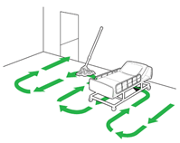
General mopping process:
Immerse the mop or cloth in the bucket with environmental cleaning solution and wring out.
Mop in a figure-8 pattern with overlapping strokes, turning the mop head regularly (e.g., every 5-6 strokes).
After cleaning a small area (e.g., 3m x 3m), immerse the mop or floor cloth in the bucket with rinse water and wring out.
Repeat process from step 1.

Slide 16
General terminal cleaning process:
Remove soiled/used personal care items (e.g., cups, dishes) for reprocessing or disposal.
Remove facility-provided linens for reprocessing.
Inspect window treatments. If soiled, clean blinds on-site, and remove curtains for laundering.
Reprocess all reusable care equipment;
Clean and disinfect all low- and high-touch surfaces,
Clean (scrub) and disinfect hand washing sinks.

Slide 17
General mopping process
Use wet floor or caution signs.
Mop from cleaner to dirtier areas.
Mop in a systematic manner, proceeding from area farthest from the exit and working towards the exit.
Change mop heads/floor cloths and buckets of cleaning and disinfectant solutions as often as needed (e.g., when visibly soiled, after every isolation room, every 1-2 hours) and at the end of each cleaning session.

Slide 18
Cleaning solutions
Usually water or water and cleaning soap are adequate for surface cleaning
Detergents such as quaternary ammonium chlorides (QTA) or sodium hypochlorite (chlorine) and aldehydes are used for infectious isolation rooms
During spraying high areas avoid leaving spots
Freshly prepared cleaning solution should be daily changed and when spoiled

Slide 19
Common high-touch surfaces which require frequent cleaning
Bedrails
IV poles
Sink handles
Bedside tables
Counters where medications and supplies are prepared
Edges of privacy curtains
Patient monitoring equipment (e.g., keyboards, control panels)
Transport equipment (e.g., wheelchair handles)
Call bells
Doorknobs
Light switches

Slide 20
Three types of cleaning program are required
Routine cleaning of inpatient areas occurs while the patient is admitted.
Terminal cleaning to disposable personal care items are discarded, patient care equipment is removed for reprocessing.
Scheduled cleaning occurs concurrently with routine or terminal cleaning and aims to reduce dust and soiling on low touch items or surfaces.

Slide 21
Patient area toilets
Toilets in patient care areas can be private or shared. They have high patient exposure and are frequently contaminated, therefore, they pose a higher risk of pathogen transmission than in general patient areas.
Toileting practices vary, (e.g., squat or sit, wet or dry). Therefore, needs for cleaning more than twice daily cleaning and disinfection may be warranted.

Slide 22
Specialized patient areas
Specialized patient areas include those wards or units that provide service to:
High-dependency patients, (e.g., ICUs)
Immunosuppressed patients (e.g., bone marrow transplant, chemotherapy)
Patients undergoing invasive procedures (e.g., operating theatres rooms)
Patients who are regularly exposed to blood or body fluids (e.g., labor and delivery ward, burn units)

Slide 23
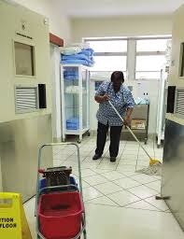
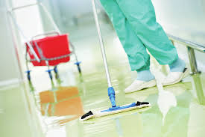
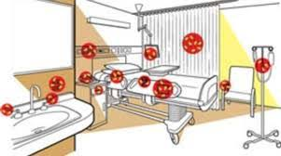

Slide 24
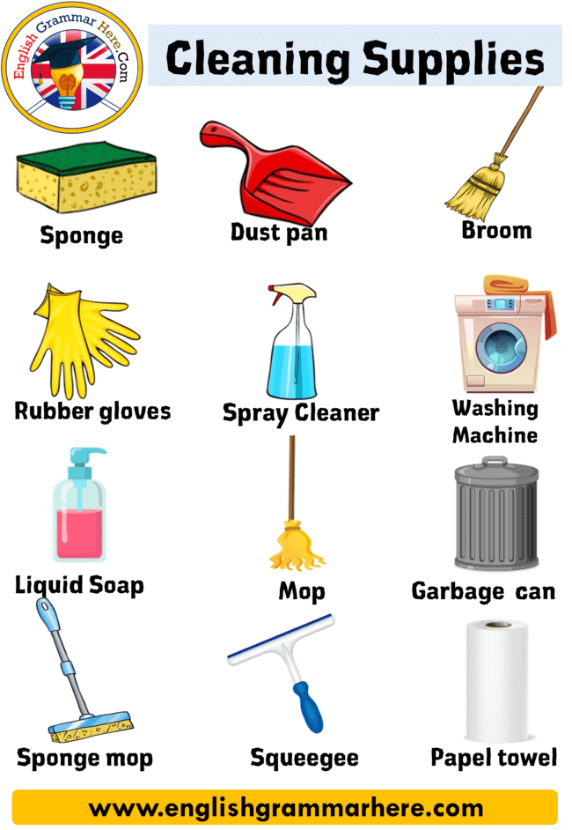
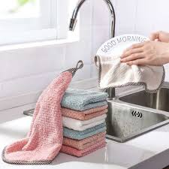
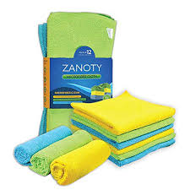
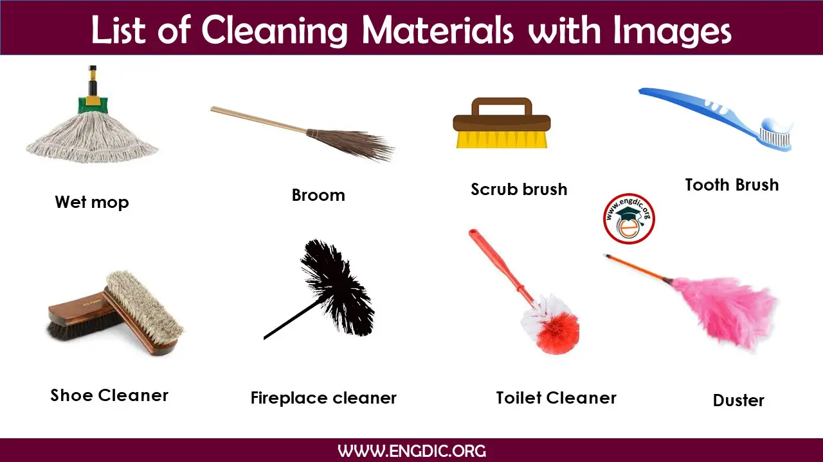

Slide 25
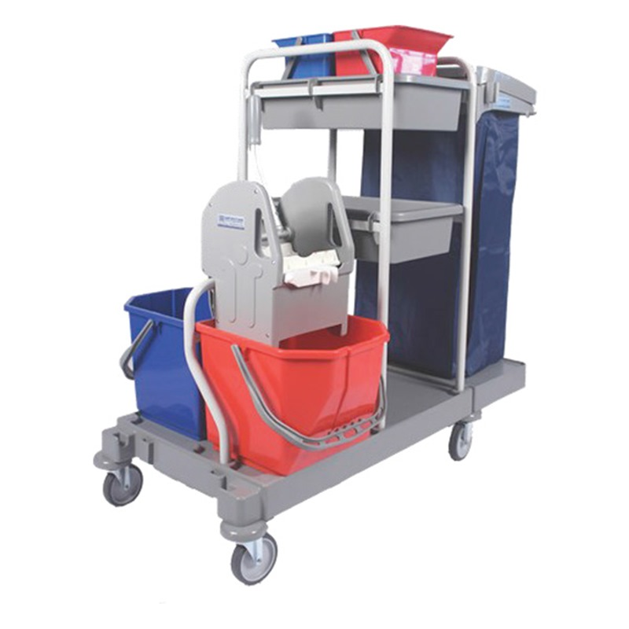
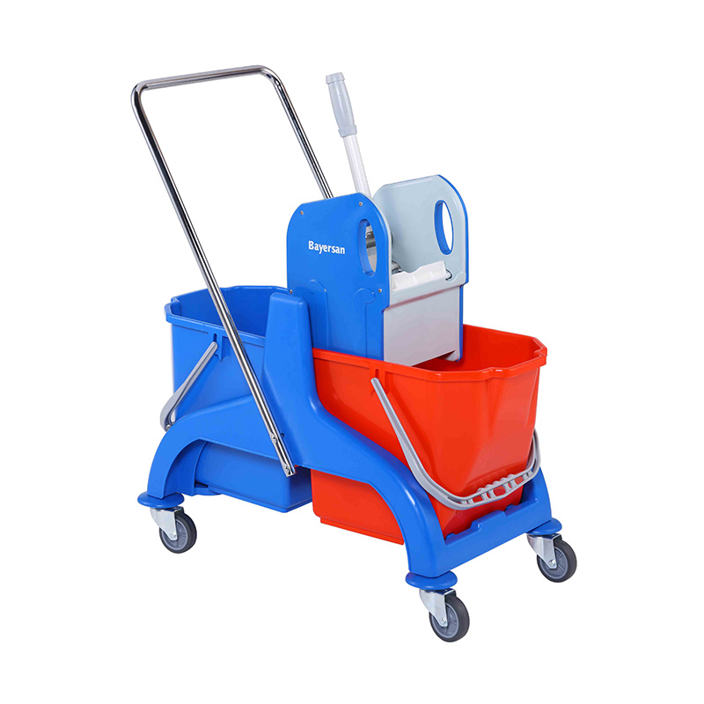
Double bin cleaning trolley

Slide 26
Glass cleaners
Doesn’t leave residues.
Never release color.
Quick removing dirt ability.
Prevent dust collection.
Didn’t leave drops or finger print
None sticky
Foam free

Slide 27
Cleaning pads
Microfiber
Multi-face foldable
Different sizes and thickness
Three colors (blue, white and green)
Reusable and tear resist
Color stable during washing
Strong absorbing ability

Slide 28
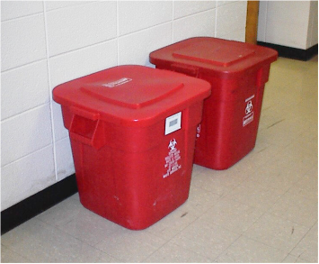
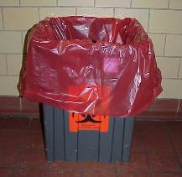
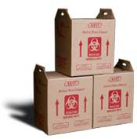
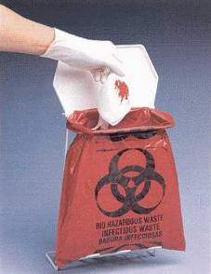
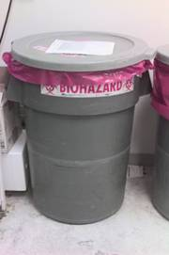
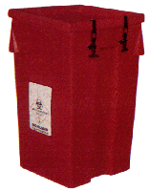

Non-Sharps Waste Management
Notes:
(This slide transitions the presentation to collection)
Note small reusable shipping container at top – great for pipettes and other “pseudo-sharps” but beware DOT shipping issues
Beware common practice of taping red bags to bench or BSC; use bag holders, preferably with cover (foot-operated great)
Photo of grey container at top by Paul Jennette
PHOTO NEED - replace others with ABSA-owned photos

Slide 29
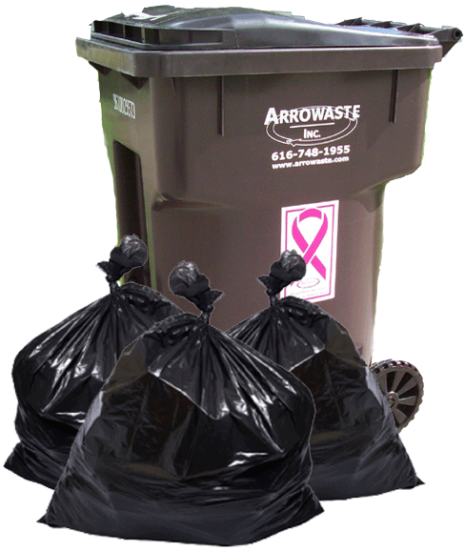
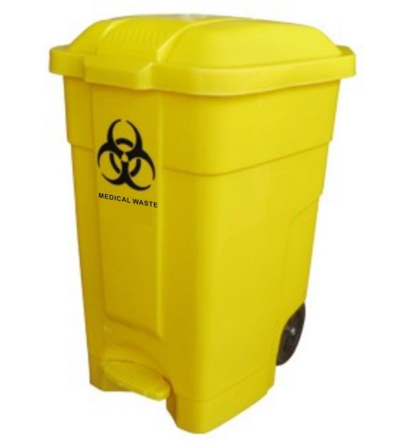
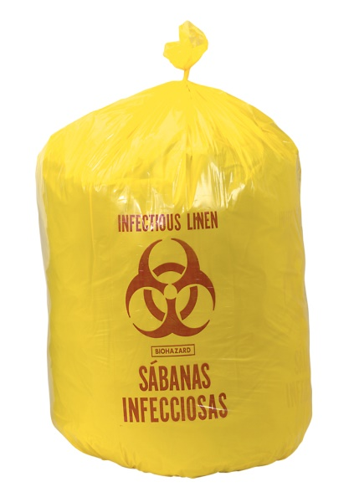
Bags & Containers types
For non hazardous waste
For not sharp, hazardous waste

Slide 30
Construction of good waste disposal
Good appearance.
Safe process.
Pest control.
Odor control.
Public health safety.

