Slide 1

Biosafety and Biosecurity
Hazardous Spillage Management
3rd lecture
Ms. Banaz A. Salih

Slide 2
Hazardous spillages in hospitals
Introduction:
The hazardous spills In a hospital could be (biological solution) such as Body fluids (blood and body secretions and excretions) or chemical spills such as Drugs, Cleaning fluids and other chemicals which are in very close proximity to people.
In hospitals, spillage of blood, body fluids or chemicals can occur at any time due to broken or faulty equipment or human error.

Slide 3
Spills Emergency Preparations
Place different Emergency Guides flipchart in near.
Assemble a spill kit tailored to clean up small spills fully stocked and easily accessible.
Make sure everyone working in the health care facility knows Locations of:
Fire extinguishers
Eye washes and Emergency showers.
Spillage management kit and telephones

Slide 4
Risk evaluation of the spills
1- Large or extremely dangerous spills:
Spills has an immediate hazard (fire, explosion, chemical).
Any spill of highly dangerous chemicals
Moderate or large-scale chemical spills
2- Small, incidental spills:
Spills that can be cleaned up without danger.
If you're confident lab staff can handle the spill safely.

Slide 5

Spills management
For a spill management we need a method to quickly remember the immediate spill recovery actions.
Remember the acronym ‘SWIM’
S Stop the spill
W Warn others
I Isolate the area
M Minimize exposure to radiation and contamination

Slide 6
Basic Biosafety Spill Kit contents
Disinfectant (bleach 1:10 dilution, prepared fresh daily) .
Absorbent pads, pillows & material (paper towels)
Waste Containers (biohazard bag, Sharps containers)
Personal Protective Equipment (lab coat, gloves, eye and face protection, shoe)
Mechanical Tools (forceps, disposable dustpan and broom).
6. Cleanup supplies such as Brush, Roll of clear tape, Flashlight, Anti-microbial wipes.

Slide 7
Steps in spillage management
Assess the risk and identify the substance.
Protect your self and use the PPE and call the team.
Confine the spill by tape or marker or caution board.
Stop the source by turning a valve, rolling a drum over or using a leak stopper product like .
Contain the spill by spill management kits cleanup.
Decontaminate the site by properly cleaning both the clean up crew and their equipment afterwards.
Complete required report.

Slide 8
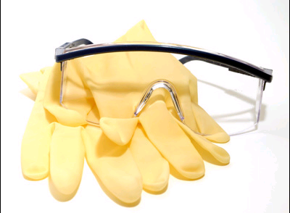
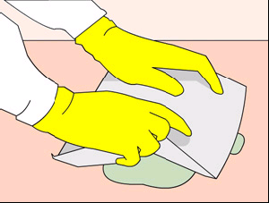
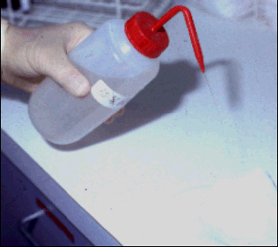
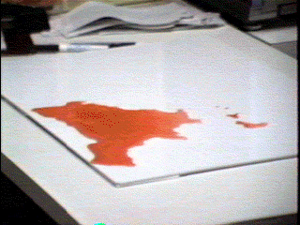
Handling Small Spills
Wear gloves and other PPE appropriate to the task.
When sharps are involved use forceps to pick up sharps.
Cover the spill with a newspaper, paper towel or dry mud and repeat it.
Wipe the spill with a wet wipes moistened with hypochlorite solution (1%) Repeat until all visible soiling is removed.
Wipe the area with a cloth mop moistened with 1% hypochlorite solution and allow drying naturally.

Slide 9
Handling Spills Large volumes (>10 ml)
Activate fire alarm this will Evacuate the area .
Confine contaminated area and wear full PPE.
Cover the spill with newspaper material to prevent spreading
Flood the spill with 10% hypochlorite or chlorine granules.
Wait for five minutes then Remove and discard the paper.
Wipe the area with paper moistened with 10% hypochlorite again if required until all visible soiling is cleaned
Wipe the area once with 10% hypochlorite and a cloth mop and allow drying naturally

Slide 10
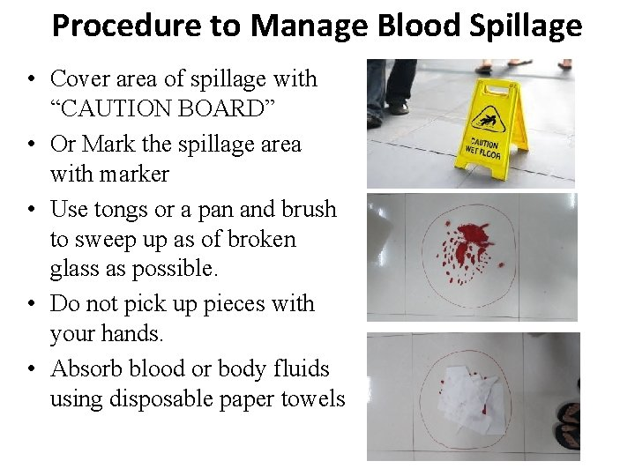

Slide 11
Chemical Spill Management
Neutralizing Acid Spills
Acid spills can be neutralized with sodium bicarbonate, sodium carbonate, or calcium carbonate.
Sprinkle powder over the spill slowly, starting from the outside to limit the extent of spreading and liquid migration.
Avoid breathing in the fine powder and the gas evolved (carbon dioxide), the neutralization should occur 1-5 minutes after application.

Slide 12
Chemical Spill Management
Neutralizing Alkali Spills
Alkali spills can be neutralised with sodium bisulphite, boric acid or oxalic acid. Many alkalis can causes burns to skin and eyes.
Ensure that there is adequate ventilation
Eliminate all sources of ignition as neutralization of alkali can produce heat.
  Wait until mixtures have cooled before sweeping up spill.
  Avoid handling spilled material until absorption is complete

Slide 13
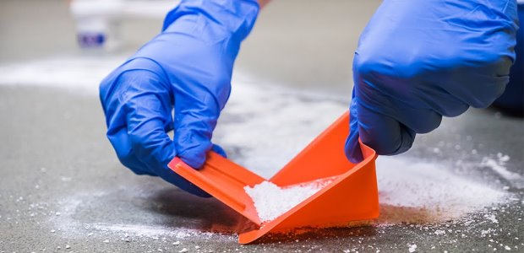
Solid Spills Process
Sweep solid material into a plastic dust pan and place in a sealed container. Care should be taken so as to minimize dust or the contaminated powder becoming airborne
Use of a dust mask is advisable
Wipe the area down with a wet paper towel and dispose off the used paper towel in a strong polyethylene bag.
Seal the bag for disposal

Slide 14
Clean-up Instructions – Mercury Spill Management
Evacuate area : As far as possible, keep people who are not involved in the clean-up away from spill area to limit exposures .
Put on face mask : In order to prevent breathing of mercury vapor, wear a protective face mask
Remove Jewelry : Remove all jewelry from hands and wrists so that the mercury cannot combine (amalgamate) with the precious metals.

Slide 15
Clean-up Instructions – Mercury Spill Management
Wear gloves : Put on rubber or latex gloves.
If there are any broken pieces of glass, pick them up on a paper towel, in a puncture proof plastic bag or container .
Locate mercury beads : Locate all mercury beads and look for mercury in any surface cracks of the floor. Use a flashlight to see glistening beads
Cardboard sheets should be ‘used to push the spilled beads of mercury.
Use syringe without a needle/eyedropper and sticky tap to suck beads an airtight lid half filled with water. .

Slide 16
Clean-up Instructions – Mercury Spill Management
The powdered sulphur or zinc stains make mercury a darker color which makes smaller beads easier to see and easily removed .
Collection in leak-proof bag or container, Labelled Hazardous Waste, Handle with Care”, date of storage/generation.
Store should be away from heat generating equipment, with Mercury Spill Kit provision, proper ventilation.

Slide 17
Cleaning of the floor
Moisten the zinc powder with water after it is sprinkled and use a paper towel to rub it into cracks in the flooring.
All the mercury spill surfaces should be decontaminated with 10% sodium thiosulfate solution.
Keep a window open to ventilate after the clean-up.
After ensuring all the mercury has been removed, resume normal vacuuming and utilize the cleaned area for routine operation.

Slide 18
