Slide 1

Biosafety and Biosecurity (Theory)
Hand Hygiene and Care
2nd lecture
Ms. Banaz A. Salih

Slide 2
Definitions
  1- Handwashing : It means the removal of visible dirts, oils and proteins with most of transient bacteria from visibly soiled hands, it is performed with soap and water with or without antiseptics.
  2- Handrubbing: It means the removal of transient bacteria and some resident bacteria from already washed hands, it is performed with alcohol-based handrub or liquids 70-75% Ethanol or propan1 or 2 .

Slide 3
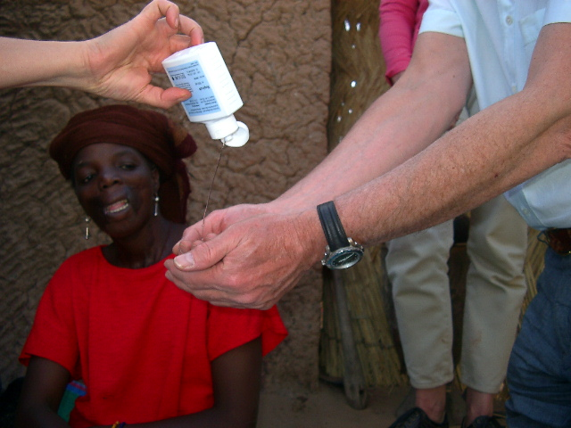
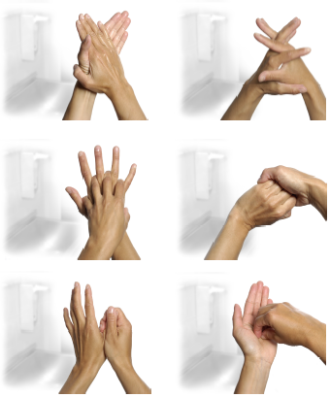
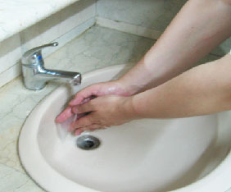
Hand Hygiene
- Clean hands reduce the burden of infection
- Alcohol based hand rubs are the gold standard for hand hygiene in health care (unless hands are visibly soiled).

Slide 4
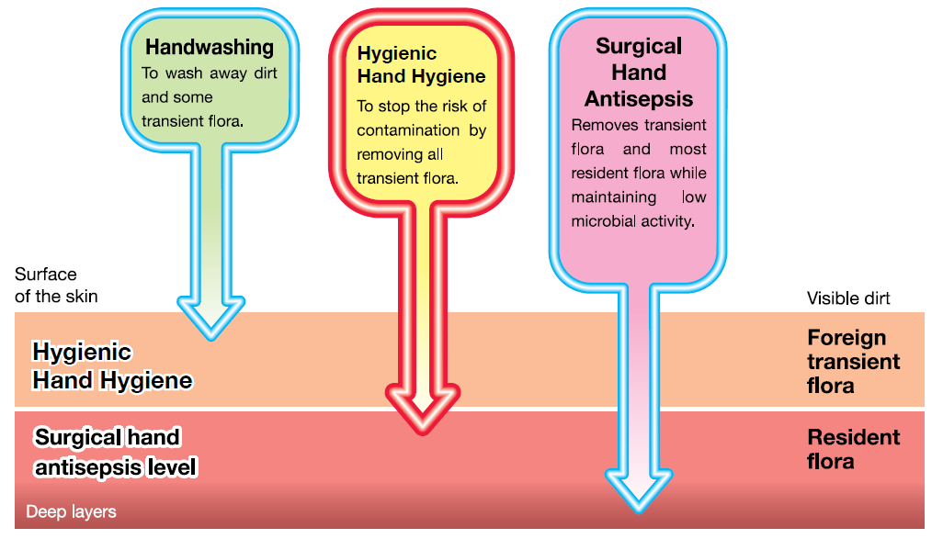
Hand Hygiene Effect

Slide 5
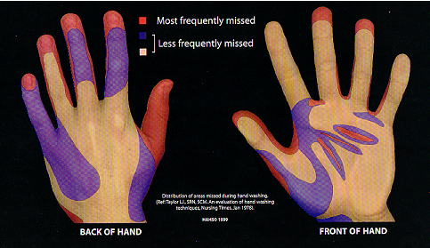
Areas Most Frequently Missed
Hand washing missed areas
HAHS © 1999

Slide 6
During Covid-19
It should be for 40 seconds with soap and water and for 20 seconds with alcohol 75%. BEFORE and AFTER
Touching your eyes, nose, or mouth
Touching your mask
Entering and leaving a public place
Touching an item or surface that may be frequently touched by other people, such as door handles, tables, gas pumps, shopping carts, or electronic cashier registers/screens

Slide 7
Compliance with hand hygiene is low, why ??
Skin irritation by alcohol (put cream).
Inaccessible hand washing facilities.
Wearing gloves
Too busy
Lack of appropriate staff
Being a physician
Working in high-risk areas
Lack of hand hygiene promotion
Lack of role model
Lack of institutional priority
Lack of sanction of non-complier

Slide 8
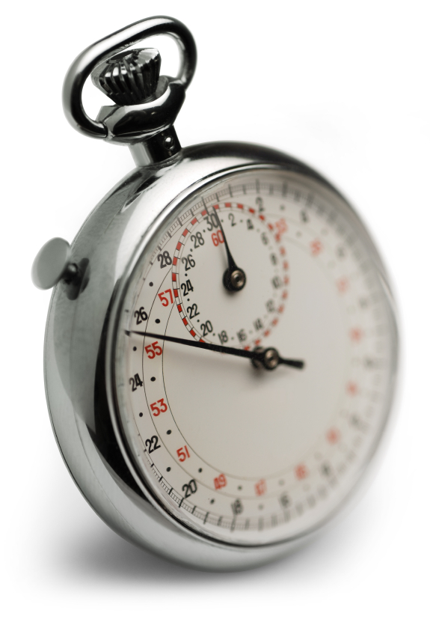
Time constraint = major obstacle for hand hygiene
Adequate hand washing with water and soap requires
40–60 seconds
Average time usually adopted by health-care workers:
<10 seconds
Alcohol-based
Hand rubbing: 20–30 seconds

Slide 9
Plain (non-antimicrobial) soap
Soaps contain esterified fatty acids and sodium or potassium hydroxide. They remove lipid and adhering dirt, soil, and various organic substances from the hands.
Plain soaps have minimal, if any, antimicrobial activity.
Occasionally, plain soaps have become contaminated, which may lead to the colonization of HCWs hands with Gram-negative bacilli.
Use liquid soap or small bars to avoid contamination.

Slide 10
The effect of water, soap and alcohol
Unwashed
Running water
Soap and water
alcohol and soap

Slide 11
Many Personnel Don’t Realize When
They Have Germs on Their Hands
Healthcare workers can get 100s to 1000s of bacteria on their hands by doing simple tasks like:
  Pulling patients up in bed
  Taking a blood pressure or pulse
  Touching a patient’s hand
  Rolling patients over in bed
  Touching the patient’s gown or bed sheets
  Touching equipment like bedside rails, overbed tables, IV pumps

