Slide 1

Biosafety & Security
Introduction and Definitions
Lecture 1
Ms. Banaz A. Salih

Slide 2
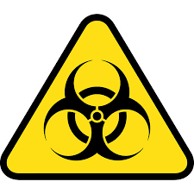
Biosafety
Definition:
Biosafety refers to the rules and practices used to handle biological materials safely.
It helps protect people, animals, and the environment from harmful pathogens and toxins.
Biosafety also prevents accidents and unintentional release of these materials.
Biosafety Symbol

Slide 3

Biosecurity
Definition:
Laboratory biosecurity refers to measures used to protect valuable biological materials in laboratories.
It focuses on controlling access and ensuring proper handling and accountability.
Biosecurity prevents theft, misuse, loss, or intentional release of biological materials.
Biosecurity Symbol

Slide 4
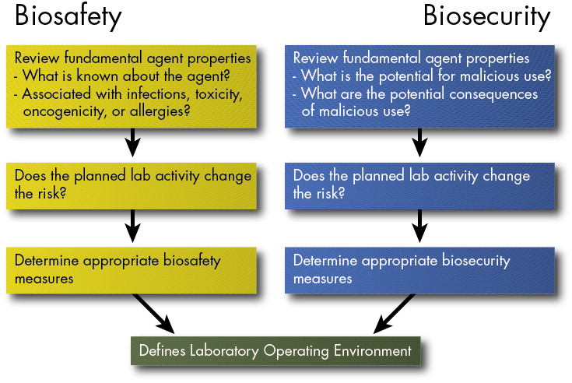

Slide 5
Terminology
Risk . It is a combination of the probability of occurrence of harm and the severity of that harm.
Risk assessment. It is a process of evaluating the risk(s) arising from a hazard(s), taking into account the adequacy of any existing controls and deciding whether or not the risk(s) is acceptable.
Threat The likelihood for an adverse event to occur, as an expression of intention to inflict evil, injury, disruption or damage.

Slide 6
Terminology
Harm The adverse effect on the health of people, animals, or plants on the environment or on property
Hazard A source, situation, or act with a potential for causing .
Bioweapon refers to the use of some biological agents as a weapon against human such as Anthrax.
Dual use refers to the probability of using some biological agents as a weapon

Slide 7
Valuable Biological Material VBM.
They require administrative oversight, control, accountability, specific protective and monitoring measures in laboratories.
VBM may include pathogens and toxins, as well as non-pathogenic organisms, vaccine strains, foods, genetically-modified organisms (GMOs), cell components and genetic elements

Slide 8
Importance of Biosafety Practices
To provide protection for Laboratory personnel, Lab support personnel, General Public and the Environment and “products”.
To comply with federal and local regulator
To Implement engineering controls, management policies and work practices.

Slide 9
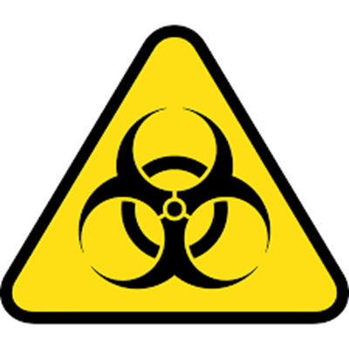
What Biosafety include?
Laboratory levels (basic 1, containment 2,3 and 4 high containment) and safety levels.
PPE and safety equipment.
Safety Precautions (standard and special).
Basic hygiene and Hand Washing.
Waste disposal.
Sterilization and disinfection.
First aid and immunization.
Administrative rules.

Slide 10
Basic safe laboratory techniques
Safe handling of samples (containers, transport, receipt and opening).
Proper use of pipettes (mouth suction avoidance).
Disposal of infectious materials.
Avoid contact with waste.
Avoid injection sharps.
Separation of samples.
Proper use of centrifuge and other mixing equipment.
Precautions.

Slide 11
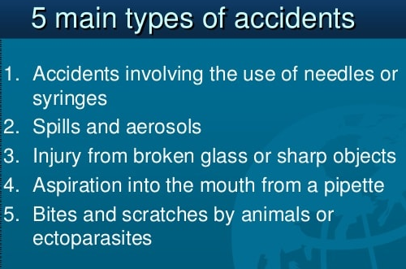
Hazards
There are different types of hazards in laboratories such as:
Biological hazards.
Sharps hazards.
Chemical hazards.
Radioactive.
Electrical.
Explosions.
Physical.

Slide 12
Examples of Biohazards Agents
Infectious microorganisms.
Diagnostic specimens (Blood products, Vaginal secretions)
Semen, Amniotic fluid, Cell cultures, Saliva, Urine, Tears, Sputum, Feces, Vomit
Recombinant DNA, cell culture
Animals reservoirs of zoonotic disease

Slide 13
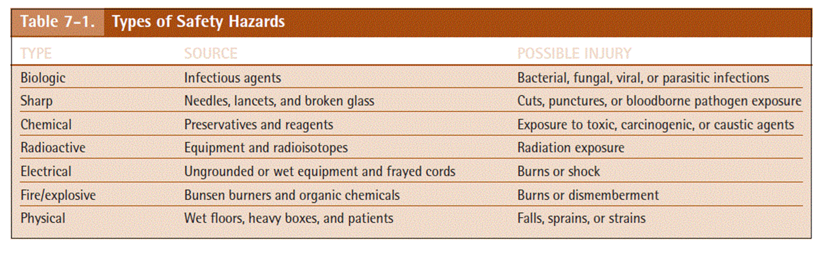
Safety and Hazards types

Slide 14
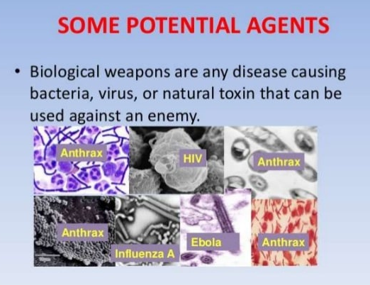

Slide 15
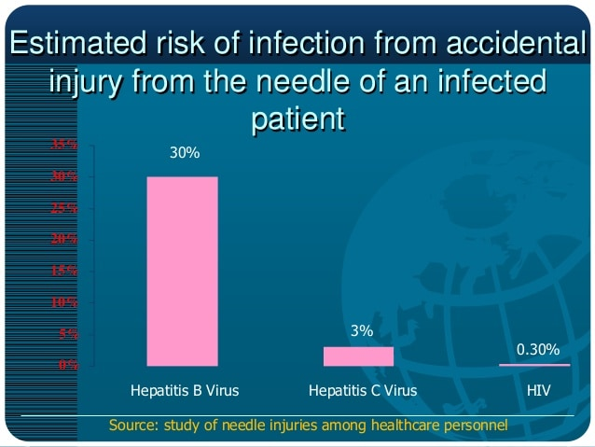

Slide 16

Laboratory safety requirements
Exits and corridors
Ventilations control
Fire Extinguishers
Eye Wash Stations
Safety Shower
Fire Blanket
Hand-washing sink
Master electricity shut off
First-aid kit

Slide 17
Laboratory safety requirements
10. Bio-hazardous waste container.
11. Sharps containers
12. Routine garbage containers
13. Safety cabinets
14. Fume hood
15. Chemical disposal containers

Slide 18
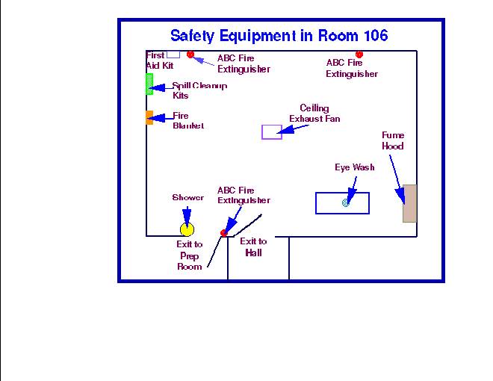

Slide 19

Standard Microbiological Practices
NOT permitted in laboratories:
  Eating
  Drinking
  Smoking
  Handling contact lenses
  Make up and cosmetic.
  Pipetting by mouth
  Storing food and drink
  NEVER Discard needles or sharps into biological waste bags
Notes:
9
These are the basic practices when working with any microorganisms, and are the foundation for BL1 containment. They are designed to prevent transmission by contact, ingestion, and puncture.
These practices are appropriate for ALL laboratories that work with radioisotopes and chemicals as well as microorganisms.

