Slide 1
Chapter Nine
The Tense-Aspect-Modality system In Discourse

Slide 2
Contents of this presentation are:
Introduction to the tense-aspect-modality (hereafter TAM)
Challenging aspects for ESL/EFL students and recommendations
The Bull framework
Motivations for changing the axis of orientation
The Frame Elaboration Hypothesis (with tenses & Modals- Phrasal Modals) with summaries
The tense-aspect modality and interaction in conversational oral discourse
Tense patterning in written discourse and oral narratives
Conclusion

Slide 3
Introduction to chapter 9
Consider this example:
I am going to buy a bicycle, so I can do errands and exercise at the same time. (Plan + outcome)
Examples like the sentence above even if well contextualized still fail to capture the TAM combinations that occur in a suprasentential level. So this chapter focuses on the TAM forms that appear in English Discourse.
William Bull’s framework
There also are database studies that examine the functions of TAM system in English discourse, spoken and written.

Slide 4
ESL/EFL learners’ challenges & recommendations
Tense is solely related to time!
Tense-Aspect is merely taught on a sentence level.
Learners undergoing powerful L1 influence as not all languages mark tense-aspect.
It is recommended for a teacher to teach ESL students each axis at a time instead of each tense at a time. This will help students better grasp the idea and show them how tenses relate to each other in discourse.

Slide 5
Consider the following examples and their tense patterns:
A. I have a splitting headache. I had it for two hours. I will take some aspirin. (choppiness)
B. I have a splitting headache. I’ve had it for two hours. I’m going to take some aspirin. (more consistent)
C. The little girl cries her heart out. She lost her teddy bear and is convinced she will never find him. (comprehensible narrative- not fully coherent- sounds disjointed)
D. The little girl cried her heart out. She had lost her teddy bear and was convinced she’d never find him. (past orientation)

Slide 6
NOTE:
Sometimes through talking, English speakers tend to jump often from tense to tense (present to past to future). A reason for that is the fact that they may have learned each tense at a time, at the sentence level, without learning how the combinations interact in discourse.
This chapter will directly address such learning challenges.

Slide 7
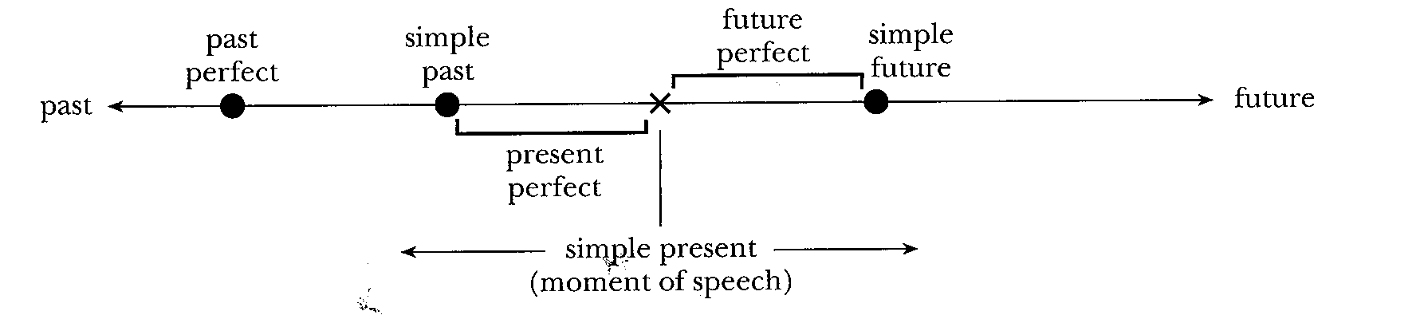
The BULL framework- by William Bull
Conceptual shift: Views tense-aspect system as a resource for taking different temporal perspectives on actions, events, and states of affairs.
I’ve already eaten. (not more recent but signals current relevant response)
I already ate. (puts the speaker’s last meal in the past)
They both describe past but the choices allow the speaker to add their perspective of the current relevance to the response- which is the condition not the linear sense of time)

Slide 8
How is Bull framework useful?
Helping ESL Students with Tense-aspect use in text. Students who don’t understand the importance of axis-orientation may “discourse hop.”
Helping ESL Students with Tense-aspect. It can provide the students with a visual model to illustrate the Bull framework and 3- axis structure
Helping ESL Students with Tense-aspect. We can then have students interact with a visual model in which they can see the cohesiveness when language follows Bull’s framework
Summation on Tense in Discourse. Learning to properly apply the right tense in discourse can be a tricky concept for ESL students to grasp.

Slide 9
Some boundary problems with timeline:
A: John will have finished all that work months ago.
B: I saw John at the market yesterday.
Examples above prove that an action can be expressed in future perfect (A) to demonstrate an event that happened after the action stated in simple past (B)
I travel to Mexico next Friday.
We (had) returned from our vacation before Jack wen tto his trip.
Each axis in Bull’s framework proposes three aspects, a time before the basic time slot, the basic time slot, and a time after it.

Slide 10
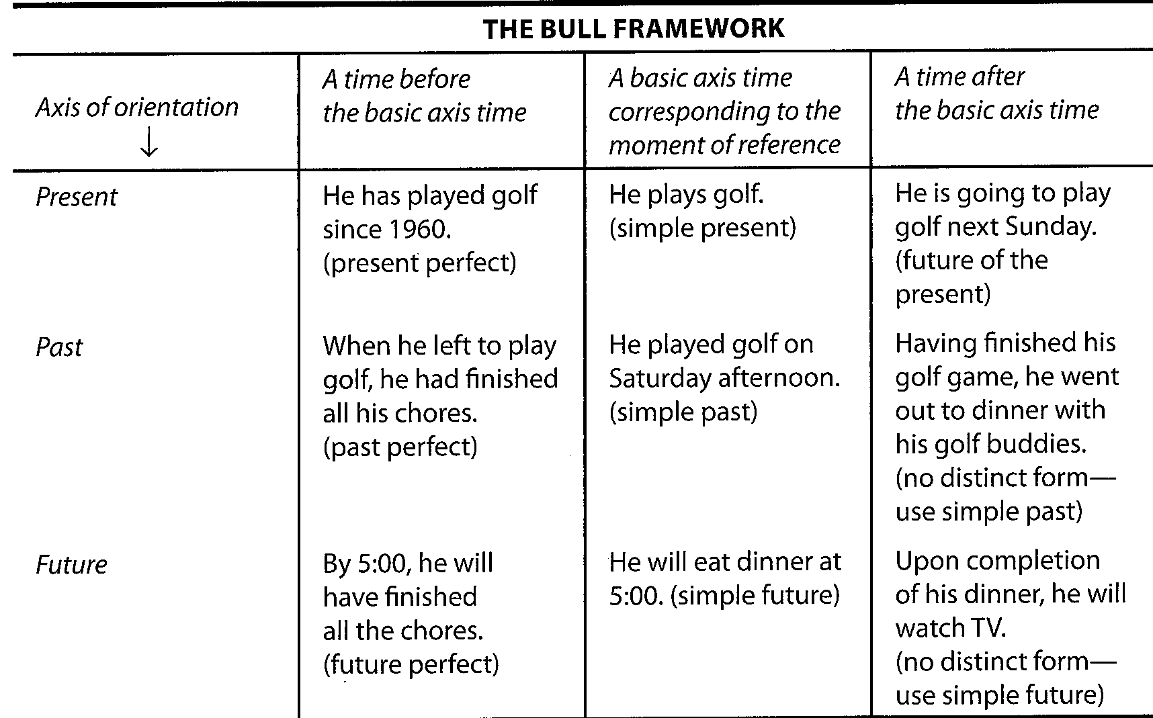

Slide 11
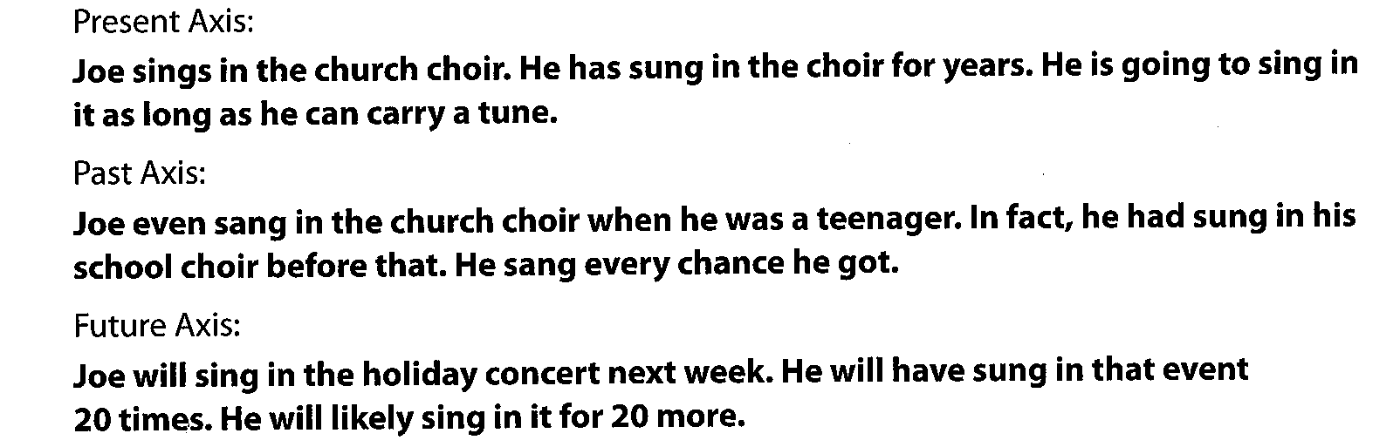
Other discourse samples created to teach students about the bull framework.
It is worth mentioning that in Bull’s framework the perfect aspect is more closely associated with tense than progressive aspect. The former for each axis reflects a (prior) time whereas the latter in the TAM combination rather expresses duration, non-completion, or iteration.

Slide 12
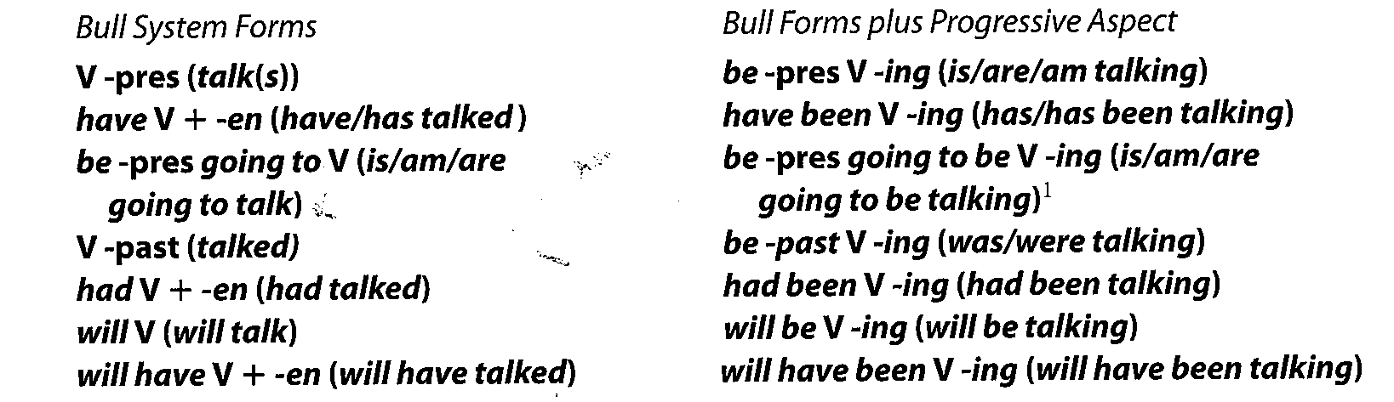
The 14 distinct Tense-Aspect combinations:
It was mentioned in Ch. 7 that there are 12 distinct Tense- Aspect combinations, which two are new here?

Slide 13
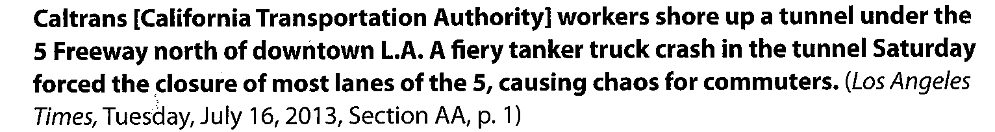
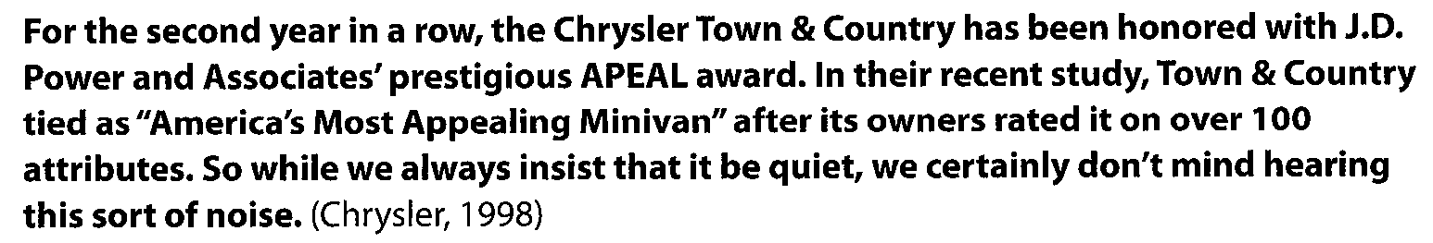
Motivations for changing the axis of orientation:
A shift of time (explicit): temporal expression that overtly signals the need for such a shift.
A shift of time (Implicit): theoretical structure of a text

Slide 14
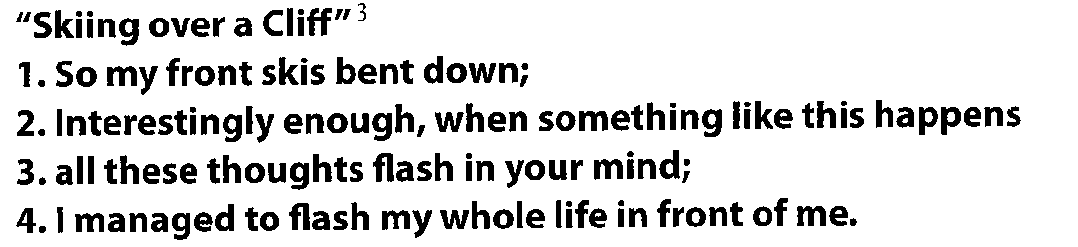
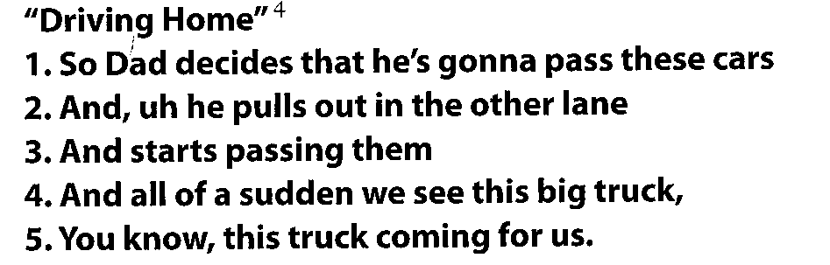
Motivations for changing the axis of orientation:
Backgrounding in Narratives: for “generic tense” that is used to make a comment or an aside:
Immediacy in narrating: to make events more vivid when described in present tense:

Slide 15
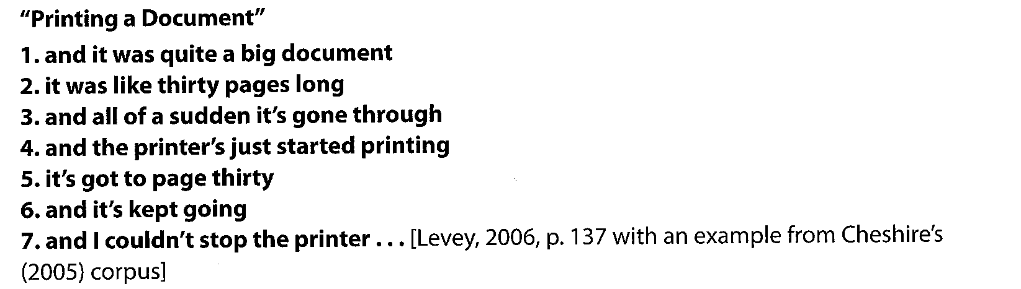
Motivations for changing the axis of orientation:
A turn of events in a narrative: when present perfect is used for a past narrative

Slide 16
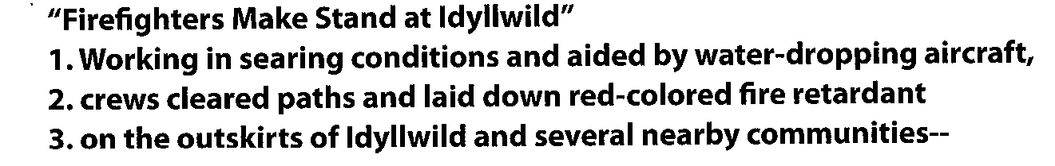
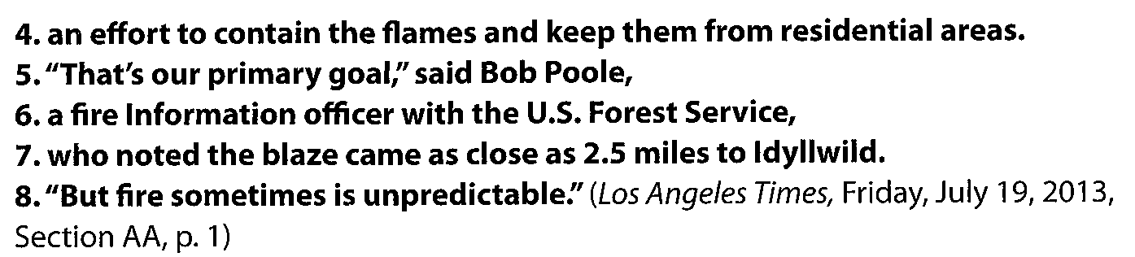
Motivations for changing the axis of orientation:
Direct Quotes:

Slide 17
The Frame Elaboration Hypothesis
The use of TAM sequence in discourse is considered from a different perspective by Kyung-Hee Suh.
Drawing from a number of existing databases, Suh hypothesized that in the course of constructing oral narratives, English speakers often use one TAM form to introduce a type of narrative or an episode. Then they switch to the remainder of the episode using another form to elaborate the episode and provide details.

Slide 18
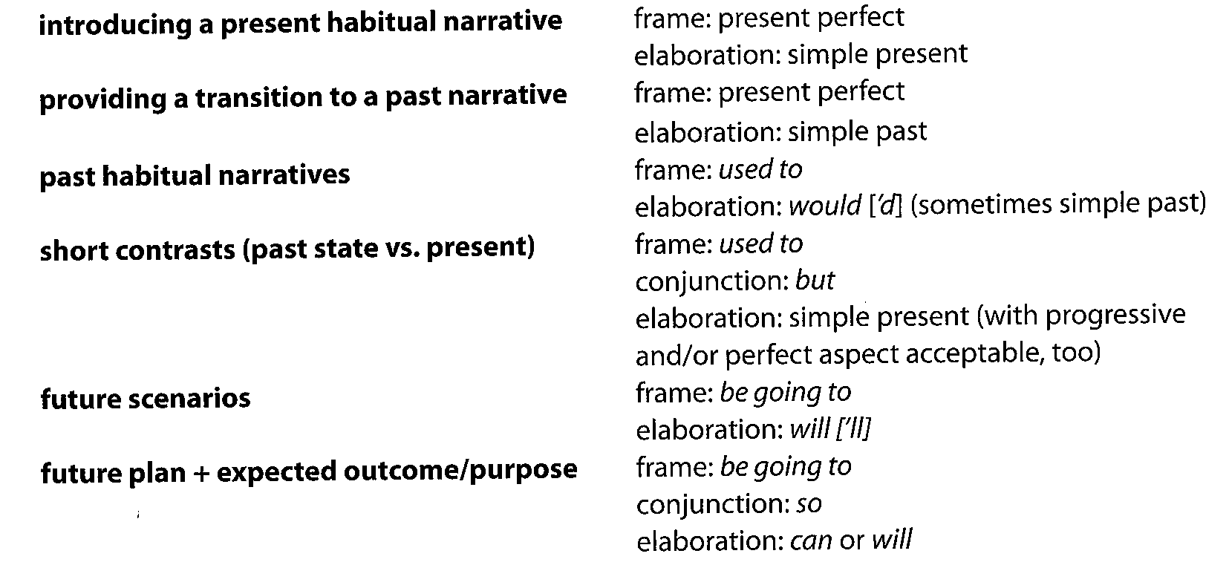
Summary of Patterns for Oral Narratives

Slide 19
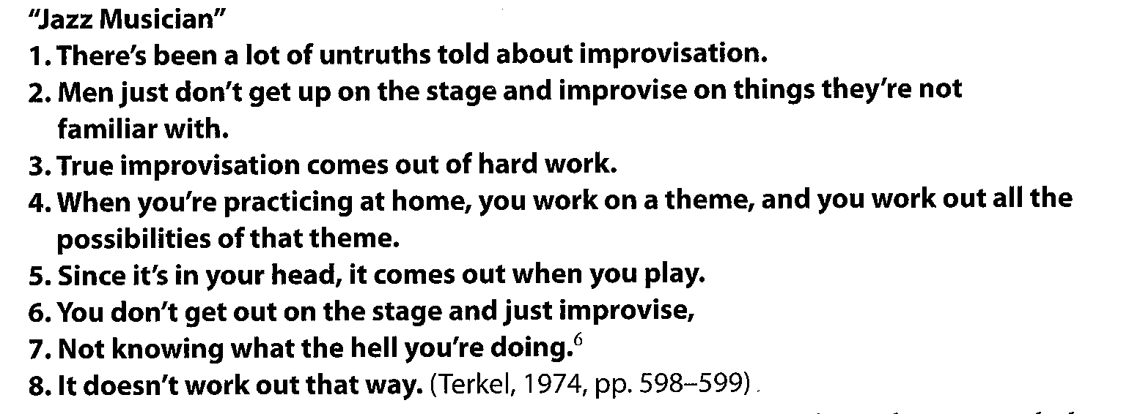
Frame-Elaboration patterns with tenses
Introducing a present habitual narrative

Slide 20
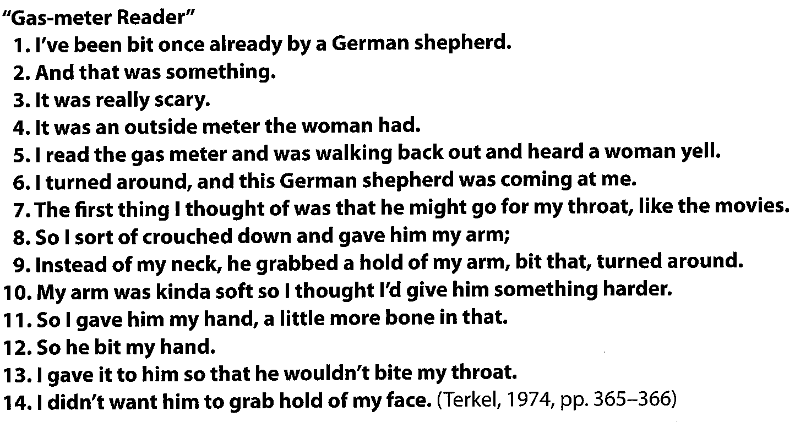
Frame-Elaboration patterns with tenses
2. Providing a transition to a past narrative:

Slide 21
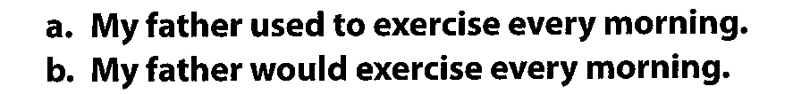
Frame-Elaboration patterns with PMs and Modal sequences
Used to and Would in habitual narratives
2. Used to …But for contrasts

Slide 22
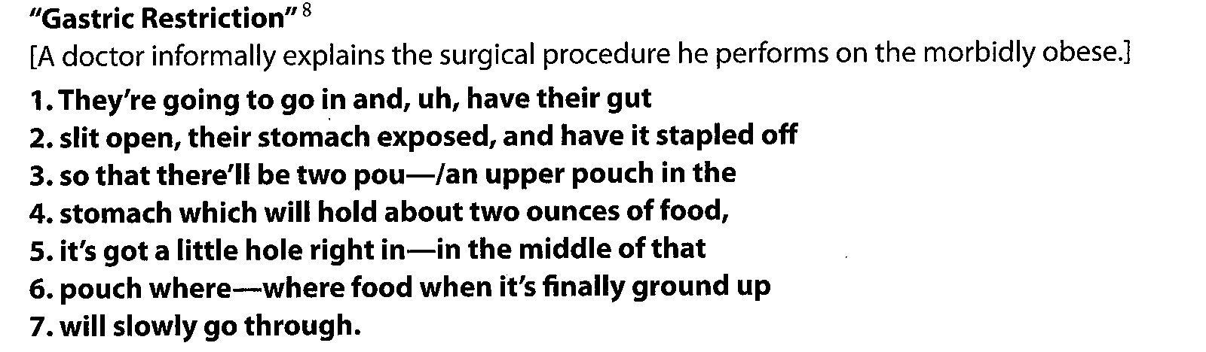
Frame-Elaboration patterns with PMs and Modal sequences
3. Be going to and will for future:

Slide 23
Frame-Elaboration patterns with PMs and Modal sequences
4. Be going to… so, can: for future plan with purpose:

Slide 24
More complexity- The present perfect progressive PPP
This structure requires background- giving prior information- & follow up.
Lucy has been hiking.
When? Prior to the time of speaking? Hiking off and on lately?
To sort this issue out, Celce-Murcia and Yoshida (2003) examined 250 tokens of PPP and ended up concluding these steps:

Slide 25
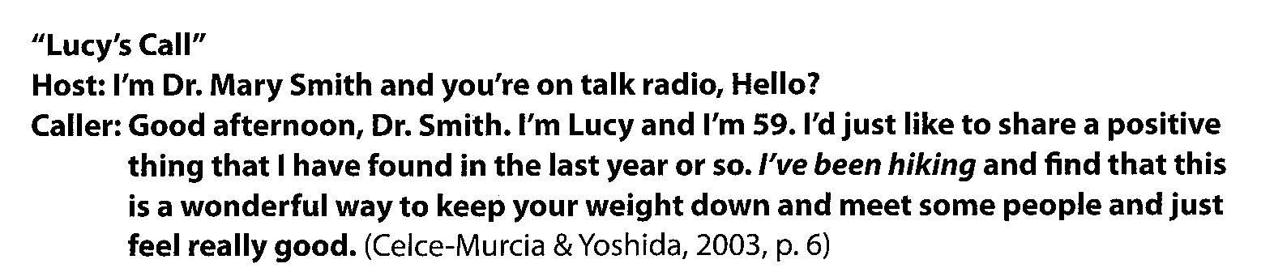
Check the following example
In the first move: present tense and present perfect
The second move: PPP
Third move: everything after the PPP
NOTE that: this three-move rhetorical structure is so salient that if there is familiarity between the speaker and listener they may skip using moves 1 and 3.

Slide 26
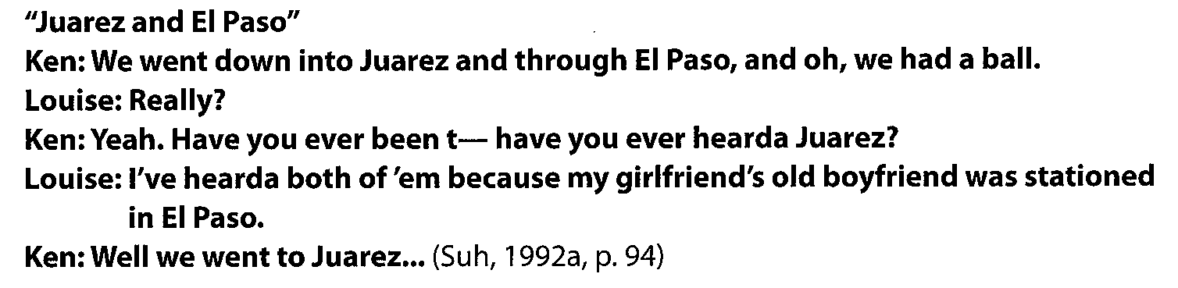
The TAM and interaction in conversational discourse
Knowledge confirmation checks:

Slide 27
The TAM and interaction in conversational discourse
Marking Personal Involvement:
Some instances between be going to and will are interactionally driven that the former presents greater personal involvement while the latter is more neutral, detached, and formal option.

Slide 28
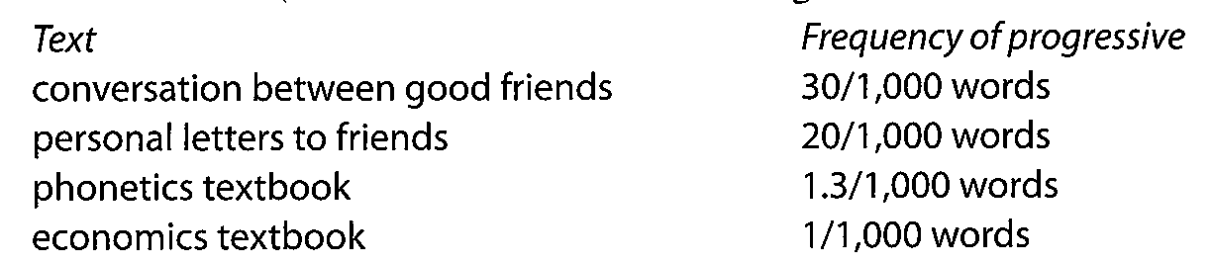
The TAM and interaction in conversational discourse
Marking involvement and interaction: there were texts that were studied attempting to capture aspects of related interest, it was found that the progressive aspect has higher interaction and involvement from texts that did not.

Slide 29
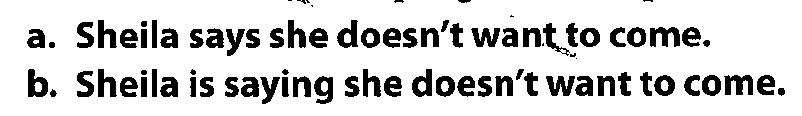
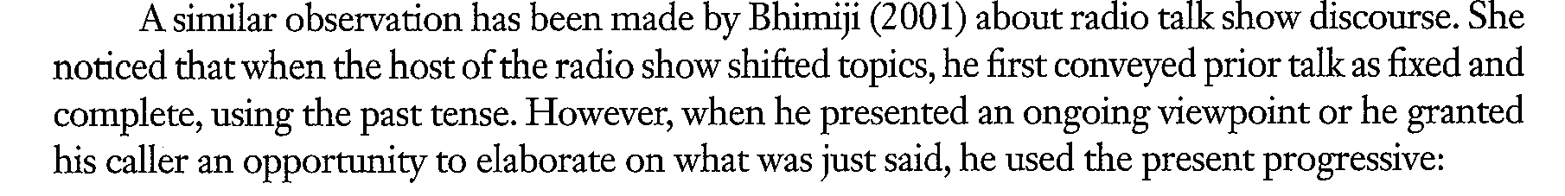
The TAM and interaction in conversational discourse
Marking the potential for change: simple tense by virtue represents a neutral, unchanging situation while the progressive represents signals for potential change. Batstone (1995)

Slide 30
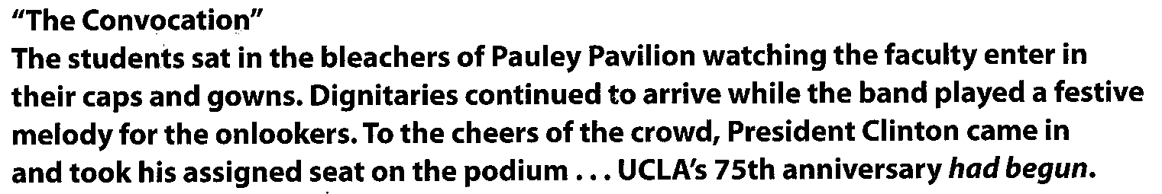
Tense Patterning in Written Discourse:
Marking a climax: Past perfect generally marks an event occurring prior to some other time or event in the past. However; in written discourse it is noticed that this tense is used to mark a CLIMAX.
Climax refers to stating a purpose for relating a prior series of events narrated in the simple past.
Notice in the above example that simple pas is used to tell the storyline while past perfect is used to terminate (end) the written narrative episode as if is functioning to mark the outcome.

Slide 31
Tense Patterning in Written Discourse:
A point worth mentioning is the fact that same aspect pattern applies to present events, as shown below:
Another point to note is the fact that the verbs used to express climax are punctual verb phrases (i.e. a verb phrase that expresses something that occurs in an instant like to begin, to find the probe) which is another significant element of the rhetorical structure.

Slide 32
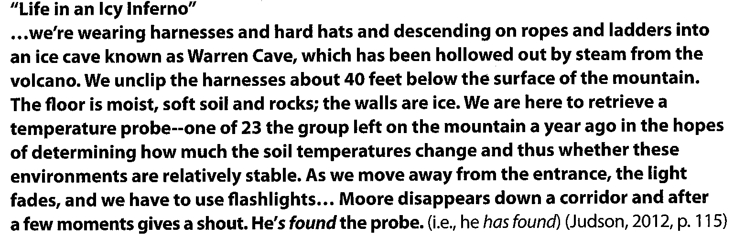
Tense Patterning in Written Discourse:
Illustrating a point and generalizing:
Brinton (1994) noticed that authors of the below psychology text frequently illustrate real-life phenomenon in the past tense.
NB: The discourse level of these tenses is similar to that of sentence level uses since simple past tense is often used to relate to a past event\fact and simple present for generalizations.
This can be taught to ESL\EFL readers\writers too.

Slide 33
Tense Patterning in Written Discourse:
Reporting Research:
Burrough-Boenisch (2003) observes that:
simple present can be used for general truths.
While the researcher’s own finding to be presented in simple past.
She also notes the following:
Content | Tense to present it
General truths | Simple present
Researcher’s own findings | Simple past
Established knowledge (previous results) | Present tense
Description of methods and results | Past tense
Presentation (figure 1 shows that…) | Simple present
Attribution (John reported that…) | Past tense

Slide 34
Further notes regarding Tense patterning in written discourse:
Tense choices are flexible.
The motivation to change tense of a particular verb was a desire to achieve tense consistency within a sentence or a paragraph.

Slide 35
Conclusion
TAM system is very important for ESL learners in:
a. achieving coherence in discourse
b. Presentation of tense and aspect as a system rather than presenting each one as a discrete construction.
It is also important to note that they are not like sentence-level grammatical rules; they are rather rhetorical tendencies.
Learners who use the TAM will be able to produce more coherent texts.

Slide 36
Conclusion
The patterns presented in this chapter can serve as templates for certain discourse functions of these forms.
Teachers of English for specific purpose should also be well aware of the TAM so as to recognize how tenses have uses in different disciplines as referred to by L. Gray.
Teachers should also well instruct their students regarding the TAM system and make sure their students are aware that TAM operates differently in different languages. Boundaries of objective time and tense are conventionalized differently in different cultures.

Slide 37


