Slide 1
The Tense-Aspect System
Part 1

Slide 2
Agenda
Definition of the Tense
The differences in tense formations among different languages
The implications the ESL/EFL students face when learning the system
The matrix of the system
The qualifications of the Tense-Aspect System
Meaning in The Tense-Aspect System in details

Slide 3
outcomes
Increase knowledge about the tense-aspect system of English language at sentence level
Increase knowledge about the system’s form, use and the core meaning associated with

Slide 4
Differences in Tenses amongst languages
Tense: Is a grammatical device for situating events, states, or actions in time.
The way Humans divide time and represent it is different from one language to another
The formation of certain common forms among the languages leads or overgeneralization or the opposite for ESL learners as French Speakers
Some other languages as Chinese, Thai, Yoruba and Indonesian have no marker on the verb at all, instead, they used lexical mean to indicate time as yesterday to indicate past tense
English has no explicit marking to future as there is in Latin or Turkish (-eceg-)
Futurity in English is signaled by combination of different forms and contextual factors

Slide 5
The differences in the languages systems may leave a negative impact on their learning of the Tense-Aspect System in English
Language teacher need do deal with meaning , use and the forms at the sentential and suprasentential levels
Since languages mapping form, meaning and use varies from one language to another, the ESL/EFL students need to put more efforts in mastering the English Tense-Aspect System

Slide 6
The formal Characteristics of the Tense-Aspect System
Tenses | example
1. Simple present | It breaks
2. Simple past | It broke
3. Simple future | It will break
4. Present perfect | It has broken
5. Past perfect | It had broken
6. Future perfect | It will have broken
7. Present progressive | It is breaking
8. Past progressive | It was breaking
9. Future progressive | It will be breaking
10. Present perfect progressive | It has been breaking
11. Past perfect progressive | It had been breaking
12. Future perfect progressive | It will have been breaking

Slide 7
In order to understand how the system works, this book deals with the respective elements of the system individually as Tenses and further combines them with the aspects
Future is considered as a tense although there is no verb inflection of future time

Slide 8
THE TENSE-ASPECT COMBINATIONS IN ENGLISH
Aspect Tense | Simple | Perfect | Progressive | Perfect Progressive
 |  | Have+ -en | Be + -ing | Have+ -en be+ -ing
Present | write/writes walk/walks | Has/have written has/have walked | Am/is/are writing am/is/are walking | Has/have been writing has/have been walking
Past | Wrote walked | Had written had walked | Was/were writing was/were walking | Had been writing had been walking
Future | Will write will walk | Will have written will have walked | Will be writing will be walking | Will have been writing Will have been walking
Notes:
point worth mentioning is regarding the matrix borders that are not easy to draw between the various tenses and aspects of the matrix, this is very challenging for students

Slide 9
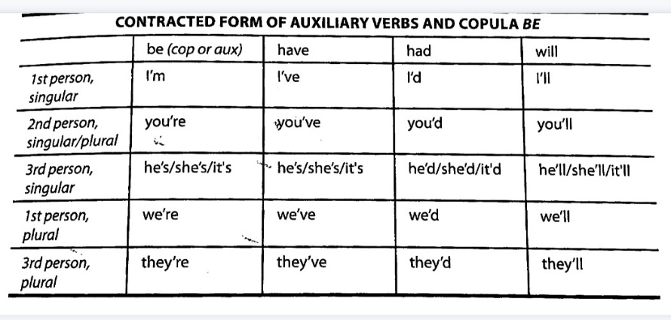
Contractions
Notes:
The third person singular forms of be and have and had and would are the same which cause ambiguity in writing .
However, the context usually disambiguates them

Slide 10
Meaning of the English Tense-Aspect System
The dimension of meaning helps the students to manage the system
The core meaning of the system indicates 3 main qualities
  One meaning can have many forms
  The tense or aspect meaning depends to certain extends on the meaning of the verb
  One form can have many meanings
Notes:
If the students were able to understand the meaning conveyed by the components of the system they would easly overcome the problems related to the system

Slide 11
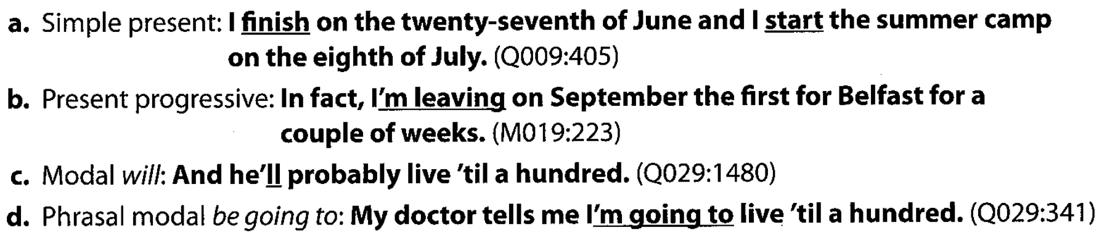
  One meaning can have many forms
Example of how future time is conveyed through different constructions:

Slide 12
  The tense or aspect meaning depends to certain extends on the meaning of the verb
English verbs are divided into two basic aspectual classes
  Perfective (have an end point)
    Ex. They built the house.
  Imperfective (no end point)
    Ex: He knows the truth
The perfective verbs resist the simple present but take the progressive while the case is revered for imperfective verbs

Slide 13
  One form can have many meanings
a. If I walked home after the school today, it would take me all afternoon.
b. They said they loved grammar.
c.Host to guest: Did you want something to eat before the game?
d.Sales clerk to customer: What is it that you wanted.
Notes:
the first sentence :condition
Second sentence : reported speech
third sentence: indirect offer (polite)

Slide 14
The core meaning of the tenses with simple aspect
Simple aspect in general indicates events that are conceptualized as complete wholes with no further development to be allowed.
This aspect stands in contrast to the progressive aspect , which is incomplete and imperfective.
Ex:
  They live in Turkey.
  They are living in Turkey.
Notes:
The simple aspect in comparison to progressive presents a whole event with no further suggestion of change while the progressive, allow possibility to change

Slide 15
Simple Present Tense: (immediate Factuality)
Application of the meaning | examples
Habitual actions in the present | She studies every day.
General timeless truths, such as the physical laws or costumes | The water boils at 100 C.
With be and other stative verbs to indicate state Inception of state | There is a large house in the corner. The car belongs to him. Now I understand.
In the subordinate clauses of time or condition when the main clause contains future-time verb | After he finishes the work, he’ll do the errands.
Future expression when a scheduled event is involved, usually with a future-time adverbial | I have a meeting tomorrow.
Present event/action(usually in sporting events or demonstrations/procedures of some sort) | Now he kicks the ball.
Present speech acts (where the action is accomplished in the speaking of it) | I resign from this commission.
Conversational historical present (used to refer to certain past events in narration) | So he stands up and waves his arm.

Slide 16
Simple Past Tense: (sense of remoteness)
Application of the meaning | examples
completed event/action in the past | I studied hard for the exam.
Habitual or repeated action/event in the past | It rained almost every day last winter.
An event with duration that applied in the past with the implication that it no longer applies to the present | She taught us grammar for 4 years.
With state in the past | He appeared to be a creative genius.
Imaginative conditional in the subordinate clause | If he took care of himself, he wouldn’t be absent so often.
Social distancing | Did you want to sit down?
Notes:
The remoteness comes in the feeling that the event is over and done with it
can even notion other than time as ex: if I walked home from school, it would take me all afternoon.( CONDITIONAL)
Social distancing refers to ( distance for politeness)
Here the remoteness is due to the hypothetical nature (it is an imaginary conditional

Slide 17
Simple Future Tense: (complete event)
Application of the meaning | examples
An action to take place at some definite future time | He will do the exam next week.
A future habitual action or state or even present habits that are expected to continue into the future | She will travel between the two cities every day. He will wake up, and before coming downstairs, he will start playing with his trains.
A situation that may obtain in the present and will obtain in the future but with some future termination in sight | She will live there until she improves her English.
In the main clause of future conditionals | If you go, you will be sorry.
Notes:
Future events cannot be factually knowable in the same way as in past or present
simple aspect allow us to talk about events that don't require development or factual statements or strong predictions

Slide 18
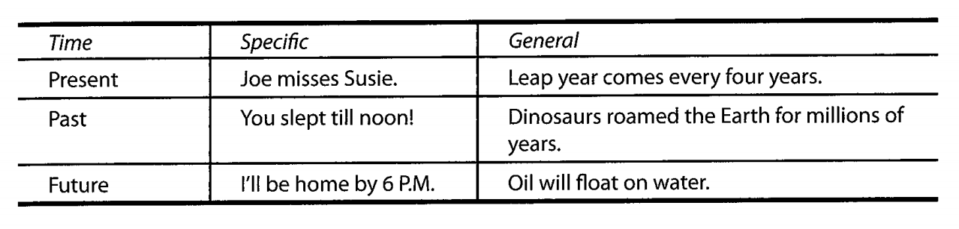
simple tense illustrate the factual statement whether they are specific or general
Notes:
In general we can say the simple aspect talks about events that have no change for development
And to make factual statements or give strong predictions about the states.

Slide 19
Perfect Aspect
The core meaning of the perfect is “prior”. It is used in relation to some other point in time.
  Have you done your homework
The past perfect offers a retrospective point of view on some past time
  He has left before I arrived.
The future perfect offers a retrospective point of view on some future time.
Mark will have finished all the chores by the time we get there.

Slide 20
Present Perfect
Application of the meaning | Example
A situation that began at a prior point in time and continues into the present | I have been a teacher since 1967
An action occurring at an unspecified prior of time that has current relevance | I have already seen the movie.
A very recently completed action | He has just arrived home.
An action that occurred over a prior time period and that is completed at the moment of speaking | The value of the Johnsons' house has doubled in the last four years.
With the verbs in subordinate clauses of time or condition | She won't be satisfied until she has finished another chapter.

Slide 21
Past Perfect
Application of the meaning | Example
An action completed in the past prior to some other past event or time | She had already left before I arrived
Imaginative conditional in the subordinate clause | If sally had studied harder, she would have passed the exam.

Slide 22
Future Perfect
Application of the meaning | Example
A future action that will be completed prior to a specific future time | I will have finished all this work by 5PM.
A state or accomplishment that will be completed in the future, prior to some other future time or event | At the end of the summer, they will be married for 10 years.
Notes:
Perfect tense allows a retrospective(looking back) point of view from a particular point in time

Slide 23
Progressive aspect
The meaning of this aspect as being imperfective, meaning that it portrays an event in a way that allows for it to be incomplete or somehow limited
Possibility and chance for change and/or development
  ex. They are living in Turkey.

Slide 24
Present progressive: (an activity in progress)
Application of the meaning | Example
Extended present(action will end and therefore lacks the permanence of the simple tense) | I’m studying English Language at UoD.
A temporary situation | She is living with her parents.
Repetition or iteration in a series of similar ongoing actions | He is kicking the ball around the backyard.
Express future (when an event is planned, usually with future time adverbial) | She is coming tomorrow.
A change in the progress | She is becoming more and more like her mother.
Emotional comment or present habit often reoccurring with frequency adverbs.(Subjective meaning ) | He is always complaining about his manager’s attitude.
Notes:
Present progressive: (an activity in progress)

Slide 25
Past progressive
Application of the meaning | Example
An action in progress at a specific point of time in the past | He was running when he fell down.
Past action simultaneous with some other event that is usually stared in the simple past. The past progressive provides the background and the simple past provides the foreground | She was doing the dishes when the phone rang.
Repetition or iteration of some ongoing past action | He was coughing all night long.
Social distancing (which comes in the form of past tense and the tentativeness of the progressive aspect) | I was hoping you would lend me some money.

Slide 26
FUTURE progressive
Application of the meaning | Example
An action that will be in progress at a specific time in the future | A driver will be waiting for you when you arrive.
Duration of some specific future action | He will be working on his thesis for the next 2 years
Notes:
The forms were commonly used in british English but now the American English uuses them too

Slide 27
Perfect progressive aspect
As the name indicates, this aspect combines the prior” sense of the perfect with the meaning of “incompleteness” inherent in the progressive aspect:
  Ex: They have been working hard on their special project.
Notes:
We understand that the event reported has begun prior to now and that their lard work is limited
We examine how these two core meanings work in tandem for each other in the tenses

Slide 28
Present perfect progressive
Application of the meaning | Example
A situation or habit that began in the past and that continues up to the present and possibly to the future | She has been going out with her friends.
An action in progress that is not yet completed | I have been reading this book.
A state that changes over time | The students have been getting better and better each week.
A subjective, evaluative comment on something observed over time triggered by current evidence | You have been drinking again!
Notes:
The form was more commonly used in British English but now the American English uses it too

Slide 29
Past perfect progressive
Application of the meaning | Example
An action or habit taking place over a period of time in the past, prior to some other past event or time | She had been working hard, so her doctor told her to take a vacation, she had been trying to finish her degree that year.
A past action in progress that was interrupted by a more recent past action | We had been planning to vacation but changed our minds after receiving the brochure on Nova Scotia.
An ongoing past action or state that becomes satisfied by some other event | I had been hoping to see that play, so I was pleased when I won the tickets.
Notes:
The form was more commonly used in British English but now the American English uses it too

Slide 30
future perfect progressive
Durative or habitual action that is taking place in the present and that will continue into the future until or through a specific future time
  ex: On Christmas Eve, we will have been living in the same house for 20 years.

Slide 31
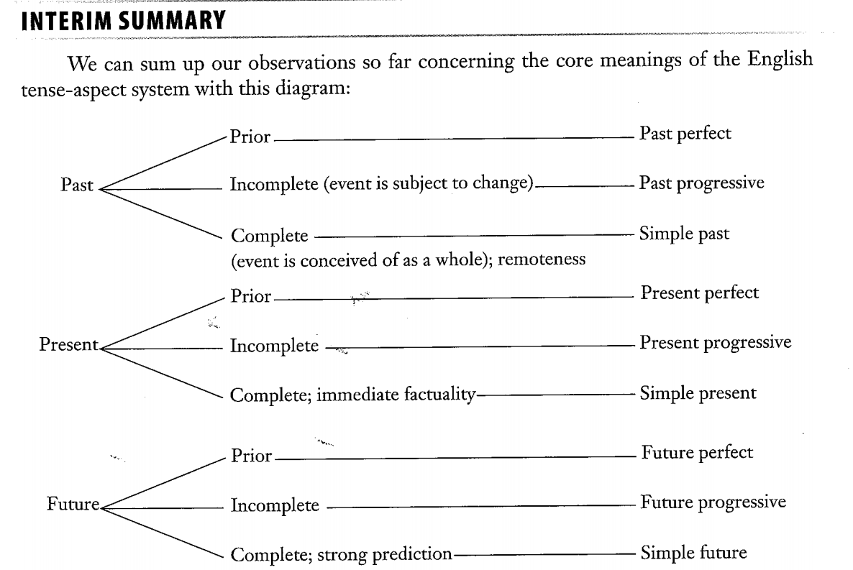

Slide 32
END OF the PRESENTATION part 1 q/a

