Slide 1
More Phrase Structure Rules: The
Predicate of a Sentence
The Auxiliary
The Verb Phrase
Adverbials
The Ordering of Sentence-final Adverbials

Slide 2
Introduction
The core elements of the predicate are auxiliary elements(AUX) and verb phrases (VP).
In addition to these, we also consider adverbials in English.
One pedagogical issue having to do with form related to adverbials is their sequence when there is more than one.

Slide 3
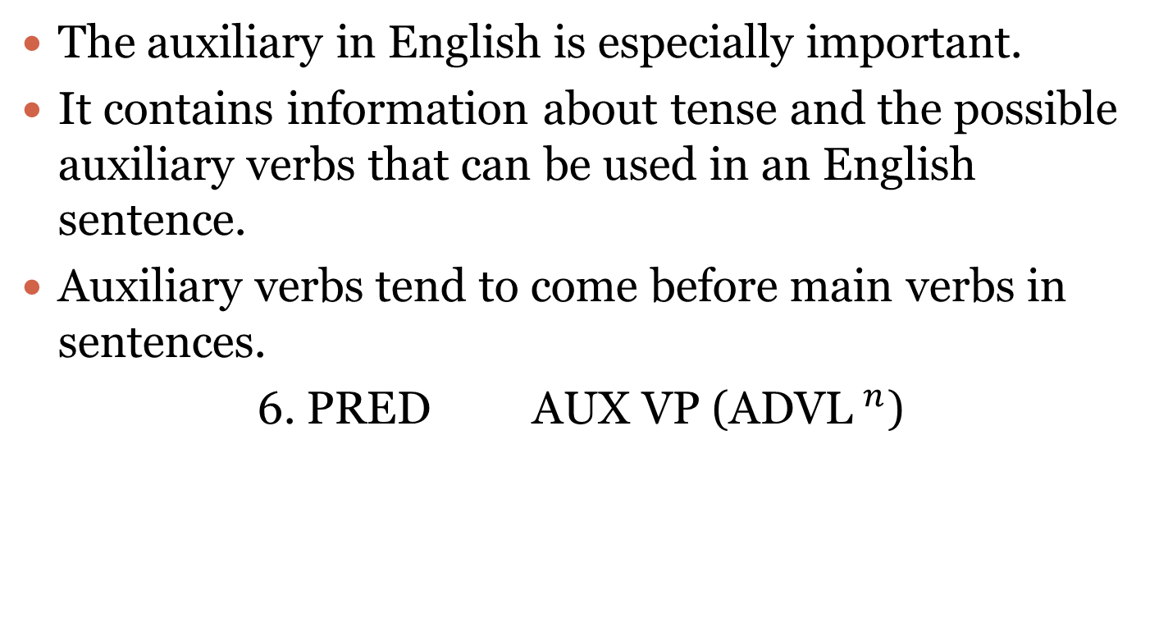
The Auxiliary
The auxiliary in English is especially important.
It contains information about tense and the possible auxiliary verbs that can be used in an English sentence.
Auxiliary verbs tend to come before main verbs in sentences.
6. PRED AUX VP (ADVL$^{n}$)

Slide 4
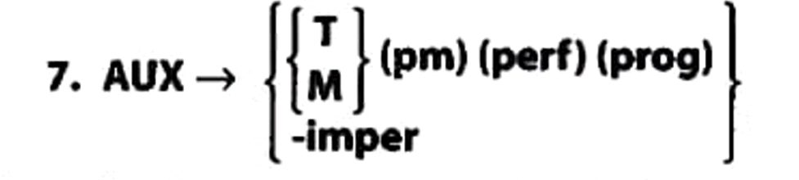
There are several kinds of adverbials, which we will enumerate later in this chapter. To do so, here is rule 7:

Slide 5
This rule tells us that every English sentence must have either
A verb tense (T)
A modal verb (M)
A sentence can then optionally have a phrasal modal
(pm) (e.g, be able to, have to, be going to), perfect aspect (perf), and/or progressive aspect(prog)
Alternatively, the auxiliary can consist only of a marker (-imper) for an imperative sentence.

Slide 6
Rule 8 tells us that that there are two tenses in English: present and past. The curly brackets tell us that for any given sentence, we must choose between the two:
-pres)
8. T
-past
It may seem odd to say that there are only two tenses because English speakers can certainly talk about the future.
However, we do so by using alternative means, such as modal verbs (e.g. I will go tomorrow) and phrasal modals («.g., He's going to go the next day). Tense, then, refers to inflections on the verb.

Slide 7
The verb be is more highly inflected than other verbs in English and can express:
present : am, is, are
past : was, were.
English has two optional structural markers of aspect:
the perfect (perf)
the progressive (prog).

Slide 8
Aspect gives information about completion or duration of an event. For example:
e.g. James has taken Linguistics 101. (suggests that the course is completed)
e.g. James is taking Linguistics 101.(suggests that the course is ongoing)
Here are the rules for these aspects:
9. perf have...-en
10. Prog be..-ing

Slide 9
Using rules 7-10, lets describe the auxiliary in the following sentences:
Description | Sentences
1. past tense | 1. John wrote a book.
2. modal should | 2. John should write a book.
3. pres tense + perfect have..en | 3. John has written a book.
4. pres tense + progressive be.-ing | 4. John is writing a book.
5. pres tense + phrasal modal be going to | 5. John is going to write a book.
6. imper | 6. Write a book.
7. modal il + phrasal modal have to | 7. John will have to write a book.
8. past tense+ phrasal modal have to + perfect hove..-en + progressive be.-ving | 8. John had to have been writing a book.

Slide 10
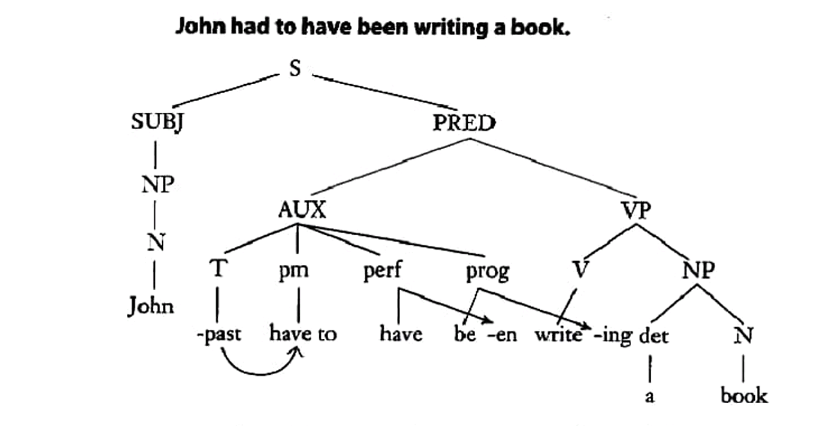
Here is how sentence 8 looks in tree form:

Slide 11
The auxiliary is very important in English. It indicates:
Tense
Modality
Aspect
Morphological complexity of verb forms.
Carries mood (the imperative is one example)
Voice (the passive is an example).

Slide 12

The Verb Phrase

Slide 13
We apply rule 11 to the eight sentences above as follows:
Examples | Rule
1. John is a teacher | 1. VP cop NP
2. Alice is very intelligent | 2. VP cop AP
3. Gaby is allergic to cats. | 3. VP cop AP
4. The students are in the room. | 4. VP cop PrepP
5. Steve snores. | 5. VP V
6. Judy studies mathematics. | 6. VP V NP
7. He gave the money to Sally. | 7. VP- V NP PrepP
8. He gave Sally the money. | 8. VP V NP NP

Slide 14
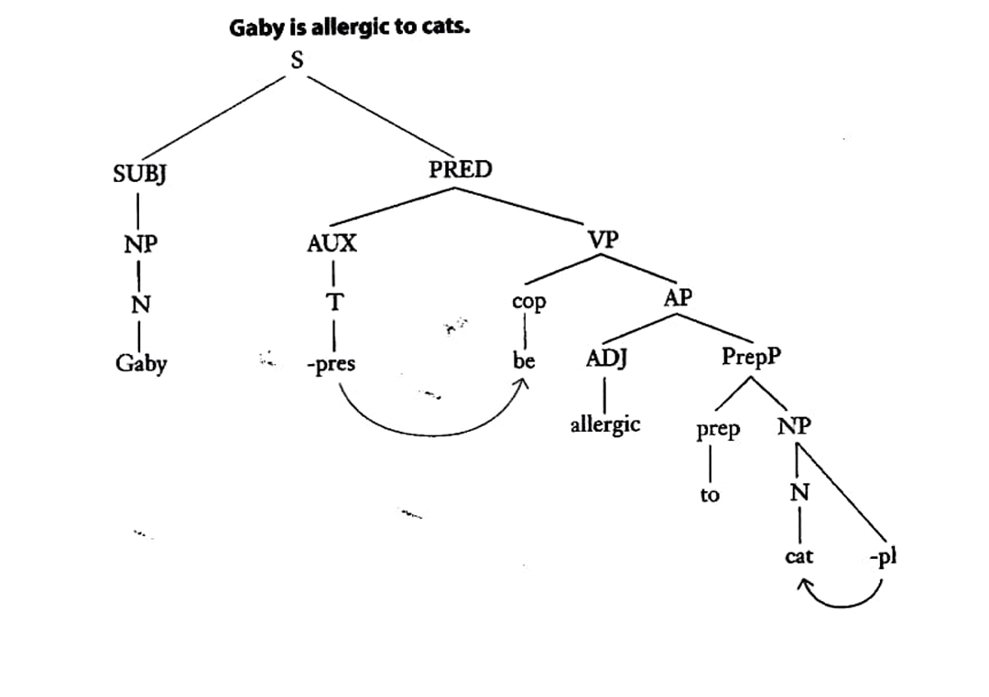
Here is the tree diagram for sentence number 4

Slide 15
Further VP option
An NP'. NP' is our symbol for an NP in the predicate directly followed by another NP, adjective, or prepositional phrase
Consider the following examples:
Object predicates/complements | Direct object
treasurer. | Sam | 1. We elected
inept. | Forrest | 2. Lola considers
on the table. | the book | 3. Sarah paced

Slide 16
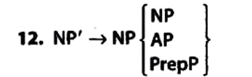
These sentences are admittedly not very common, but to account for them, we need one further rule:

Slide 17
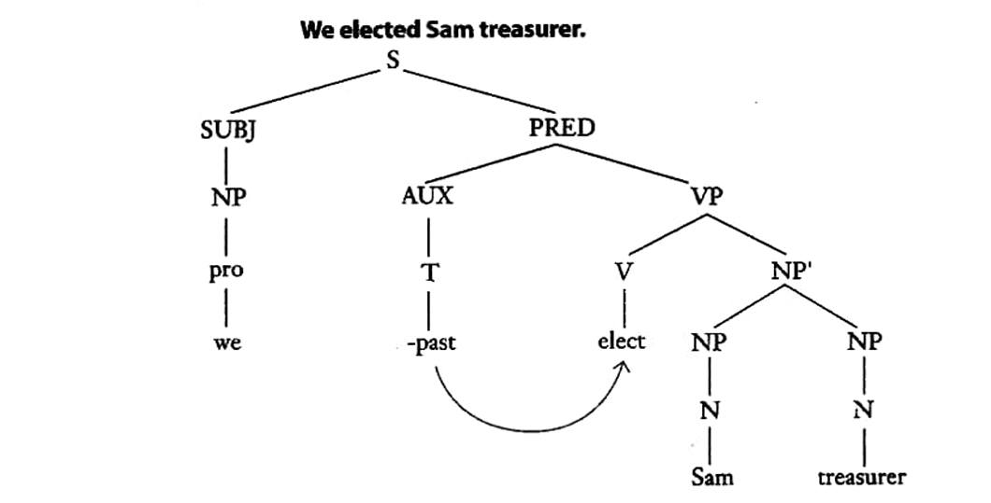
These sentences are admittedly not very common, but to account for them, we need one further rule:
Rule 12 allows us to account for sentences like the three sentences above with object predicates. Below, we diagram the first such sentence as an example:

Slide 18
Subject NP: e.g. The hospital is across the street
The subject NP can be followed by an NP object of a preposition within the subject phrase;
e.g. "The city of New York is called "the Big Apple."
NPs can function as objects or predicates. They function as three types of objects:
direct objects (what receives the action of the verb): Jim read a book.
indirect objects (to whom or for whom the action of the verb applies: She gave me a book
object of prepositions (noun phrases following prepositions): Sam lives In a big house

Slide 19
NPs also function as two types of predicates:
Predicate NPs
NPs function as predicates of subjects when they occur after a copular verb. These are referred to as subject predicates or subject complements:
Subject predicate: Mark is a teacher
They can function as predicates of objects in small clauses, in which they are called object predicates or object complements:
Object predicate: We elected Sam treasurer.

Slide 20
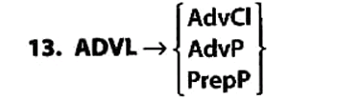
Adverbials
Rule 13 provides us with three syntactic possibilities for each sentence-final adverbial
AdvCl: The boys left before their father could find them.
AdvP: The boys left very quickly
PrepP: The boys ran out the door.
An adverb clause is expanded to include an adverb subordinator (adv sub) followed by a new sentence (S):
14. Advcl adv sub S

Slide 21
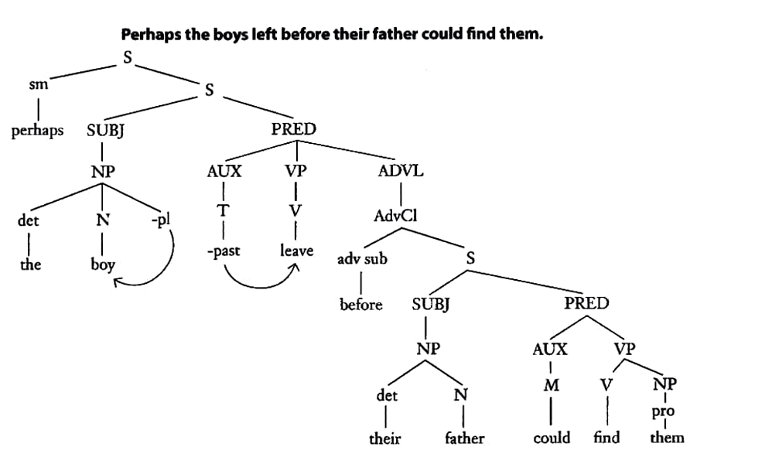
Another possible expansion of the adverbial in rule 13 is an adverb phrase (AdvP), which is rewritten as follows:
Let us consider the tree diagram for a sentence with an adverb clause:
15. AdvP (ADV")Adv
an adverb phrase contains an obligatory adverb, ADV, optionally preceded by one or more other adverbs.
An adverb occurs not only before adjectives as, but also before adverbs.

Slide 22
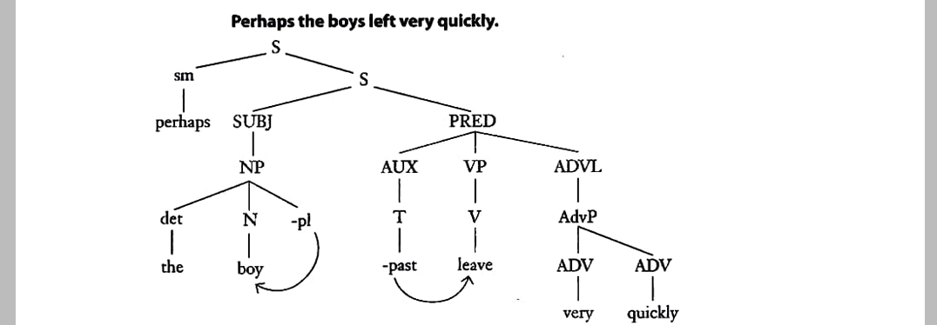
The following sentence and tree diagram illustrate a case where an optional adverb has been selected to modify an adverb:
some adverbs may be repeated, while other series can have different adverbs:
(very, very quickly, really very quickly)

Slide 23
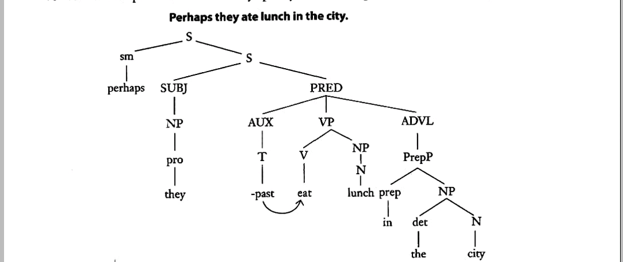
Finally, an optional adverbial may also be expanded as a prepositional phrase.
Rule 5, which was introduced earlier and which is repeated here, would apPply in such a case:
5. Prep P prep NP

Slide 24
There is a difference between PrepPs that come under the adverbial node and PrepPs that are part of the VP.
In case of PrepPs under adverbial node
In case of PrepPs that are part of VP,
All other cases where the preposition follows the verb are adverbial in origin and come under the adverbial node (ADVL).
Jack sells auto parts for a living.
e.g. She gave the book to Mavis.
*She gave the book.
The same applies to the copular be. The PrepP is essential to completing the VP:
e.g. John Is in the house.
e.g. *John is.

Slide 25
Just as there are pronouns for NPs, there can be pro-adverbs for PrepPs. For example:
Joe is a tourist guide in Miami Beach. He likes working there.
Tourists flock to Miami Beach in the winter. Tourists flock there then.

Slide 26
The Ordering of Sentence-final Adverbials
To understand the order, it is important to first establish that there are many semantically different types of sentence-final adverbials
direction adverbial: John ran to the store.
position adverbial: John is at home.
manner adverbial: John runs quickly.
time adverbial: Judy eats lunch at noon.
frequency adverbial: Judy eats lunch every day.
purpose adverbial: Harry works to earn money.
reason adverbial: Harry works because he has to pay bills.

Slide 27
The Ordering of Sentence-final Adverbials
Adverbials of Manner, Direction, and Position:
1. Manner tends to precede or to follow direction and position.
2. Direction tends to precede position, and they tend to be adjacent.
quickly around the track at the park. [manner, direction, position]
e.g. He ran
around the track at the park quickly. [direction, position, manner
Adverbials of Time and Frequency:
1. Time and frequency tend to follow manner, direction, and position.
2. Time and frequency are variable in order with respect to each other.
e.g. She eats lunch quickly (every day at noon/at noon every day).
manner(frequency, time/ time, frequency)

Slide 28
Adverbials of Purpose and Reason:
1. Purpose and reason tend to follow all other adverbials.
2. Purpose tends to precede reason.
in order to have time to read.
e.g. She eats lunch quickly every day [purpose]
because she likes to have time to read.
[reason]
e.g. Jane went to Ohio to visit her uncle because she hadn't seen him for years.
purpose reason
e.g. Jane went to Ohio because she hadn't seen her uncle for years to visit him.
reason purpose

Slide 29
The ordering of sentence-final adverbials thus exhibits some variability, yet it is far from being random, since sequences such as the following are awkward, if not ungrammatical:
e.g. Marcia walked this morning to the shopping center
e.g. Jane fixes dinner every day quickly.
e.g. Harry goes jogging in order to stay fit at noon.
For now, perhaps we should just adopt a rule of thumb that looks like this:
direction+ position manner + time frequency + purpose + reason

Slide 30
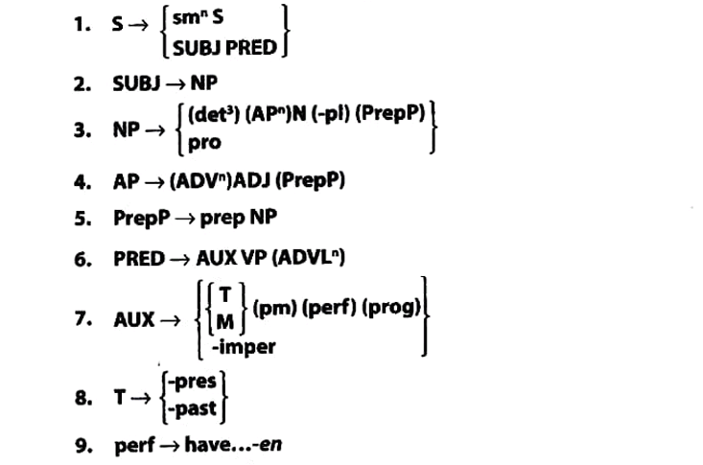
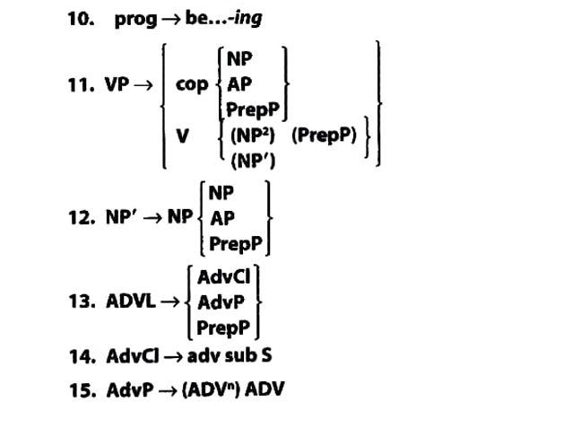
Summary of the Phrase Structure Rules

