Slide 1
Word Order and the Phrase Structure Rules for the Subject of the Sentence
Presented by : Bahzad Ameen
Pedagogical Grammar

Slide 2
Presentation Outline
Objectives and aims
Introduction to word order (Linearty)
Phrase structure (Categorality and Hierarchy)
Noun phrase NP
Adjective phrase AP
Prepostional phrase PP
Conclusion

Slide 3
Objectives and Aims
1. Focusing on the middle level – basic Syntax (property of Linearty)
2. Formulate some basic rules for English word order called ( phrase structure rules )
3. show how a sentence can be broken down into categories and their constituent parts
4. introducing the property of hierarchy from the level of sentence down to the smallest constituent

Slide 4
An Introduction to Word Order (Linearty)
In English, word order within the sentence is less flexible than it is in many other languages.
English came to rely on linear word order to distinguish subjects from objects.
English is an SVO language (the standard order) like Spanish, French and many other languages but the major defference is both English and French ask for a subject to appear but Spanish does not have this requirement for the sentence with pronominal subjects (pro-drop langauge). For example:
English French Spanish
I speak English Je parle francais (Yo) hablo espanol
There is a certain type of English sentence without an expressed subject which is imperative sentences. For example: Stop that car

Slide 5
In English spoken language sometimes the subject is elided where we can easily infer the subject into the sentence especially when the subject is (I) or (it)and such subject ellipsis occure when the subject is recoverable in the context. For example:
E.g.Amanda: (I) saw Sally yesterday. (I) bought her flowers
E.g. I broke my arm
Reply: must be painful instead of (it) must be painful

Slide 6
Not all langauges follow the same typologies ?
For instance:
Japanese & Turkish: SOV
Indonesian & classical Hebrew and Arabic: VSO
Carib language in Brazil: OVS
Malagsy of Madagascar:VOS
Some common languages are not in our list ?
For example: German
main clauses are SVO but subordinate clauses the verb is final that’s why the word order is SOV.

Slide 7
In English the word order isn’t invariant.
How ?
Topicalization or Object fronting for Emphasis
e.g. A: I love coffee SVO
B: What about tea?
A: Tea i don’t like OSV

Slide 8
Phrase structure (Categorality and Hierarchy)
Sentences aren’t only made of words in a linear order but they have other properties as well. For example, if you are asked to divide the following sentence into two main parts, where would you draw the line?
e.g. Sally / sings country music
The point is that sentences are structured strings of words and it isn’t a matter of dividing the sentence into two parts arbitrarily. We believe that words at the either side of the line go together (Cluster). And this illustrates the property of categorality. So, in the above example, Sally is considered as subject category and sings country music is categorized as predicate. And these categories are in a hierarchical relation.

Slide 9
An English sentence can be followed by a sentence modifier or more than one, for example:
Surely, Amanda / sings counrty music
S
╱╲
Adv. S
╱╲
Sub predicate

Slide 10

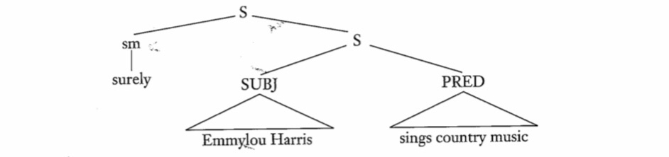
Phrase structure rules
Rule :
E.g.

Slide 11

Noun phrase (NP)
RULE 2 : Subject is NP
The second phrase rule tells us that a subject might be a NP.
a phrase formed by a noun and all its modifiers and determiners, for example: a proper noun like Ali is simple NP.
Rule 3 :
A noun phrase can more complicated i.e. It can be preceded by determiners.
e.g. The car
The other car
All the other cars
A noun phrase can be preceded by an adjective phrase
e.g. All the other red car

Slide 12
There must be agreement between the determiner and the noun it modifies.
e.g. All the other famous singers
NP can be followed by a prepositional phrase.
e.g. All the other famouse singers of today
Minimally the NP is an infleacted lexical noun such as rice, book, Sally and optionally the NP can expanded in any number of ways, for example:
A noun with three determiners : all her other memories
A noun with a determiner and an adj. : a blue car
A noun with plural inflection: cars
A noun with a determiner and followed by a prepositional phrase : a man of honor
A noun with various combinations of above options: the famous city of Erbil

Slide 13
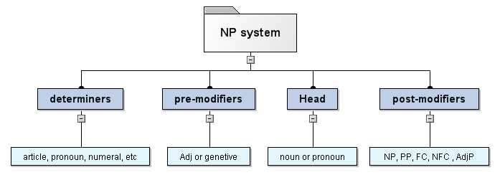

Slide 14
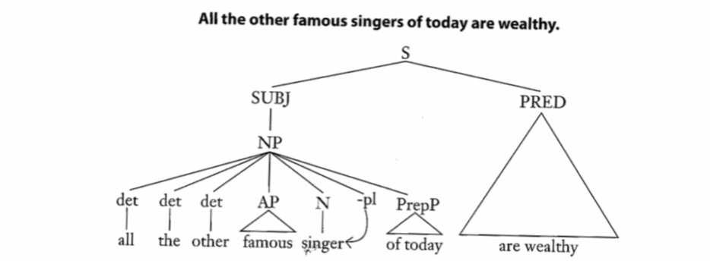

Slide 15
Adjective Phrase (AP)
Rule 4 : AP ╼> (adv) adj (pp)
It is a group of words that describe a noun in a sentence.. The adjective phrase can be placed before, or after, the noun in the sentence.
e.g. Pretty girl, the girl is pretty
An adjective phrase contains an adjective as a head.
e.g. Fond of games, very happy
An adjective can be preceded by an adverb (optional) to indicate any of the following:
Manner: his quietly confident behavior
Duration: his permanently sad expression
Degree: an extremely valuable collection
Condition: the otherwise perferable course of action
Location: his internationally famous daughter
Time: their recently aggressive behavior
Frequency: her sometimes harsh criticisims

Slide 16
Sometimes the same adverb is repeated which referred to as redublication:
e.g. Very very famous person
e.g. Really very famous person
An adjective can be followed by a prepositinal phrase
e.g. My good for nothing cousin

Slide 17
Prepositinal Phrase (PP)
Rule 5 : prep NP
Simply a preposition followed by a noun phrase:
e.g. A man of honor
pre + NP
Some prepositional phrases can’t have predicative relation to the head noun:
e.g. The city of Chicago i.e. We can’t say (the city is of Chicago) but some other prepositional phrases are semantically predicative for example: the book on the table which means (the book is on the table)

Slide 18
Conclusion
we have got some essential points:
Linear word order
Categorality
How constituents of sentences go together to form categories and haierarchy
How smaller categories comprise larger categories
We introduced what a sentence, subject, NP, AP, and PP are comprised of.

Slide 19
Thank you

