Slide 1


Biological membranes and Transport
Cell and Molecular Biology/ Theory
By: Dr. Karwan Idrees Jarjees
COLLEGE of
VETERINARY MEDICINE
THE UNIVERSITY of DUHOK

Slide 2
Learning objectives
This lecture should help student
Understand the structural features of the membrane lipid components
Know the types of membrane proteins
Know the general functions of biological membranes
How cell membranes organize

Slide 4
Biological membranes
Biological membranes is a selectively permeable membrane that separates the interior of a cell from the external environment or creates intracellular compartments by serving as a boundary between one part of the cell and another. It consists of bilayer leaflets that contain lipids, proteins and sugars.
Formation of Biological membranes
Biological membranes are formed by adding to a pre-existing membrane. In eukaryotes, synthesis of membrane compositions take place in the endoplasmic reticulum and Golgi body then transported to the plasma membrane via secretory vesicle.

Slide 5
Main functions of Biological membrane
Biological membranes have three primary functions:
1. They keep toxic substances out of the cell
2. They contain receptors and channels that allow specific molecules, such as ions, nutrients, wastes, and metabolic products, that mediate cellular and extracellular activities to pass between organelles and between the cell and the outside environment.
3. They separate vital but incompatible metabolic processes conducted within organelles. Such as lysosomes isolating digestive enzymes from the cytosol or separating ATP production from other reactions.

Slide 6
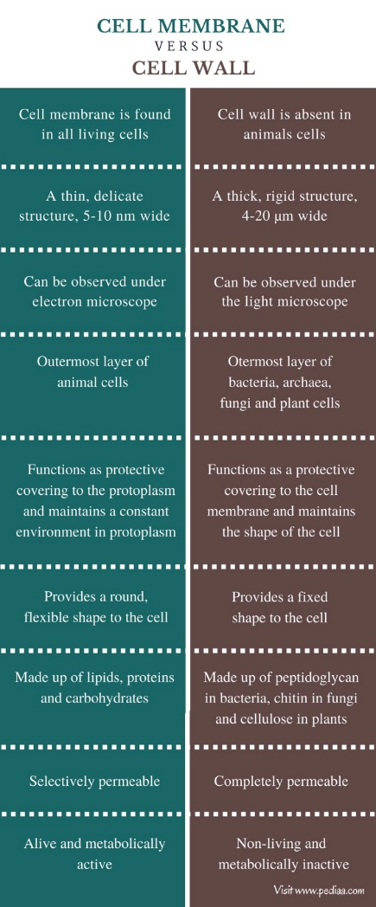

Slide 7
Biochemical composition
Cell membranes are composed of lipids, proteins and carbohydrate
I- Lipid bilayer composition
Biological membranes consist of a double sheet (known as a bilayer) of lipid molecules. This structure is generally referred to as the phospholipid bilayer. All membrane lipids are amphipathic—that is, they contain both a hydrophilic (water-loving) region and a hydrophobic (water-hating) region.
Plasma and organelle membranes
contain between 40% and 80% of lipid.
Notes:
Polar and non polar region

Slide 8
Types of membrane lipids
1- Phospholipids: are the most abundant membrane lipids, phospholipids consist of two fatty acid chains (hydrophobic tail region ) that directed toward one another at the center of bilayer membrane. They are linked to glycerol and a phosphate group (hydrophilic ‘head’ region)
2- Sterols: It consists of a hydroxyl group ( hydrophilic ‘head’ region), a four-ring steroid structure and a short hydrocarbon side chain (hydrophobic tail region). Cholesterol is located between phospholipids to support the cell membrane. Cholesterol is present in animal cell membranes and plays a crucial role in maintaining membrane fluidity. It prevents the membrane from becoming too rigid in cold conditions or too fluid in warm conditions.
3- Glycolipids: Lipids attached with carbohydrate (sugars), They acts as markers, for example, antigens composed of sugar chains on the surface of red blood cells determine an individual's blood group. These antigens are recognized by antibodies to cause an immune response.

Slide 9
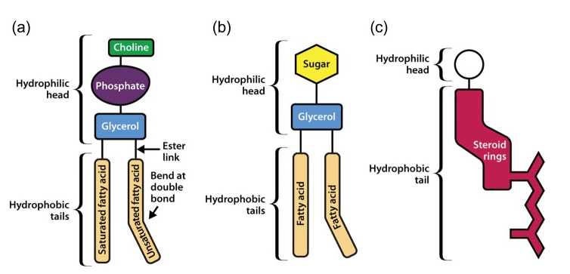
A- phospholipid
B- glycolipid
C- Sterol

Slide 10
II- Proteins
They weigh about 50% of membrane mass.
There are two basic types of proteins according to their orientations within cell membrane:
Integral membrane proteins have one or more segments embedded in the lipid bilayer, Transmembrane proteins are Integral proteins that penetrate the entire membrane and exposed on both sides.
Peripheral membrane proteins are attached to the membrane by binding to integral membrane proteins or head groups of lipid, and they usually found on the cytosol side of membrane .

Slide 11
Membrane proteins

Slide 12
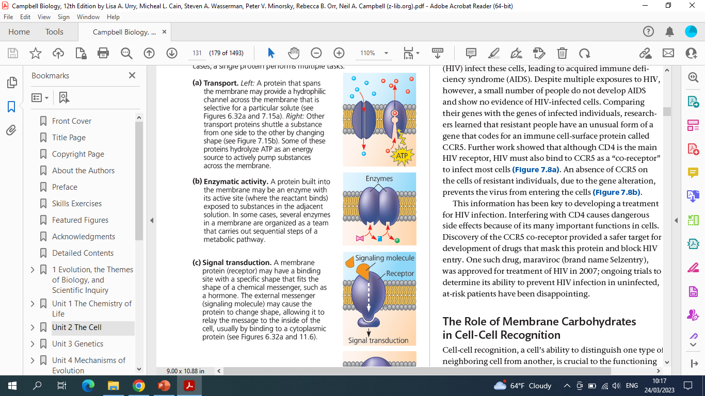
Functional classes of membrane Proteins
Transporters
  Transporters (channels): membrane proteins that enable molecules to enter and exit a cell such as transmembrane proteins.
  Enzymes: membrane proteins that increase the rate of a chemical reaction without changing themselves
  Receptors: A membrane protein that have a binding site with a specific shape that fits the shape of a chemical messenger (ligand), such as a hormone.

Slide 13
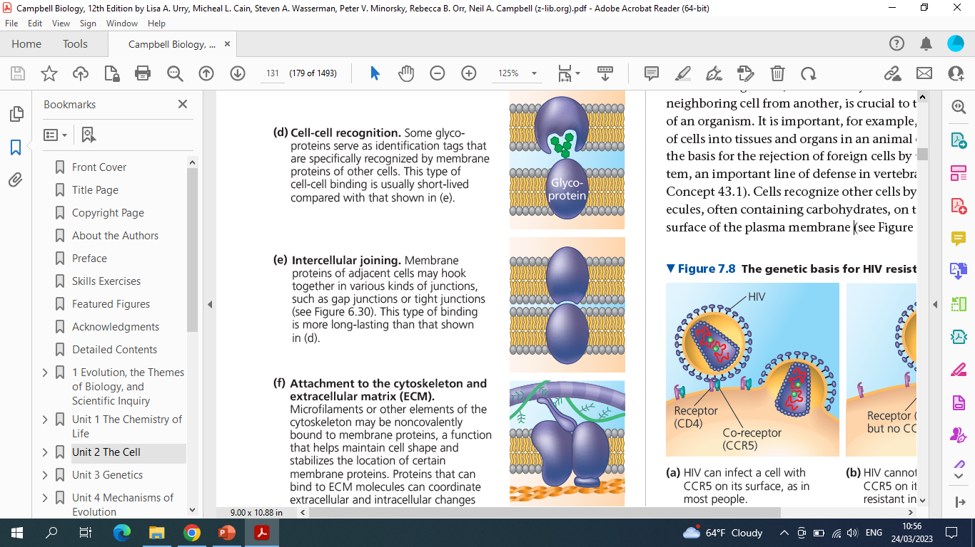
Cell-cell recognition proteins : Some membrane glycoproteins serve as identification tags that are specifically recognized by membrane proteins of other cells.
Joining proteins: Membrane proteins of adjacent cells may hook together, such as in gap junctions or tight junctions or Membrane proteins that bind cytoskeleton filaments to extracellular matrix (ECM) which helps maintain cell shape.
ECM

Slide 14
III- Carbohydrate:
Carbohydrates attached to lipids or proteins form glycoproteins and glycolipids. They are found on the outer layer of membrane. These structures are important for cell recognition, immune responses, and communication between cells.
Membrane organization
Fluid mosaic model :- the membrane model proposed by Singer and Nicholson in 1972 that has been used to describe plasma membranes.
The membrane is described as a fluid mosaic because it is composed of diverse, scattered pattern of various molecules—primarily proteins, cholesterol, and carbohydrates—embedded within or attached to the phospholipid bilayer of the cell membrane. . This dynamic nature allows the membrane to adapt and function efficiently.

Slide 15
Membrane organization
Notes:
Membrane organization

Slide 16
Membrane functions (Transport)
Movement of substances across membrane is essential to life of the cell.
Substances need to move IN to cell…..
to support metabolic processes
Substances need to move OUT of cell
if they are produced for export (e.g. secretions)
if they are waste products
Notes:
Transporting of substances is very important

Slide 17
Types of membrane transport
Movement of substances across membrane can be PASSIVE or ACTIVE
PASSIVE processes
II. ACTIVE processes
substance moves down a gradient concentration (from high to low area). It does not need energy.
Simple diffusion
Facilitated diffusion
3. Osmosis
substance can move against a gradient (from low to high area), it
requires cellular energy (ATP).
Active Transporter
Endocytosis
Exocytosis
Drug transport

Slide 18
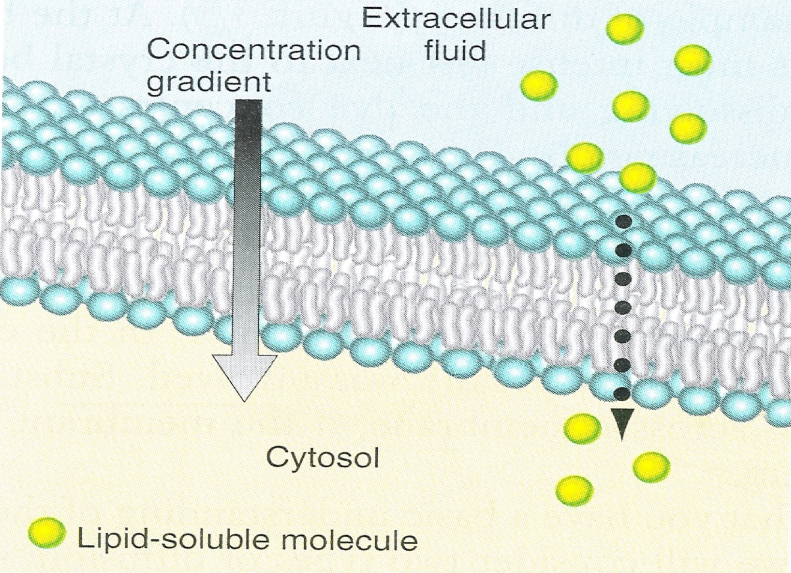
I- Passive processes
1 – Simple Diffusion
  lipid-soluble substances can cross the lipid bilayer, for examples:
  oxygen, carbon dioxide, steroid hormones, fatty acids, fat-soluble vitamins (A, D, E & K)

Slide 19
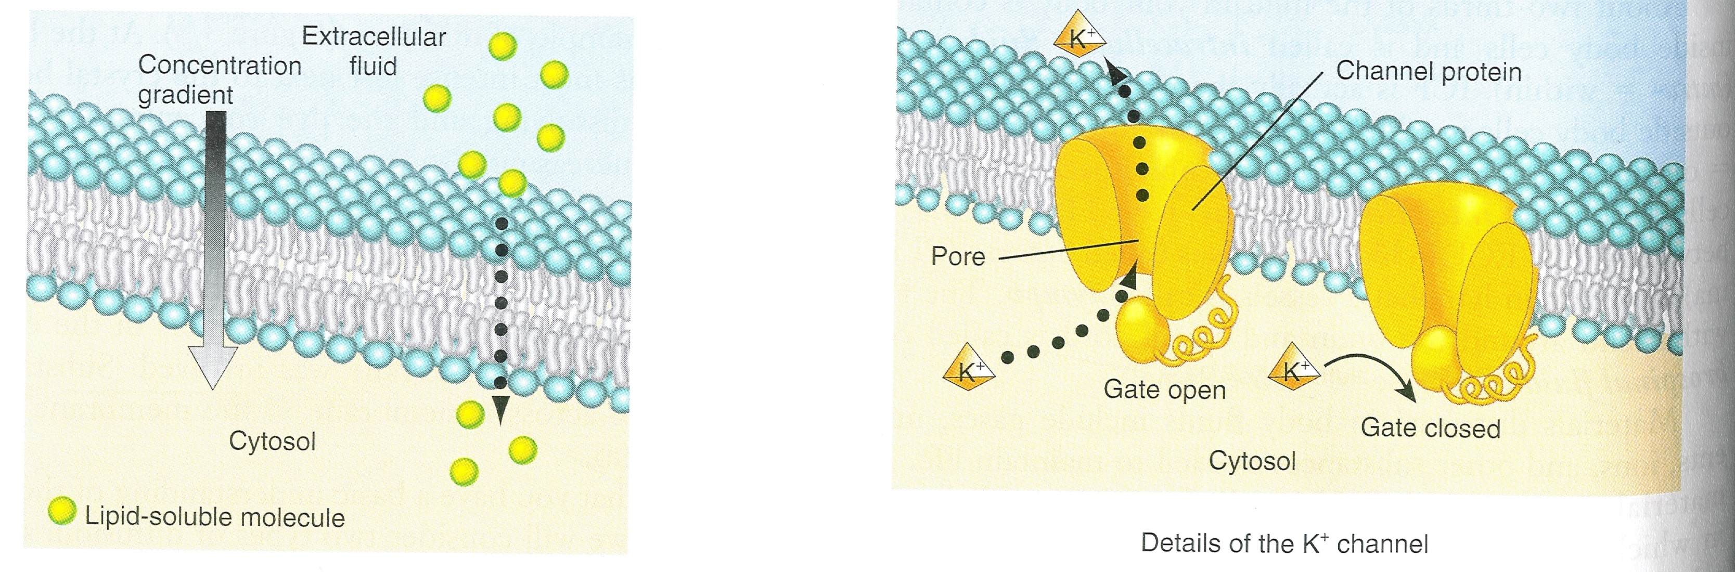
2- Facilitated Diffusion
substances that are not lipid soluble transport across lipid bilayer with aid of integral membrane proteins.
A. Ion Channels
Transport of ions with help of channel proteins. Ion channels are selective that allow entering ions of certain size and charge. e.g., calcium channels are specific for calcium and sodium channels for
sodium.

Slide 20
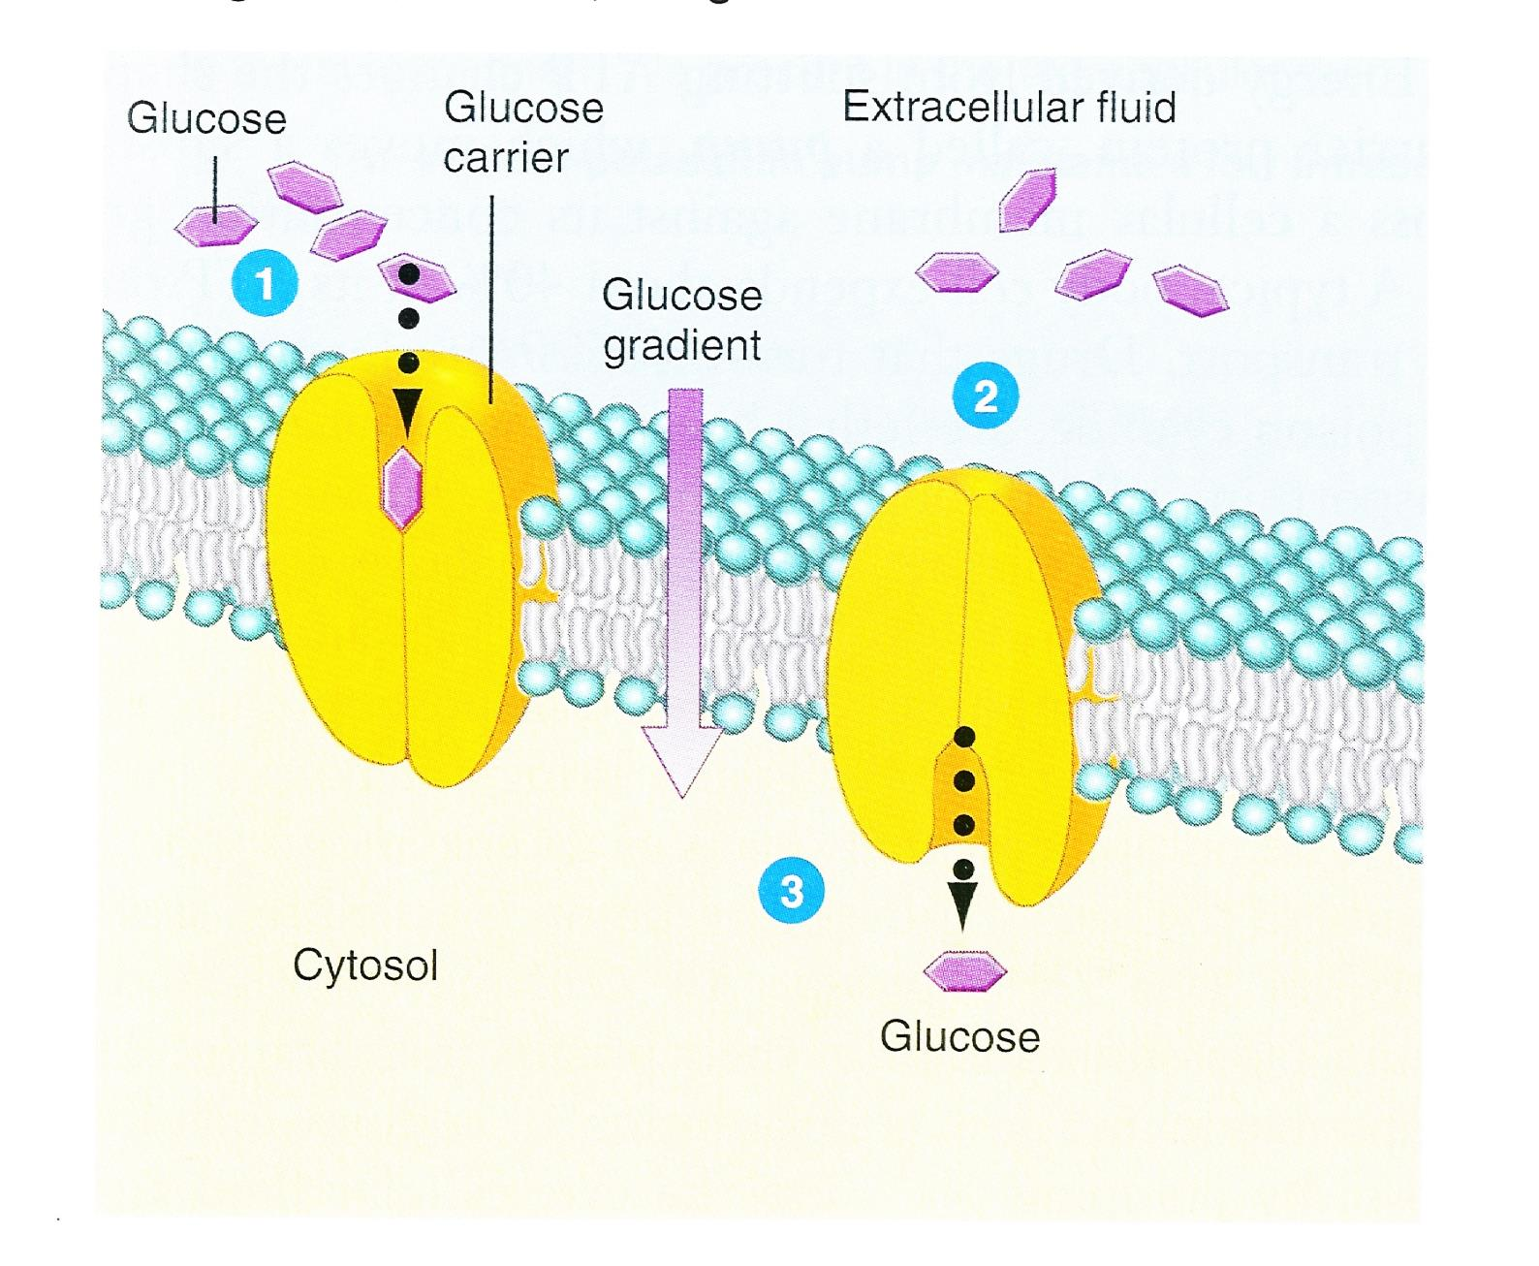
B. Carrier Proteins
Transport of glucose with help of carrier proteins (GLUTs). Glucose bind to GLUT and transport from an area of higher concentration to an area of lower concentration.
Osmosis:
Movement of water from high concentration area to an area of lower concentration through aquaporins.
Aquaporins: Membrane proteins (water channels) that enable water to pass through hydrophobic part of phospholipid membrane.
Notes:
Glucose transporters (GLUTs) are proteins that aid the transportation of glucose to various tissues where they are effectively utilized as an energy source.

Slide 21
Role of Insulin
Insulin is a hormone released by β cells of the islets of Langerhans in the pancreas. It regulates glucose (and other carbohydrates) transport into cells. A deficiency in insulin and GLUTs protein lead to diabetes mellitus (type 1 and type 2)
Insulin resistance: the cells do not respond to insulin

Slide 22
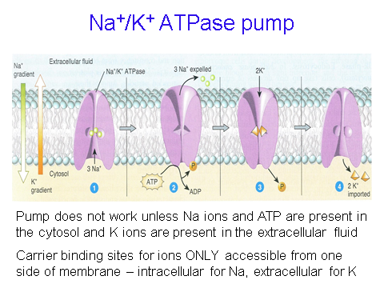
II- Active process
1- Active transport
Use of cellular energy ATP to actively transport substances across the membrane. Mainly ions: Na⁺ K⁺ H⁺ Ca²⁺ I⁻ Cl⁻
Transport is against a concentration gradient using a carrier protein (transporter) or called a PUMP. For example, Sodium/Potassium pump.

Slide 23
2- Cytosis
is an active transport mechanism for the movement of large quantities of molecules into and out of biological cells.
There are two types of cytosis: endocytosis and exocytosis
Endocytosis
is the process in which cells engulf extracellular molecules and bring them into cytoplasm through active transport which requires ATP.
The cell extends two pseudopodia around the materials forming a vesicle that can detach from the membrane and release into cell.

Slide 24
A- Endocytosis:
There are three types of endocytosis:
a. phagocytosis ( cell eating): it is responsible for engulfing large cellular particles like bacteria. The vesicle formed is called (phagosome).
b. pinocytosis ( cell drinking): The engulfed material is liquid, the liquid is taken up by cell and transported across membrane in pinocytotic vesicle.
c. Receptor mediated endocytosis: in this process, materials bind to specific receptors on the cell membrane and collect it in endosome vesicle.

Slide 25
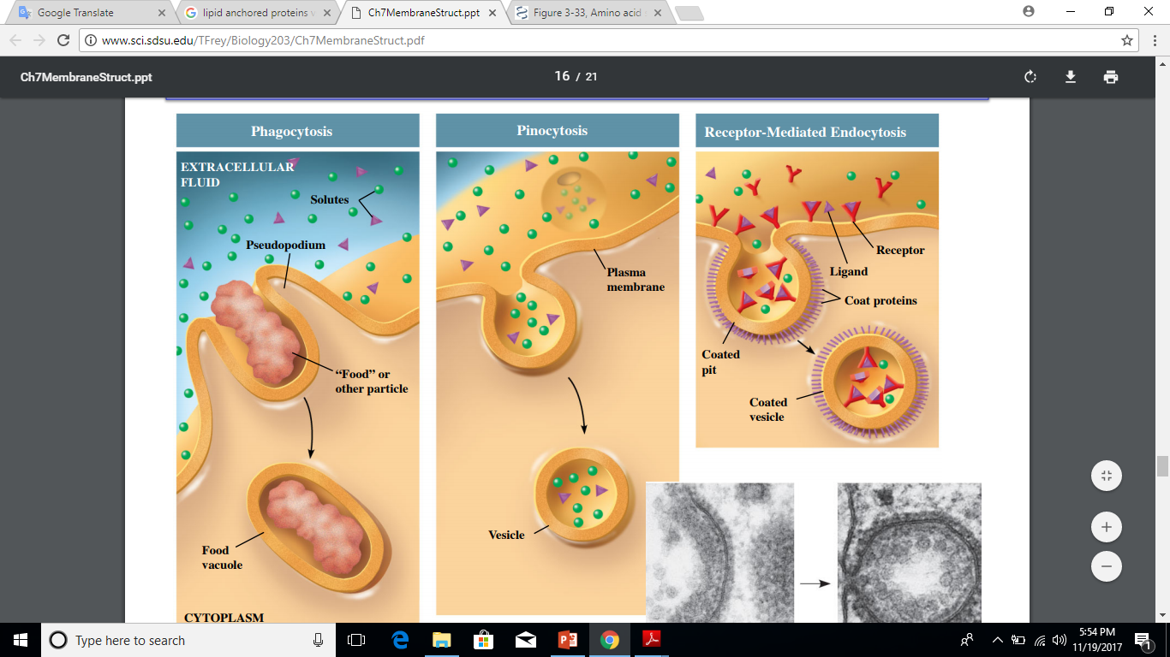
A- Endocytosis

Slide 26
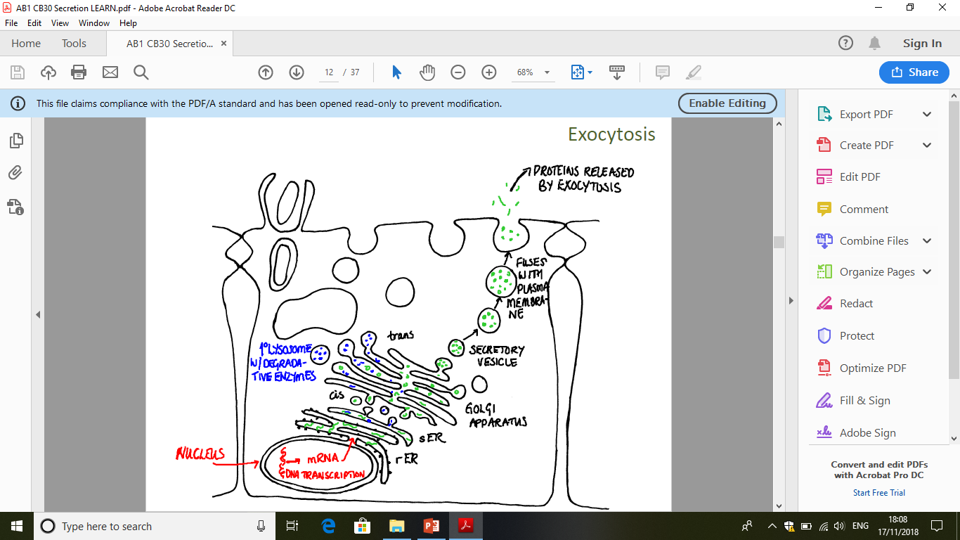
B. Exocytosis:
Exocytosis is the movement of materials from inside to outside of cell . The plasma membrane can excrete its contents outside cells to remove undigested material (excretion) and to secrete useful substances (secretion) such as hormones and enzymes.
During exocytosis, the secretory vesicle fuses with the cell membrane and releases its contents into the extracellular matrix.
.

Slide 27
3. Drug transport
Drugs administered by the oral route must cross plasma membranes in the intestinal epithelium in order to be absorbed into the blood circulation.
Drugs administered intravenously reach the systemic circulation and completely absorbed by the target cell.

Slide 28
Revised questions
Explain how the biological membrane are formed
List the types of lipid bilayer components
Mention the types of membrane proteins depending on their orientation
What are the functional classification of membrane proteins
Explain the organisation of cell membrane
Distinguish between passive and active processes across membrane
Explain the concept of active transport
Compare the facilitated diffusion through channel with that via carriers
Explain the essential mechanisms of endocytosis and exocytosis.
Describe the three different processes of endocytosis

