Slide 1

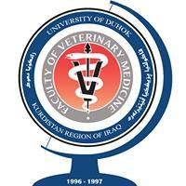
Introduction to Cell Biology
Cell and Molecular Biology/ Theory
By Dr. Karwan Idrees Jarjees
COLLEGE of
VETERINARY MEDICINE
THE UNIVERSITY of DUHOK

Slide 2
Learning outcome:
This lecture should help student to:
Know the characteristics and function of living organisms
Know the structure and organisation of pro-and eukaryotic cells

Slide 3
What is Biology?
Biology is the scientific study of life and living organisms, derived from the Greek words bios (life) and logia (study of). It explores the structure, function, growth, origin, evolution, and distribution of living things, ranging from microscopic bacteria to complex ecosystems.
The Cell : The cell (from Latin cell meaning small room) is the basic structural, functional and biological unit of all known organisms. A cell is the smallest unit of life. Cells are often called the building blocks of life. The study of cell is called Cell Biology, Cellular Biology or Cytology.

Slide 4
Characteristics of Living organisms:
Self Organization: living organisms are highly organized and complex. They are composed of one or more cells.
Self Reproducing Capacity: Contain a blueprint (genome) to transfer information from one generation to the next.
Mechanism of Energy Transfer: Need and use energy, the cellular energy is obtained from nutrients that is used to make new cellular components.
Self Regulation Capacity: Carry out and control numerous reactions, these reactions include the chemical processes that are important to growth and repair of living cells.

Slide 5
Adaptation Capacity: living organisms adapt to stimuli such as physical or chemical signal from the internal or external environment.
Maintain homeostasis: the tendency of an organism to maintain
a constant internal environment, they can control their internal conditions, such as their temperature or water content.
Evolution and Biodiversity: Evolve and show great diversity, living organism can be classified into different species.

Slide 6
Levels of Biological Organization
1. The Biosphere
Biosphere consists of all life on Earth and all the places where life exists
2. Ecosystems
An ecosystem consists of all the living things in a particular area, along with all the non living components of the environment such as soil, water, atmospheric gases, and light.
3. Communities
Community consists of all the populations of different species living and interacting in a particular area.
4. Population
A population is a group of individuals of the same species living in a specific area

Slide 8
5. Organisms
Individual living things such as human, animal, bacteria
6. An organ system
is multiple organs working together to carried out a particular function.
For example, the digestive system.
7. An organ
is a group of different types of tissues functioning together to perform a particular activity. For example, the heart.
8. Tissues
Tissues are groups of cells performing a common function.
9. Cells
Cells are the structural and functional units of life, in all tissue, organs and organ systems.

Slide 9
10. Organelles
“little organs” are intracellular structures that have specific function which keep the cell alive
11. Molecule
Molecule is a chemical structure consisting of two or more units called atoms

Slide 10
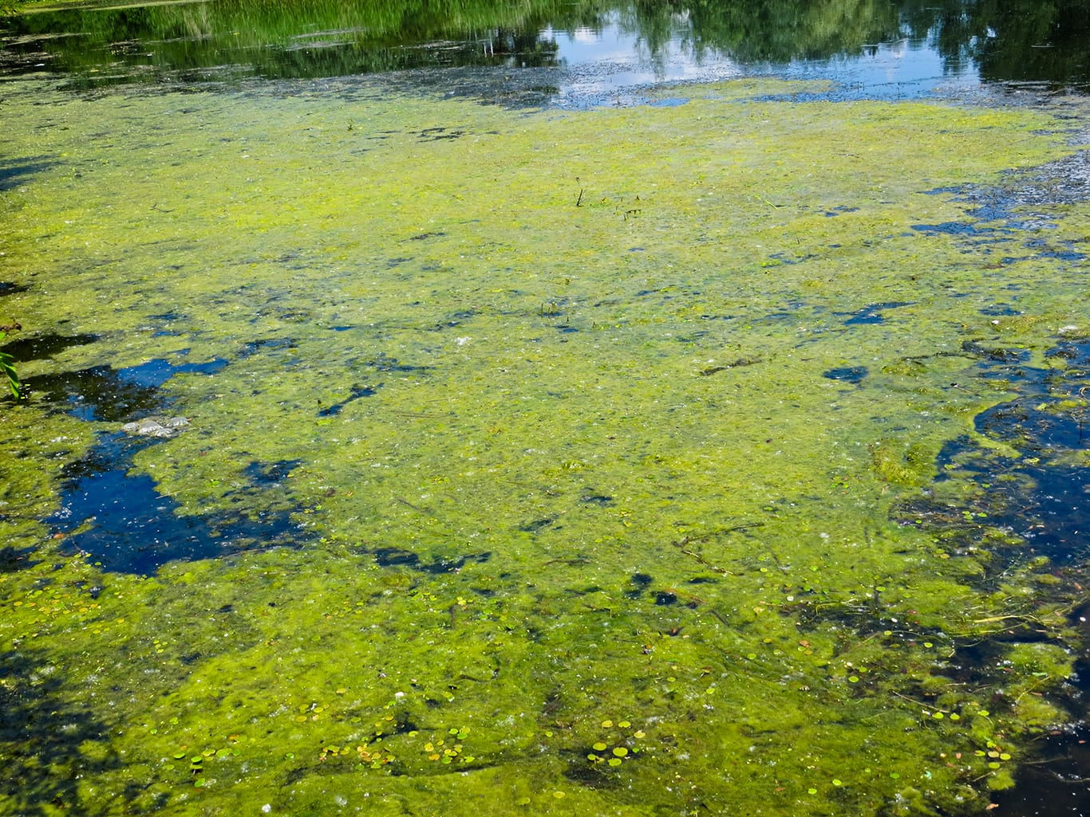
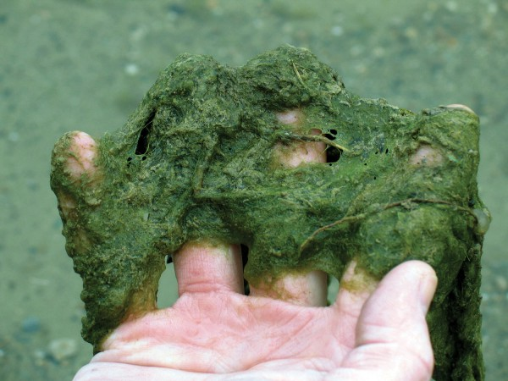
History of Cell
In the late 1600s Robert Hooke (English physicist) used the term ‘cell’ in latin means little rooms after observing cork cells using primitive, light microscopes.
In 1673, Anton von Leeuwenhoek discovered single-celled organisms (protists) in pond scum. Leeuwenhoek was also the first to see blood cells, bacterial cells, and yeast cells.
Notes:
A protist is any eukaryotic organism that is not an animal, plant, or fungus, generally unicellular and microscopic. Found mostly in aquatic environments,

Slide 11
Cork cells
Light microscope

Slide 12
The Cell Theory:
The cell theory includes four principles in modern biology:
1- All organisms are composed of one or more cells. While many organisms, such as the bacteria, are single-celled unicellular, other organisms, including humans and plants, are multicellular within the life processes of metabolism and heredity occur.
2- Cells are the smallest living things.
3- Addition cells are not originating at present, rather, life on earth represent a continuous line of descent from those early cells.
4- Cells arise only by the division of previously existing cell.

Slide 13
Some types of Cell

Slide 14
The functions or capacities of cells:
1- The capacity to extract energy from the environment and change it from one form to another.
2- The capacity to use this energy to build more organic molecules to maintain themselves and grow.
3- The capacity to deal with the environment selectively.
4- The capacity to reproduce.

Slide 15
Chemistry of the Cell
The cell is chemically composed of water, organic molecules and inorganic ions. Water form 70% or more of total cell mass.
Biological properites of the water:
1- In the body the major components of cells such as proteins, DNA, and organelles are all dissolved in water
2- Water transport into and out of the cell is strictly regulated
3- Water’s high heat capacity insulates our boidies from drastic temperature changes
4- Water’s chemical and physical properities contribute to all life on earth at the planetary, organismal, cellular and molecular levels.

Slide 16
Prokaryotes and Eukaryotes
Biologists classify cells into two broad categories the Prokaryotes and Eukaryotes.
The primary difference between a prokaryotic cell and a eukaryotic cell is the presence or absence of a nucleus, a membrane-bound structure that houses the DNA.
Prokaryotic cells lack a nucleus, whereas eukaryotic cells possess a nucleus. Despite their differences, both types of cells have a plasma membrane, a membrane that regulates what enters and exists a cell.

Slide 17
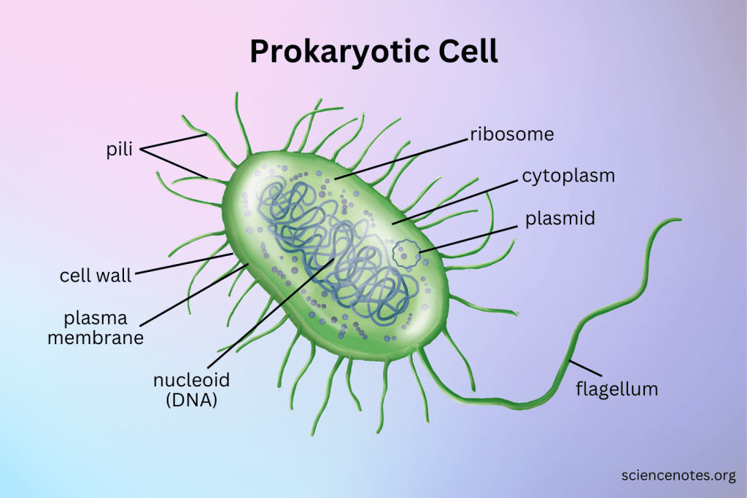
Eukaryotic cell

Slide 18
Differences Between Prokaryotic and Eukaryotic Cells
1. Nucleus:
Prokaryotic cells lack a true nucleus; their DNA is in a nucleoid region.
Eukaryotic cells have a defined nucleus enclosed by a nuclear membrane.
2. Organelles:
Prokaryotic cells do not have membrane-bound organelles.
Eukaryotic cell contain membrane- bound organelles like mitochondria, Golgi apparatus, and endoplasmic reticulum.
3. Size:
Prokaryotic cells are smaller, typically 0.1 to 5.0 micrometers in diameter.
Eukaryotic cells are larger, usually 10 to 100 micrometers in diameter.
4. Chromosomes:
Prokaryotic cells have a single circular chromosome.
Eukaryotic cells have multiple linear chromosomes within the nucleus.
5. Cell Division:
Prokaryotic cells divide by binary fission.
Eukaryotic cells divide by mitosis (for growth) and meiosis (for reproduction).
Notes:
Binary fission is the process of one cell simply dividing into two. Binary fission is a type of asexual reproduction, where the offspring are genetic clones of the parents;

Slide 19
6. Cell Wall Composition:
Prokaryotic cell walls are often made of peptidoglycan.
Eukaryotic cell walls, if present (in plants and fungi), are made of cellulose or chitin.
7. Ribosomes:
Prokaryotic cells have smaller ribosomes (70S).
Eukaryotic cells have larger ribosomes (80S).
8. DNA Packaging:
Prokaryotic DNA is not associated with histone proteins.
Eukaryotic DNA is wrapped around histone proteins, forming chromatin.
9. Flagella:
Prokaryotic flagella are simpler and rotate for movement.
Eukaryotic flagella are more complex and whip back and forth.
10. Examples:
Prokaryotic like bacteria and archaea
Eukaryotic like animal cell, Plants and Fungi, including yeast

Slide 20
Revised questions
Why we study Biology?
What are the characteristic features of living organism?
Describe the Levels of Biological Organization
Define Biology, cells, organelles, eukaryotes, prokaryotes
Describe the theories of cell
List the classification of eukaryotes
Compare between prokaryotes and eukaryotes

