Slide 1


8- The Genome
DNA replication
Gene expression (Transcription and Translation)
Cell and molecular Biology/ Theory
Asst. Prof. Dr. Bushra T. Mohammed
BVM&S, MSc, PhD in Molecular Biology
COLLEGE OF
VETERINARY MEDICINE
THE UNIVERSITY of DUHOK

Slide 2
Learning objectives
Understand how the genetic information transfer (Central Dogma)
Understand how the process of DNA replication
Explain how RNA synthesis is performed in eukaryotes.
Explain the way that proteins are synthesized and targeted in a cell.

Slide 3
The central dogma describes the transfer of sequence information during DNA replication, transcription into RNA, and translation into amino-acid chains forming proteins.
Information transfer
DNA replication
DNA
DNA
when the cell divides
transcription
RNA processing – splicing, capping, polyadenylation
transport to ribosomes
mRNA
when the cell/organism needs the gene product (protein)
translation
Protein
post-translational modification – phosphorylation, glycosylation etc
transport to site of function
Function

Slide 4
DNA replication
Deoxyribonucleic acid (DNA) contains all the information necessary for the development and function of all organisms. The replication or copy DNA from DNA occurs during the S or synthesis phase of the cell cycle.
Cytokinesis: is the process by which
the cytoplasm divides, resulting
in the formation of two separate
daughter cells after mitosis or meiosis.
Cell cycle

Slide 5
DNA Replication Enzymes (proteins)
Gyrase (A topisomerase): Acts to reduce torsion or twisting in the DNA double helix
DNA Helicase: Breaking hydrogen bonds to unwinds the double strand DNA
Single Strand Binding Proteins: Binds to nucleotide of DNA template to prevent premature annealing.
DNA Primase: Synthesis of primer to start copying
DNA Polymerase: Stimulates the formation of new DNA strands by adding a nucleotide to a free 3 end and therefore synthesizes DNA in the 5 to 3 direction.
DNA Ligase: Joins adjacent short fragments of DNA strands together
Telomerase: Helps to maintain the telomere (the end of a chromosome)

Slide 6
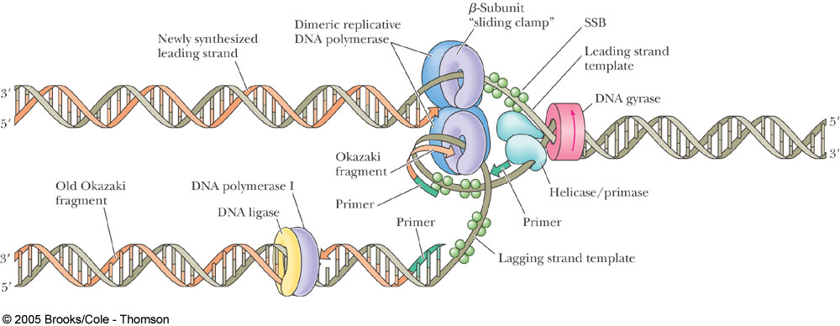
Review of DNA synthesis
DNA replication
Single Strand Binding Proteins

Slide 7
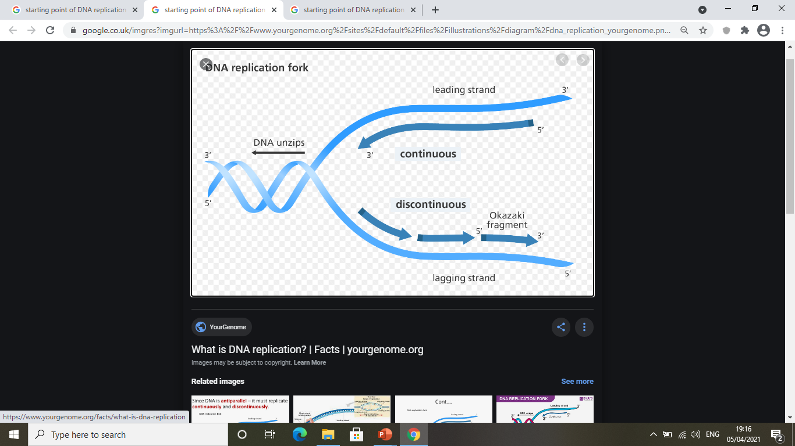
Steps of DNA replication
1- Initiation
At the start of replication, replication fork forms when the parental strands of DNA unwind which allow to create a single stranded DNA template. Both DNA strands can act as templates to create two new identical DNA molecules

Slide 8
2- Elongation
DNA synthesis or coping requires primer that is complementary in sequence to the DNA template strand.
Two newly strands form, one strand is continuous (leading strand) and one is discontinuous short fragments (lagging strand or Okazaki fragment) that are joined together by DNA polymerase and ligase

Slide 9
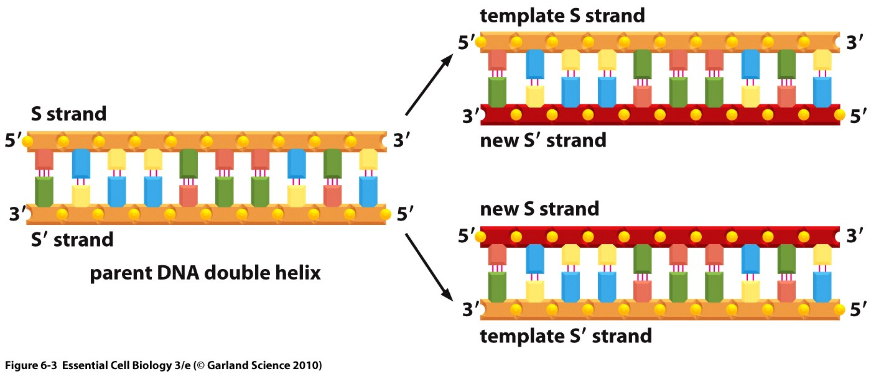
3- Termination
At the end of DNA replication, the RNA primers will be removed by the enzyme ribonuclease and double strand of DNA will be formed

Slide 10
DNA replication in prokaryotic and eukaryotic.
Prokaryotic replication semiconservative replication i.e. it produces two copies that each contain one of the original strands and one new strand Bidirectional single origin replication (oriC) primer synthesized by primase processing enzyme: DNA polymerase III removal of primer: DNA polymerase I DNA free in cytoplasm as nucleoid circular DNA | Eukaryotic replication semiconservative replication Bidirectional multiple origins of replication (ARS) primer synthesized by subunits of DNA polymerase α processing enzymes: DNA polymerases α and δ removal of primer: DNA polymerase β DNA in nucleus arranges as chromatin structure linear DNA

Slide 11
DNA Replication – why do you need to know?
Differences between eukaryotes and prokaryotes allow for targeted drugs
Understanding the role of changes involving DNA packaging in disease
Errors in replication can lead to genetic diseases
Increasing numbers of diagnostic tests based on DNA replication (PCR, sequencing etc)

Slide 12
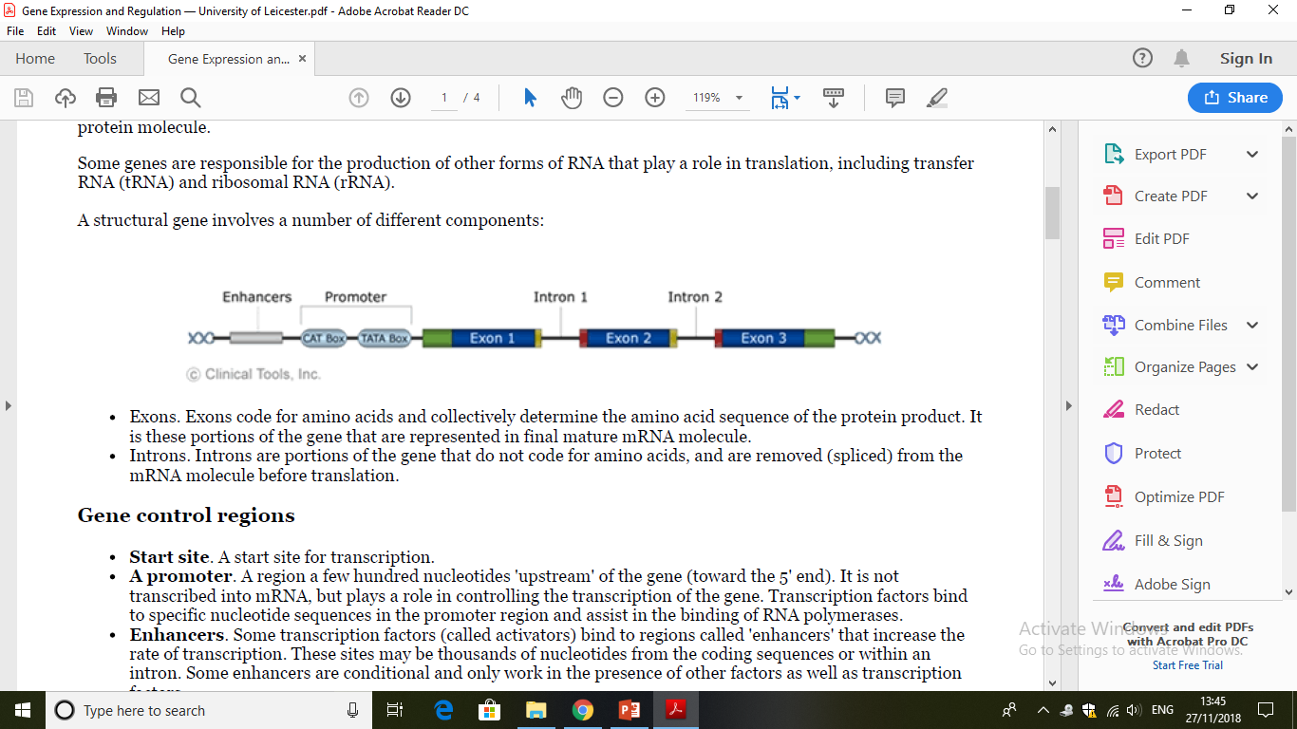
Gene expression
Gene expression is the process by which the genetic code (the nucleotide sequence) of a gene (DNA) is used to direct protein synthesis.
Genes that code for proteins are known as 'structural genes’.
Gene expression involves two main stages:
1- Transcription: Copying RNA from strand of DNA by enzyme RNA polymerases which occurs in the nucleus.
2- Translation: Using genetic information in the RNA to make a protein which happens in the cytoplasm.
Structural genes (DNA)

Slide 13
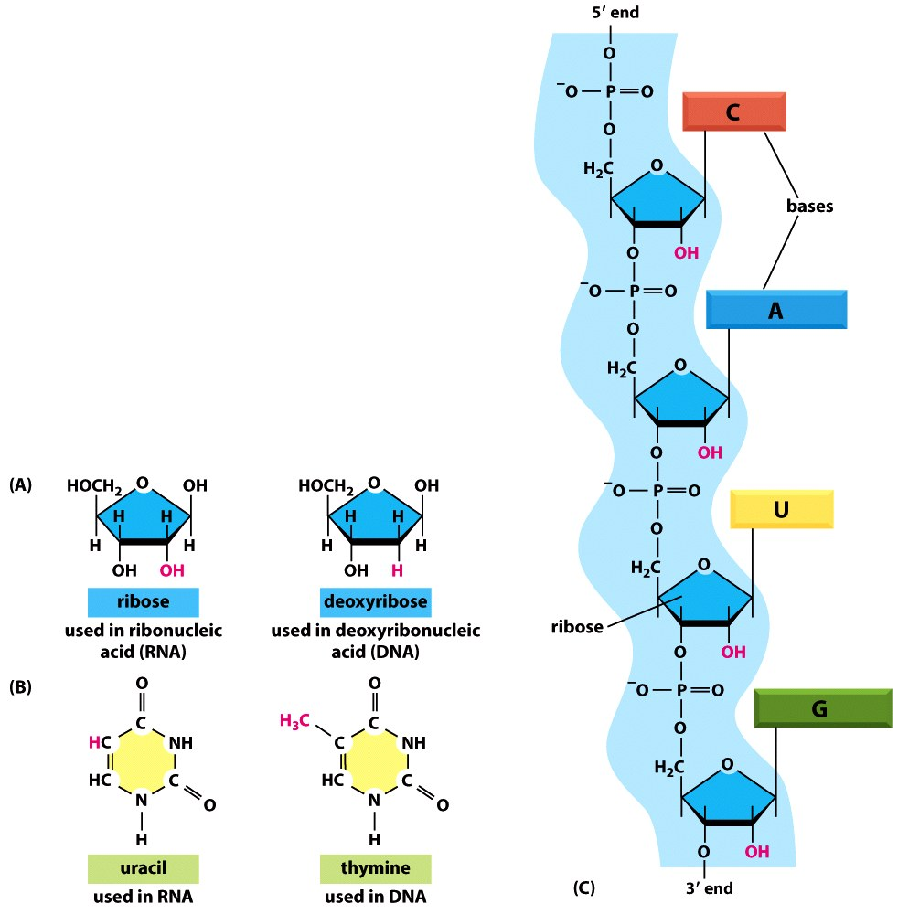
Transcription – making RNA
Copying RNA from strand of DNA by enzyme RNA polymerases which occurs in the nucleus
Structure of RNA
Single stranded molecule
Uracil instead of thymine
Ribose sugar instead of deoxyribose

Slide 14
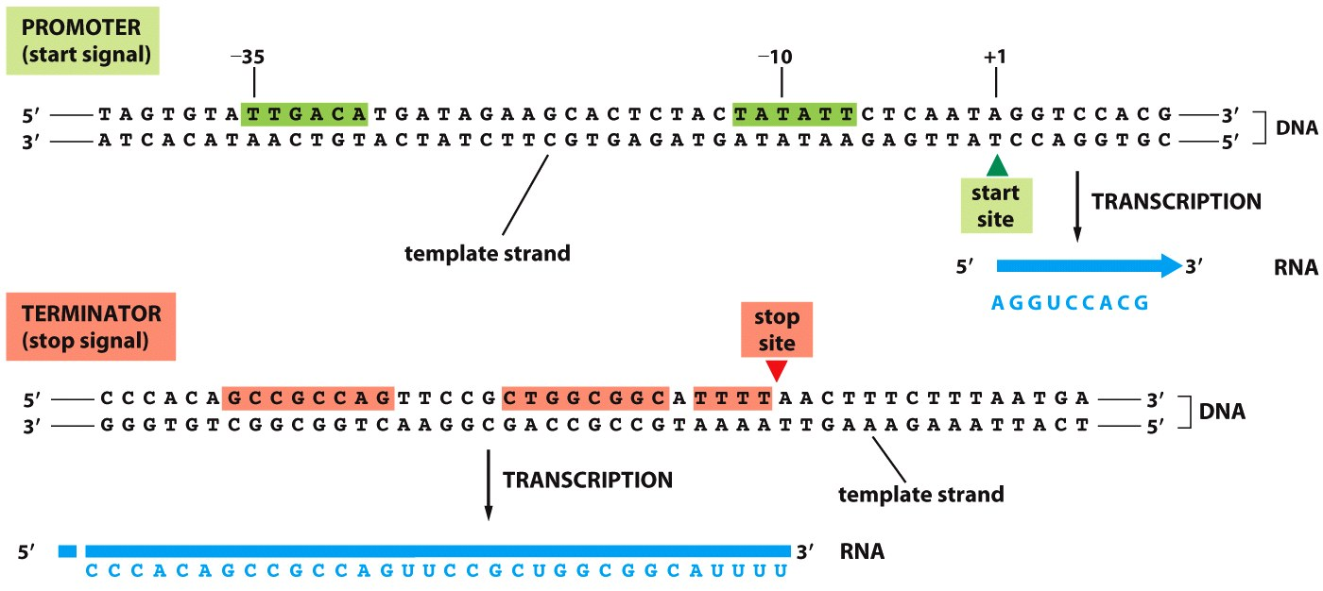
Steps of transcription
1- Initiation:
Some proteins (initiation factors) will recognise the start of the gene and they will guide RNA polymerase where to start.
The RNA polymerase will bind to the unwind DNA sequence at the promoter (a start signal)
2- Elongation: Once the RNA polymerase binds, it runs along the DNA strand and starts transcribing from a start site by adding nucleotides

Slide 15
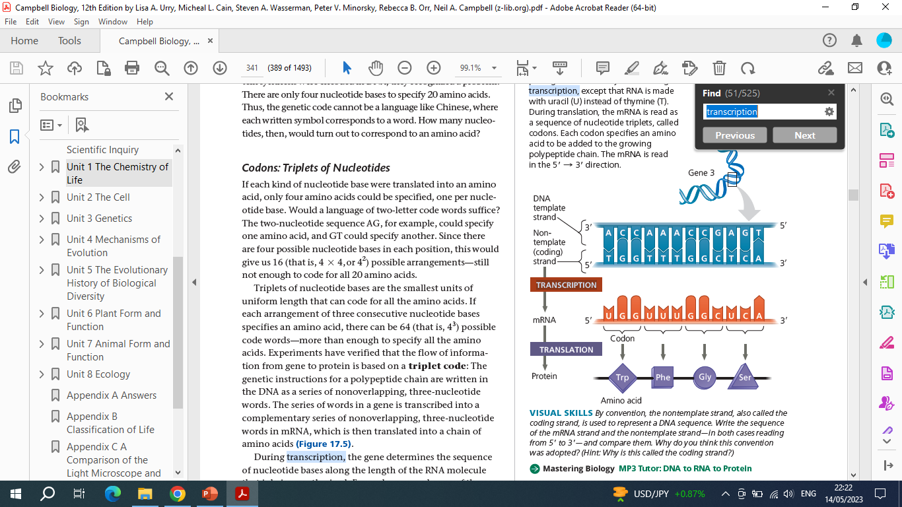

Slide 16
3- Termination:
Other proteins will recognise the end of the gene at terminator
RNA polymerase will stop transcription at stop site and RNA will be formed.
RNA will get out of the nucleus through nuclear pore to cytoplasm for protein synthesis

Slide 17
Types of RNA in a cell
Messenger RNA (mRNA)
  It carries genetic information from DNA to encodes protein
  Its about 5% of total RNA in the cell
Transfer RNA (tRNA)
  Brings amino acids to the protein synthesising organelles called ribosomes
Ribosomal RNA (rRNA)
  Makes up 80% of total RNA in the cell
  Its part of the ribosomes
  Plays an active role in recognizing codon and anticodon portions of mRNAs and tRNAs.
Notes:
he primary function of rRNA is in protein synthesis - in binding to mRNA and tRNA, to ensure that the codon sequence of the mRNA is accurately translated into a protein. rRNA in the larger subunit of he ribosome catalyses the reaction that forms a peptide bond between the amino acid in the A-site and the growing polypeptide chain in the P-site. The polypeptide synthesis is terminated when the ribosome reaches a stop codon and rRNA catalyses the addition of a water molecule to the polypeptide in the P-site.

Slide 18
Four types of RNA in a cell

Slide 19
Three main types of RNA polymerase
4. Non coding RNA (MicroRNA (miRNAs)
  miRNAs, are single-stranded non coding RNA, they are about 21 to 23 nucleotides in length.
  They function in regulating gene expression (coding protein)
RNA polymerase I
  Synthesises large ribosomal RNAs
RNA polymerase II
  mRNA and microRNA synthesis
RNA polymerase III
  tRNA and 5S (small) rRNA synthesis

Slide 20
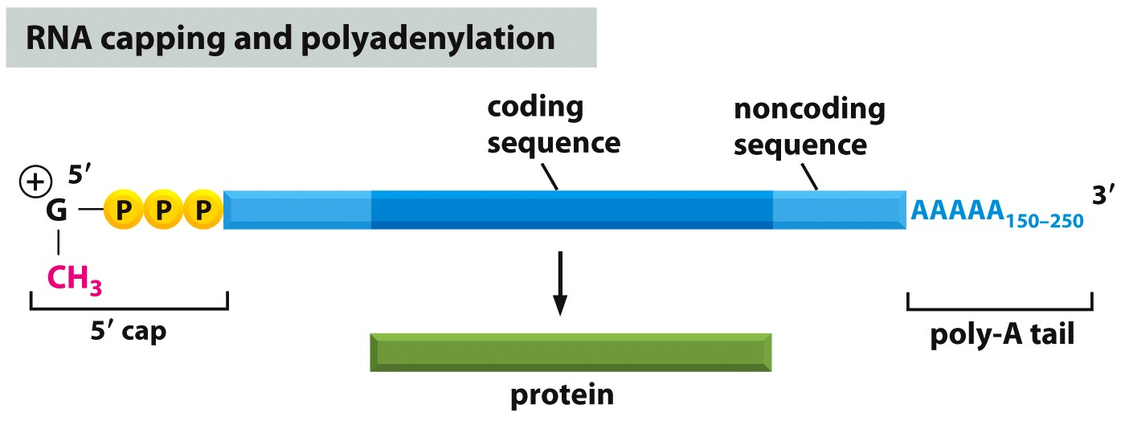
Processing of eukaryotic mRNA
Transcript (mRNA) modified or processed so only the exons (coding sequences) remain because they contain the genetic information for protein synthesis.
After transcription, mRNA is processed by:
Capping (addition of modified G to 5’ end)
Splicing (removal of introns ( noncoding sequence)
Polyadenylation (addition of A to 3’ end) called poly-A-tail

Slide 21
Causes of DNA mutation
DNA can be damaged by:
Chemical mutagens: Industrial chemicals such as vinyl chloride and hydrogen peroxide, and environmental chemicals such as polycyclic hydrocarbons found in smoke, soot and tar
Radiation: X-rays and radioactive radiation
Free radicals: UV-A light creates free radicals

Slide 22
