Slide 1


8- Cellular energy
Cell and Molecular Biology/ Theory
By: Dr. Karwan Idrees Jarjees
COLLEGE of
VETERINARY MEDICINE
THE UNIVERSITY of DUHOK

Slide 2
To Support Your Survival, Your Organs Must Have Cells With Mitochondria That Effectively Perform Cellular Respiration.
What Is The Equation For Cellular Respiration?

Slide 3
Equation is simple but the processes that support cellular respiration are complex. Let’s look at it in more detail.
Cellular respiration occurs in nearly all of the cells in the body, with most of the key processes occurring in the mitochondria.
How does the glucose and oxygen get to the cells?
carbon dioxide
CO₂
water
H₂O
ATP
glucose
C₆H₁₂O₆
+
oxygen
O₂
+
+

Slide 4
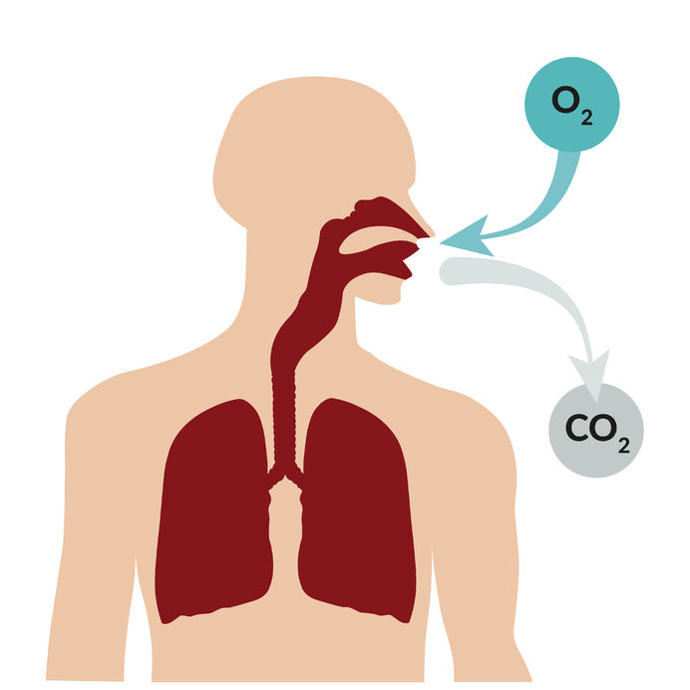
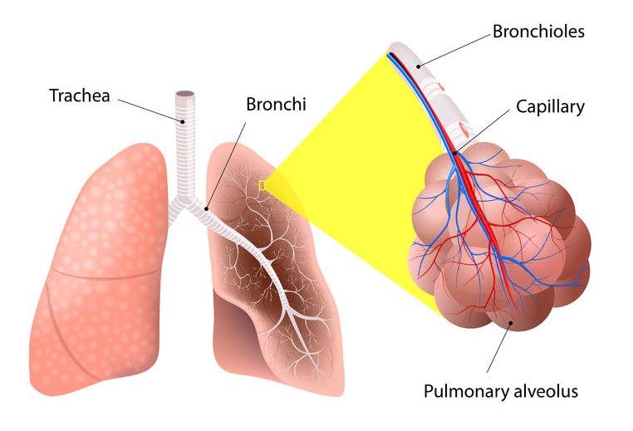
Source of cellular oxygen:
The air has 21% oxygen
Oxygen enters the body through your mouth and nostrils when you breath in.
Oxygen then travels down the trachea, then enters the lungs via the bronchi and bronchioles before entering the alveoli
Within the alveoli, oxygen crosses the thin membranes of the lung’s alveoli and the thin membranes of capillaries that surround the alveoli.

Slide 5
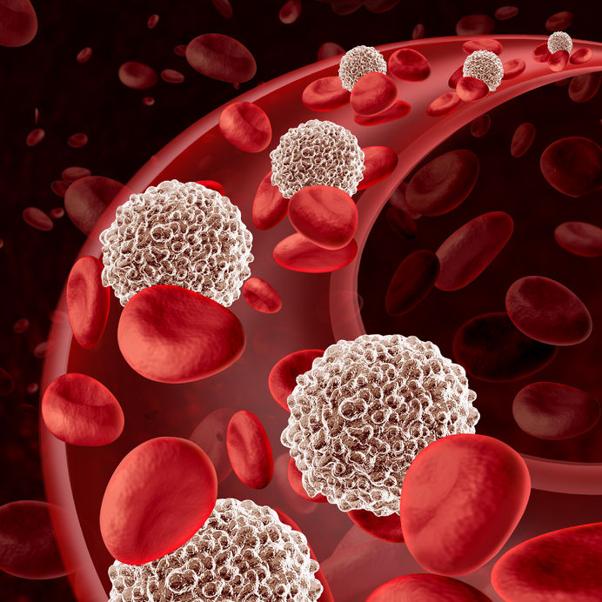
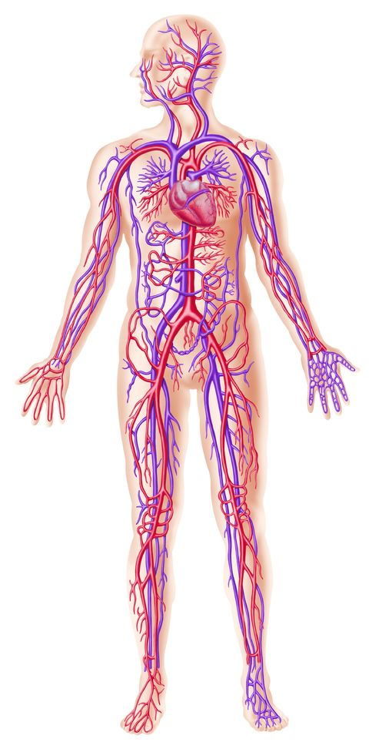
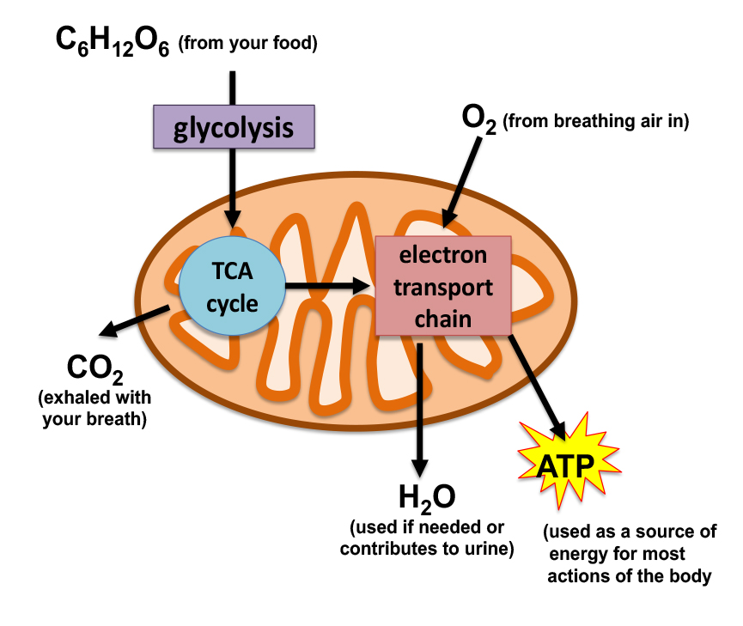
Source of cellular oxygen:
Once oxygen enters the capillaries, it will be picked up and carried in the red blood cells.
The capillaries are associated with the circulatory system that carry blood and red blood cells past all cells in the body.
When cells need oxygen, oxygen is downloaded from the red blood cells, in the blood, across the walls of the capillaries, and then across the walls of the cells where they are available to the mitochondria.

Slide 6
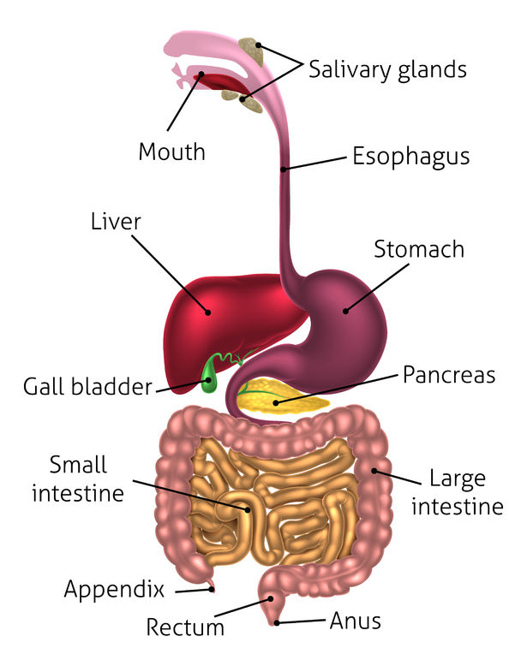
Source of glucose:
Glucose is a sugar. It can comes directly from the diet and the breakdown of other nutrients to glucose within, the body and particularly from the liver.
Once you swallow your food, it passes from the mouth, to the esophagus, stomach, and intestine.
In the intestine, broken down food molecules cross the thin cell walls of the intestine and cross the thin walls of capillaries and enter the circulation.

Slide 7
Source of glucose:
The liver can make glucose from the breakdown of other macronutrients and transfer glucose into the circulation.
Glucose is then delivered to the cells, where needed, much like oxygen is.

Slide 8
Cellular respiration:
In the cell, glucose is broken down to acetyl-coa by glycolysis.
Acetyl-coa is transferred into the mitochondrion.
Acetyl-coa enters the citric acid (tca) cycle where co₂ is produced in the production of nadh and fadh_{2.}
Nadh and fadh₂ provide electrons to the electron transport chain.
The electron transport chain uses the electrons to power the conversion of oxygen into water and to power the production of ATP.

Slide 9
Removing waste:
The water that is produced by the electron transport chain can be used by the cells as needed or excreted by the body, after it re-enters the circulation and is delivered to the kidneys for release by urination.
Carbon dioxide enter the circulation and it is release from capillaries at the lungs to the lungs alveoli. Carbon dioxide is released from the lungs when you exhale.

Slide 10
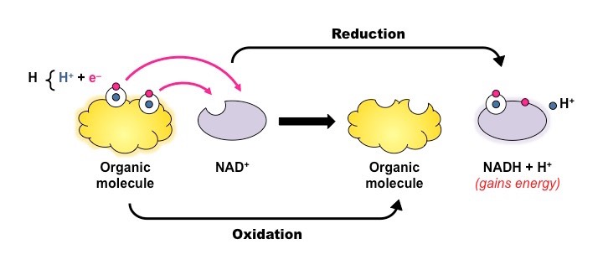
In more Details
Cellular Energy or respiration
is the process by which cells obtain ATP (energy) from the substrate glucose derived from the food molecules using enzymes.
Energy is the capacity to cause change.
Cellular respiration uses Glucose + O2 = ENERGY + CO2 + H2O
Respiration is important because ATP is required in muscle contraction, DNA replication, vesicle transport, cell signaling, protein synthesis and active transport.
It involves oxidation and reduction – a redox reaction.
Oxidation = moving electrons from one molecule
to another (Food molecules act as electron
donors and Activated carrier molecules are acceptors)
Reduction: addition of electrons

Slide 11
Two types of cellular respiration:
Aerobic Respiration—it is breakdown of glucose in the presence of O2 which results in forming large number of ATP (energy)
Anaerobic Respiration (Fermentation) —It is the breakdown of glucose in
the absence or low amount of O₂ which leads to make small amount of ATP (energy)

Slide 12
Stages of cellular energy or respiration:
Stage I (occurs outside cell or inside cells)
Stage II (occurs in cytoplasm and involves glycolysis)
Stage III (occurs in mitochondria and involves two pathways: Citric acid cycle and membrane oxidative phosphorylation)
1- Stage I
Breakdown of food macromolecules by enzymes either outside the cell in the intestine or in lysosomes within cell.
proteins into amino acids
polysaccharides into sugar
fats into fatty acids and glycerol

Slide 14
2- Stage II
Glycolysis occurs in the cytosol, begins the degradation process by breaking glucose into two molecules of pyruvate.
Activated carrier molecules: are energy-carrying molecule that is used by cells to store and release energy very quickly such as adenosine 5’‐triphosphate (ATP) and nicotinamide adenine dinucleotide (NADH).

Slide 16
ATP is formed by Substrate level phosphorylation: which means moving a phosphate group from the substrates (glucose) to ADP, producing ATP
NADH is formed by oxidation, electron from glucose will be removed and placed on NAD to form NADH

Slide 18
Anaerobic Respiration (Fermentation) —It is the breakdown of glucose in the absence of O₂ which leads to produce small amount of ATP (energy)
e.g: skeletal muscle can function in anaerobic conditions, pyruvate is converted into Lactic acid (human or animal) or ethanol (plant and yeast). Lactic acid produces the sensation of sore muscles and fatigue.
Finally, lactic acid is carried away in the bloodstream and converted back to pyruvic acid in the liver.

Slide 19
3- Stage III
The stage III occurs in the mitochondrion and requires abundant oxygen (O2).
Stages III involves:-
The citric acid or Krebs Cycle or Tricarboxylic acid (TCA) cycle : pyruvate enters the mitochondrion and is oxidized to acetyl CoA. The cycle use acetate (in the form of acetyl-CoA) and water to produce carbon dioxide as a waste product and reduces NAD+ to NADH.
Major products of Kreb cycle :
High energy in form of
2 ATP, 6 NADH, 2 FADH2
CO2 waste

Slide 20

Aerobic Respiration
Location: Mitochondria
Process cells use to get the most energy out of food molecules.
Aerobic process – requires oxygen
Balanced Equation:
6O₂ + C₆H₁₂O₆ 6CO₂ + 6H₂O + 36 ATP
2 processes: Krebs cycle and ETC

Slide 21
Membrane Oxidative phosphorylation and Chemiosmosis
Membrane Oxidative phosphorylation : it occurs on Electron‐transport chain
Electron‐transport chain: are specialized proteins that embedded in inner membrane of mitochondria. It is responsible for transporting hydrogen ions (“protons”, NADH+ which store energy) produced from the Krebs cycle and glycolysis across the inner mitochondrial membrane to intermembrane space. Large quantities of energy form in this process

Slide 22
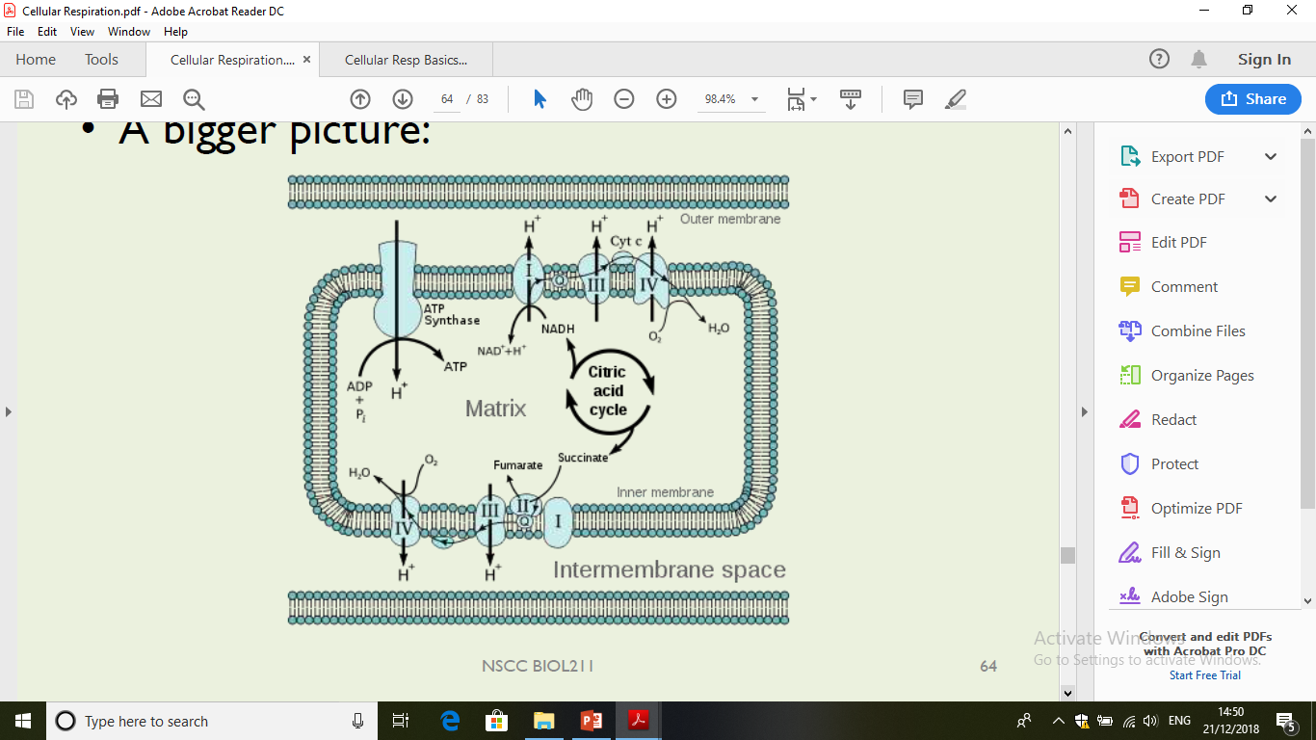
Chemiosmosis: Movement of H+ from mitochondrial matrix to the intermembrane space will create an electrochemical gradient. All the hydrogen ions will move back across the membrane from high to low concentration through a protein called ATP synthase. The energy provided by the protons is used to bind a phosphate group to ADP, creating ATP.

Slide 24
Revision questions:
• Types of cellular respiration
List the stages of cellular energy
Explain the process of Chemiosmosis

