Slide 1


7-The extracellular matrix and cell adhesion
Cell and Molecular Biology/ Theory
By: Dr. Karwan Idrees Jarjees
karwan.jarjees@uod.ac
COLLEGE of
VETERINARY MEDICINE
THE UNIVERSITY of DUHOK

Slide 2
What is the extracellular matrix?
Extracellular matrix: is the non-cellular components that present within all tissues and organs. It is composed of a complex network of polysaccharides (such as proteoglycans ) and proteins (such as collagen) that are secreted by cells.
A large network of proteins and other molecules that surround, support, and give structure to cells and tissues in the body. The extracellular matrix helps cells attach to, and communicate with, nearby cells, and plays an important role in cell growth, cell movement, and other cell functions.
They also serve as a structural element in tissues and are required for tissue morphogenesis, differentiation and homeostasis

Slide 3
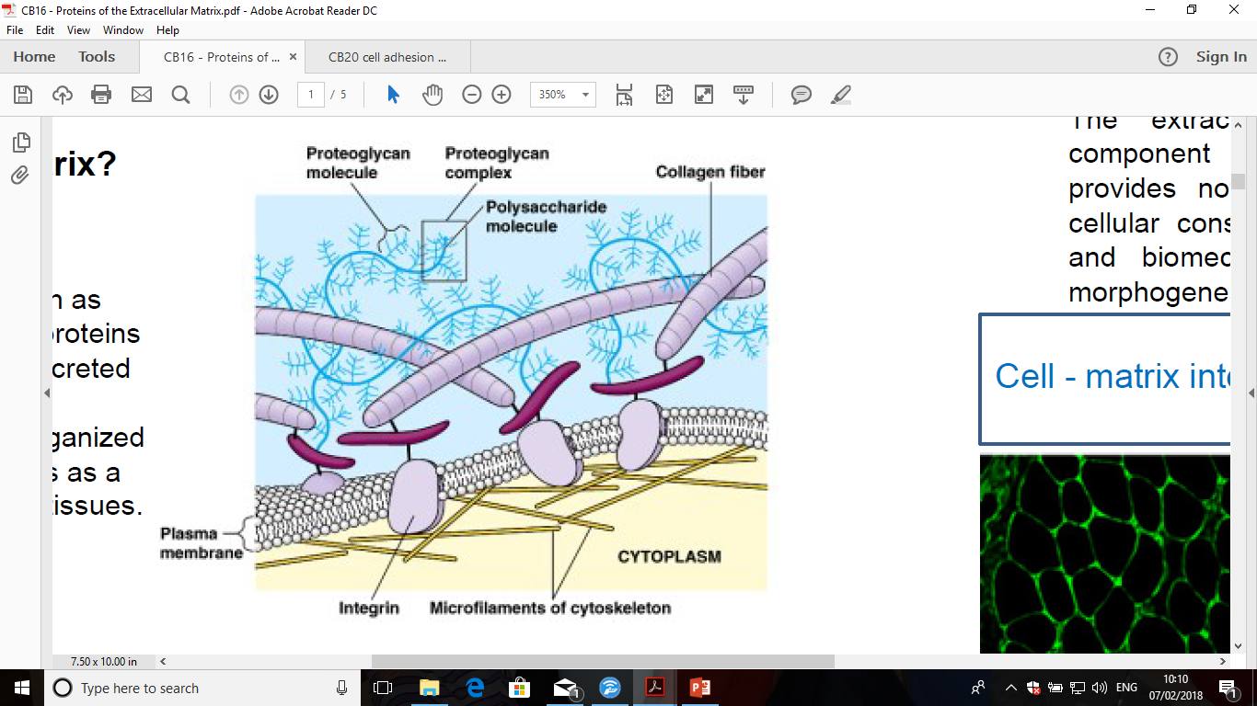
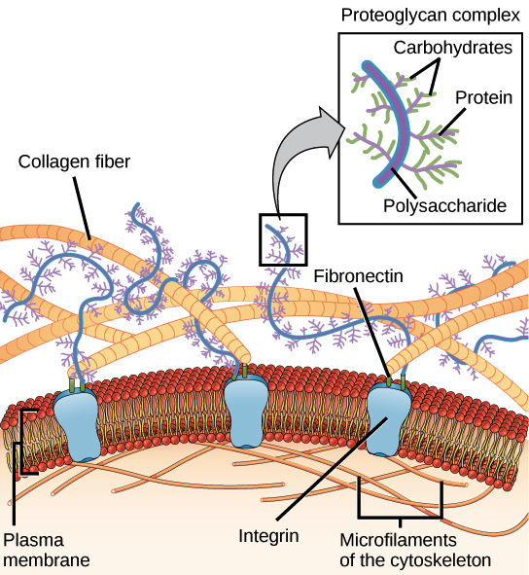
Extracellular matrix

Slide 4
Composition of extracellular matrix
The extracellular matrix is composed of two main classes of macromolecules:
Fibrous proteins
Proteoglycans
1. The main fibrous extracellular matrix proteins are:
Collagen
A glycoprotein in the extracellular matrix of animal and human cells that forms strong fibers, the most abundant protein in the animal kingdom. It exists in many forms: type I, the most common, is found in skin, tendon, and bone; type II is found in cartilage; type III, found in artery walls, intestine, uterus; type IV is present in basal laminae.
Notes:
The collagens constitute what is now known to be a highly specialized family of glycoproteins. At present, 20 genetically distinct types encoded by at least 30 genes have been described. All collagens contain a domain with a triple helical conformation and are integral components of the extracellular matrix.. As skin ages, collagen production slows down. Additionally, over time, collagen fibers become rigid. Theoretically, this damage is caused by
free radicals that attach to collagen, causing collagen strands to bind together and become thicker and more unyielding to movement. This process is the basis for wrinkle formation and the loss of firmness in
mature skin. Collagen injections are sometimes given to restore volume and reduce the appearance of
wrinkles. Antiaging products commonly contain antioxidants that may inhibit free radicals and slow the
damage to collagen

Slide 5
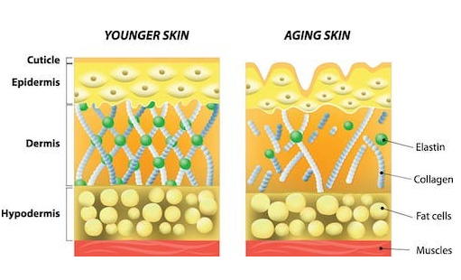

Slide 6
What does collagen do?
Helping fibroblasts form in your dermis (middle skin layer), which helps new cells grow.
Playing a role in replacing dead skin cells.
Providing a protective covering for organs.
Giving structure, strength and elasticity to your skin.
Helping your blood to clot.

Slide 7
B. Elastin: A protein that forms extracellular extensible fibers (elastic fibers). It found in skin, lungs and blood vessels allowing them tissues in your body to stretch out and shrink back without tearing.
C. Fibronectin: Extracellular matrix protein that is involved in cell–adhesive interactions. Intracellular signaling induced by cell adhesion on fibronectin plays a critical role in cytoskeletal organization, cell cycle progression, growth and cell survival and differentiation
D. Laminin: Extracellular matrix protein found in basal laminae of the epithelia. plays important roles in cell differentiation, adhesion, and migration
E. Tenascin: An extracellular matrix protein regulate the cell adhesion and migration during embryonic development

Slide 8
2. The proteoglycan
A proteoglycan molecule consists of a small core protein attached with many carbohydrate to form polysaccharide chains called Glycosaminoglycans (GAGs). Proteoglycans make up a major part of the extracellular matrix, filling the spaces that occur between cells.
Use of glucosamine as therapy for osteoarthritis
Osteoarthritis is the most common form of joint disease; it causes pain and physical disability in elderly persons.
Notes:
Glycosaminoglycans (GAGs) are a family of highly sulfated, complex, polydisperse linear polysaccharides that display a variety of important biological roles. Based on the difference of repeating disaccharide units comprising GAGs, they can be categorized into four main groups: heparin/heparan sulfate, chondroitin sulfate/dermatan sulfate, keratan sulfate, and hyaluronan.

Slide 9
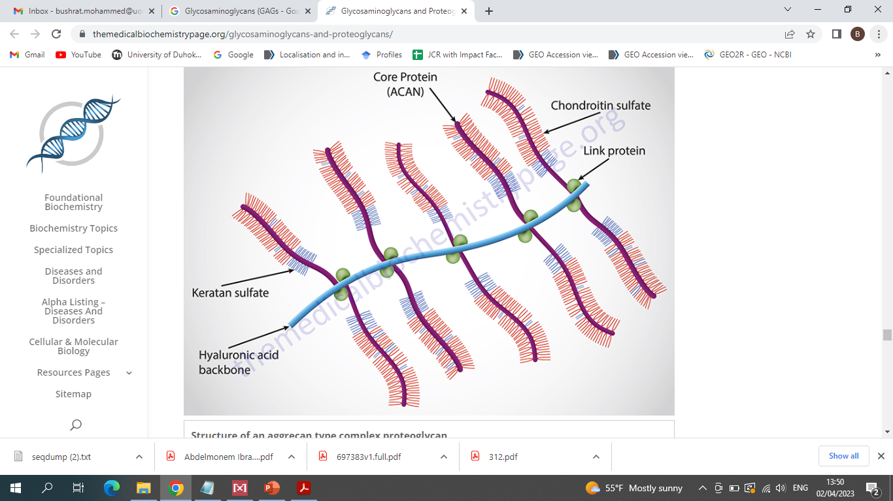
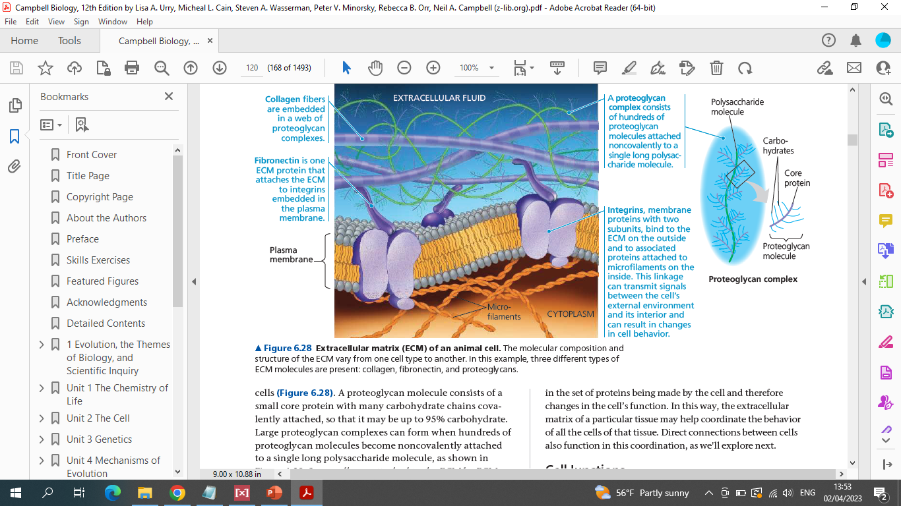

Slide 10
Types of Extracellular Matrix
The ECM has two basic forms:
Basement membrane Extracellular Matrix : is a thin layer of Extracellular Matrix that forms between the epithelia and endothelia. It surrounds muscle, fat and nerve cells.
Interstitial matrix: is a loose meshwork surround the cells. It is located under the Basement membrane and acts as one of the major structural layers of the lamina propria and submucosa

Slide 11
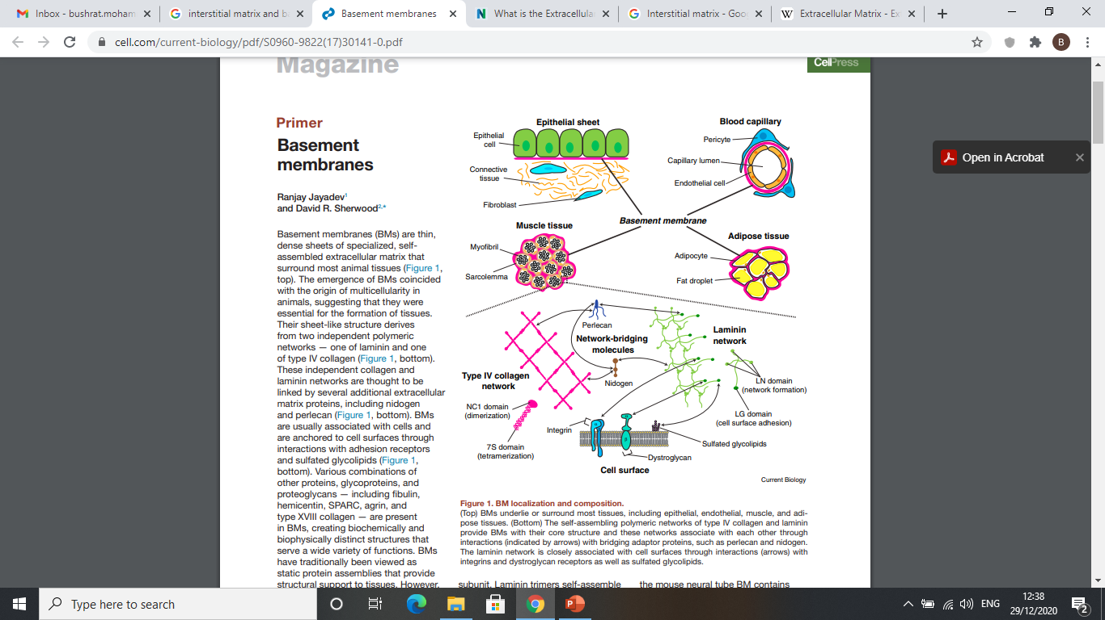
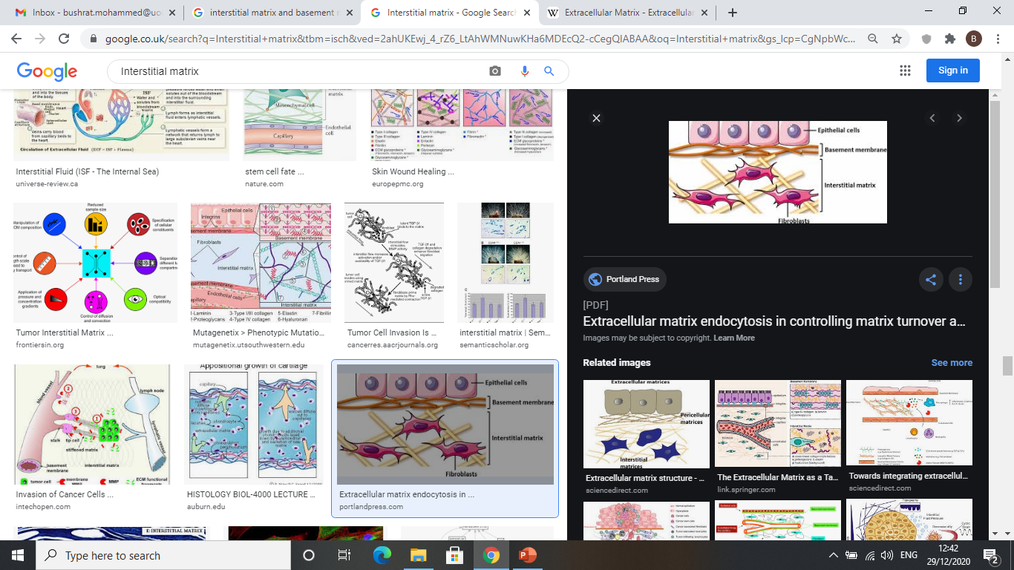

Slide 12
Ehlers Danlos Syndrome
A defect in the connective tissue fibers may lead to loose joint, skin stretching and abnormal scar formation

Slide 13
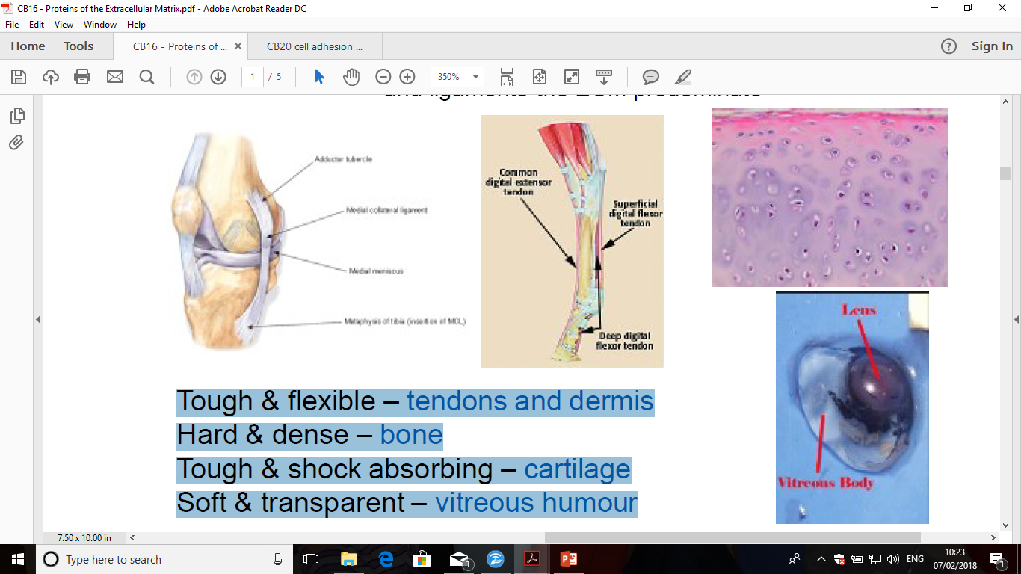
Function of extracellular matrix
It gives toughness and flexibility – tendons and dermis
It can be calcified to become a hard and dense tissue
such as bone
It can be hard and shock absorbing – cartilage
It can form a soft and transparent – vitreous body in eye
Cartilage
Eye

Slide 14
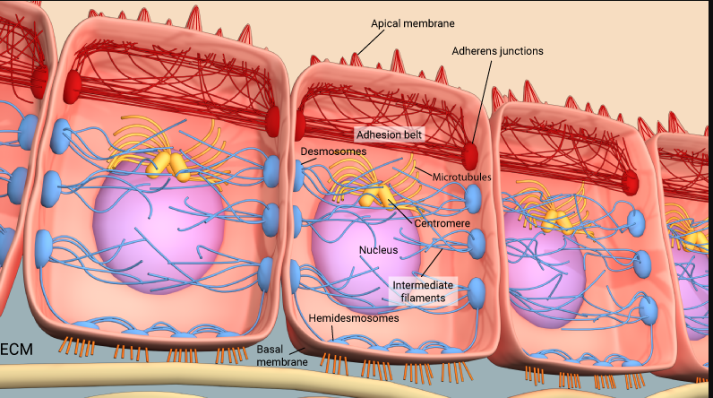
Cell Adhesion

Slide 15
Cellular Communities
Multicellular organisms are made up of an organized collections of cells – cells are organized into tissue
- Nervous tissue
- Epithelial tissue
- Connective tissue
- Muscular tissue

Slide 16
Cell adhesions
Cellular adhesion is the binding of a cell to its neighboring cell or to the extracellular matrix. Cell Adhesion is accomplished by specialized adhesion molecules such as integrins and cadherins.
Integrins and cadherins are two of the best-studied classes of adhesion receptors. Integrins mediate adhesion between the cell and its extracellular matrix (ECM), and cadherins mediate homotypic adhesion between cells.
This is required for single cells to form tissues in an organized and functional manner.
Notes:
This tight adherence prevents materials from leaking between the cells. These junctions are typically found in epithelial tissues that line internal organs and cavities and comprise most of the skin. For example, the tight junctions of the epithelial cells lining your urinary bladder prevent urine from leaking out into the extracellular space.
2-The cadherins join two adjacent cells together and maintain the cells in a sheet-like formation in organs and tissues that stretch, such as the skin, heart, and muscles.
3- gap junction he electrical signal for the muscle to contract is passed efficiently through gap junctions, which allows the heart muscle cells to contract in tandem.

Slide 17
Classification of Cell Junctions according to their functions:-
Tight junctions
Adherens junction
Desmosomes
Hemidesmosomes
Gap junctions

Slide 18
Cell junctions
Tight junctions: junctions that bind neighboring cells together to form a belt-like adhesive seal that selectively limits the diffusion of water, ions, and larger solutes between epithelial cells.
Adherens junction: is the binding between neighboring cells by linking cadherins with the actin cytoskeleton. They mainly function to maintain the shape of tissues and to hold cells together.
Desmosomes: are cell–cell adhesion structures that link cadherin molecules to the intermediate filament (IF) cytoskeleton. Desmosomes attach muscle cells to each other in a muscle. Some “muscle tears” involve the rupture of desmosomes.

Slide 19
Cell junctions can be classified according to their functions
Cadherins
integrins
Notes:
Cadherins connect to intermediate filaments

Slide 20
4. Hemidesmosomes: anchor keratin filaments in an epithelial cell to the basal lamina. The linkage is mediated by integrins which links the laminin of the basal lamina to the intermediate keratin filaments. Its important in maintaining structural stability of epithelial cells
5. Gap junctions: are composed of channels (transmembrane proteins called connexins) across the two cellular membranes. This allows the movement of ions and small water-soluble molecules from the cytosol of one cell to another

Slide 21
Transient Cell Adhesions
• This process is required for cell movement. Transient cells modulate cell adhesion via integrin function.
Examples of Transient Cell Adhesions
Extravasation—the normal process of movement of a leukocyte through the vascular endothelium into infected tissues.

Slide 22
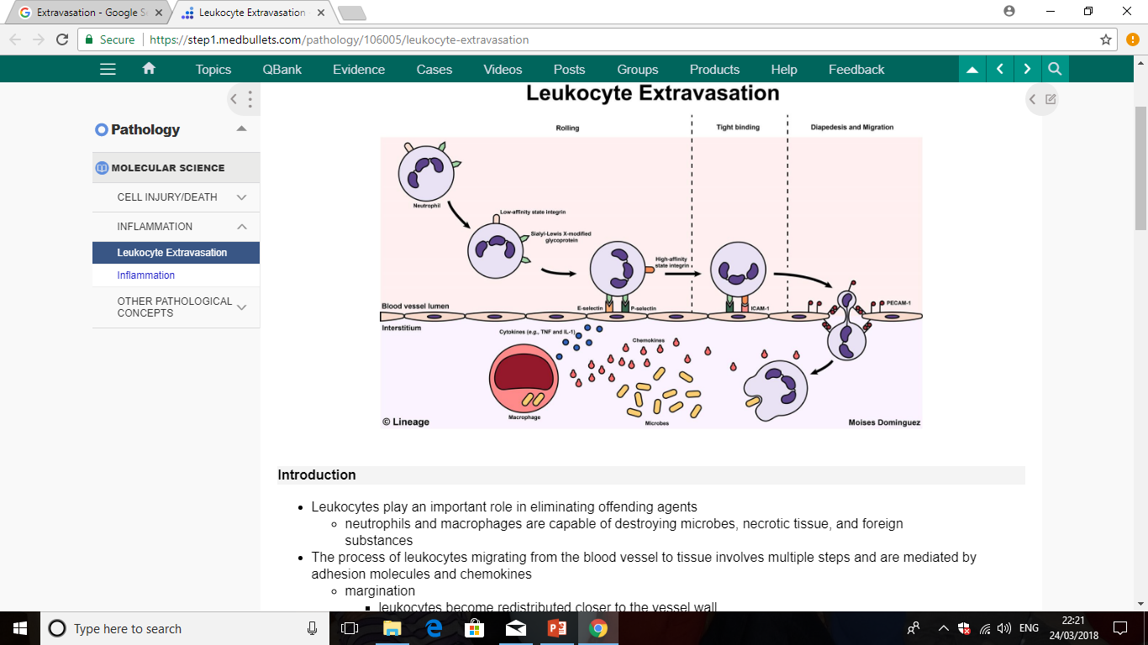

Slide 23
Disorders of cell attachment
•Pemphigus is a rare group of autoimmune blistering diseases that affect the skin and mucous membranes due to separation of cells from each other.

