Slide 1


5- The Genome
Gene expression (Transcription and Translation)
Cell and Molecular Biology/ Theory
Dr. Bushra T. Mohammed
BVM&S, MSc, PhD in Molecular and Developmental Biology
COLLEGE OF
VETERINARY MEDICINE
THE UNIVERSITY of DUHOK

Slide 2
Learning objectives
Explain the way that proteins are synthesized and targeted in a cell.

Slide 3
The central dogma describes the transfer of sequence information during DNA replication, transcription into RNA, and translation into amino-acid chains forming proteins.
Information transfer
DNA replication
DNA
DNA
when the cell divides
transcription
RNA processing – splicing, capping, polyadenylation
transport to ribosomes
mRNA
when the cell/organism needs the gene product (protein)
translation
Protein
post-translational modification – phosphorylation, glycosylation etc
transport to site of function
Function

Slide 4
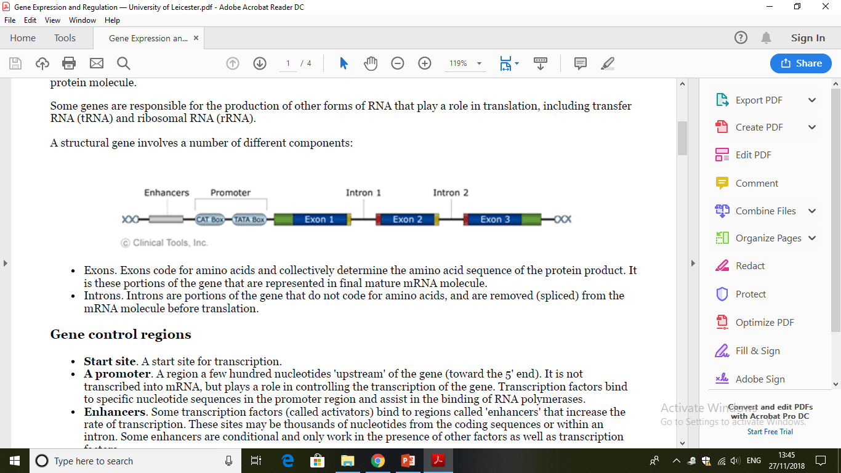
Gene expression
Gene expression is the process by which the genetic code (the nucleotide sequence) of a gene (DNA) is used to direct protein synthesis.
Genes that code for proteins are known as 'structural genes’.
Gene expression involves two main stages:
1- Transcription: Copying RNA from strand of DNA by enzyme RNA polymerases which occurs in the nucleus.
2- Translation: Using genetic information in the RNA to make a protein which happens in the cytoplasm.
Structural genes (DNA)

Slide 5
2- Translation
is the synthesis of a polypeptide (protein) using the information in the mRNA which happens in the cytoplasm
transcription → synthesis of RNA → translation → synthesis of protein

Slide 6
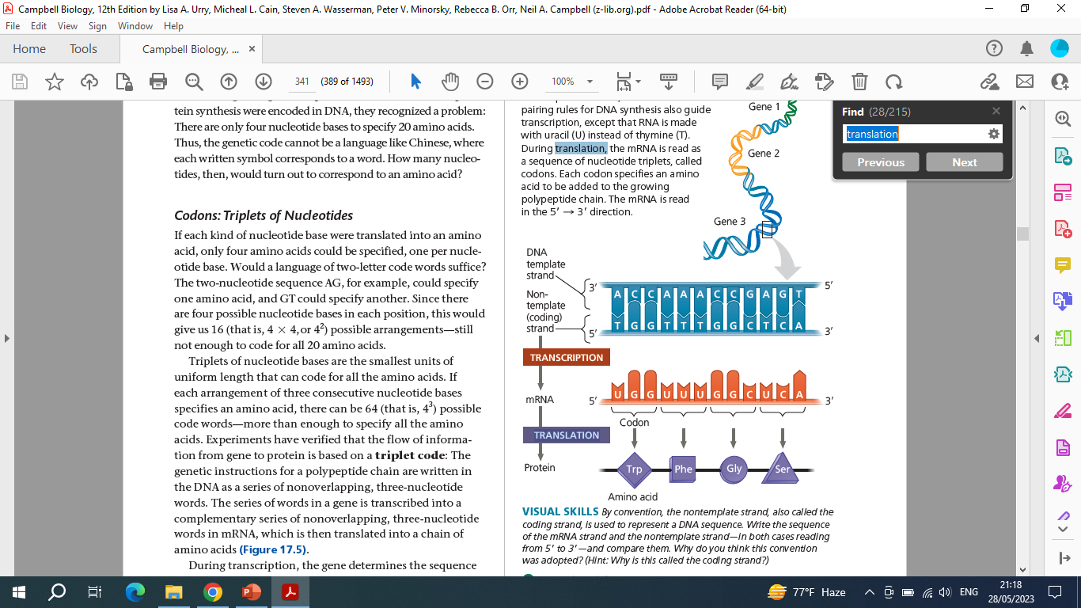
Components Needed For Translation
    Amino acid (food or diet contains essential 20 amino acids)
    Three types of RNAs: Messenger RNA (mRNA), Transfer RNA (tRNA), Ribosomal RNA (rRNA)
    Genetic code (codon) is a triplet code where three nucleotides specify one amino acid. Codons present in the messenger RNA (mRNA).

Slide 7
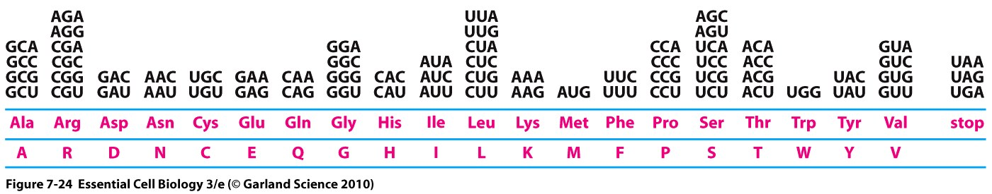
One codon, AUG, signals the start of the protein coding sequence
  AUG encodes methionine
Three codons encode stop signals (UGA,UAG,UAA)

Slide 8
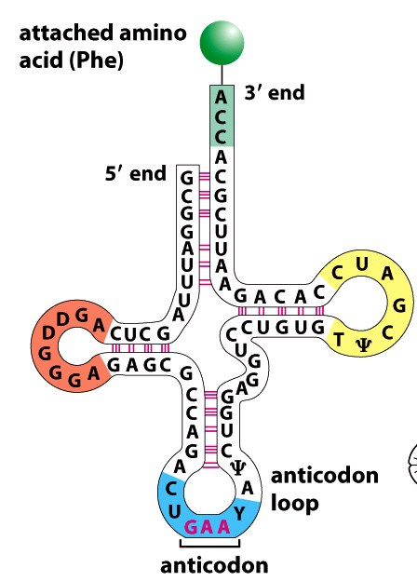
Anticodon is three nucleotide bases in the tRNA that complementary to a codon in the mRNA. i.e. it recognizes a specific codon on the mRNA
3. Enzymes (Aminoacyl-tRNA synthetases): is an enzyme that links amino acids to the 3’ end of tRNAs with the correct anticodon
tRNA

Slide 9
    4. Ribosomes (large complexes of protein and ribosomal RNA (rRNA) . They consist of two subunits— large and small. The ribosome has three binding sites for tRNA molecules
    5. Source of energy (ATP and GTP) provides energy for the translation
rRNA
Large subunit
small subunit
Ribosomes

Slide 10
Formation of the protein occurs in three steps
  Initiation
  small ribosome subunit binds at the 5’ end of mRNA and move toward a start codon (AUG) at the 3 end direction which forms a complex with the large unit of the ribosome then tRNA bind to the complex and initiate translation.

Slide 11
2- Elongation
Elongation of the polypeptide chain is formed by addition of amino acids to 3 end of growing chain.
tRNAs occupy three sites in the ribosomes as the ribosome moves from the 5′ end to the 3′ end of the mRNA.
    Site A (aminoacyl tRNA binding site) holds the tRNA carrying the next amino acid to be added to the chain.
    Site P (peptidyl-tRNA binding site) holds the tRNA carrying the growing polypeptide chain.
    Site E (exit site): empty tRNA will release

Slide 13
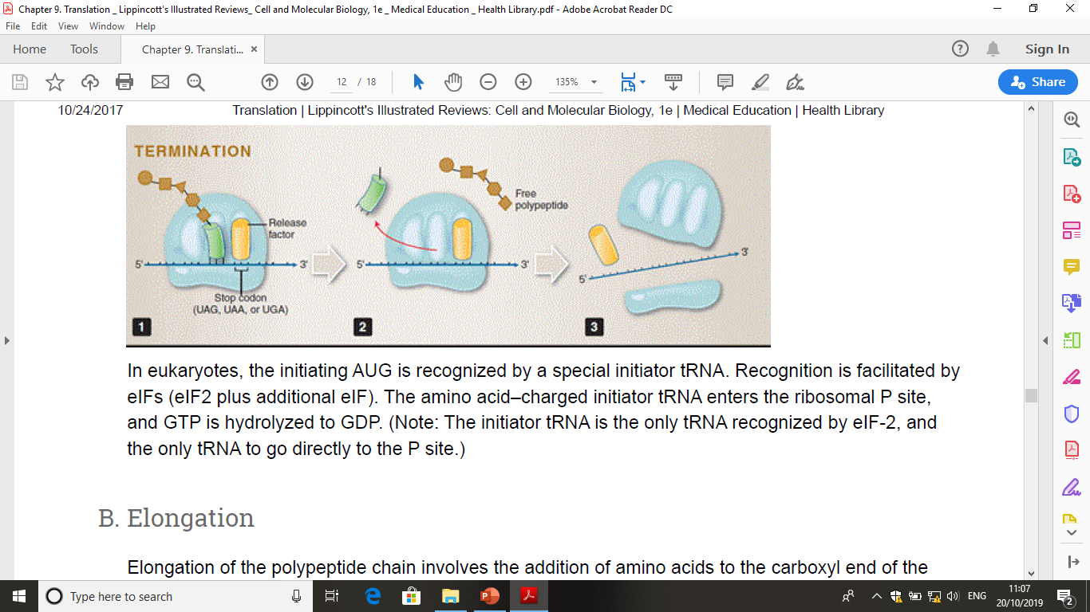
3- Termination
Elongation continues until a stop codon (UAG, UAA, and UGA) in the mRNA reaches the A site.
Then the protein will be released and the ribosome dissociates

Slide 14
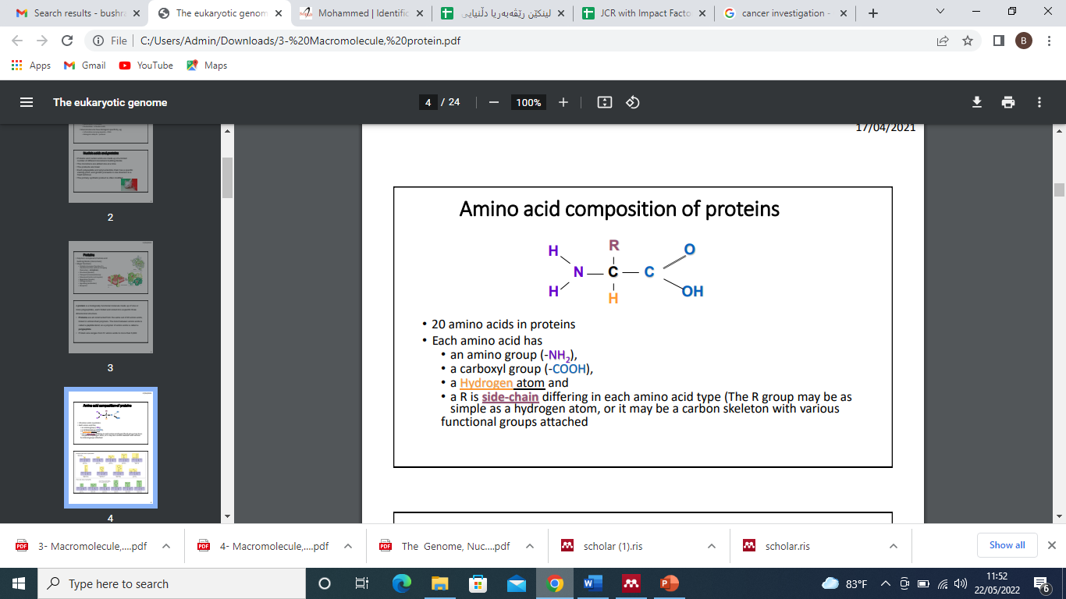
Composition of proteins
• There are 20 amino acids in proteins linked by peptide bonds
• Each amino acid has:
• an amino group (-NH2 ),
• a carboxyl group (-COOH),
• a Hydrogen atom
and • R is side-chain differing in each amino acid type (The R group may be as simple as a hydrogen atom, or it may be a carbon skeleton

Slide 15
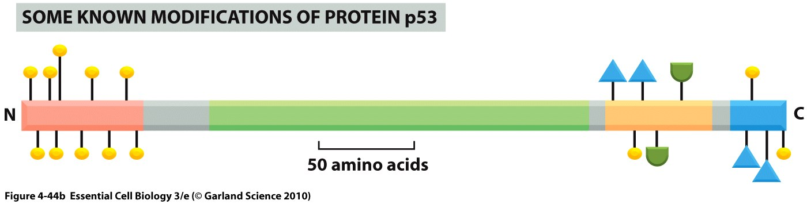
Protein modifications
Proteins can be modified after production
protein modification: a chemical group is added to, or removed from the protein to change cell activity or function.
For examples:
Glycoproteins and proteoglycans – addition of sugars
Lipoproteins – addition of lipid
Addition of fatty acid palmitate – directs protein to membrane
Phosphorylation – addition of phosphate
Ubiquitination – removal of bond to degrade protein
Acetylation – addition of acetyl group

Slide 16
Transcription regulation (regulation of gene expression)
It’s all about responding to changes in environment
Cell receives a signal that something has changed
Signal cross the plasma membrane
Signal will stimulate Transcription factors are proteins that bind to specific sequences in DNA promoter known as motifs. They regulate gene expression by turning transcription on or off.
Transcription will be activated so the protein product made
The signal must be turned off again.

Slide 17
Revision questions
Describe initiation, elongation and termination in DNA replication
Compare the mechanism of DNA replication in eukaryotic and prokaryotic
Define the distinct roles of DNA primase, DNA helicases, topoisomerase, DNA polymerase , DNA ligase, single strand binding proteins, telomerase
Explain the process of gene expression
Draw and label the component of structural gene
Explain the steps of transcription (synthesis of RNA)
Explain the nature of the genetic code

Slide 18
What are the start codons and Which amino acid does it encode?
What are the three stop codons?
What are the components needed for translation
Describe initiation, elongation and termination in protein synthesis (translation)
Explain the roles of the A, P and E sites on the ribosome.
Describe the regulation of gene expression
Describe the proteins that make in the free and rough endoplasmic reticulum ribosomes

