Slide 1


Introduction to molecular Biology
- Nucleic acid structures
Cell and molecular Biology/ Theory
COLLEGE OF
VETERINARY MEDICINE
THE UNIVERSITY of DUHOK

Slide 2
Learning objectives
Understand the science of molecular Biology
Understand the structure and function of nucleic acids
Understand the concept of complementarity in nucleic acids

Slide 3
Molecular Biology
Molecular Biology is the study of the structure of macromolecules as well as studying biochemical and molecular processes within cells, especially the processes of DNA replication, RNA transcription, and protein translation.
Organisms are composed of matter, which is anything that takes up space and has mass. Matter exists in many forms. Rocks, metals, oils, gases, and living organisms.

Slide 4
Elements and Compounds
Matter is made up of elements.
An element is a substance that cannot be broken down to other substances by chemical reactions. Chemists recognize 92 elements occurring in nature; gold, copper, carbon, and oxygen are examples.
A compound is a substance consisting of two or more different elements combined in a fixed ratio. Table salt, for example, is sodium chloride (NaCl), a compound composed of the elements sodium (Na) and chlorine (Cl) in a 1:1 ratio

Slide 5
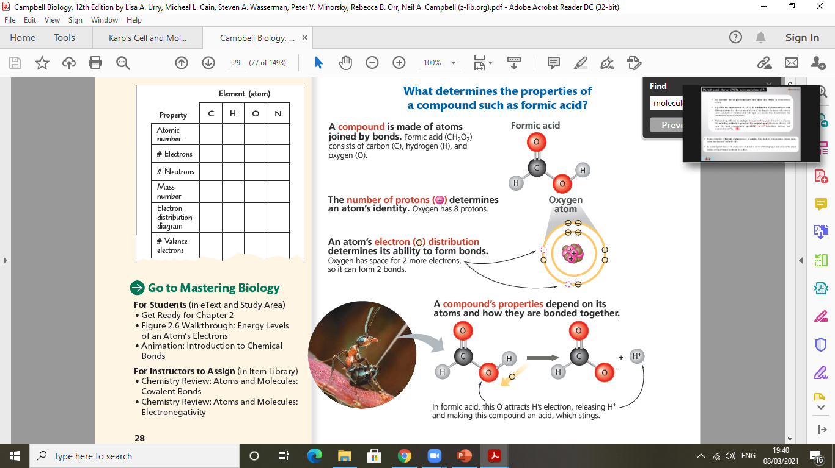

Slide 6
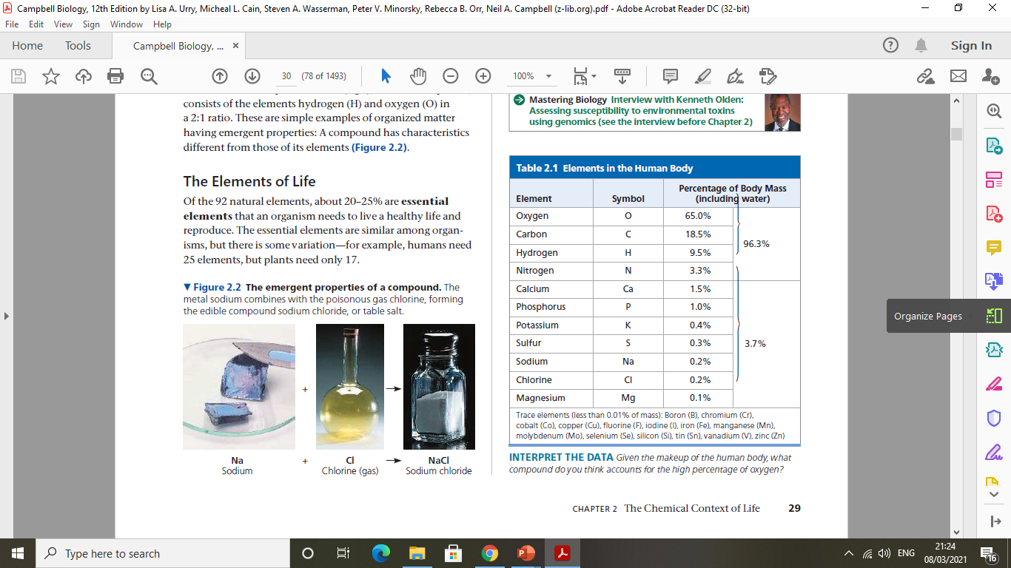
The elements of life
Notes:
The element of life

Slide 7
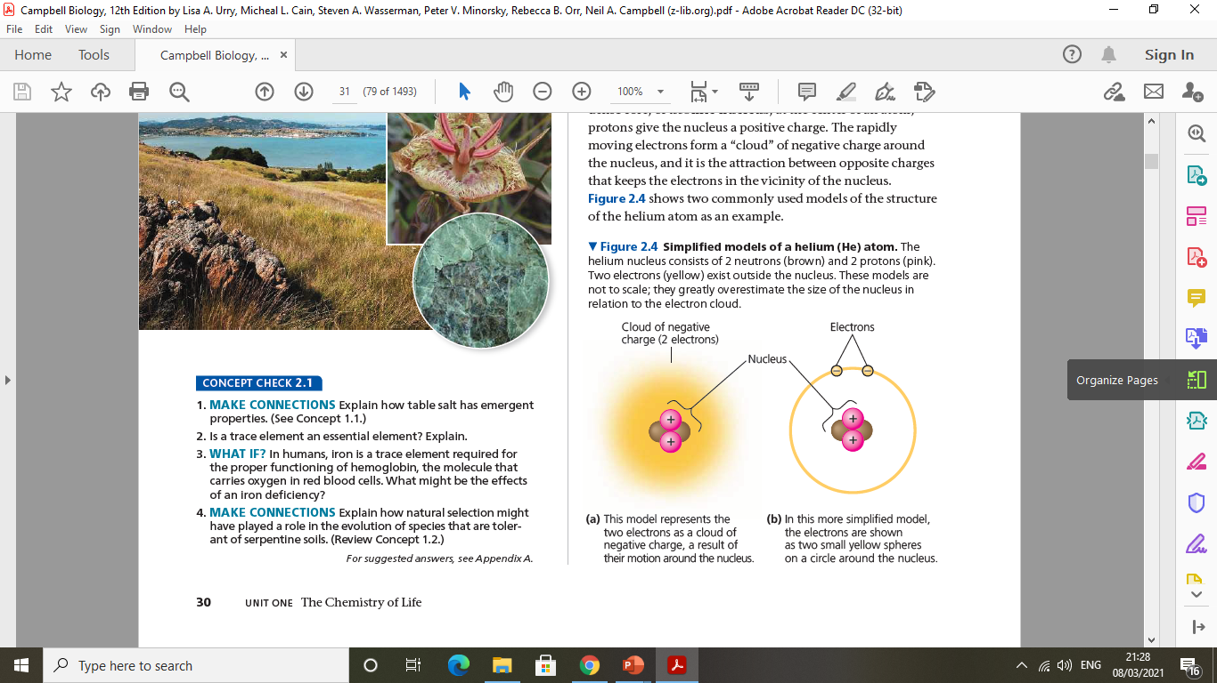
A molecule is a chemical structure consisting of two or more units called atoms,
The atoms that make up a molecule are joined together by covalent bonds in which pairs of electrons are shared between pairs of atoms.

Slide 8
Macromolecules of the cell
A macromolecule is an organic molecule of >1000 molecular weight
  monomer units linked via covalent bonds to form polymer (macromolecule)
Combination of different monomer units builds a range of macromolecules
  Sugars → Polysaccharides
  Amino acids → Proteins
  Nucleotides → Nucleic acids
  Fatty acid → lipid

Slide 9
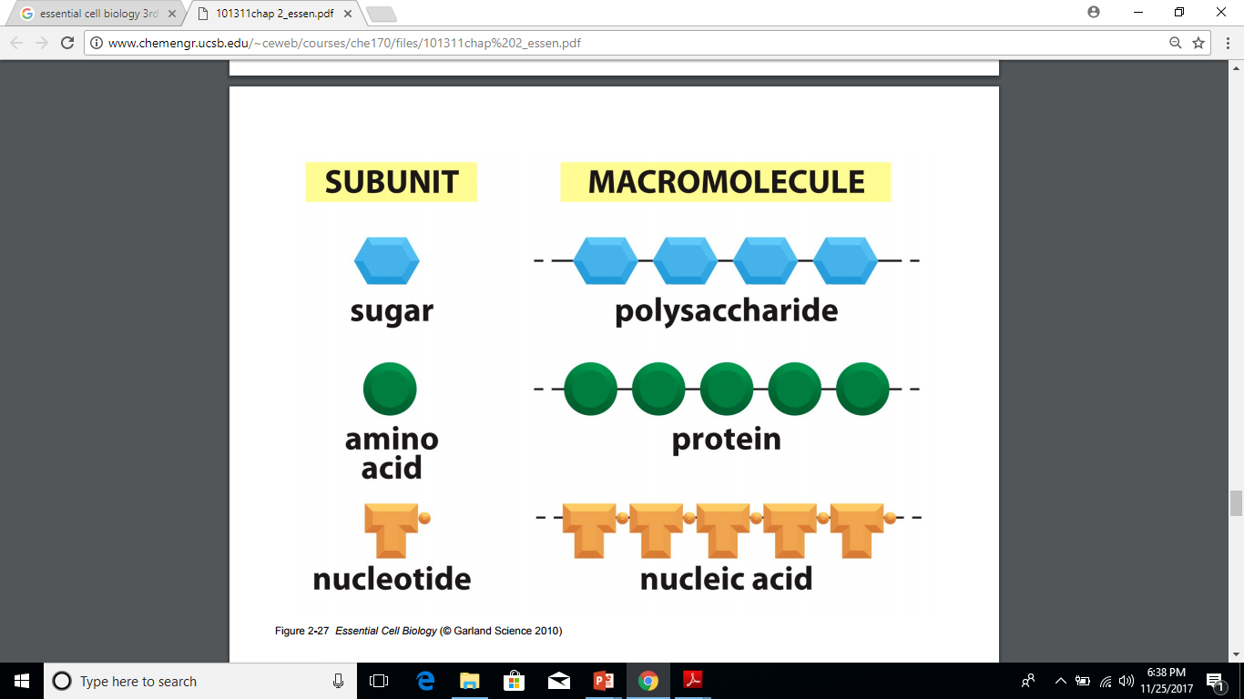
Macromolecules have biological importance such as:
  Information carrying capacity – DNA
  Biological catalysts – proteins

Slide 10
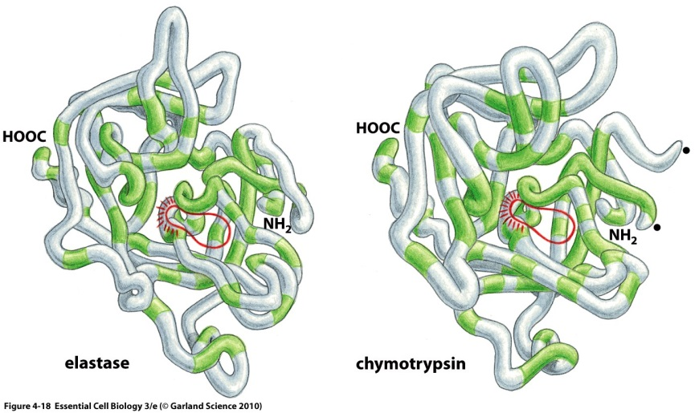
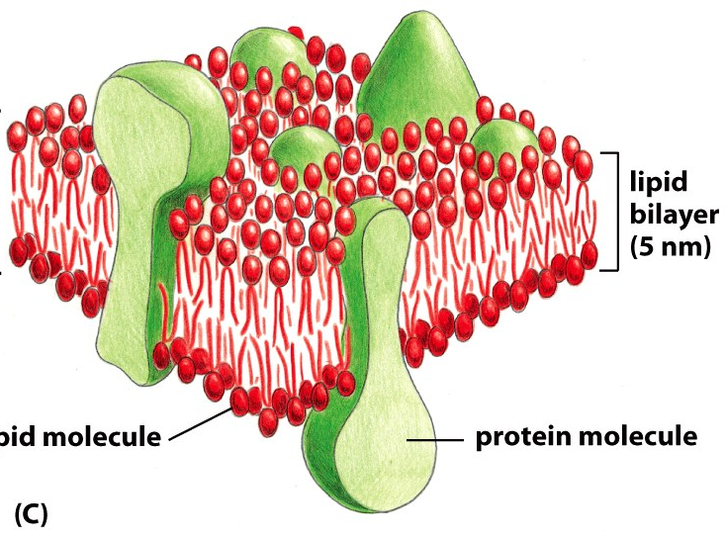
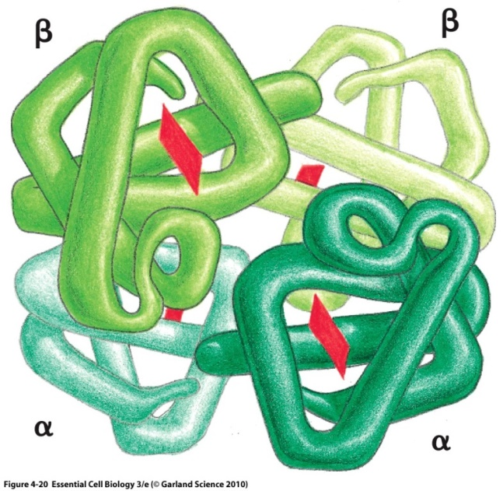
Proteins
Polymers composed of amino acid building blocks (monomers)
Major functions
  Catalytic (increase the rate of a chemical reaction without changing themselves - enzymes)
  Structural
  Transport (transmembrane)
  Movement
  Regulation
  Storage
  Signalling
  Receptors
Protein size ranges from 51 amino acids to more than 5,000

Slide 11
Genome (blueprint)
Deoxyribonucleic acid (DNA) is double helix structure that contains the structural blueprint for all genetic instructions.
Two types of nucleic acids
  DNA: deoxyribonucleic acid
  RNA: ribonucleic acid

Slide 12
The genomes of all multicellular animals, consists of two distinct parts:
1- The nuclear genome
- Found in the nucleus of the cell
- 3,3 billion bases arranged in linear chromosomes
- Two copies of each chromosome present
- Maternally and paternally inherited
- Contains approximately 20,000 - 30,000 genes
- 93% of the genome contains non-coding DNA
Notes:
In mammalian sperm cells, the copy number of mtDNA is low (50–75 [13]), whereas in mammalian oocytes the copy number is extremely high (≥10⁵
Production of energy in mitochondria, by means of oxidative phosphorylation, strictly depends upon factors which are encoded both by the mitochondrial DNA (mtDNA) and the nuclear genome (nDNA). Respiratory chain complexes are formed,
Mitochondrial donation (MD) is a technique (or collection of techniques) that aims to prevent the transmission of mitochondrial diseases from mother to offspring by using a mitochondrial donor (in the form of an egg or embryo from which the nuclear material has been removed but normal mitochondria remain). MD is now lawful in the UK.

Slide 13
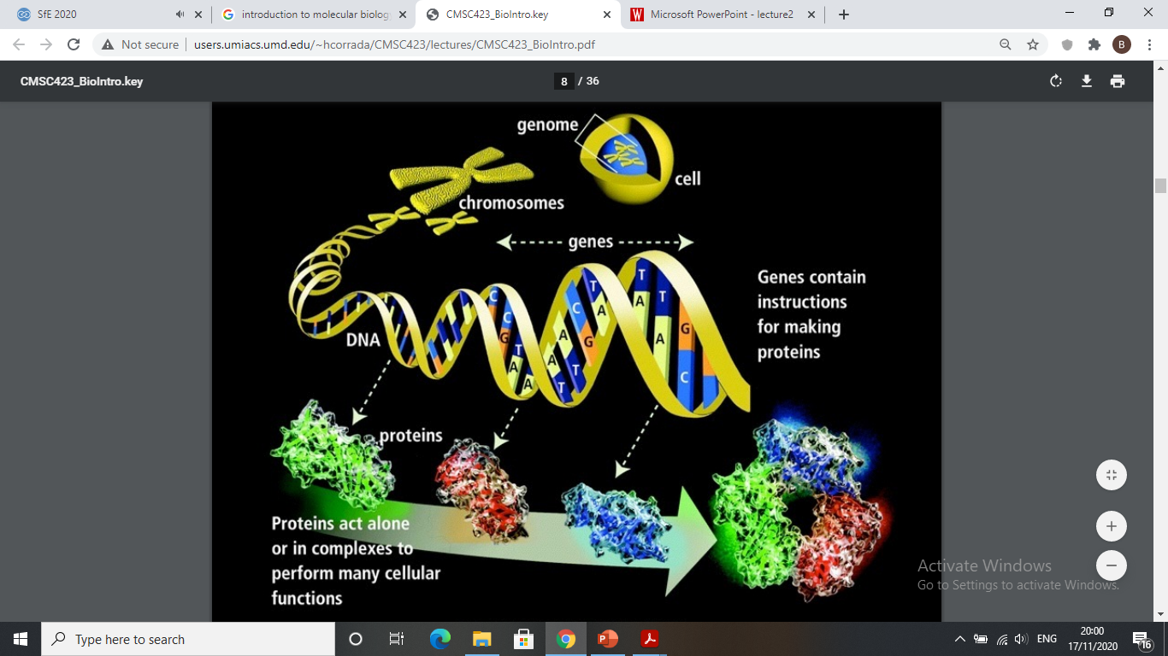

Slide 14
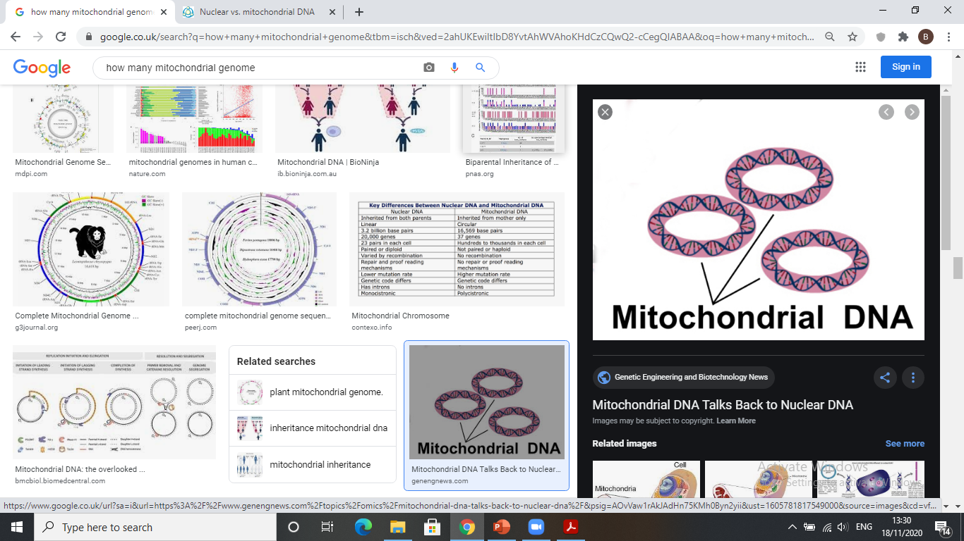
2- The mitochondrial genome
- Found in the mitochondrial matrix
- Around 20,000 bases in a circular chain of DNA
- Multiple copies present in each mitochondrion
- Maternally inherited
- Contains 37 genes that encode:
13 proteins-coding genes
22 tRNAs genes and 2 rRNAs genes
- 3% of the genome contains non-coding DNA

Slide 15
Structure of Nucleic acids
Both DNA and RNA are polymers and composed of nucleotide monomers
Nucleotide: it consists of pentose sugar, phosphate group and nitrogen-containing bases (purine or pyrimidine).
DNA Backbone: it consists of sugars and phosphates
  Bases are attached to the sugars and project from the backbone chain
  Nucleotide monomers are linked by phosphodiester bond between the sugar and the phosphate.
In DNA the pentose is deoxyribose, in RNA it is ribose

Slide 16
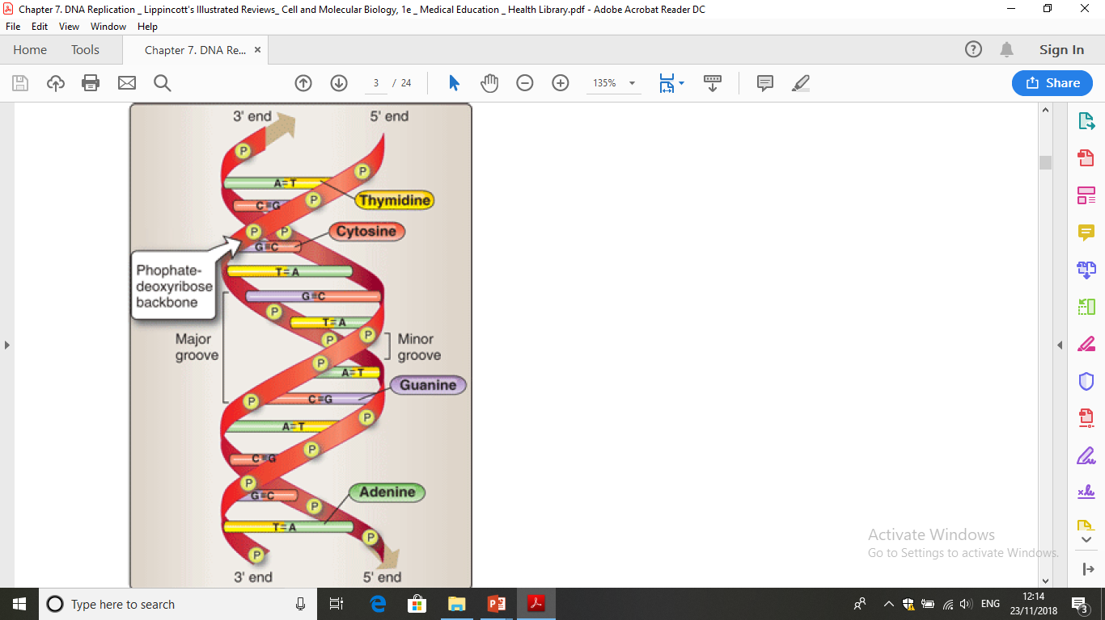

Slide 17
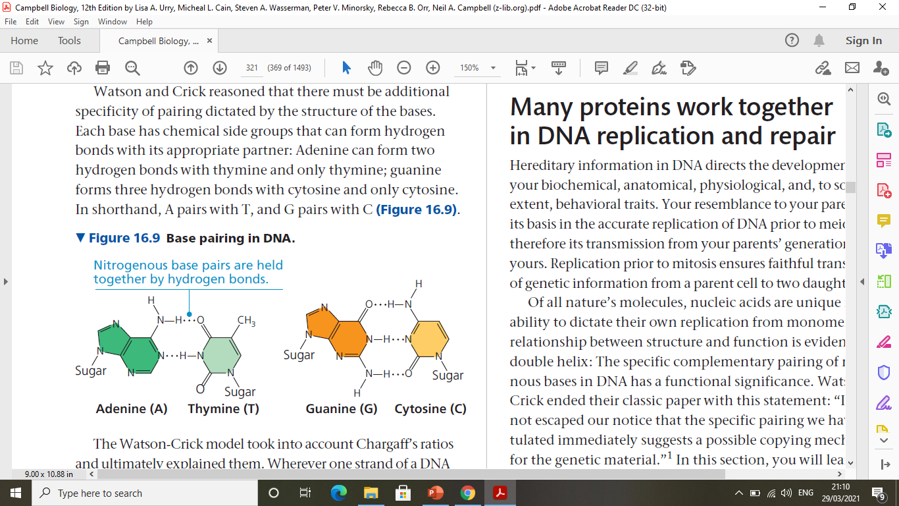
Nitrogenous base pairs are held together by hydrogen bonds
In DNA the four different bases are:
  Purines: adenine (A) and guanine (G)
  Pyrimidines: cytosine (C) and thymine (T)
In RNA the four bases are:
  Purines: adenine and guanine
  Pyrimidines: cytosine and uracil (U)

Slide 18
Complementarity of nucleic acids (Watson-Crick Base Pairs)
The two strands in the DNA duplex are opposite in chemical polarity, so strands can synthesize only in the 5 end to 3 end direction.
The two strands are anti-parallel in nature; that is, one strand will have the 3′ carbon of the sugar, whereas the other strand will have the 5′ carbon
Bases pair through hydrogen bonds: adenine (A) always pairs with thymine (T), guanine (G) always pairs with cytosine (C).
for example: 5’ AACGTGTT 3’ is complementary to 3’ TTGCACAA 5’

Slide 19
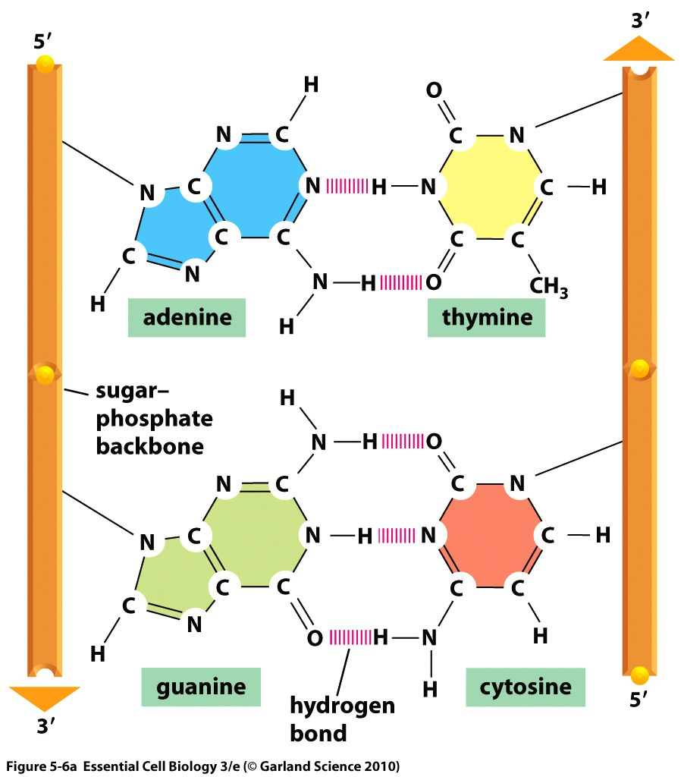
3’ end
5’ end
hydrogen bonds
5’ end
3’ end

