Slide 1


2- Cell Biology
Cell compartments
Cell and Molecular Biology/ Theory
COLLEGE of
VETERINARY MEDICINE
THE UNIVERSITY of DUHOK
Notes:
Biology/ Theory

Slide 2
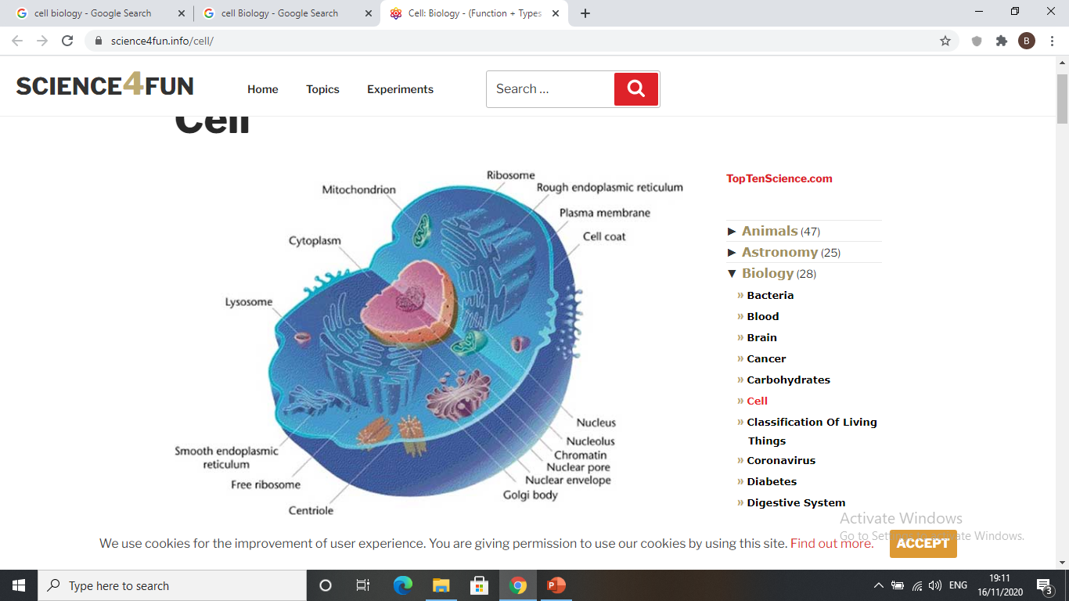
Cell biology
Cell biology is a branch of biology focused on the study of cell structure and function, on how cells form and divide, and how they differentiate and specialize

Slide 3
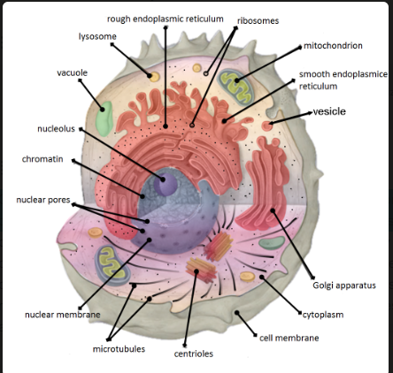
Cellular components
Cellular compartments in eukaryotic cells are closed, membrane-bound regions within the cytosol that are specialized for specific biological processes
Each eukaryotic cell has a Nucleus, Cytoplasm and cell membranes

Slide 4
Cellular components
I- Nucleus
The nucleus is a spherical or elongated structure covered with membrane, about 5-10 microns in diameter. Within the nucleus, the DNA is organized into discrete units called chromosomes, structures that carry the genetic information. Each chromosome contains one long DNA molecule associated with many proteins, including histones.
All eukaryotic cells contain a nucleus (plural = nuclei) except mature erythrocytes (red blood cells)
Each nucleus consists of a nuclear envelope, chromatin, nucleoli and nucleoplasm

Slide 5
I- Nuclear components
Nuclear envelope: The nucleus is surrounded by a nuclear envelope, which consists of two lipid bilayers. The space between the two layers called the perinuclear space The envelope is perforated by nuclear pores that regulate the passage of substances into and out of nucleus.
Chromatin: it consists of DNA and proteins (histone), the DNA wrap around histone to make nucleosome. Nucleosome coils and condenses to form chromosomes during cell division.
The main function of chromatin is package DNA into a small volume; to fit into the nucleus, strength the DNA during mitosis and prevents chromosome breakage.

Slide 6
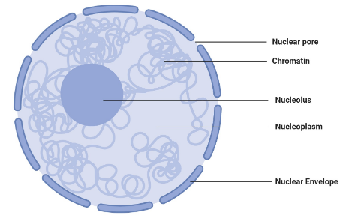
Nucleus
Perinuclear cisterna
Notes:
Nucleus

Slide 7
The process of DNA packaging
DNA
Nucleosome
Extended Chromosome
Condensed Chromosome
Paired Chromosome
Notes:
Paired Chromosome

Slide 8
Types of Chromatin
Chromatin in the nucleus exists as euchromatin or heterochromatin.
Heterochromatin is tightly packed DNA that darkly stained with basic dyes. It present in inactive cells where the transcription cannot occur.
Euchromatin is extended DNA that poorly stained and is difficult to distinguish even by electron microscopy. Euchromatin presents in active cells that have more transcriptional activity and cell division.
3- Nucleoli: are one or two round basophilic bodies located within the nucleus. It consists of proteins and DNA that responsible for synthesis of ribosomal RNA (rRNA). They are present in embryonic cells, in cell that synthesize protein and tumour cells.
4- Nucleoplasm: is the fluid in which the nuclear components are embedded. It is composed of protein, metabolites, ions and water.

Slide 9
II. Cytoplasm
Cytoplasm is composed of organelles and cytosol (jelly like material consisting of mainly water and proteins.
Cytoplasm contains non membranous organelles such as ribosomes and centrosome as well as membranous organelles, such as endoplasmic reticulum, Golgi apparatus, mitochondria, lysosomes, vacuoles.

Slide 10
II- Cytoplasmic organelles
Non membranous cytoplasmic organelles
1- Ribosome
rRNA
Large subunit
Prokaryotic
small subunit
Ribosomes are round shaped organelles that synthesize protein in the cell. Ribosomes are complexes made of ribosomal RNAs and protein subunits (large and small).
Ribosomes are found within the cytoplasm either free or attached to the Endoplasmic reticulum (ER).
rRNA
Large subunit
Eukaryotic
small subunit

Slide 11
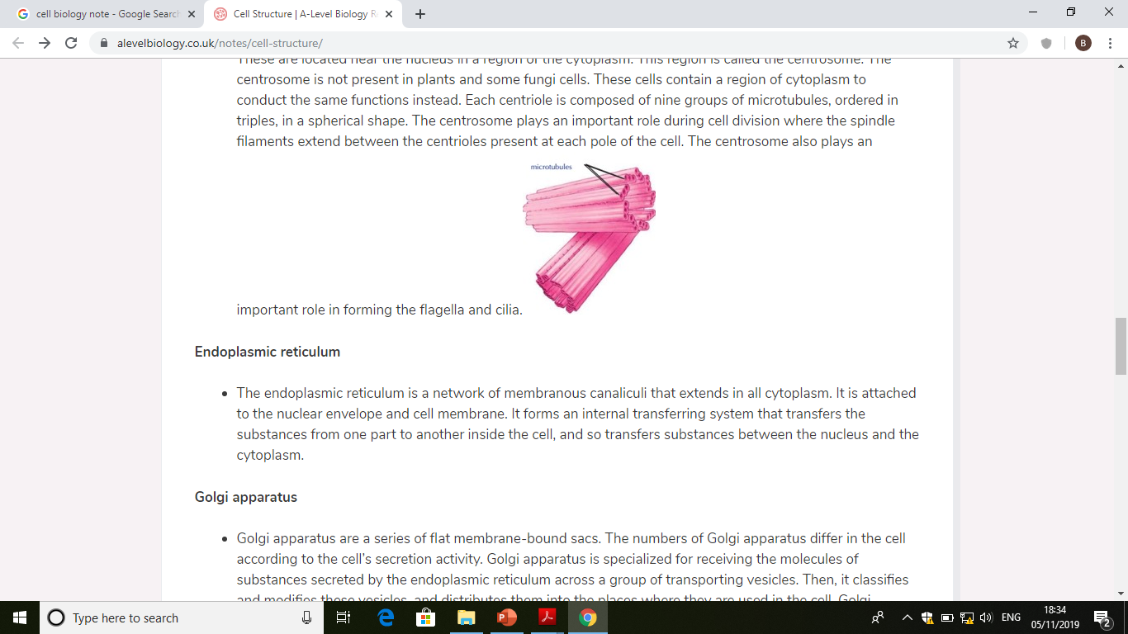
2- Centrosome
Centrosome is a small body, located near the nucleus, it is composed of two centrioles arranged at right angles to each other .
The centrosome plays an important role during cell division where the spindle filaments extend between the centrioles present at each pole of the cell.

Slide 12
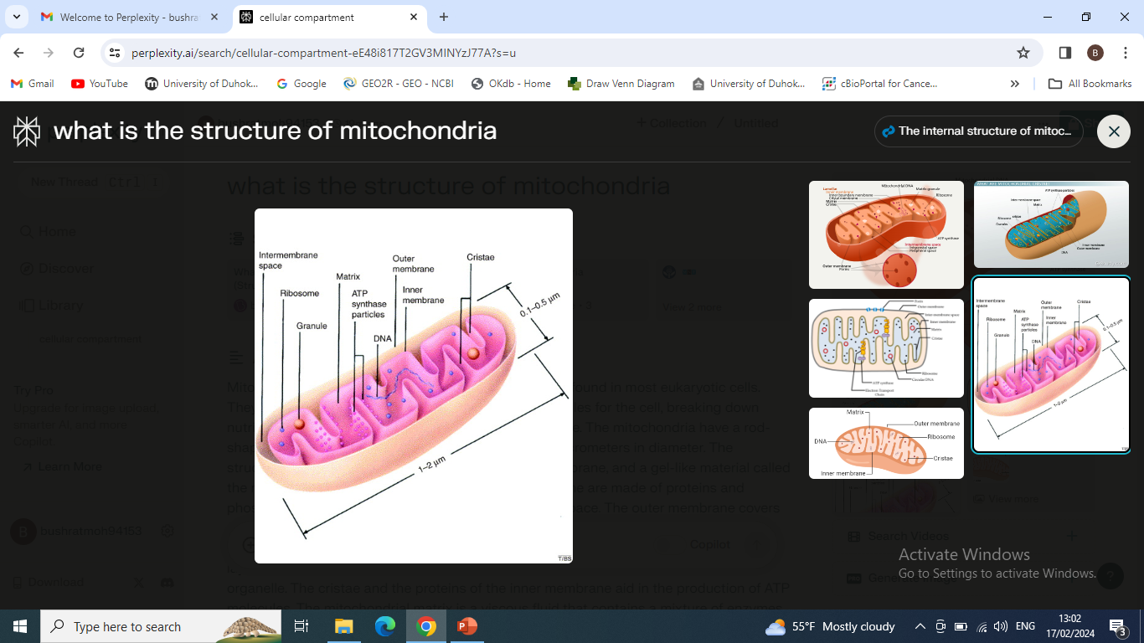
Membranous cytoplasmic organelles
1- Mitochondria
Mitochondria are sac-like structure, bounded by two layered membrane (inner and outer).
Cristae is folds that extends from The inner mitochondrial membrane into the matrix.
Mitochondrial matrix contains circular DNA and ribosome allowing it to self replicate and produce protein. They are abundant in metabolically active cells (muscle, brown adipose tissue)
They are the sites of cellular respiration (ATP)

Slide 13
2- Endoplasmic Reticulum (ER)
Endoplasmic reticulum: The ER is a complex network of flattened sacs and tubules that extends throughout the cytoplasm of the cell. They are the sites of protein and lipid production.
Types of Endoplasmic reticulum (ER)
It can be divided into the following types:
A. Rough endoplasmic reticulum: it is covered with ribosomes which gives it a rough appearance and is continuous with the outer nuclear membrane. Rough ER transport materials through the cell and produces proteins in cisternae.
B. Smooth endoplasmic reticulum: it lacks ribosomes and contains enzymes that are important in lipids (fats) metabolism and steroid hormones production.

Slide 14
2- Endoplasmic reticulum
Ribosome

Slide 15
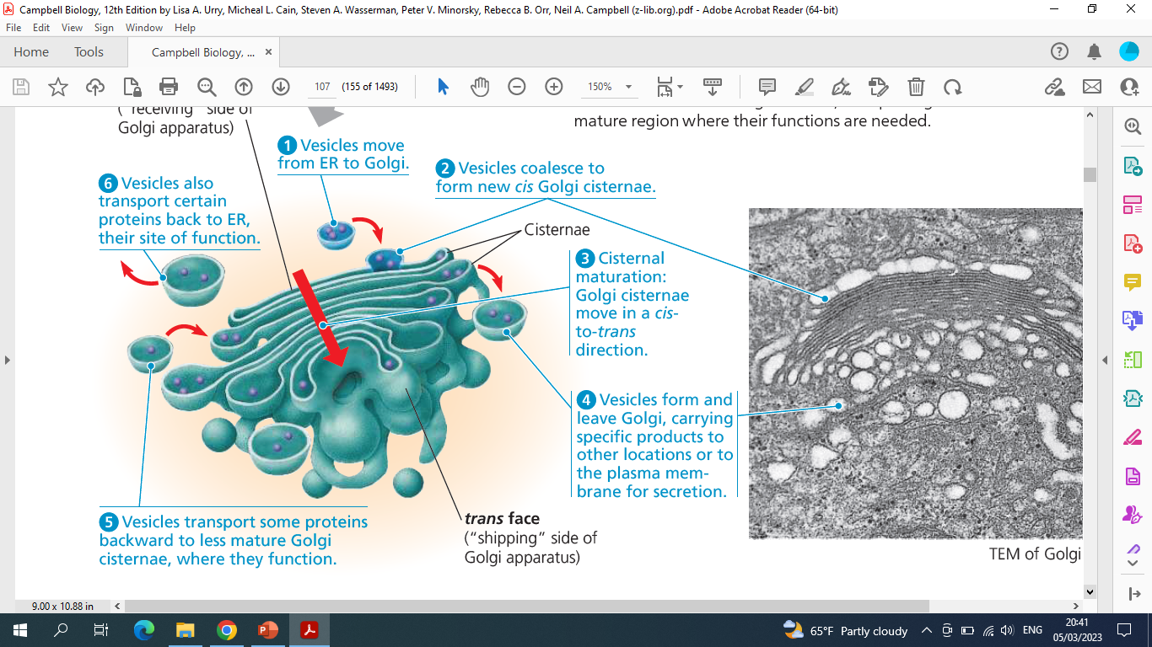
3- Golgi body(apparatus):
The Golgi apparatus consists of a group of flattened membranous sacs-cisternae
Golgi apparatus is responsible for receiving substances at the cis face, materials that secreted by the endoplasmic reticulum, modified, and packaged into vesicles at the trans face for delivery to extracellular space

Slide 16
4- Lysosome
Lysosomes are a membranous sac of hydrolytic enzymes with acidic (PH 5.0) that facilitate the digestion of proteins, organelles, and extracellular debris through the action of acid hydrolases. therefore, they described as stomach of the eukaryotic cell.
5- Endosomes
Endosomes are internal membrane-bound structures, formed by endocytosis process, and found in the cytoplasm.
6- Phagosomes
Phagosomes are membranous vesicles that contain materials such as damaged organelles. Phagosomes fuse with lysosomes to digest these contents

Slide 17
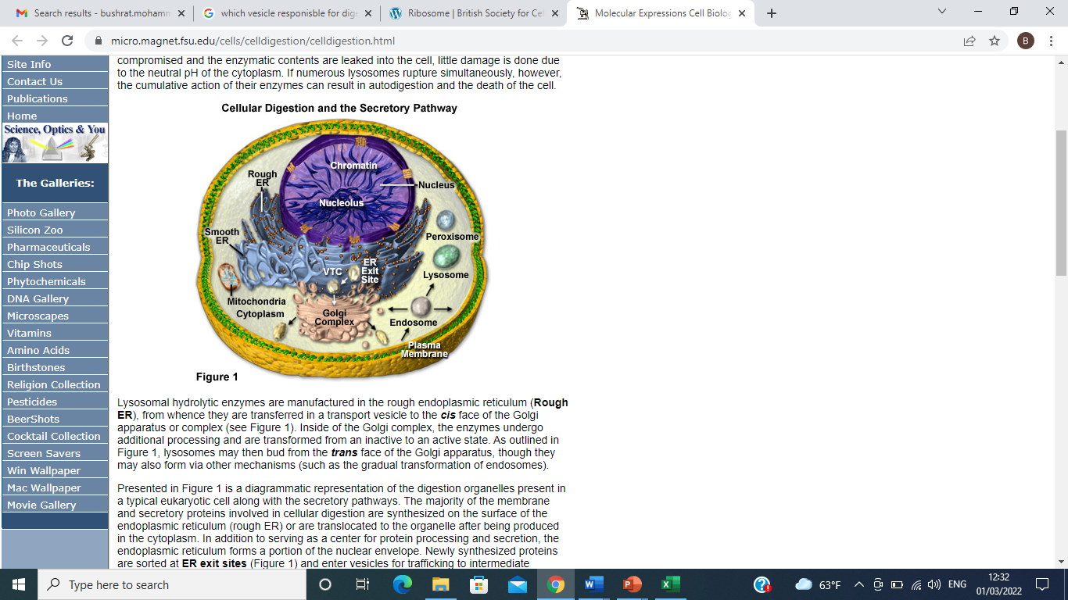
Cell digestion

Slide 18
7- Peroxisome
is a specialized metabolic compartment bounded by a single membrane. It produces hydrogen peroxide as a product and then converts it to water.
8- Cilia and Flagella
Cilia and flagella are projection from the cell motile, they move the cell or materials around the cells. Sperm has flagellum and cells lining the respiratory tract have cilia
9- Other cytoplasmic inclusions:
Lipid droplet
Glycogen granules
Melanin: is a brown pigment present in epidermis, retina and brain
Notes:
Other cytoplasmic inclusions

Slide 20
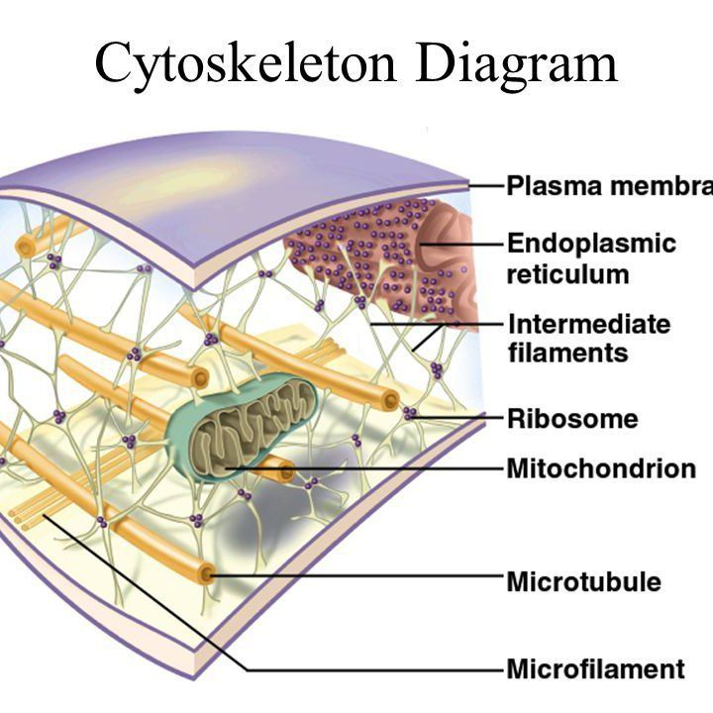
Cytoskeleton
Cytoskeleton The cytoskeleton is a network of protein fibers inside the cell that gives it shape, strength, and support. It also helps the cell move and transport materials.
Cytoskeleton has three types
Microtubules are the thickest of
the three types; microfilaments (also called actin filaments) are the thinnest; and intermediate filaments are fibers with diameters in a middle range
Notes:
Plasma membrane
Endoplasmic Reticulum

Slide 21
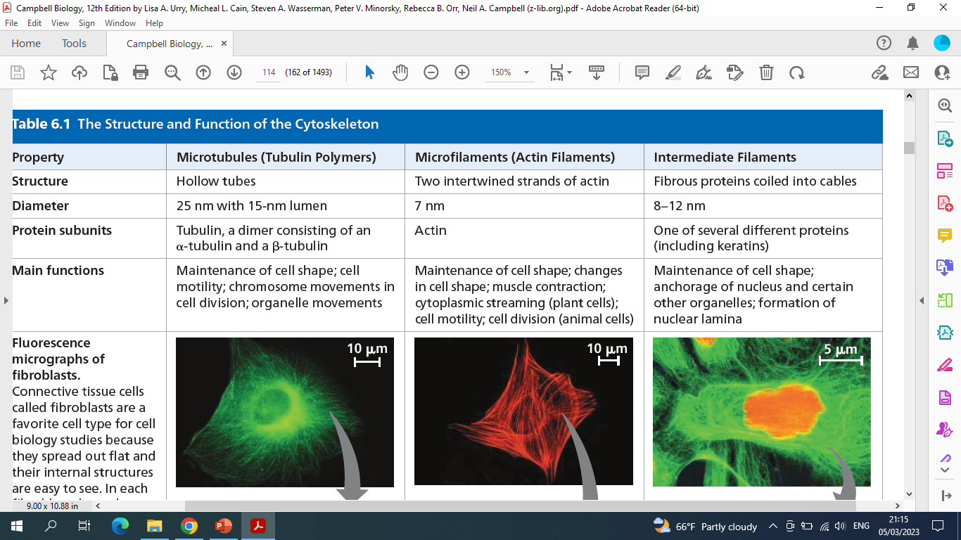
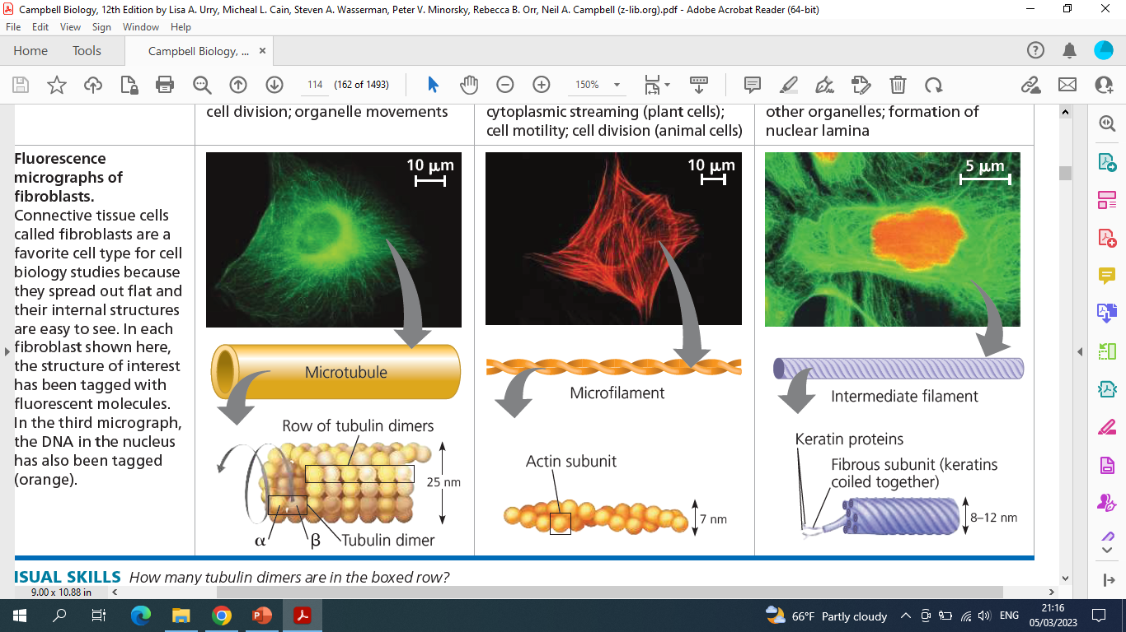

Slide 22
Types of Intermediate filaments

