Slide 1


1- Introduction to Biology
Cell and Molecular Biology/ Theory
By Dr. Karwan Idrees Jarjees
COLLEGE of
VETERINARY MEDICINE
THE UNIVERSITY of DUHOK

Slide 2
Learning outcome:
This lecture should help student to:
Know the characteristics and function of living organisms
Know the structure and organisation of pro-and eukaryotic cells

Slide 3
What is Biology?
Biology is the study of life (Bio= life, logos= study) and living organisms.
The first organisms appeared on the planet over 3 billion years ago and, through reproduction and natural selection have given rise to different species alive today.
Important reasons for studying Biology:
Biology is relevant to our everyday experience
Public health
Medical Advances:
Biodiversity Preservation:
Biotechnology advances

Slide 4
Characteristics of Living organisms:
Self Organization: living organisms are highly organized and complex. They are composed of one or more cells.
Self Reproducing Capacity: Contain a blueprint (genome) to transfer information from one generation to the next.
Mechanism of Energy Transfer: Need and use energy, the cellular energy is obtained from nutrients that is used to make new cellular components.
Self Regulation Capacity: Carry out and control numerous reactions, these reactions include the chemical processes that are important to growth and repair of living cells.

Slide 5
Adaptation Capacity: living organisms adapt to stimuli such as physical or chemical signal from the internal or external environment.
Maintain homeostasis: the tendency of an organism to maintain
a constant internal environment, they can control their internal conditions, such as their temperature or water content.
Evolution and Biodiversity: Evolve and show great diversity, living organism can be classified into different species.

Slide 6
Levels of Biological Organization
1. The Biosphere
Biosphere consists of all life on Earth and all the places where life exists
2. Ecosystems
An ecosystem consists of all the living things in a particular area, along with all the non living components of the environment such as soil, water, atmospheric gases, and light.
3. Communities
Community consists of all the populations of different species living and interacting in a particular area.
4. Population
A population is a group of individuals of the same species living in a specific area

Slide 8
5. Organisms
Individual living things such as human, animal, bacteria
6. An organ system
is multiple organs working together to carried out a particular function.
For example, the digestive system.
7. An organ
is a group of different types of tissues functioning together to perform a particular activity. For example, the heart.
8. Tissues
Tissues are groups of cells performing a common function.
9. Cells
Cells are the structural and functional units of life (and of disease process) in all tissue, organs and organ systems.

Slide 9
10. Organelles
“little organs” are intracellular structures that have specific function which keep the cell alive
11. Molecule
Molecule is a chemical structure consisting of two or more units called atoms

Slide 10
History of Cell
In the late 1600s Robert Hooke (English physicist) used the term ‘cell’ in latin means little rooms after observing cork cells using primitive, light microscopes.
In 1673, Anton von Leeuwenhoek discovered single-celled organisms (protists) in pond scum. Leeuwenhoek was also the first to see blood cells, bacterial cells, and yeast cells.

Slide 11
Cork cells
Light microscope

Slide 12
Cell theory
Theodor Schwann and Matthias Jakob Schleiden cell theory:
All living organisms are composed of cells
Cells are the smallest unit of life.
Then in 1855, Rudolf Virchow added another point to the theory
Cells come from pre-existing cells

Slide 13
Classification of cells
There are two basic cell types
A- Prokaryotes are microscopic, single-celled organisms that lack a membrane bound nucleus and other specialized organelles (e.g. bacteria and archaea. ) .
B- Eukaryotes are refer to any single-celled or multicellular organisms whose contain membrane bound nucleus and organelles. (fungi, protists, most plants and animals)
Classification of eukaryotes
Animals
Plants
Fungi, including yeast
Protists (e.g. ameobae)

Slide 14
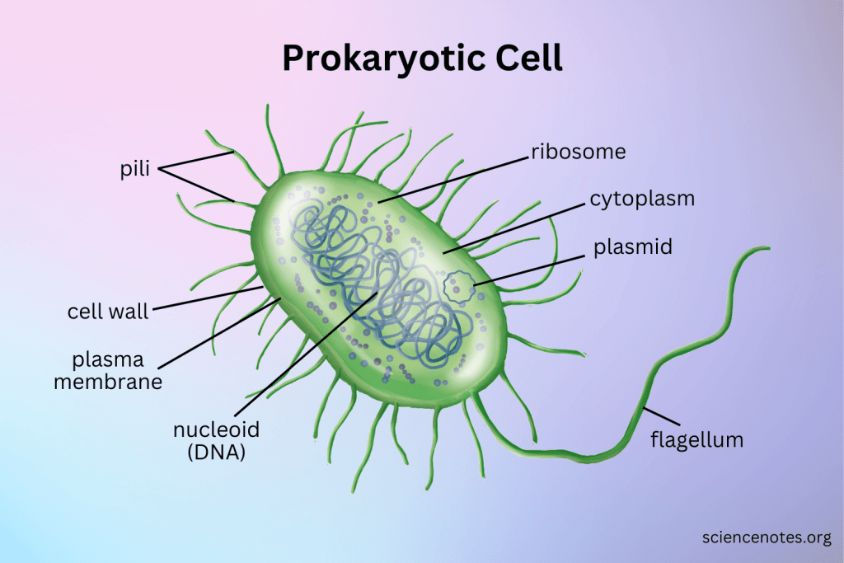
Eukaryotic cell

Slide 15
Differences Between Prokaryotic and Eukaryotic Cells
1. Nucleus:
Prokaryotic cells lack a true nucleus; their DNA is in a nucleoid region.
Eukaryotic cells have a defined nucleus enclosed by a nuclear membrane.
2. Organelles:
Prokaryotic cells do not have membrane-bound organelles.
Eukaryotic cell contain membrane- bound organelles like mitochondria, Golgi apparatus, and endoplasmic reticulum.
3. Size:
Prokaryotic cells are smaller, typically 0.1 to 5.0 micrometers in diameter.
Eukaryotic cells are larger, usually 10 to 100 micrometers in diameter.
4. Chromosomes:
Prokaryotic cells have a single circular chromosome.
Eukaryotic cells have multiple linear chromosomes within the nucleus.
5. Cell Division:
Prokaryotic cells divide by binary fission.
Eukaryotic cells divide by mitosis (for growth) and meiosis (for reproduction).
Notes:
Binary fission is the process of one cell simply dividing into two. Binary fission is a type of asexual reproduction, where the offspring are genetic clones of the parents;

Slide 16
6. Cell Wall Composition:
Prokaryotic cell walls are often made of peptidoglycan.
Eukaryotic cell walls, if present (in plants and fungi), are made of cellulose or chitin.
7. Ribosomes:
Prokaryotic cells have smaller ribosomes (70S).
Eukaryotic cells have larger ribosomes (80S).
8. DNA Packaging:
Prokaryotic DNA is not associated with histone proteins.
Eukaryotic DNA is wrapped around histone proteins, forming chromatin.
9. Flagella:
Prokaryotic flagella are simpler and rotate for movement.
Eukaryotic flagella are more complex and whip back and forth.
10. Examples:
Prokaryotic like bacteria and archaea
Eukaryotic like animal cell, Plants and Fungi, including yeast

Slide 17
Revised questions
Why we study Biology?
What are the characteristic features of living organism?
Describe the Levels of Biological Organization
Define Biology, cells, organelles, eukaryotes, prokaryotes
Describe the theories of cell
List the classification of eukaryotes
Compare between prokaryotes and eukaryotes

Slide 18
Reference
1. Biology Campbell et.al, 12 ed2021
2. Biology concepts and connectionsCampbell et.al, 6ed2009
3. Essential Cell Biology. Garland Science; B. Alberts, D. Bray, K. Hopkin, A. Johnson, K. Roberts, J. Lewis, M. Raff, P. Walter, 4th edition2013
4. Lippincott’s Illustrated Reviews: Cell and Molecular Biology, Lippincott Williams & Wilkins2010

