Slide 1
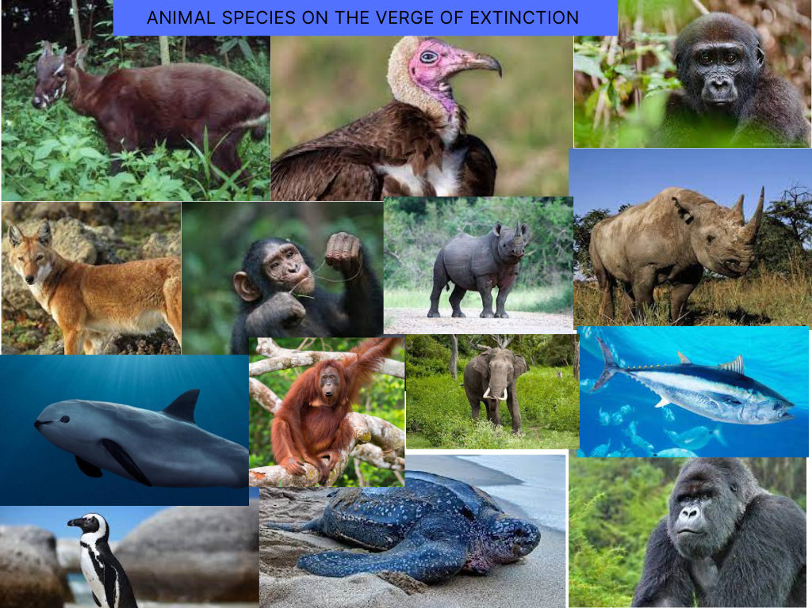
Extinction of Species
Evolution lectures /third class 2024
second Semester
Lecture No. 4
By
Dr.Bushra MA Mohammed

Slide 2
Extinction of Species
There might be as many as 10 million species of complex life on this planet today – a huge number. But add up all of the complex species that ever lived and some biologists think the grand total would be about five billion.
The estimate leads to an astonishing conclusion: a staggering 99% of species are not around any more. They have been driven to extinction.
Species very near to extinction called Endangered species

Slide 3
What is Extinction?
Extinction of a species occurs when no more members of a particular species remains. Extinction through time is very common, Extinctions are a way of clearing the path for new kinds of life that is potentially more advanced.
This is a natural part of life’s process.

Slide 4
Environmental conditions on Earth and the diversity of its life-forms.
Environmental changes on earth are usually an indicator of a species extinction (or a species addition).
These changes can be brought about by
an asteroid or comet impact,
Volcanic activity,
or Climatic changes like the onset of ice ages. Natural phenomena that can contribute to the extinction of a species include global climate changes, volcanic explosions.

Slide 5
Extinction of the dinosaurs:
1- asteroid or comet impact It is The most well-known extinction , the Scientists think that this mass extinction was caused by a large comet that impacted the earth in present-day Mexico, causing a massive quantity of dust to rise up into the atmosphere, possibly blocking out the sun and affecting the oxygen levels. So Many plants died, and the animals that depended on those plant for life died as well. In addition, it may have become very cold in a short period of time.
It took millions of years for the earth to recover, and when it did, the large dinosaurs were gone forever.

Slide 6
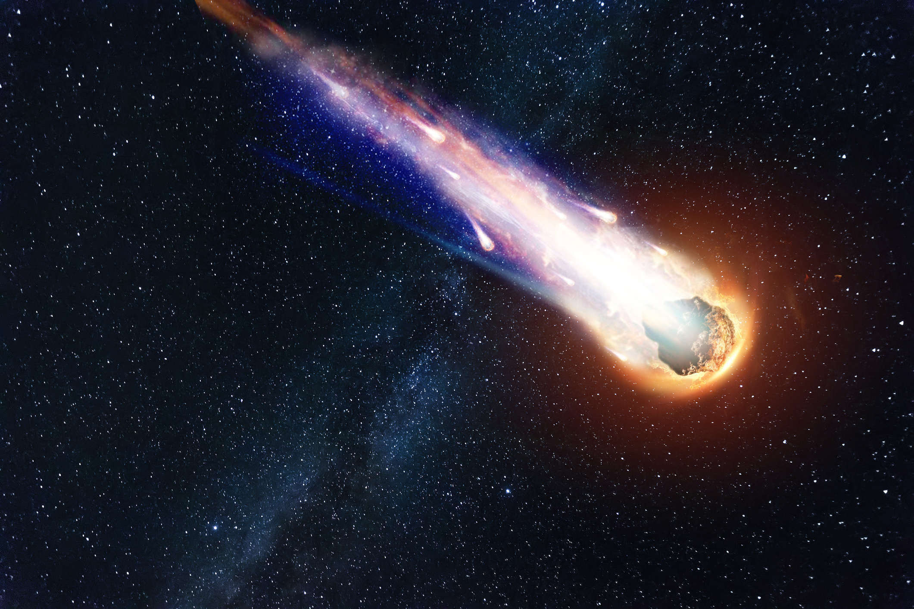
Comets are made of ice, dust, and pieces of rock

Slide 7
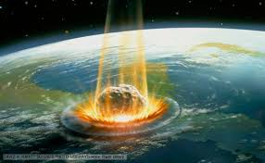
Notes:
Comets hitting earth

Slide 8
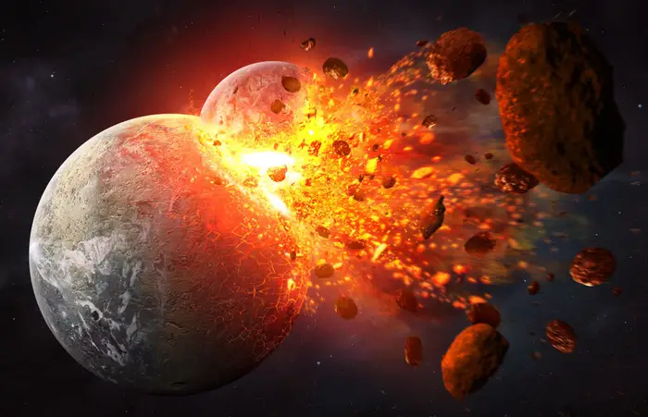

Slide 9
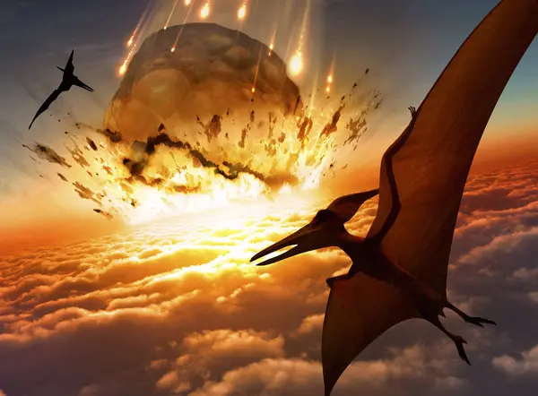

Slide 10
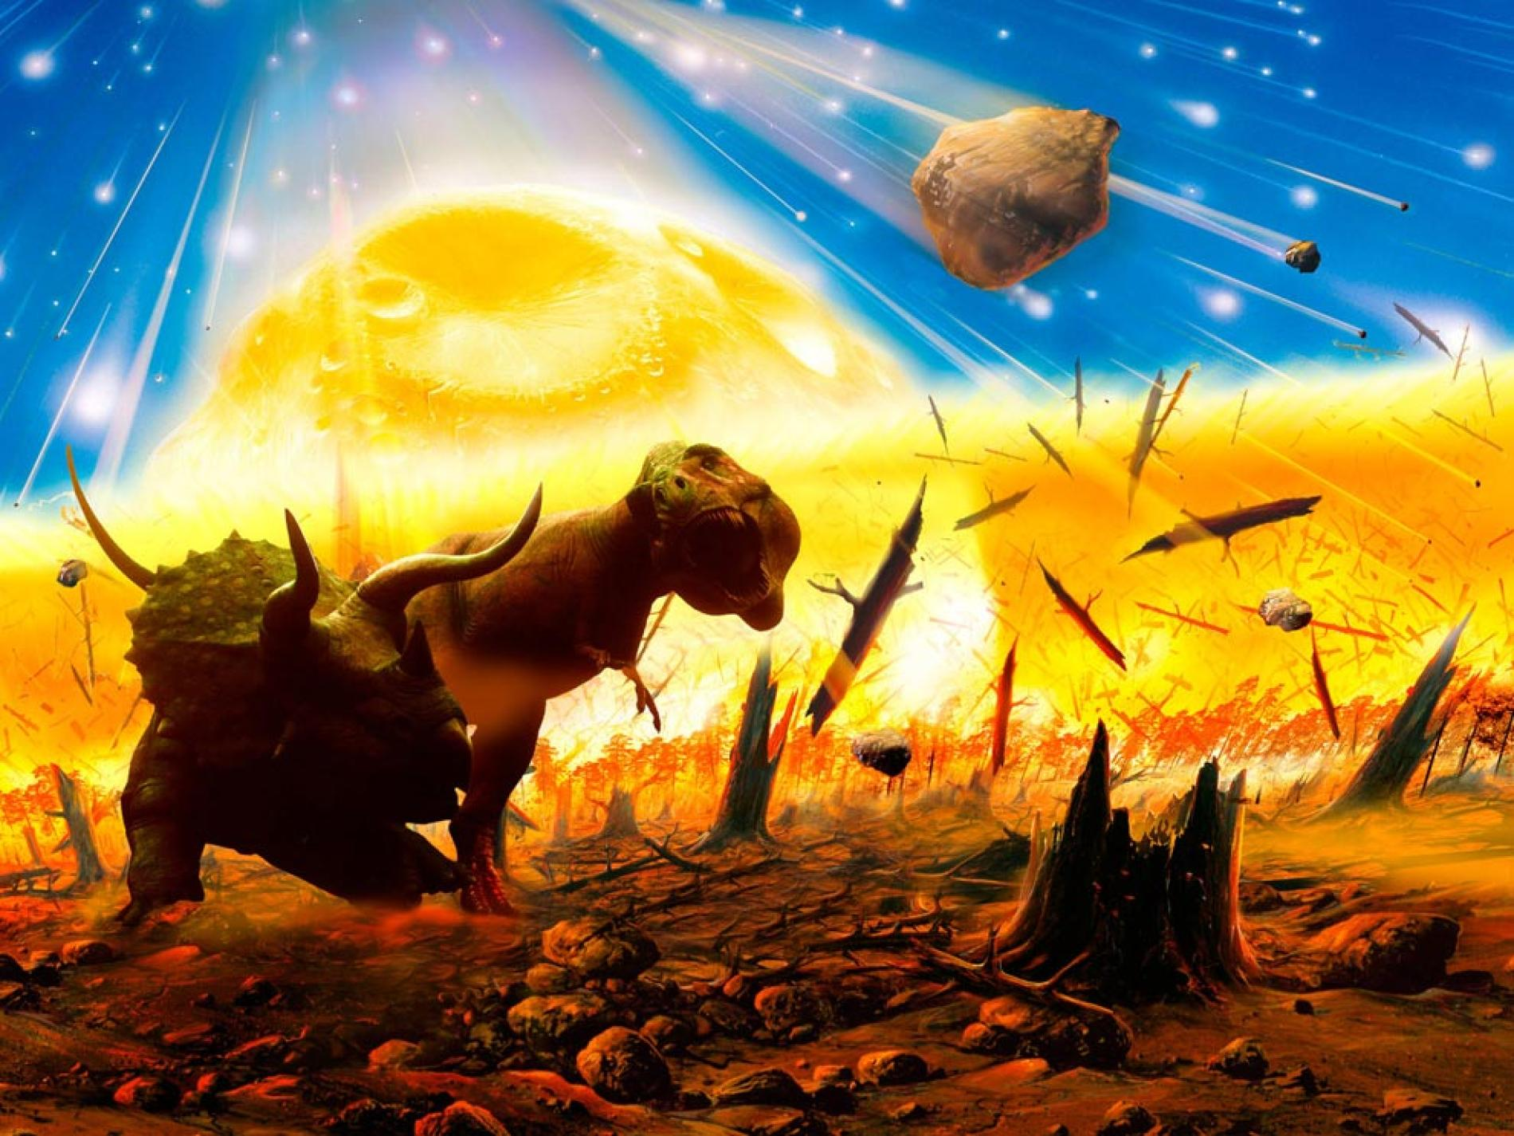
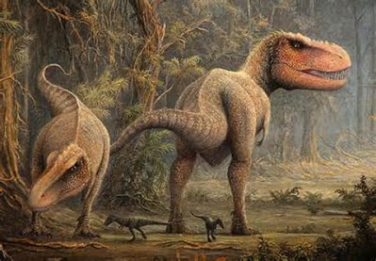

Slide 11
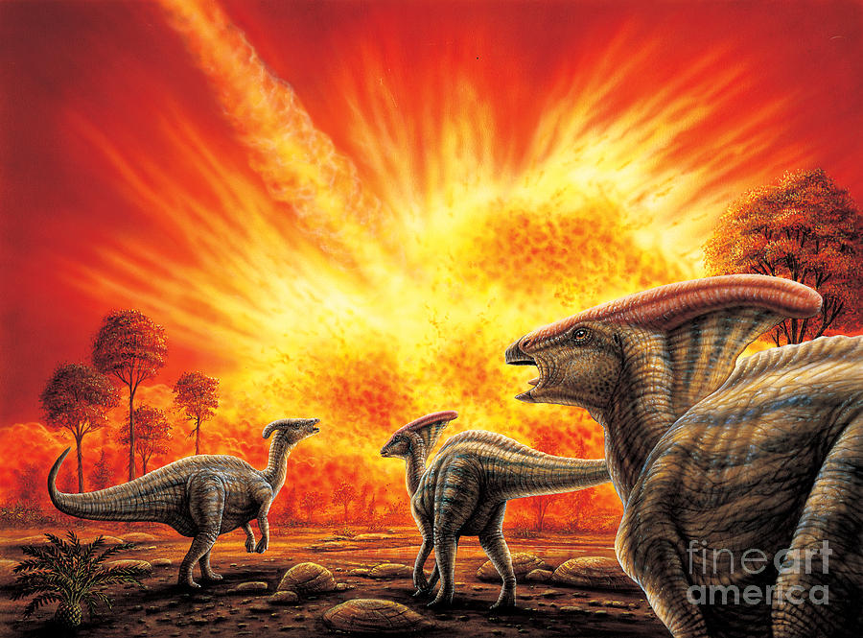

Slide 12
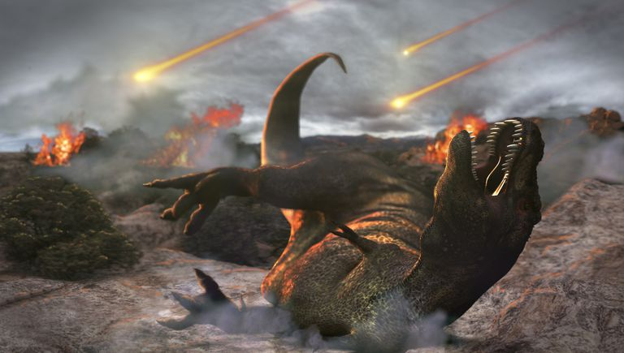

Slide 13
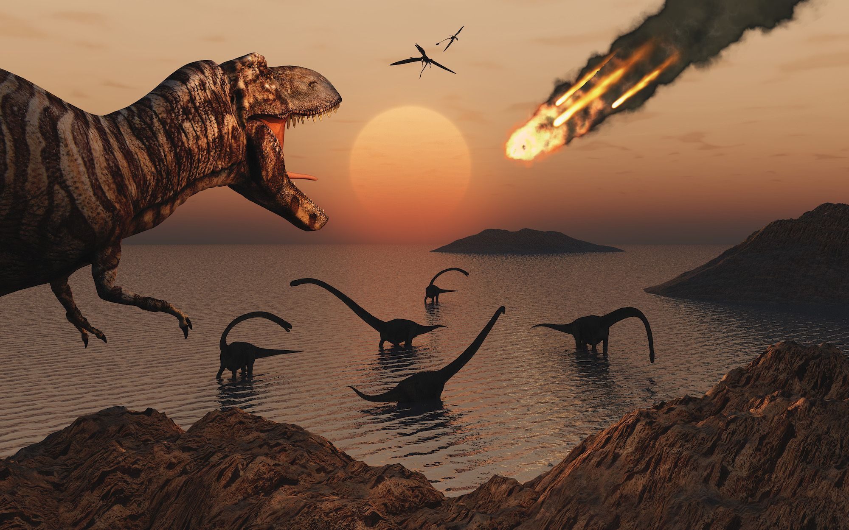

Slide 14
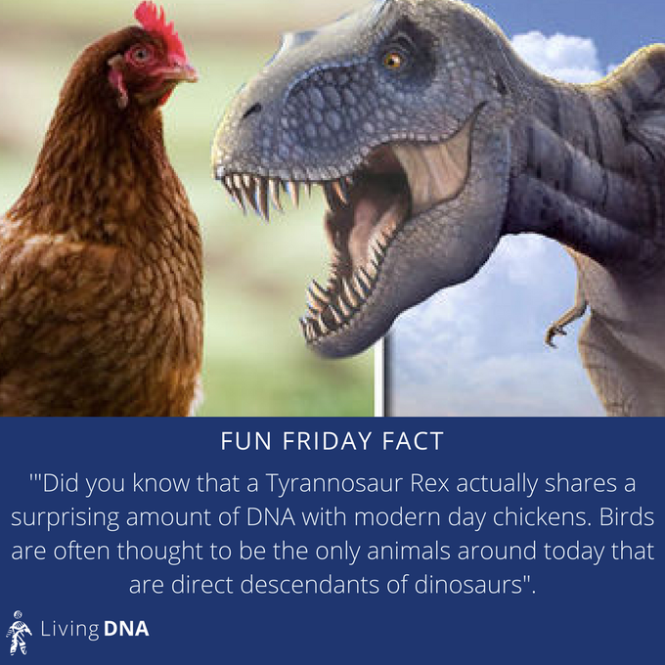
Tyrannosaurus rex
Scientist think that Certain species of birds, however, did survive and began to flourish. Well, technically dinosaurs are still here in the form of birds. Birds are thought to be direct descendants of dinosaurs.

Slide 15
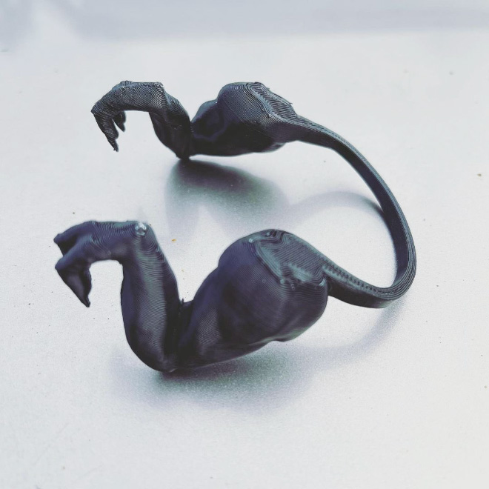
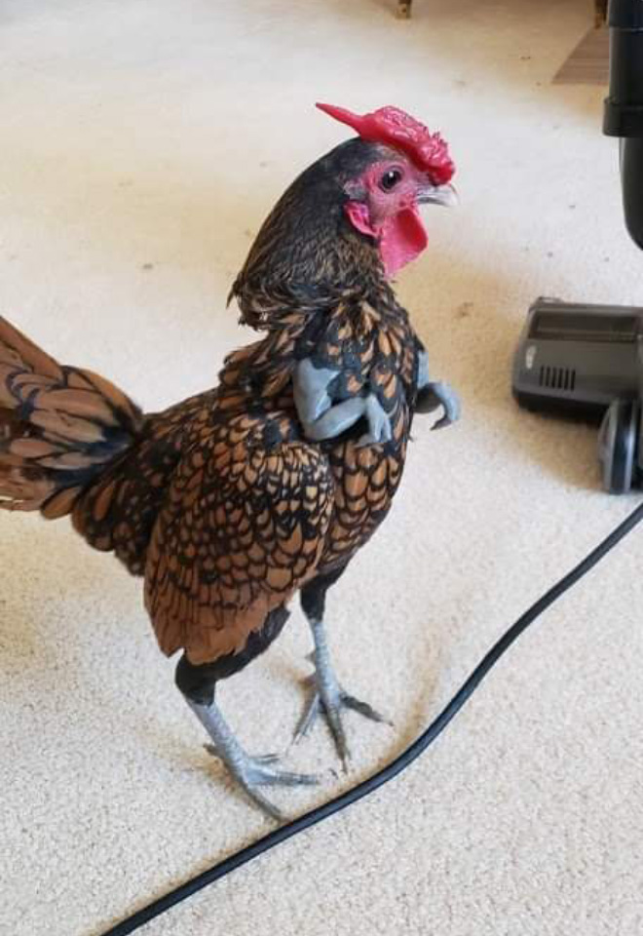

Slide 16
2-Climate Changes
During the Paleozoic era, warm shallow seas and tropical climates were common. Life forms that could not adapt to these conditions disappeared.
Throughout the Mesozoic era, plate movement shifted the continents and only the animals and plants with the greatest ability to adapt could survive the extreme changes in temperatures that occurred as a consequence.
Plants with seed coverings and animals with constant internal temperatures (warm-blooded) lived during this era.

Slide 17
Climate continued to change during the Cenozoic era and continues to change to this day, as issues of “Global Warming” have been on the fore-front for over a decade.
It was only ~12,000 years ago that the world was in an “ice age” mode. Also, many mountain ranges formed during this era, causing climate differences due to elevation changes.
Ice ages have occurred many times in Earth’s history. Climate shifts like these may be caused by magnetic polar reversals or variation in the tilt of the earth . قد يكون ناتجًا عن الانعكاسات القطبية المغناطيسية أو التباين في ميل الأرض.
The tilt of the Earth's is important for a habitable Earth. The Earth's spin axis is tilted 23.5°, giving moderate seasons and preventing temperature extremes anywhere on the planet.

Slide 18
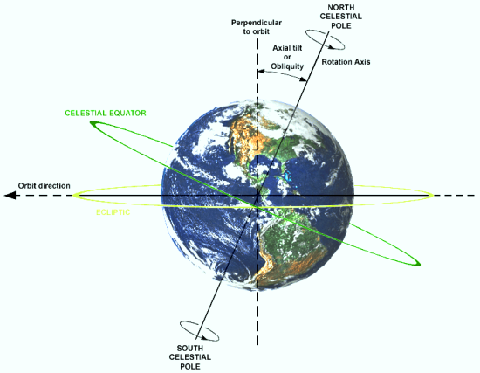
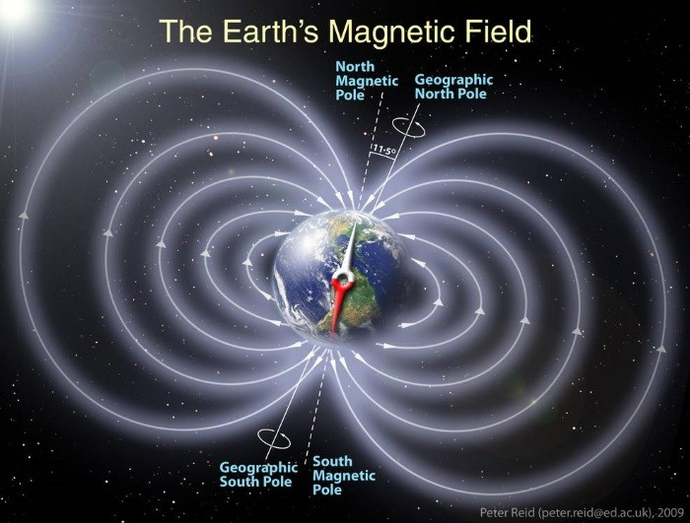
Climate shifts like these may be caused by magnetic polar reversals

Slide 19
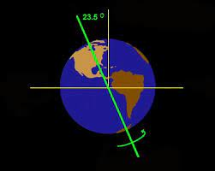
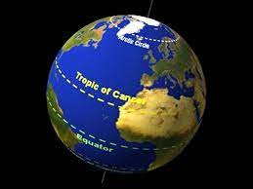
Climate shifts like these may be caused by variation in the tilt of the earth

Slide 20
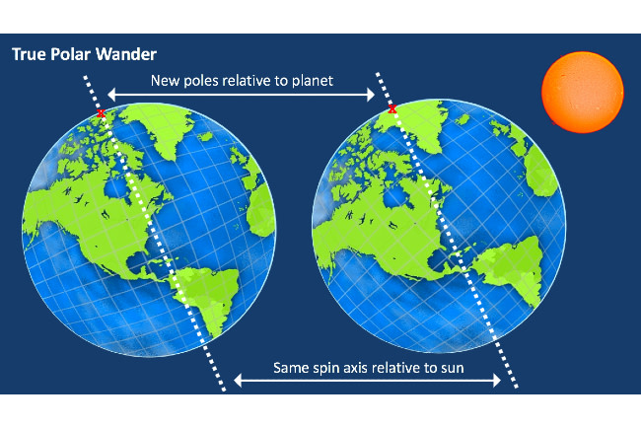

Slide 21
Mammals from the ice age would have likely had thick fur coats, they would have found it difficult to adapt to the changing climate. which probably contributed to the extinction of the wooly mammoth.
Although the last ice age was not a major extinction event, roughly 35 different types of large mammals went extinct.. Huge multi-ton animals like mammoths disappeared along with apex predators like saber-toothed tigers and dire wolves. قمة الحيوانات المفترسة مثل النمور ذات الأسنان والذئاب الرهيبة.

Slide 22
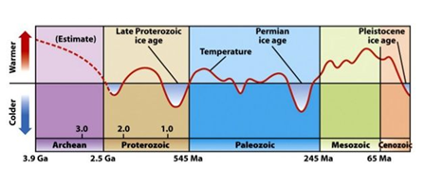
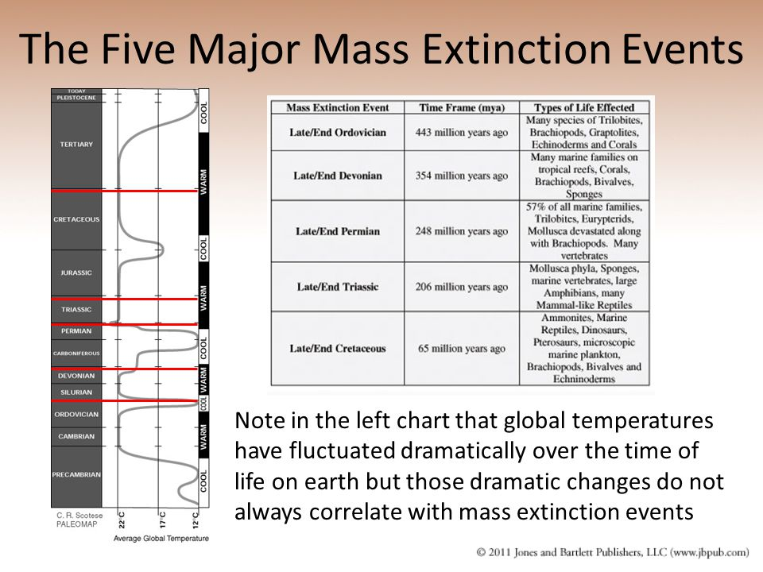

Slide 23
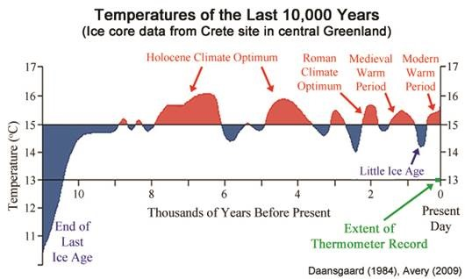
Holocene Temperature during 11000 years ago

Slide 24
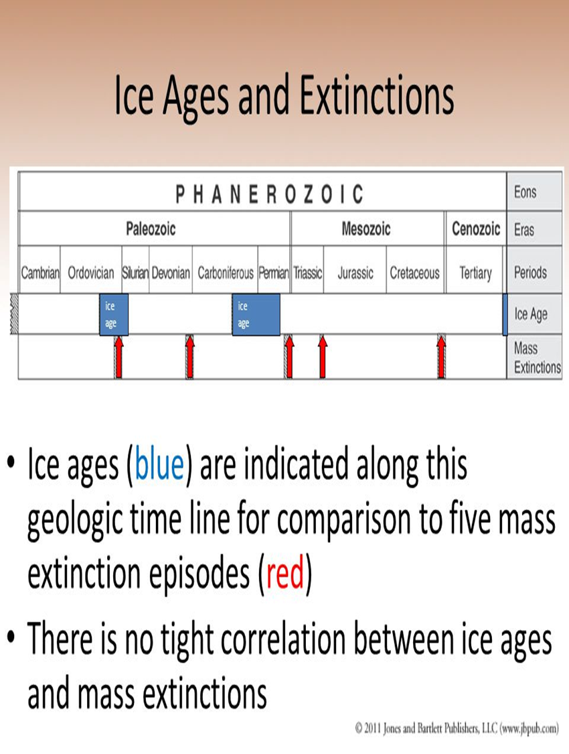

Slide 25
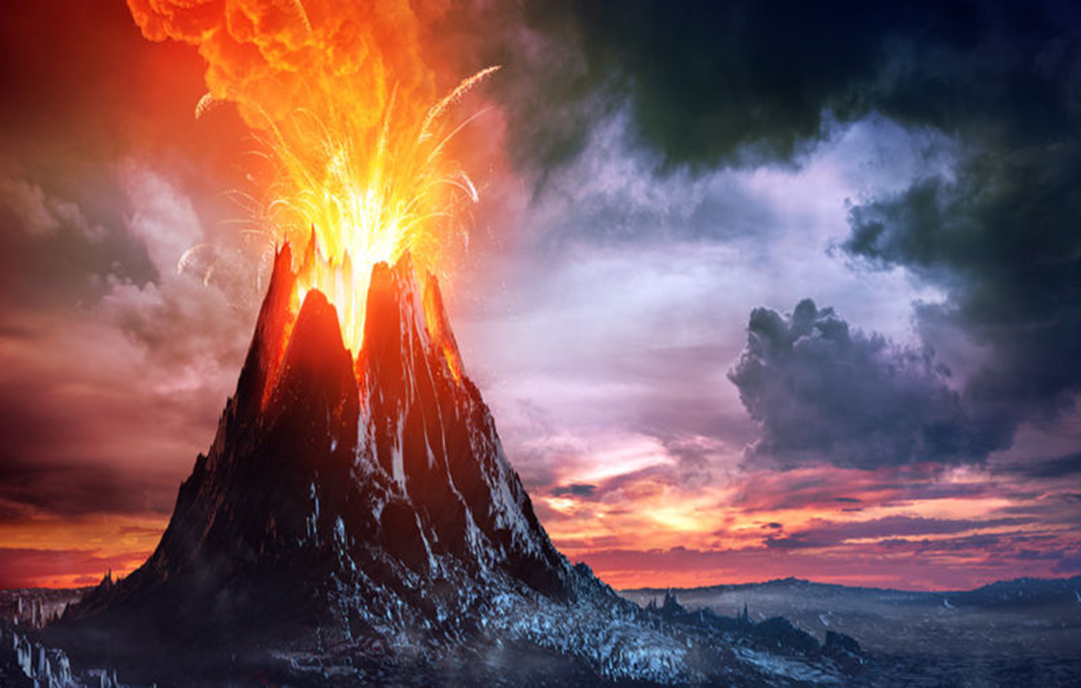
3. Volcanic Activity
Significant volcanic activity, which produced ash clouds in the air and lava flows on the Earth’s surface وتدفق الحمم البركانية على سطح الأرض ،, was common during the Precambrian.
It was extremely hot, and most life forms could not exist in these conditions.
Volcanic eruption

Slide 26
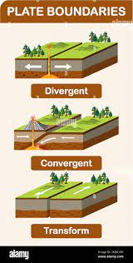
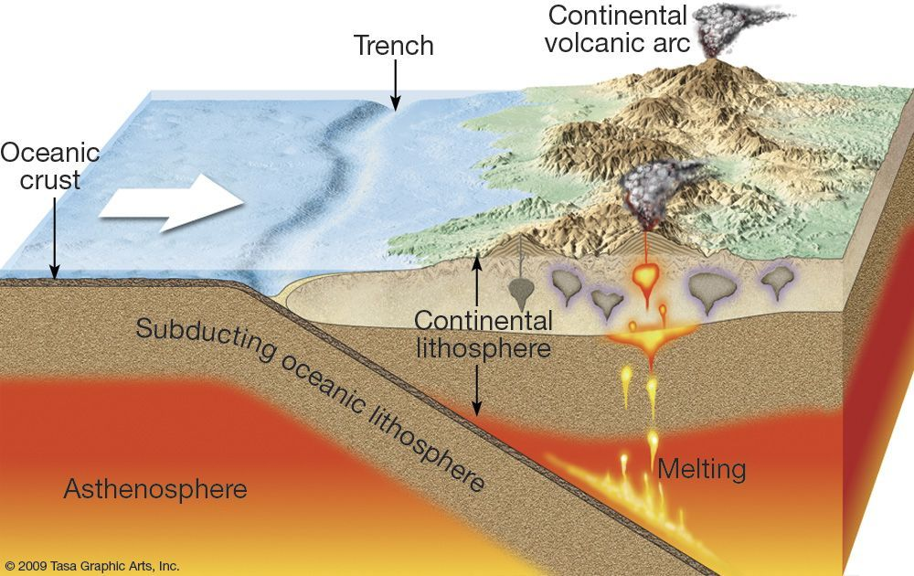
Molten rocks wells up to erupt from Volcanoes

Slide 27
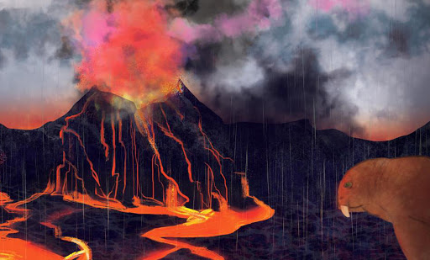
Volcanic eruption produced ash clouds in the air and lava flows on the Earth’s surface

Slide 28
Volcanism is a common by product of tectonic plate collision. ، البراكين منتشر نتيجة تصادم الصفائح التكتونية If one plate collides with another and is pulled underneath it, a subduction zone is formed underneath the plates and a volcanic arc forms on the Earth’s surface.
During the Paleozoic and Mesozoic, continents were regularly colliding with each other and volcanism was common. Plate boundaries are still the most common sites of volcanoes today.

Slide 29
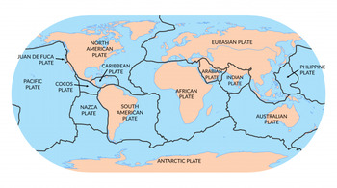
Don't live beside Tectonic plate boundaries

Slide 30
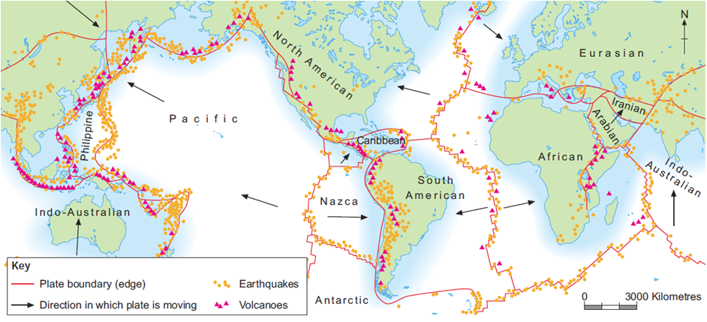

Slide 31
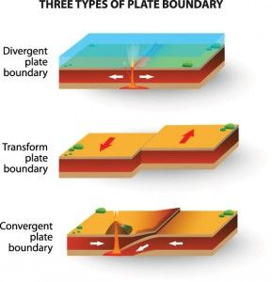
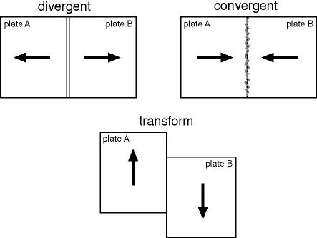
There are three kinds of plate tectonic boundaries: divergent, convergent, and transform plate boundaries. This image shows the three main types of plate boundaries: divergent, convergent, and transform.

Slide 32
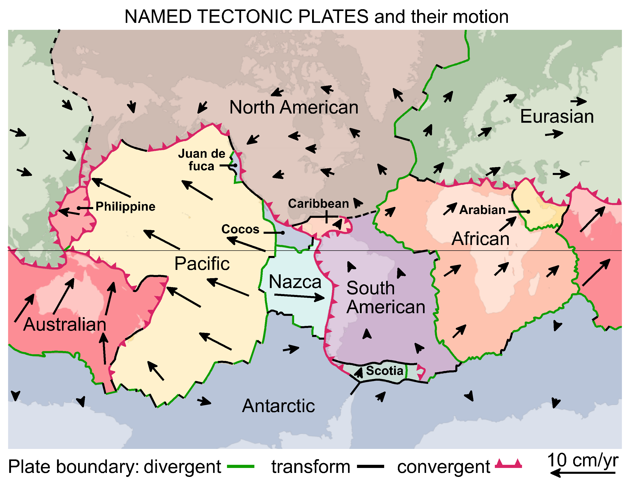

Slide 33
Other causes of Extinction :
The possible causes for the extinctions do not stop at climate change and overhunting. Others think contagious and deadly diseases – carried by migrating humans or their animals .
However, human activity has been to blame. Habitat destruction as farming land expands and forests are cut-down is the main cause of modern extinctions, along with pollution, the introduction of alien species, and over fishing or hunting. Increasingly, however, climate change is thought to be driving extinctions.

Slide 34
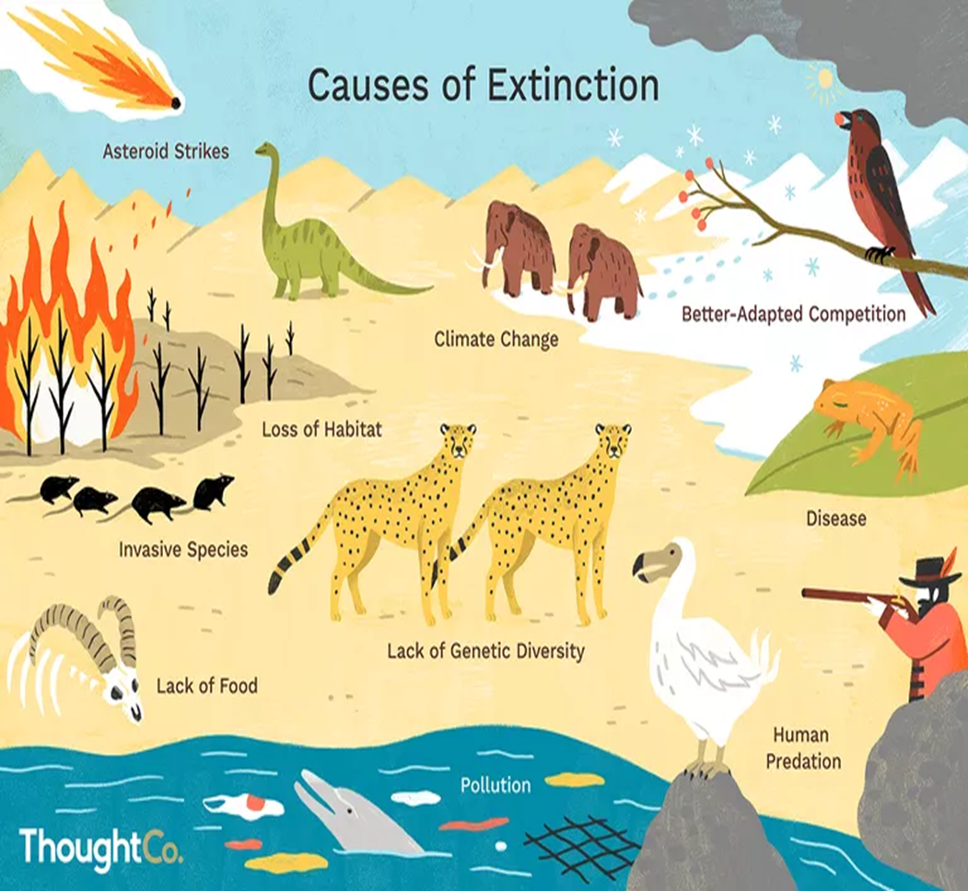

Slide 35
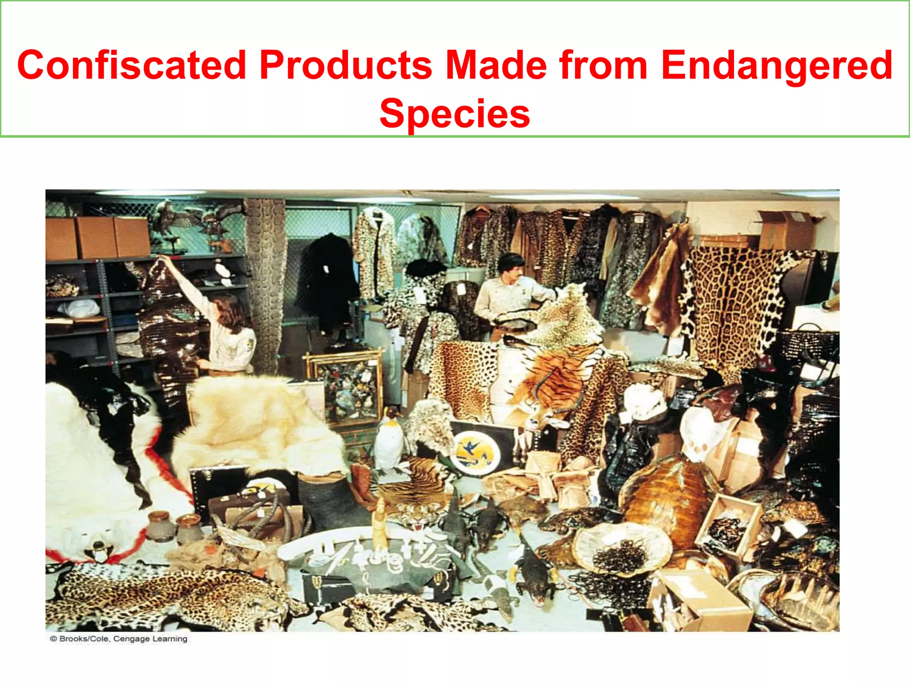

Slide 36
The Five major mass extinctions events:
Terminal Ordovician (445 My),
Late Devonian (340 MY),
Terminal Permian called the "Great Dying" (250MY),
Terminal Triassic (200 MY), and the
Terminal Cretaceous (65 MY), also called the K/T event. (Cretaceous–Tertiary (K–T) extinction)
The most important extinction events were:
The terminal Cretaceous extinction event, is the most well-known,
but the terminal Permian extinction event was even more severe, with approximately 95% of species driven to extinction.

Slide 37
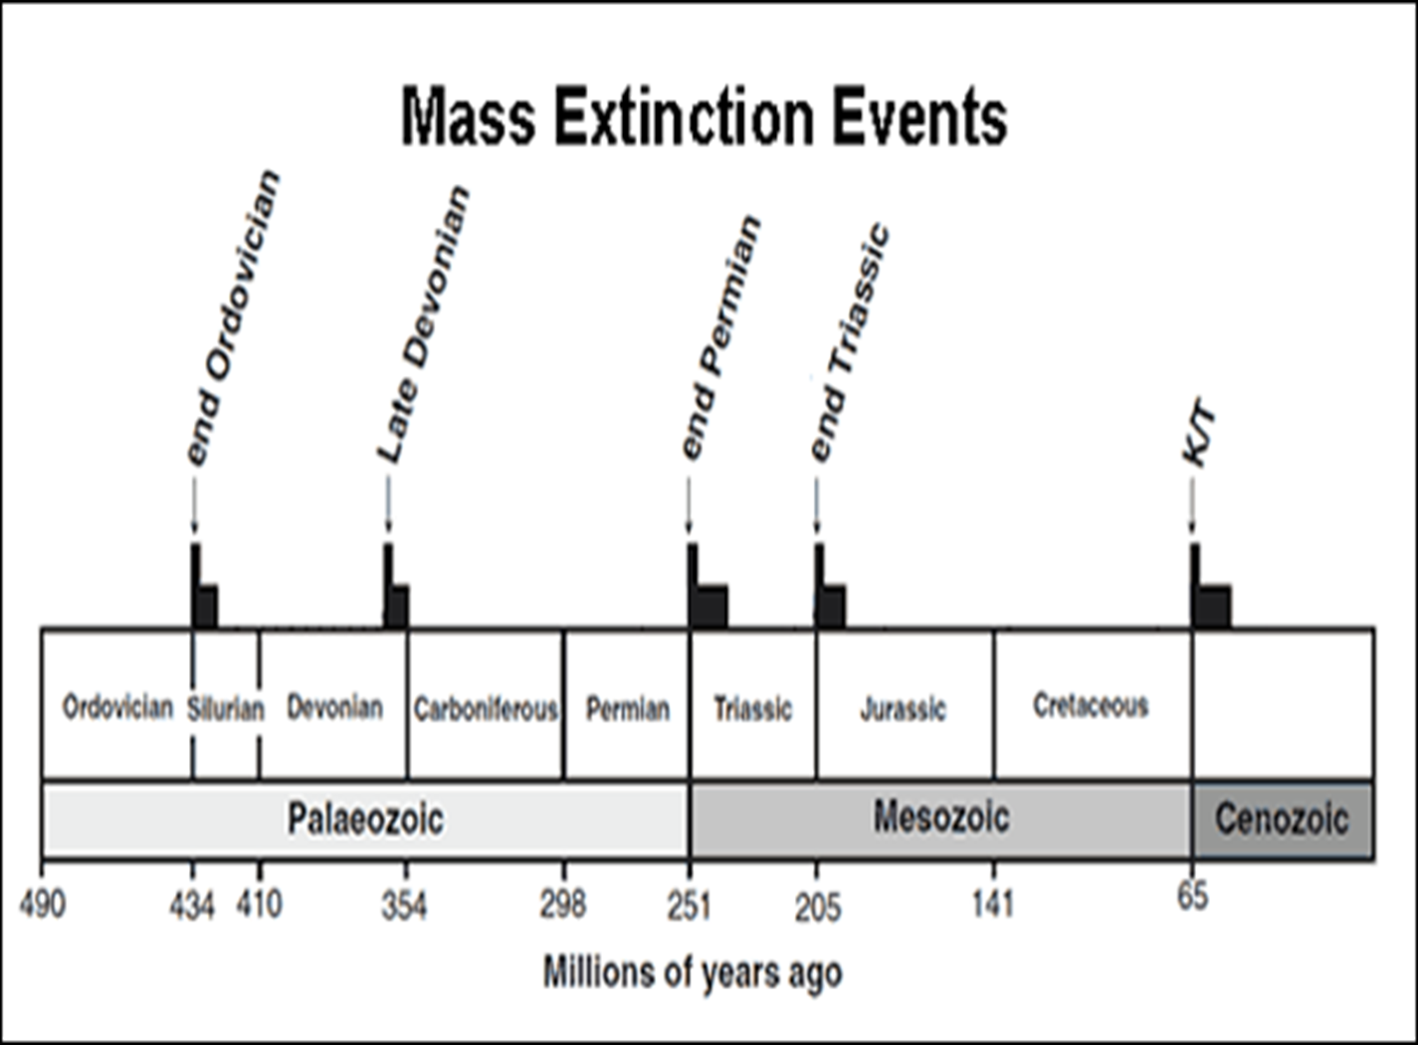
Mass Extinctions
        (#= millions of years ago)

Slide 38
1-Terminal Ordovician extinction
When: about 445 million years ago
Species lost: 60-70 percent
Likely cause: Short but intense ice age
Most life at this time was in the oceans. It is thought that the rapid, planet-wide formation of glaciers froze much of the world's water, causing sea levels to fall sharply.
Marine organisms such as sponges and algae, along with primitive snails, clams, cephalopods and jawless fish called ostracoderms,

Slide 39
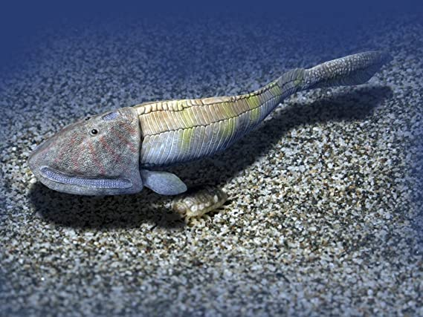
jawless fish called ostracoderms

Slide 40
2-Late Devonian extinction
When: about 340 million years ago
Species lost: up to 75 percent
Likely cause: oxygen depletion in the ocean
. One theory holds that the massive expansion of plant life on land released compounds that caused oxygen depletion in shallow waters. Armoured, bottom-dwelling marine creatures called trilobites were among the many victims, though some species survived.

Slide 41
3-Terminal Permian extinction
When: about 200 million years ago
Species lost: 95 percent
Possible causes: asteroid impact, volcanic activity
The mother of all extinctions, the "Great Dying" devastated ocean and land life alike, and is the only event to have nearly wiped out insects as well.
In the sea, trilobites that had survived the last two wipeouts finally succumbed, along with some sharks and bony fishes. On land, massive reptiles known as moschops met their demise. Asteroid impacts, methane release and sea level fluctuations have all been blamed

Slide 42
4-Terminal Triassic extinction
When: about 200 million years ago
Species lost: 70-80 percent
Likely causes: multiple, still debated
The mysterious Triassic die-out eliminated a vast menagerie of large land animals, including most archosaurs, a diverse group that gave rise to dinosaurs, and whose living relatives today are birds and crocodiles. Most big amphibians were also eliminated.
One theory points to massive lava eruptions during the breakup of the super-continent Pangea, which might have released huge amounts of carbon dioxide, causing runaway global warming. Other scientists suspect asteroid strikes are to blame, but matching craters have yet to be found.

Slide 43
5-Terminal Cretaceous extinction
When: about 65 million years ago
Species lost: 75 percent
Likely cause: asteroid strike
An space rock impact is Suspect No. 1 for the extinction event that wiped out the world's non-avian dinosaurs, from T-Rex to the three-horned Triceratops. A huge crater off Mexico's Yucatan Peninsula supports the asteroid hypothesis.
But most mammals, turtles, crocodiles and frogs survived, along with birds as well as most sea life, including sharks, starfish and sea urchins. With dinosaurs out of the way, mammals flourished, eventually giving rise to the species—Homo sapiens—that has sparked the sixth mass extinction.

Slide 44
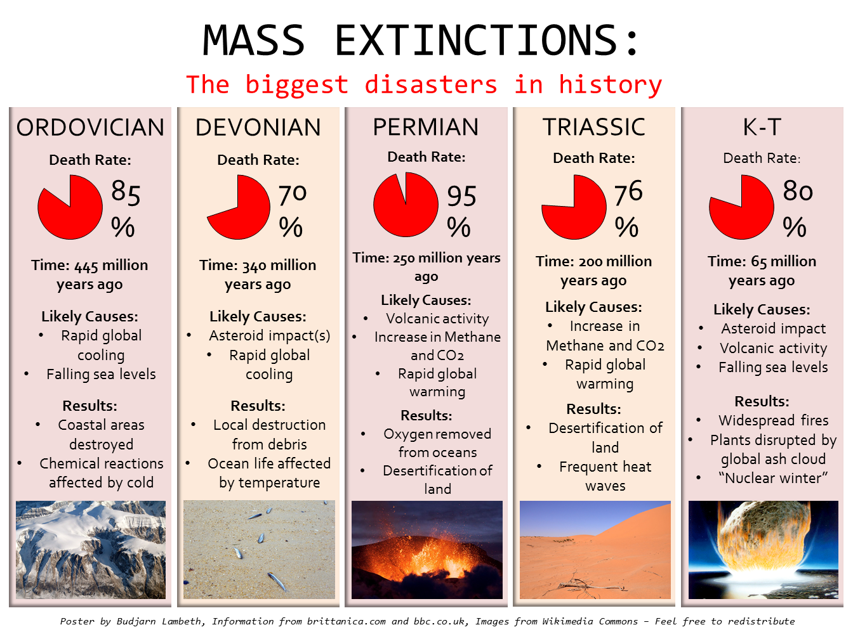

Slide 45
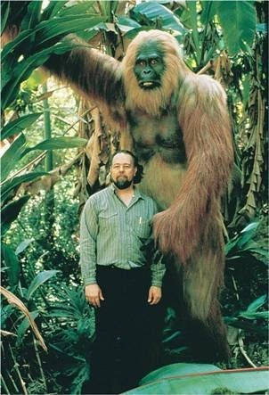
Some Extinct Animals
The largest species of ape ever to have existed. This beast could be up to 10 feet tall.

Slide 46
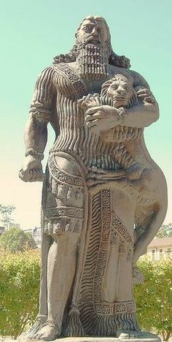
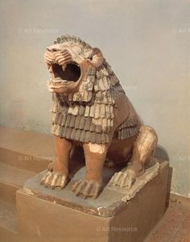
The extinct Iraqi lion
It is a descendant of the rare Asiatic lions, previously this lion was completely inhabited by Mesopotamia and appears abundantly in Assyrian and Babylonian murals. The last known lion in Iraq was killed on the lower Tigris in 1918.

Slide 47
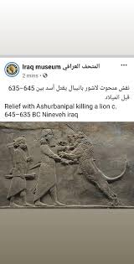
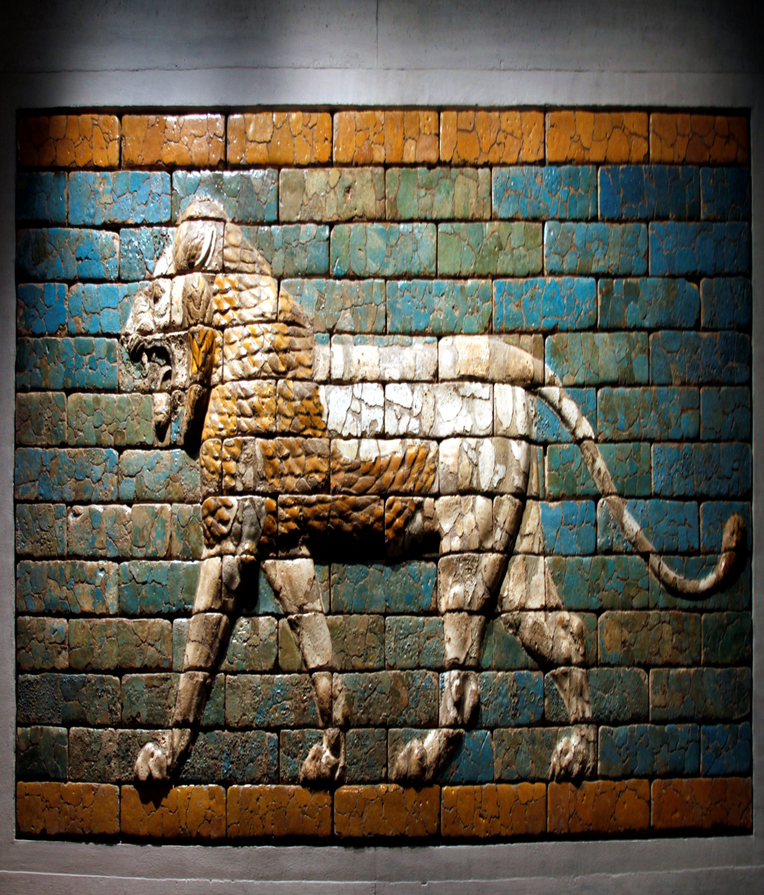
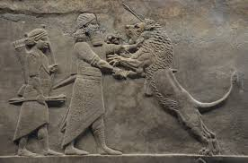
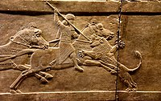
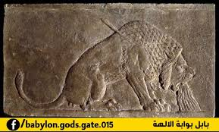

Slide 48
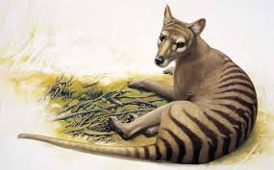
Tasmanian Tiger
The Tasmanian Tiger was a large carnivorous marsupial. Not related to tigers, the creature had the appearance of a medium-to-large-size dog (it weighed 30kg with a nose to tail length of almost 2 meters) but dark stripes gave it a tiger-like appearance. The last known thylacine to be killed in the wild was shot in 1930 by Wilf Batty, a farmer from Mawbanna in the state's northwest.

Slide 49
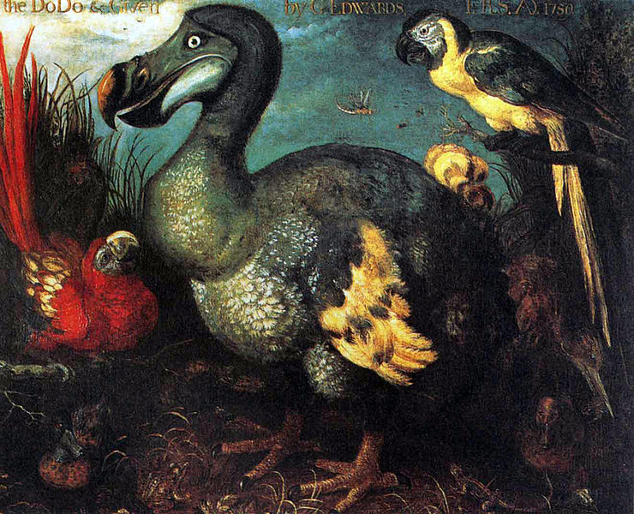
Dodo bird
An extinct flightless bird that inhabited ,the Dodo was about one meter tall and may have weighed 10–18 kg. The dodo was extinct by 1681.
The dodo is frequently cited as one of the most well-known examples of human-induced extinction

Slide 50
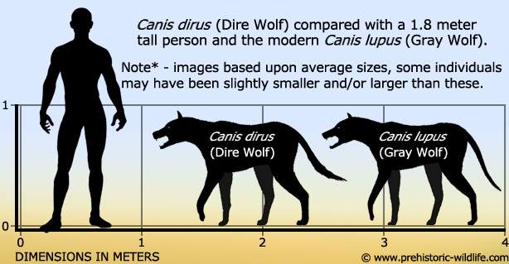

Slide 51
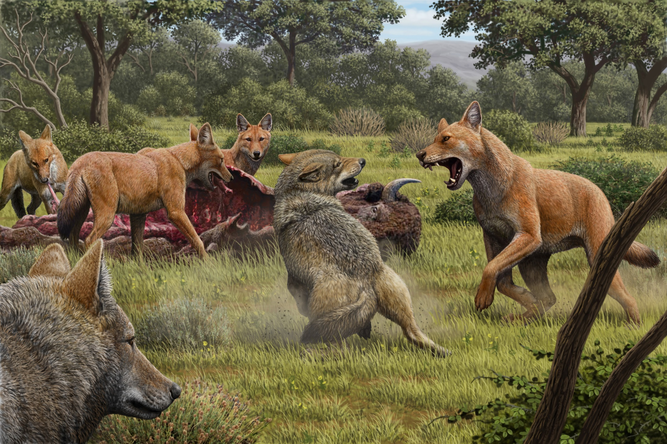
Dire wolves died out around 13,000 years ago

Slide 52
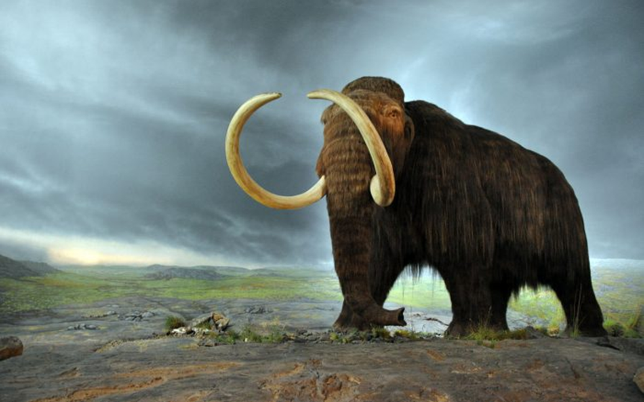
Woolly Mammoth
The Woolly Mammoth eventually disappeared 10,000 years ago through a combination of hunting by humans and the disappearance of its habitat through climate change.

Slide 53
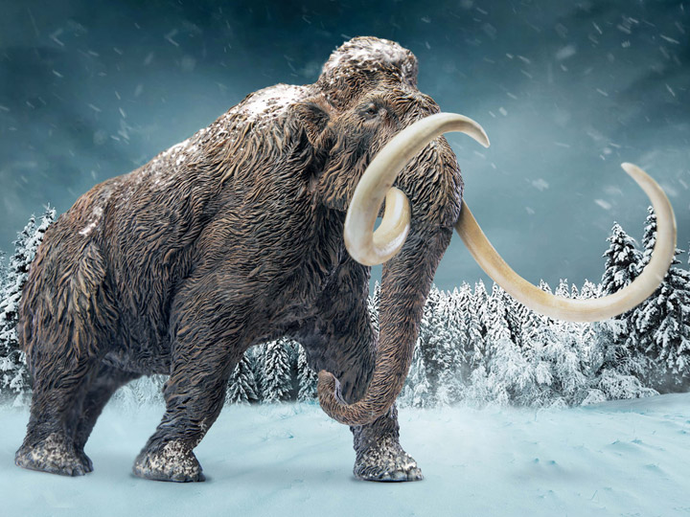

The wooly mammoth.

Slide 54

Sabre-toothed Cat
Often called Sabre-toothed Tigers or Sabre-toothed Lions, they existed 55 million years ago. Sabre-tooth Cats were carnivores, almost twice as wide as a modern lion! It is believed the Sabre-tooth Cat’s extinction may be linked to the decline and extinction of the large herbivores they hunted. Other explanations include climate change and competition with humans.

Slide 55

Dinosaurs
Dinosaurs are a diverse group of reptiles of the clade Dinosauria. They first appeared during the Triassic period, between 243 and 233.23 million years

Slide 56


Slide 57


Slide 58


