Slide 1
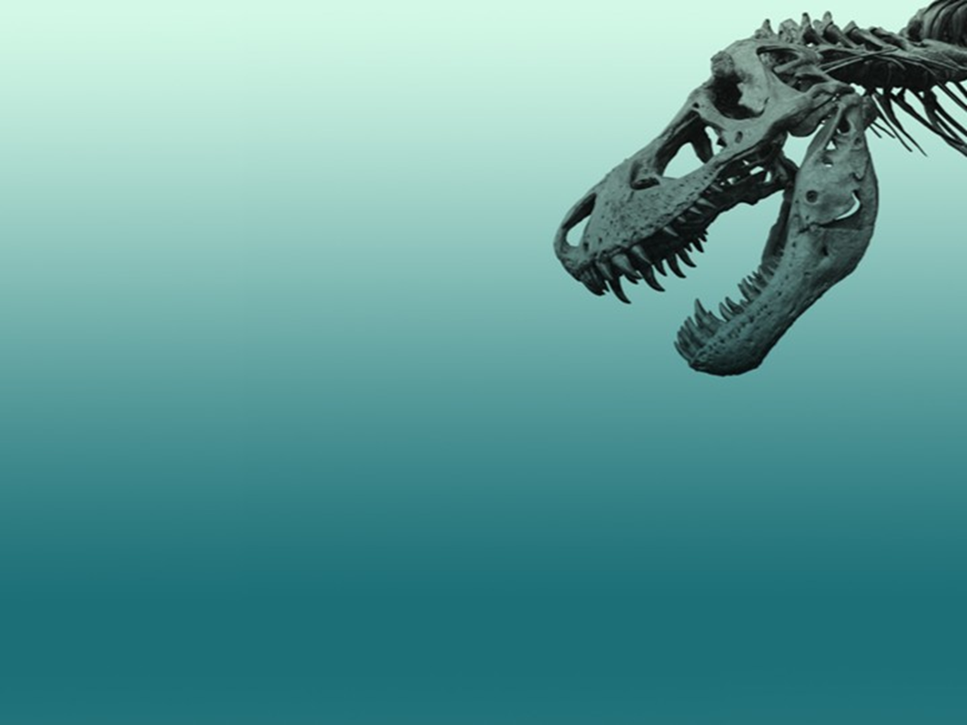
The fossil Record
Evolution Lectures
Lecture No.3
By
Dr.Bushra MA Mohammed
Notes:
Evolution Lectures

Slide 2
The fossil record is made up of all the fossils ever discovered on Earth, A paleontologist is a scientists who studies fossils. All the information that paleontologists have gathered about past life is called the fossil record.
What is a fossil ?
Fossils are the preserved remains, or traces of remains, of ancient organisms.
A fossil can preserve an entire organism or just part of one. Bones, shells, feathers, and leaves can all become fossils.
What do fossils tell us?
Fossils give clues about organisms that lived long ago.
Fossils are evidence of not only when and where organisms once lived, but also how they lived.
They also provide evidence about how Earth’s surface has changed over time.
Fossils help scientists understand what past environments may have been like.
Fossils also show how animals changed over time and how they are related to one another.

Slide 3
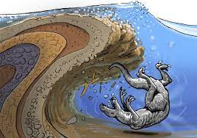
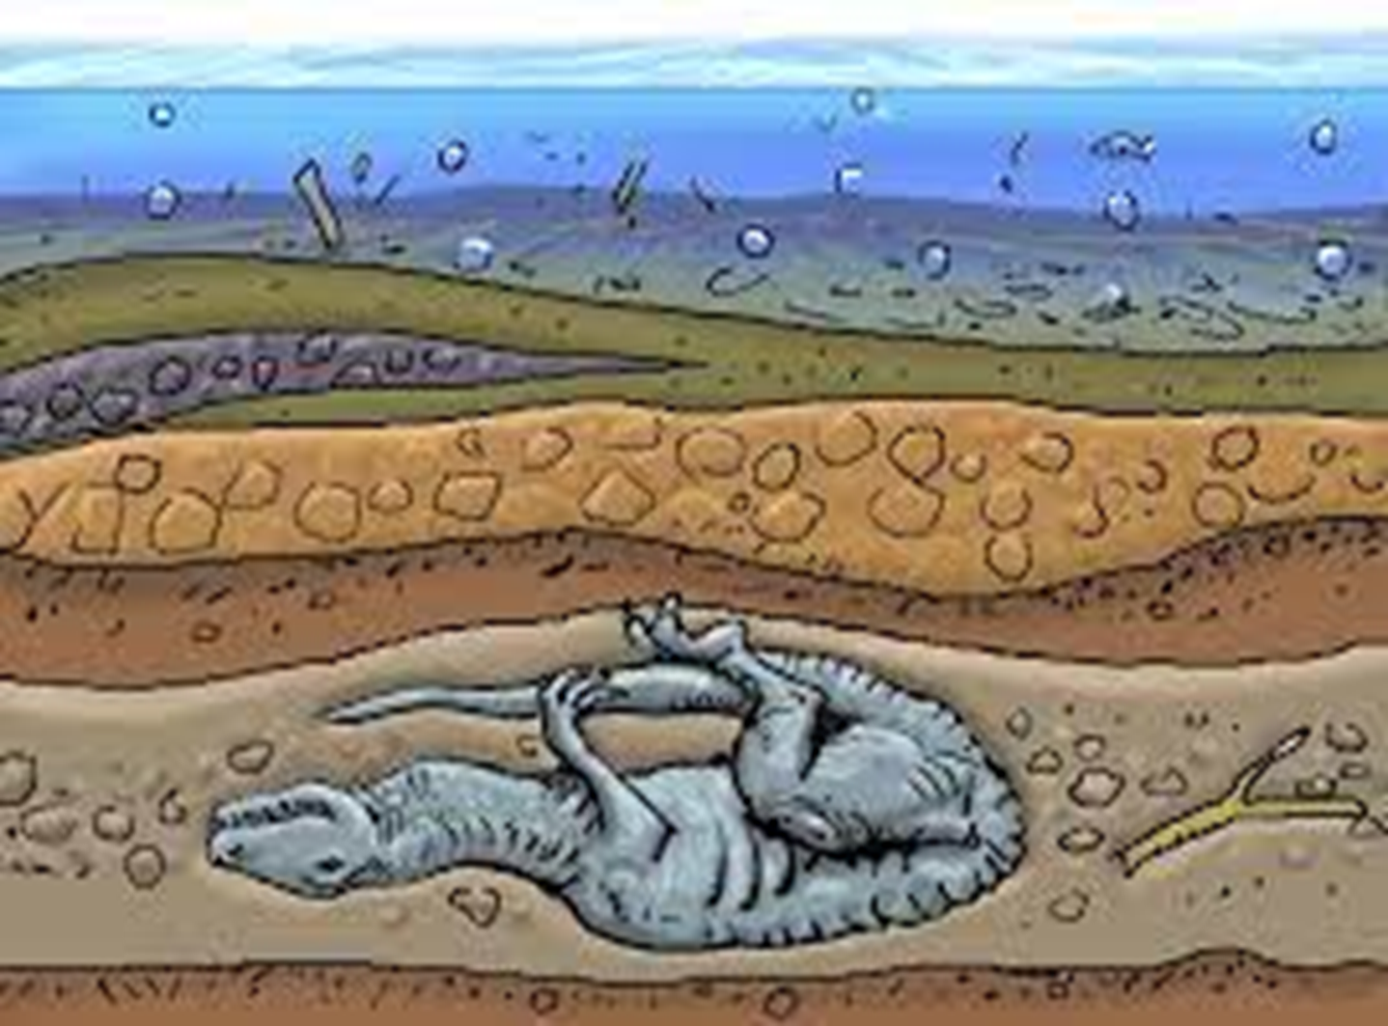
Fossil Formation
For an organism to be preserved, it must be in an environment free of oxidation and bacterial decay.
The organism must be quickly buried by sediment and must be shielded from oxygen When some animals died quick death (e.g., volcano eruption), their bodies can be encapsulated in stone/dirt and become a fossil .
Environments that are covered by water are more likely to preserve organisms
Ex: Swamps, deep lakes, tar pits, oceans

Slide 4
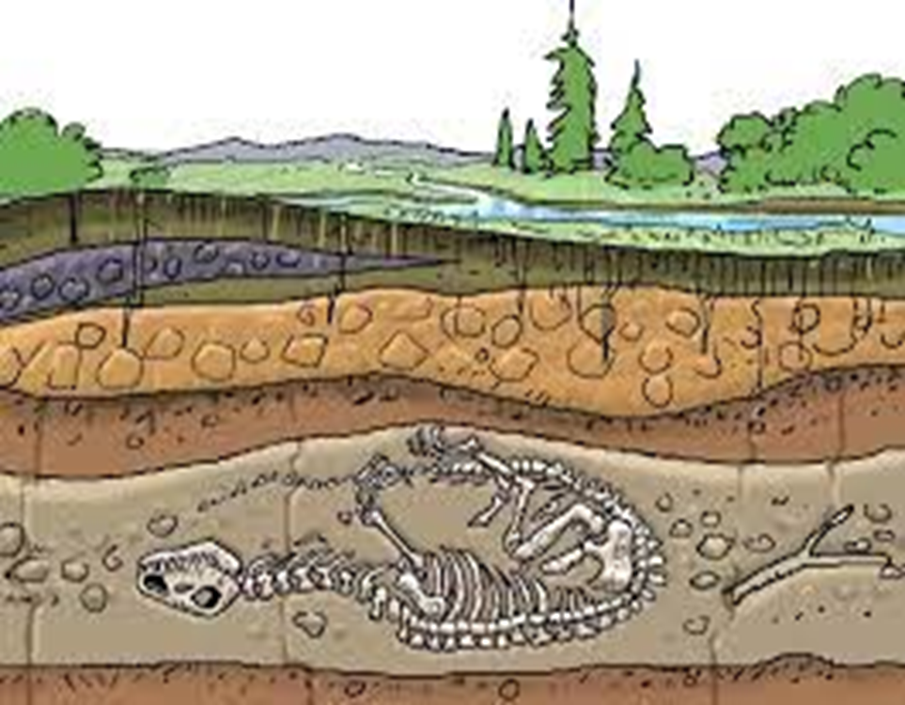
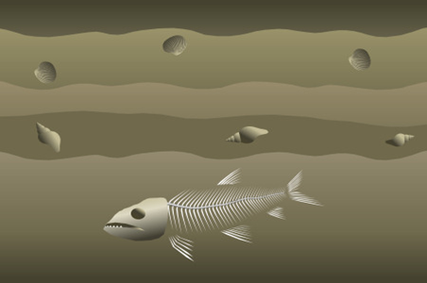
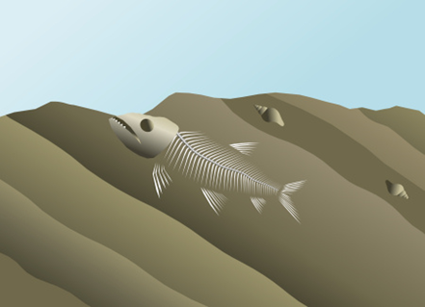
When an organism dies, its soft parts often decay or are eaten by animals.This is why only hard parts leave fossils.
Ex: bones, shells, seeds, stems
Sediments cover over the organism remains
The sediment becomes rock, preserving parts of the organism.
As the sediment hardens, minerals take place of any holes left by the skeleton as it dissolves. The result is a mineralized copy of the original organism
Weathering and erosion eventually expose the fossil at the surface.

Slide 5
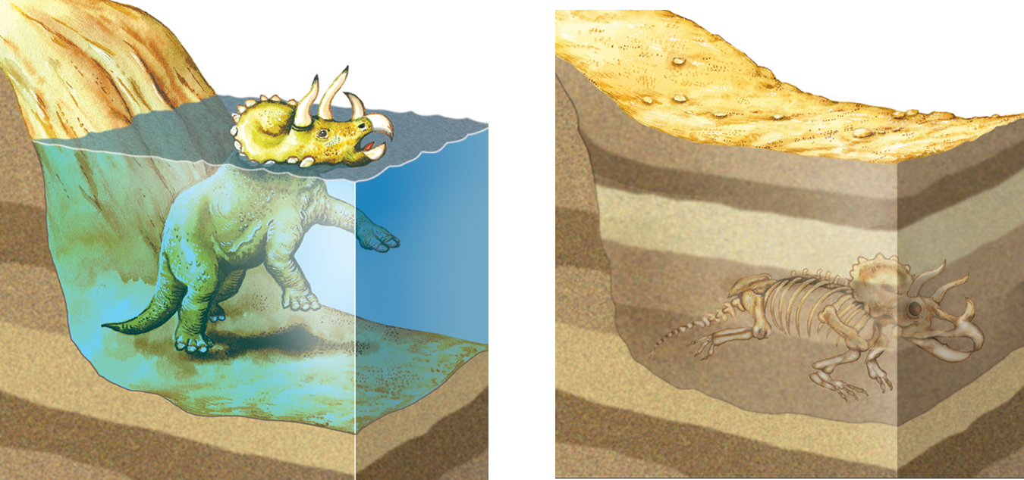
How long does the fossilization process take?
Fossils are defined as the remains or traces of organisms that died more than 10,000 years ago, therefore, by definition the minimum time it takes to make a fossil is 10,000 years.

Slide 6
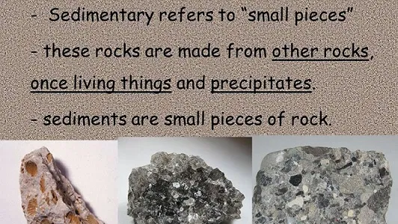
Sedimentary rocks are types of rock that are formed by the accumulation or deposition of mineral or organic particles at the Earth's surface, followed by cementation. Sedimentary rocks form when sediments (sand, silt, mud) are hardened into stone as the environment changed in response to changes in climate or geography.

Slide 7
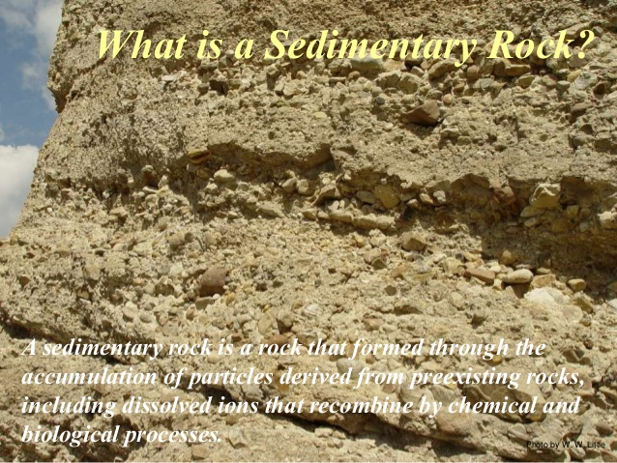

Slide 8
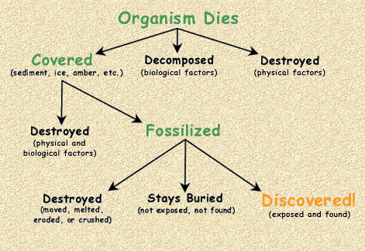
process of fossilization

Slide 9
What are the 5 types of fossilization?
Scientists categorize fossils into four main groups –
1-Impression fossils or Mold fossil
2-Trace fossils.
3-Replacement fossils or Petrified Fossils
A-Mineralization
B- Recrystalization
4- Carbonization fossils
5-True form fossils
A-Frozen remains
B-Preservation in amber or tar

Slide 10
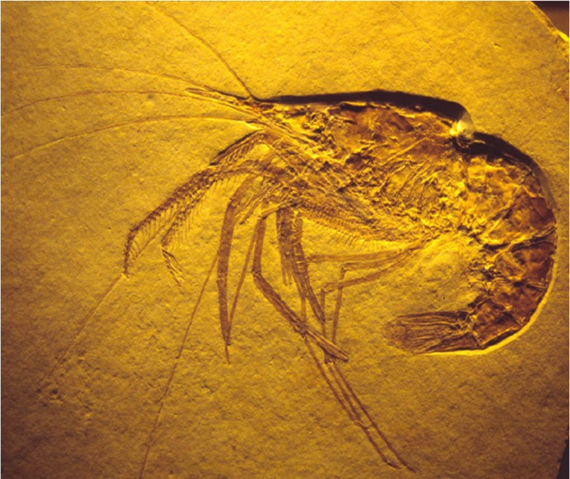
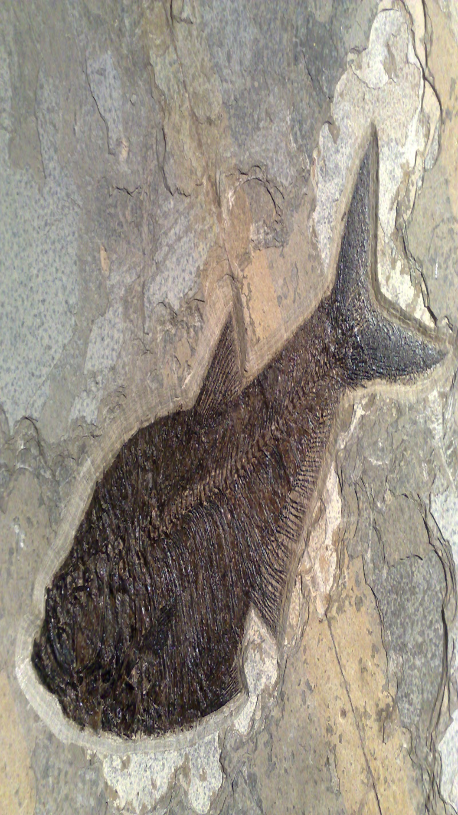
1-Impression fossils or Mold fossils:
Impression fossils form when a leaf, shell, skin, or foot. When the imprint hardens, it forms a fossil in the shape of the original object.

Slide 11
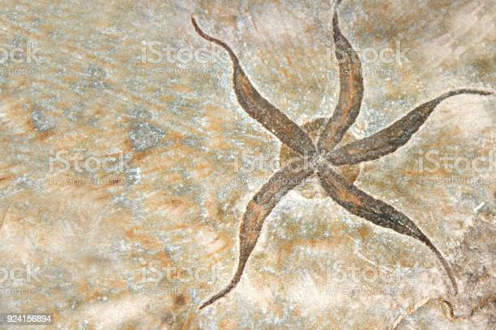
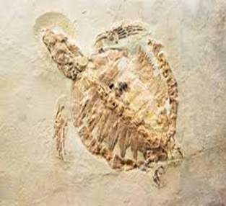
Impression fossils

Slide 12
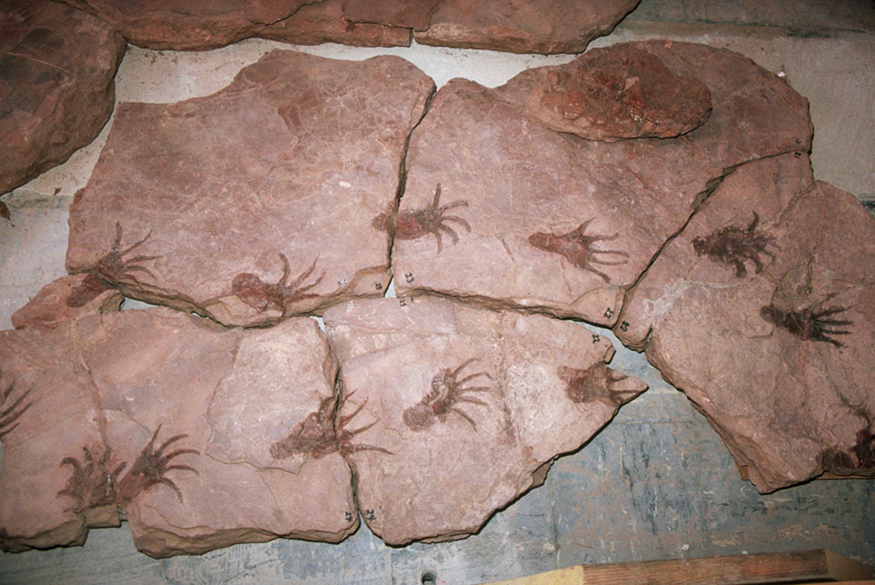
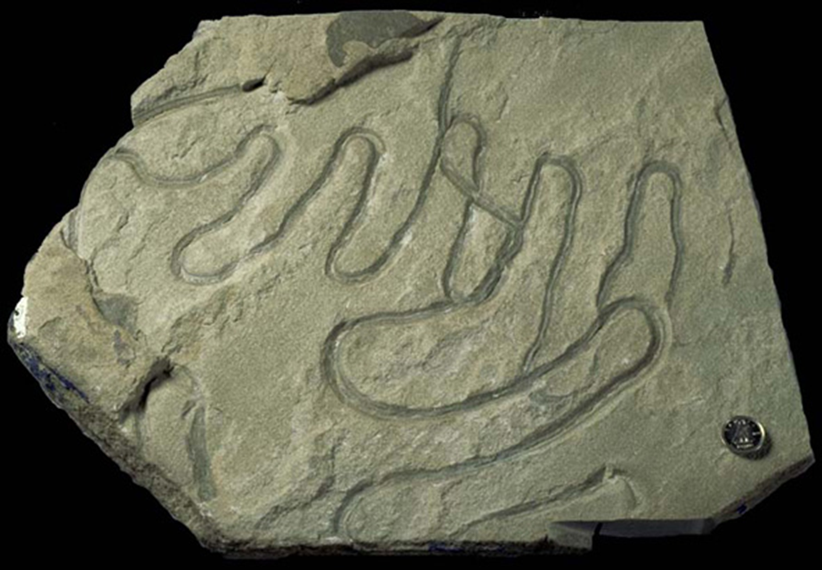
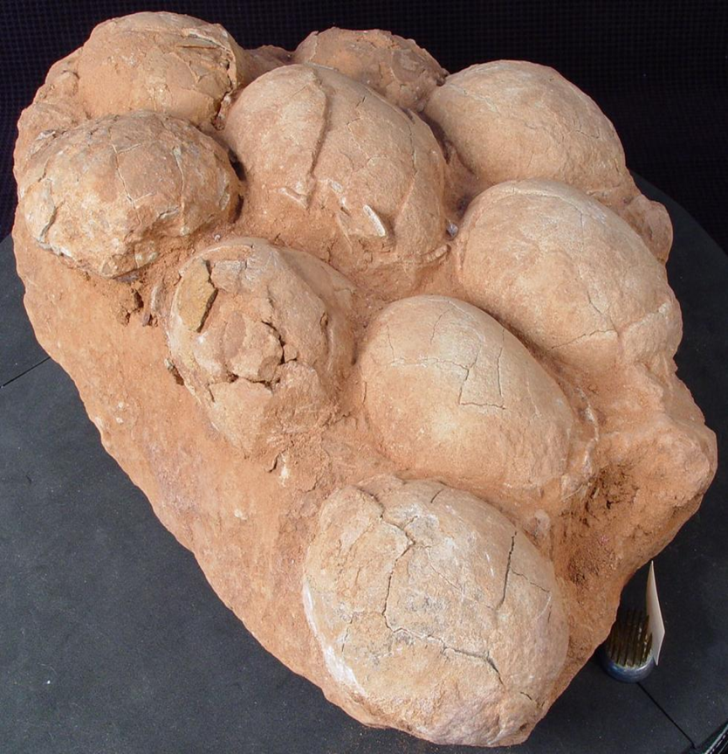
2-Trace fossils,
Are geological records of the activities and behaviors of past life. Some examples include rock evidence of nests, burrows and footprints.
footprints
nests
Foot print
burrows
Notes:
Foot print

Slide 13
3-Replacement fossils or Petrified Fossils
Different, secondary material replaces the original material shortly following the death of the organism.
A-Mineralization
Inorganic material replace organic material, fossils in which minerals replace all or part of an organism,Water rich in dissolved minerals seep into spaces of the organism.
Over time, the minerals come out of the solution and harden filling in all the spaces. This causes the organism to be preserved.
B-Recrystalization
Recrystallization involves a change in crystal structure of the hard parts of organisms , but not a change in mineral chemistry.
For example, Some shells are made of layers of calcite and aragonite. The small crystals of calcite in shells may recrystallize into larger calcite crystals. The overall shape of the shell may remain, a more geologically stable form of the same chemical

Slide 14
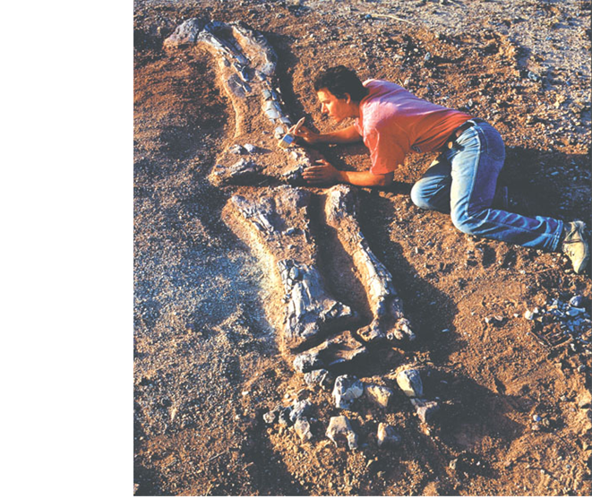
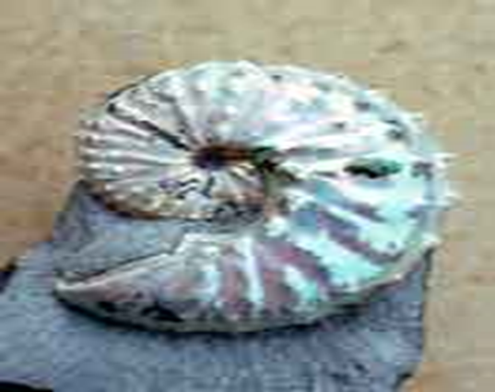
Mineralization

Slide 15
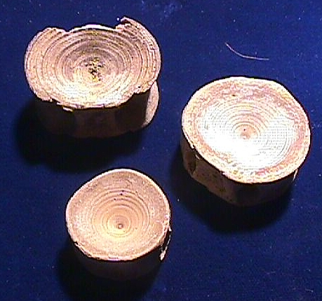
Replacement: Phosphatization
(replacement by calcium phosphate minerals)
shark vertebrae
(originally cartilage (organic), now phosphatic)

Slide 16
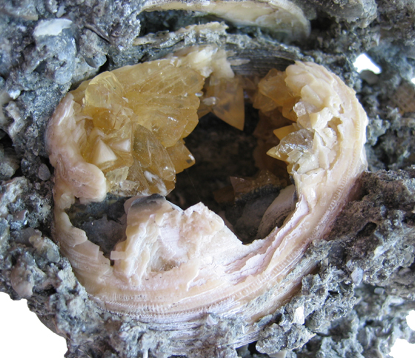
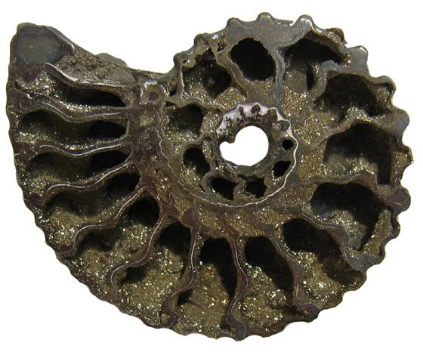
B-Recrystalization
Some shells are made of layers of calcite and aragonite.
The small crystals of calcite in shells may recrystallize into larger calcite crystals. The overall shape of the shell may remain.

Slide 17
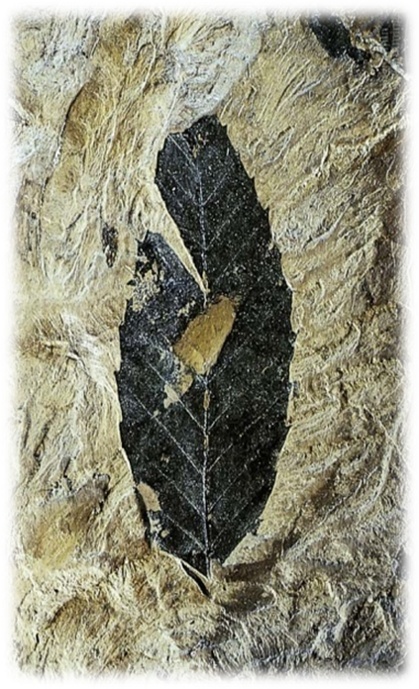
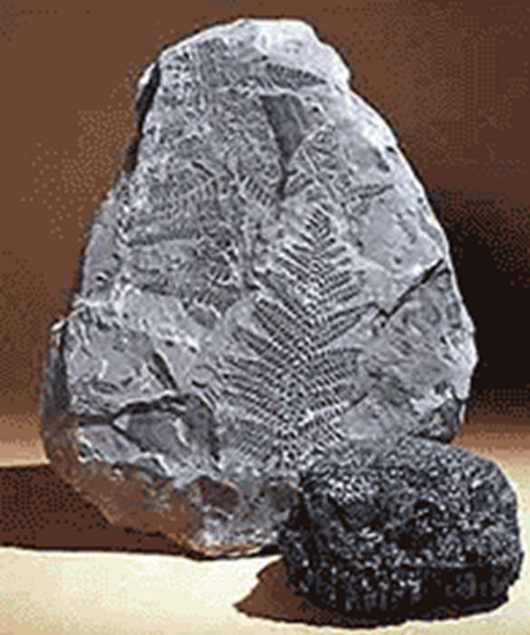
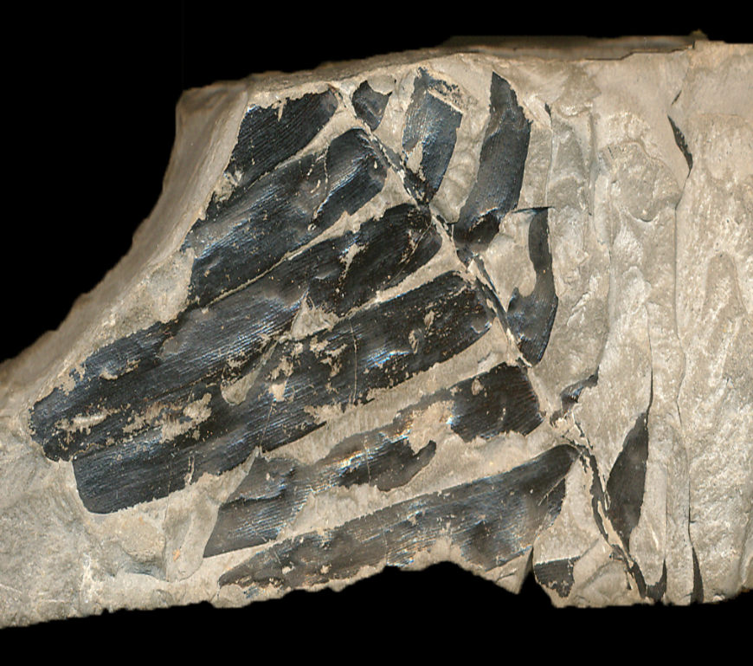
4—Carbonization fossils
Carbonization is the process where only the residual carbon of the organism remains.
A very common example of carbonization are fossil plants, where only a thin carbon layer is left on a piece of shale.
They are most often black in color, reflecting the fact that they composed mostly of carbon (as is coal, which is also black in color )

Slide 18
What are the 5 types of fossilization?
Scientists categorize fossils into five main groups –
1-Impression fossils or Mold fossil
2-Trace fossils,
3-Replacement fossils.
A-Mineralization
B- Recrystalization
4- Carbonization fossils
5-True form fossils
A-Frozen remains
B-Preservation in amber or tar

Slide 19
5-True form fossils
True form fossils are formed when animals or plants are trapped within ice, tree sap, or tar, and remain there for years, keeping their original features intact. The hard parts do not decay for years, and remain as they were when fossilized.
A-Frozen remains
Fossils with this type of preservation have been found frozen in ancient permafrost in Siberia.
Unlike all other types of preservation, frozen remains allow direct study of the actual soft tissues and sometimes organs that made up an animal’s body. Further, hair commonly covers the bodies of these frozen remains, telling us what color the animals were they were alive.
Many different kinds of frozen extinct animals have been found in Siberia. , including woolly mammoths and rhinoceras, horses, and bison.

Slide 20
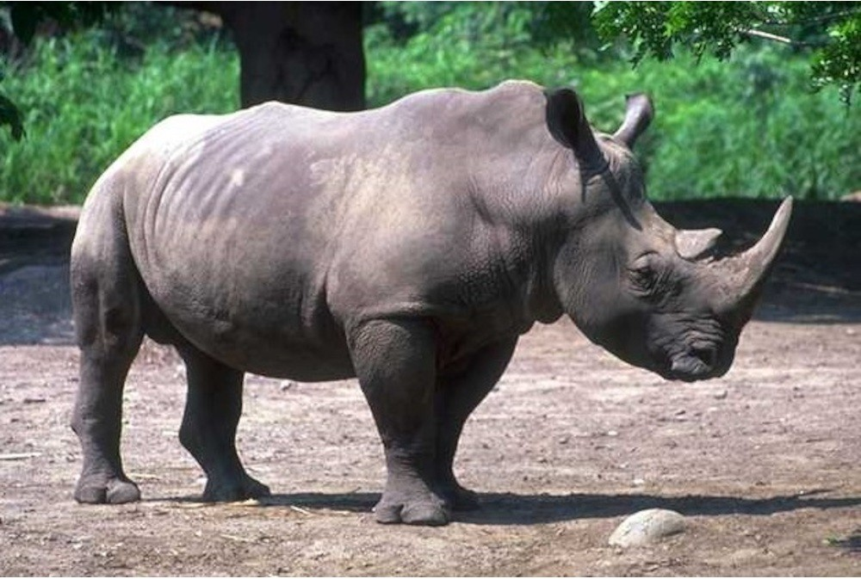
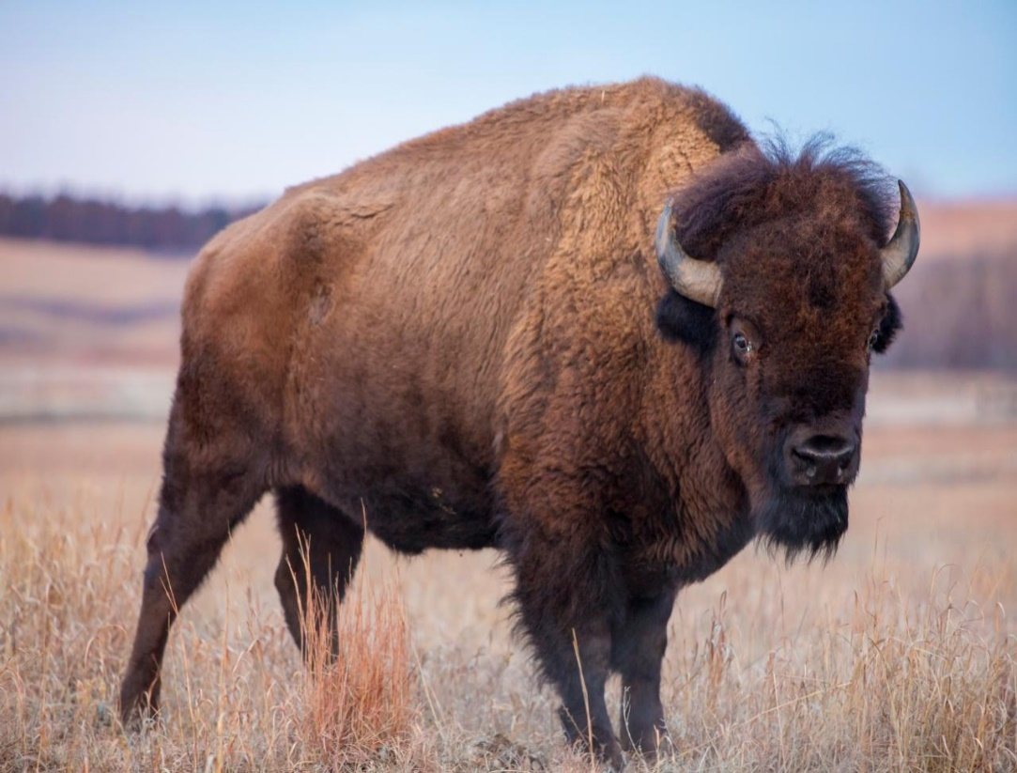
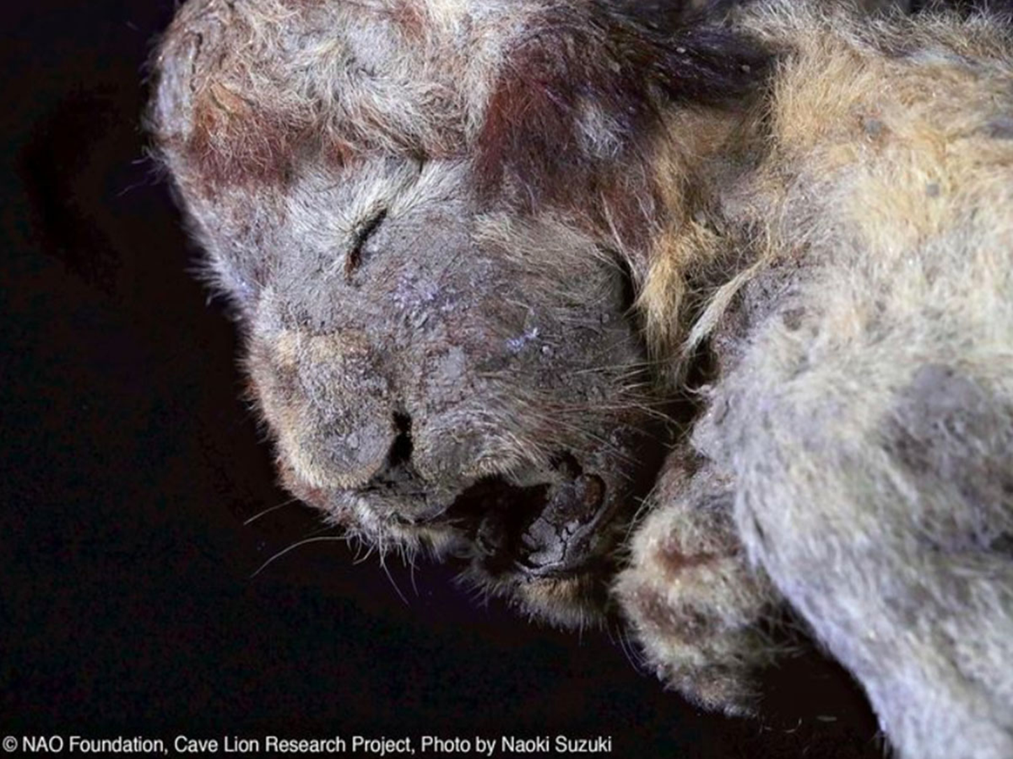
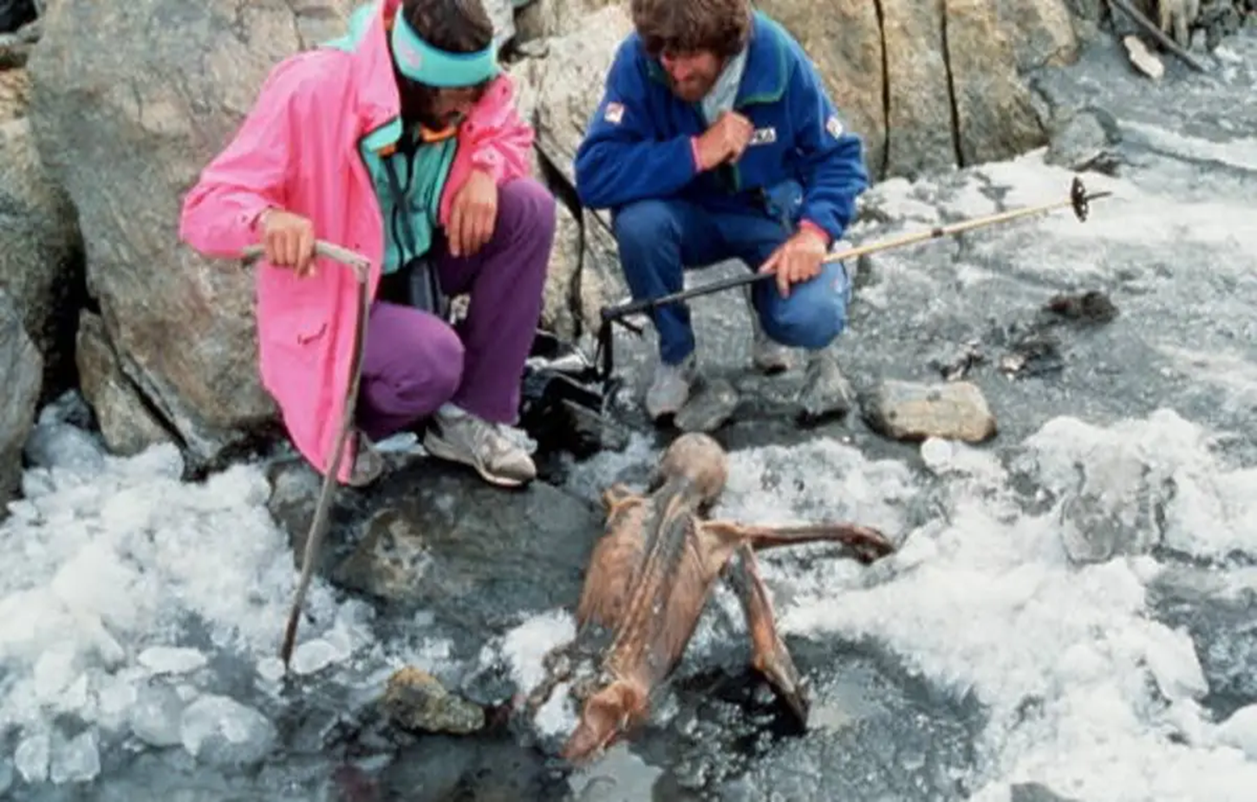
Rhinoceras
bison
30,000-year-old 'cave lion' found in Siberian

Slide 21
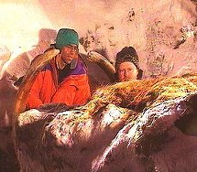
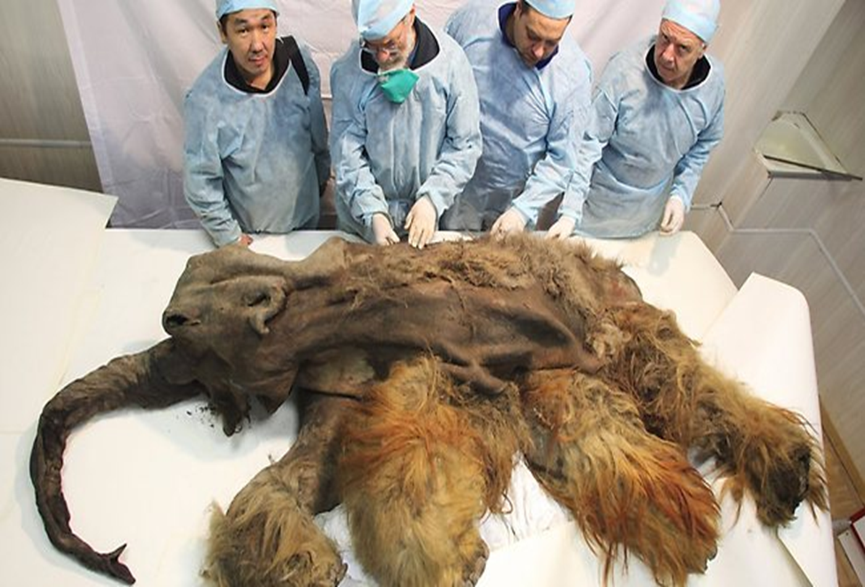
Unaltered/Actual or true Remains
Soft Tissue Preservation: Refrigeration
20,000 year old Siberian Wooly Mammoth preserving the original hair and flesh. The flesh is so well preserved that it is still edible, and has apparently been served to various people on several occasions in the last century.This is certainly a highly exceptional case of unaltered preservation!

Slide 22
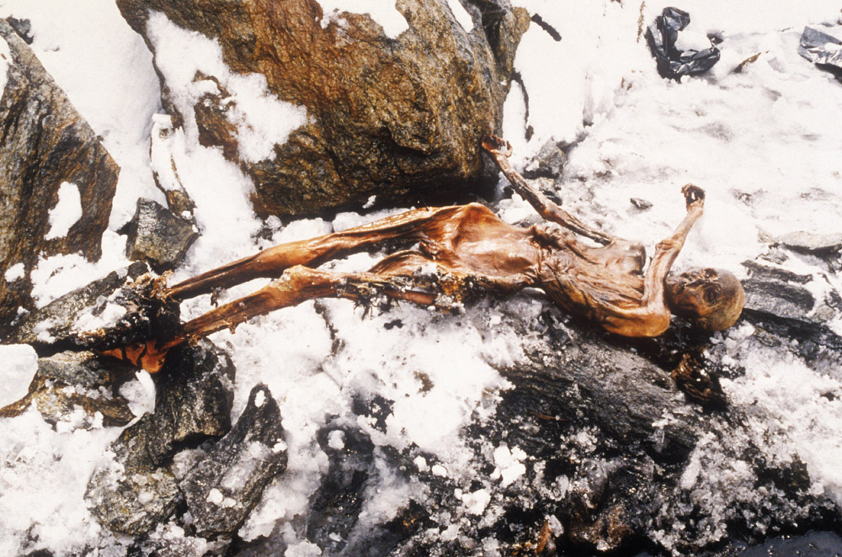
Preserved remains form when an entire organism becomes encased in material such as ice. Mexico search team finds 2nd frozen body near volcano's summit

Slide 23
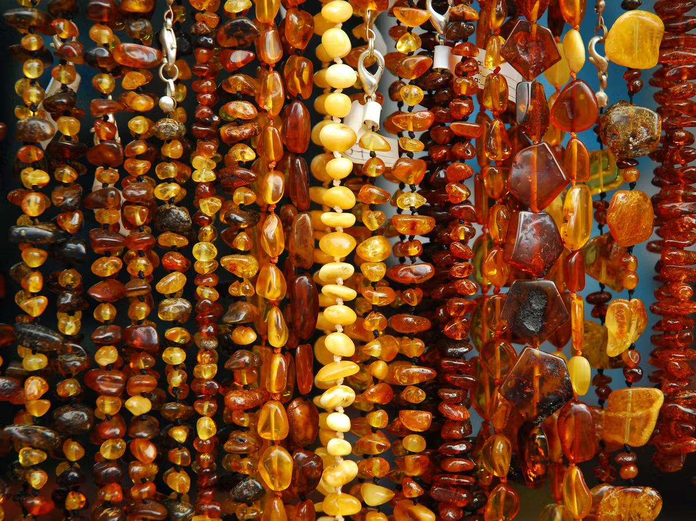
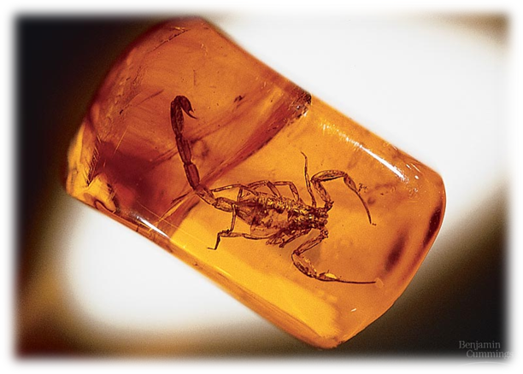
B-Preservation in amber الكهرب
Amber is a yellow- or orange-colored semi-precious stone and is frequently used in jewelry. Many people do not realize, however, that amber is fossilized, hardened tree resin.
amber tree resin jewelry

Slide 24
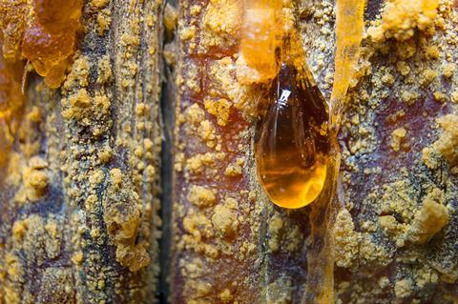
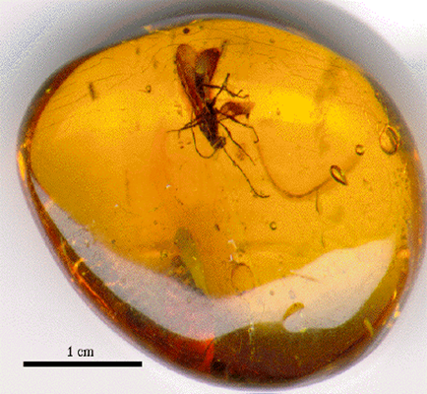
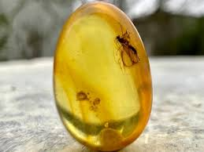
fossilization in amber

Slide 25
C-Trapped in tar
The key thing about preservation in tar or amber is lack of oxygen. Oxygen is a very active chemical and it will break down organic materials.
So when the large mammals fell into amber or the tar pits and sank, they were located in an environment that lacked oxygen.
In La Brea Tar Pits research found huge, extinct mammals such as saber-toothed cats, dire wolves, and mammoths, as well as “microfossils”—the tiny remains of plants and animals that can give us clues about past and present climate change.
they were preserved between 50,000 years ago

Slide 26
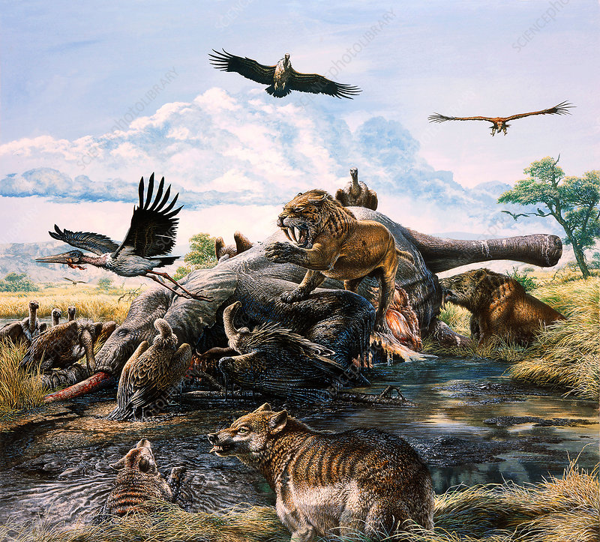
La Brea Tar Pits

Slide 27
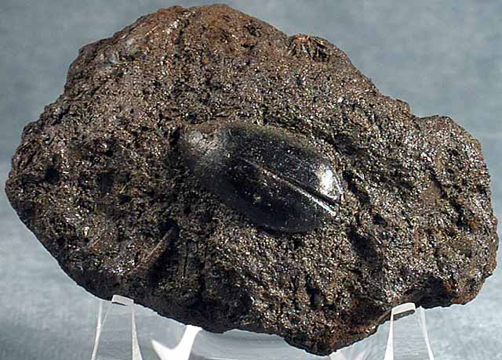
Unaltered/Actual Remains
Soft Tissue Preservation: Tar Immersion/Impregnation
Beetle encased in solidified tar

Slide 28
To understand how living things have changed through time, scientists need to be able to determine the age of the fossil. Scientists can determine fossils age in two ways:
Relative dating
2. Radioactive dating
The fossil record provides information about species that are __Extinct__ (or have died out).

Slide 29
1-Relative Dating
Sedimentary rock is laid down in layers or strata the deepest usually being the oldest
Shows what organisms lived together.
Scientists look at where fossils are located within the rock column.
Use the Law of Superposition
However, due to earth movements in the past and to the great time spans and migrations of some organisms, this method is not very accurate.
Shows the order in which fossils occurred- does not give exact ages.

Slide 30
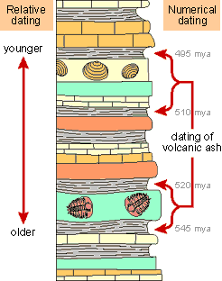
Relative dating - It determines which of the two fossils is older.
The Exact age cannot be determined;
you can
only say that something appears earlier or later
than something else.
Youngest fossil
Oldest Fossil

Slide 31
2-Radioactive dating:
Scientists determine the actual age of a sample based in the amount of remaining radioactive isotopes it contains. Radioactive parent elements decay to stable daughter elements.
Radioactivity decay to measures the age of rocks and minerals.
Calculations are based on half-life – the time it takes
for ½ of the radioactive sample to decay
Two vocabulary terms associated with radioactive dating are:
Half-life – the time it takes for half of the atoms in a radioactive element to decay.
Radioactive element – An unstable element that breaks down into a different element. These elements are used in nuclear fission to produce energy that we use in electricity.
Naturally-occurring radioactive materials break down into other materials at known rates. This is known as radioactive decay.
Radioactive parent elements decay to stable daughter elements.
Two types of Radioactive dating--
A-Carbon-14 (radiocarbon)
B- Potassium-Argon

Slide 32
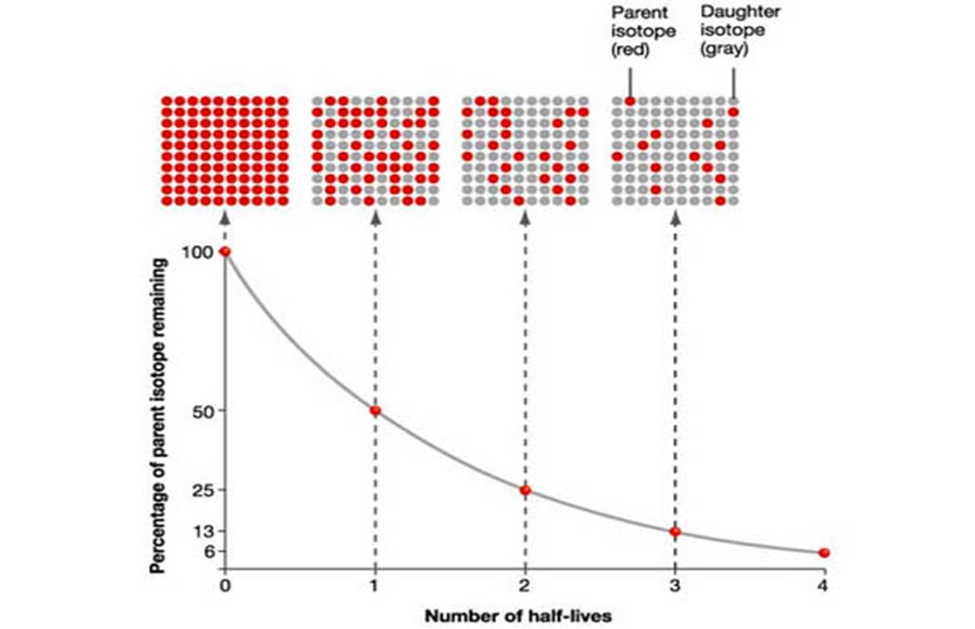
Radioactive decay is the process by which a radioactive isotope changes into a new stable element. the rate at which a radioactive element decays. It is the time it takes for half of the atoms of the radioactive element to decay to a stable END PRODUCT

Slide 33

A-Carbon-14 and ¹⁴C dating
All living things are mostly made of carbon.
A small portion of this carbon is in the form of Carbon-14, an unstable radioactive isotope.
Carbon-14 (14-C) decays to form nitrogen-14
Carbon-14 has a half-life of 5,730 ± 40 years
Carbon-14 is formed in the upper atmosphere by the action of cosmic rays on Nitrogen-14
14-C is oxidised to 14-CO₂ that gets taken up by plants in photosynthesis. The 14-C becomes incorporated in living tissue and travels up the food chain.
Humans in turn take ¹⁴C into their bodies by eating both plants and animals
At death, no more is taken in, and so the amount declines as the 14-C decays back to 14-N
After an additional 5,730 years–or 11,460 years total–only a quarter of the 14C remains.
Problem:
most of mankind’s evolution occurred prior to 50,000 years ago
Death starts the clock!

Slide 34
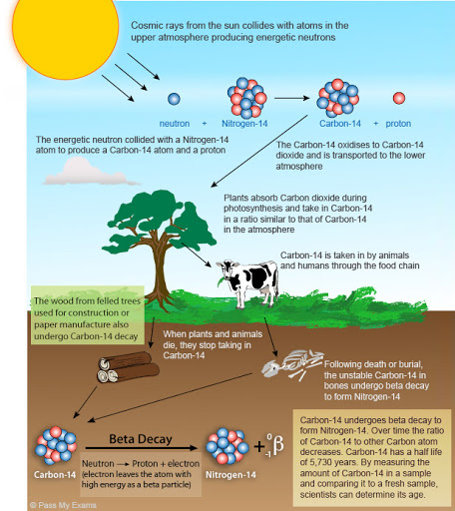

Slide 35
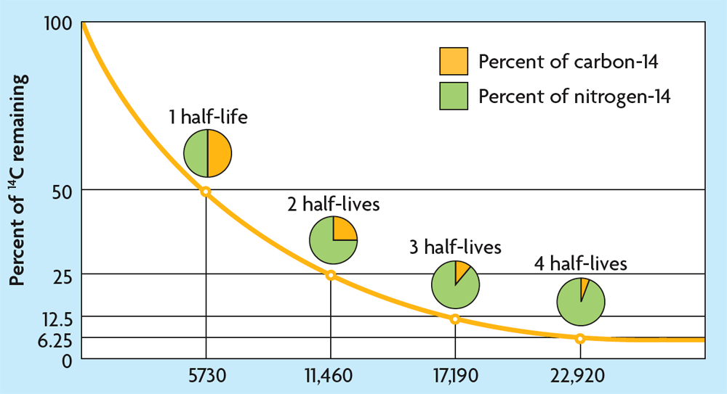
A half-life is the amount of time it takes for half of the isotope to decay.

Slide 36
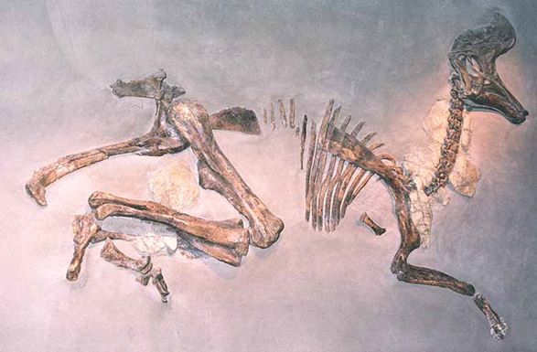
Why can't we use carbon 14 on dinosaur remains?
due to the short half-life of radiocarbon .The half-life of carbon-14 is only 5,730 years, so carbon-14 dating is only effective on samples that are less than 50,000 years old.
so to determine the ages of dinosaurs, scientists need an isotope with a very long half-life. Dinosaurs age is more than millions of years ago .

Slide 37
B-Potassium-Argon Dating
(K-Ar dating)
Potassium-argon dating, method of determining the time of origin of rocks by measuring the ratio of radioactive argon to radioactive potassium in the rock. This dating method is based upon the decay of radioactive potassium-40 to radioactive argon-40 in minerals and rocks.
Potassium-argon dating is accurate from 4.3 billion years (the age of the Earth) to about 100,000 years before the present.
At 100,000 years, only 0.0053% of the potassium-40 in a rock would have decayed to argon-40,

Slide 38
Scientists determine the age of the rock surrounding the fossil to determine the fossil’s age.
Used only for inorganic substances (rocks and minerals)
Scientists measure the amount of argon in the rock to determine its age
If fossil sandwiched between volcanic deposits, K-Ar dating provides minimum and maximum age
The resolution of the K-Ar technique is not a fine as radio carbon –why ?

Slide 39
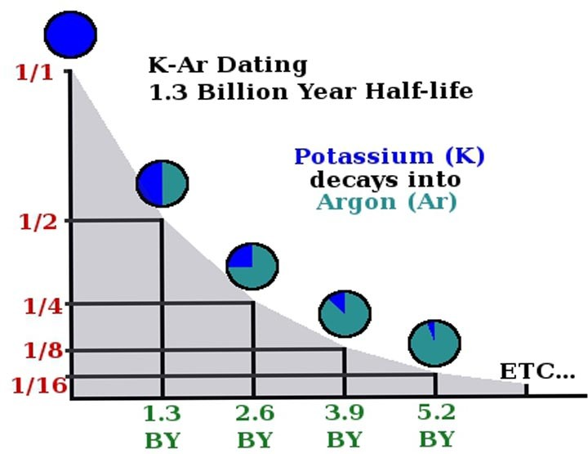
The ratio of radioactive argon to radioactive potassium in the rock.

Slide 40
