Slide 1


What is Life?
When, Where and How did life originate?
Evolution course/second semester 2024
Lecture no.1
Dr.Bushra MA Mohammed

Slide 2
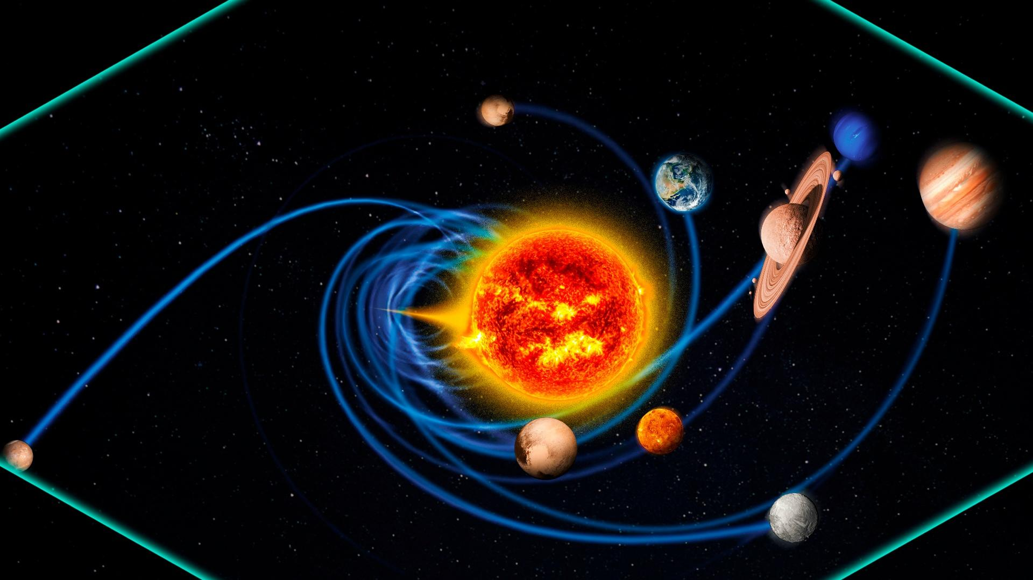
Very deep in history , The Earth and other planets separated from sun then began to be cold and solidified

Slide 3
What is Life?
There is no simple definition of Life, except that life forms are able to act on their own behalf to support their own existence, and to reproduce themselves. Scientists admit they don't even have a good definition of life !
The field of science known as Biology is dedicated to the study of life, its component species, and the variations within species of life forms.
Conditions on the Early Earth
Early stages of formation of Earth; much of the surface is still molten,the earth was very hot, evaporating the liquid water into the atmosphere. As Earth cooled, an atmosphere formed mainly from gases spewed from volcanoes.

Slide 4
It included hydrogen sulfide, methane, and ten to 200 times as much carbon dioxide as today's atmosphere. After about half a billion years, Earth's surface cooled and solidified enough for water to collect on it.
with a solidified surface and as the earth cooled, gravity-trapped water , vapor condensed, fell as rain, and did not boil away but remained impounded in pools that became lakes and oceans.
Their was also many volcanic eruptions at that time.
.

Slide 5
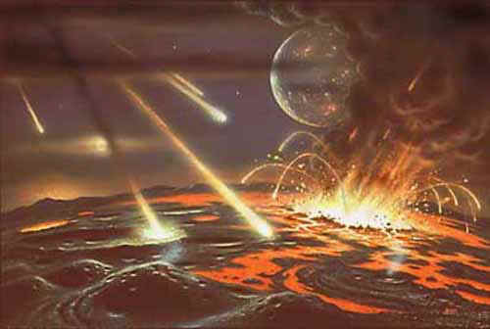
Early stages of formation of Earth; much of the surface is still molten,

Slide 6
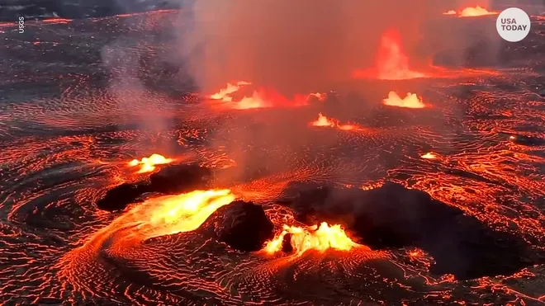
Early stages of formation of Earth; much of the surface is still molten

Slide 7
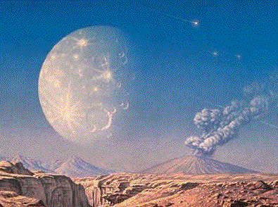
Volcanic eruptions

Slide 8
Ice might have covered the oceans 3 billion years ago, as the sun was about a third less luminous than it is now, scientists say.
This layer of ice, possibly hundreds of feet thick, might have protected fragile organic compounds in the water below from ultraviolet light and destruction from cosmic impacts.
The cold might have also helped these molecules to survive longer, allowing key reactions to happen

Slide 9
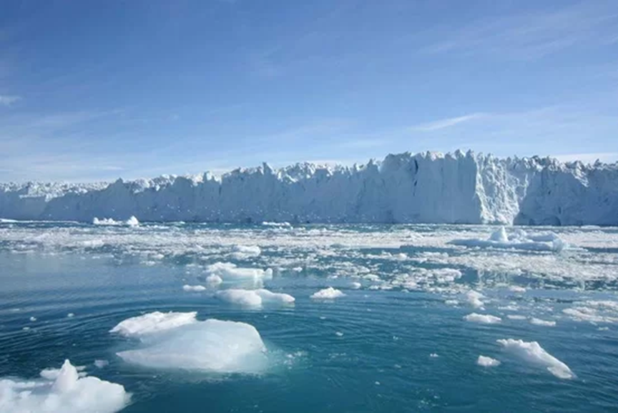

Slide 10
According to evidence from radiometric dating and other sources, Earth formed about 4.54 billion years ago.
Within its first billion years, life appeared in its oceans and began to affect its atmosphere and surface, promoting the proliferation of aerobic as well as anaerobic organisms. Since then, the combination of Earth's distance from the Sun, its physical properties and its geological history have allowed life to emerge, develop photosynthesis, and, later, evolve further and thrive.
The earliest life on Earth arose at least 3.5 billion years ago.

Slide 11
Theories of the Origin of Life

Slide 12
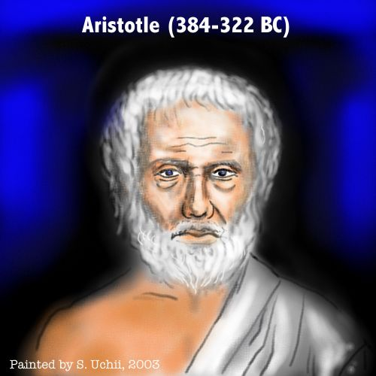
Theories of the Origin of Life: Early Ideas
1-Spontaneous Generation theory (Aristotles 384-322 BC)
Proposed the theory of Spontaneous Generation,
  idea popular in the 1600-1700’s Century
  (living things come from the nonliving)
  Their evidence was that :
  beetles and other insect larvae arise from cow dung;
  frogs emerge from mud.

Slide 13
Disproving Spontaneous Generation
In 1668, Francesco Redi, an Italian physician, did an experiment with flies and wide-mouth jars.
He demonstrated that meat that was covered did not produce maggots
This may have been the first true scientific experiment…
Redi used open & closed flasks which contained meat.
His hypothesis was that rotten meat does not turn into flies.
He observed these flasks to see in which one(s) maggots would develop.

Slide 14
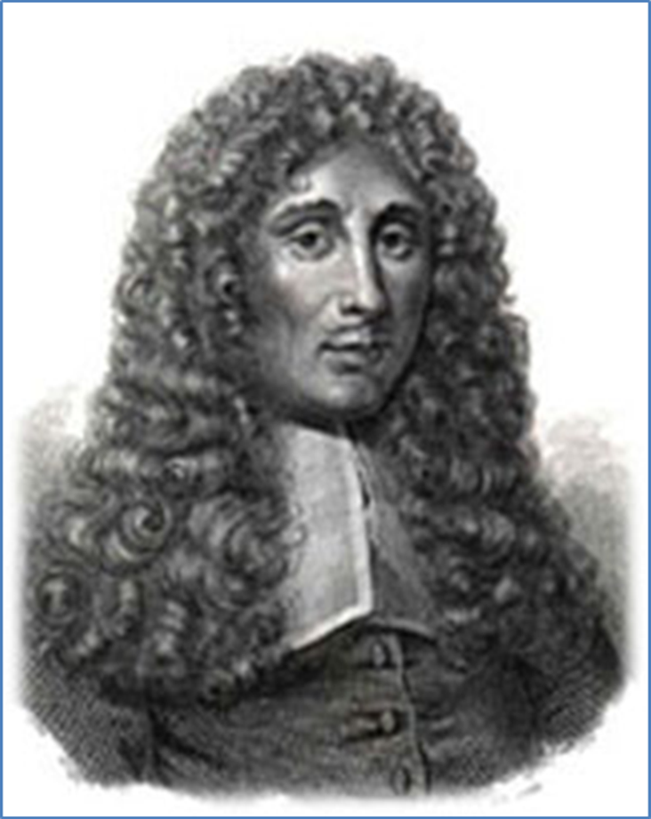
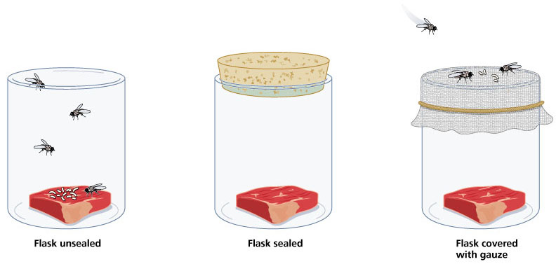
Redi’s (1626-1697) Experiments
1. Unsealed – maggots on meat
2. Sealed – no maggots on meat
3. Gauze – few maggots on gauze, none on meat

Slide 15
He found that if a flask was closed with a lid so adult flies could not get in, no maggots developed on the rotting meat within.
In a flask without a lid, maggots soon were seen in the meat because adult flies had laid eggs and more adult flies soon appeared.
The results of this experiment disproved the idea of spontaneous generation for larger organisms,
but people still thought microscopic organisms like algae or bacteria could arise that way.

Slide 16
Other Ideas:
2-Life from a Religion Creation
The Judaism religion
then Christian Creationism states that the world, including all life, was created in six literal days by God.
Moreover Muslims' Creationism also confirm the same idea .
So …God creates living beings roughly one after another, which is in essence the idea of evolution.

Slide 17
3- The Raelians Theory
This idea suggested that life developed elsewhere in the universe and arrived on Earth in the form of spores.
This is not a theory of how life began, but a theory of how it might have spread.
It may have spread, for example, by meteorites.
For instance, rocks regularly get blasted off Mars by cosmic impacts, and a number of Martian meteorites have been found on Earth that some researchers have controversially suggested brought microbes over here, potentially making us all Martians originally.

Slide 18
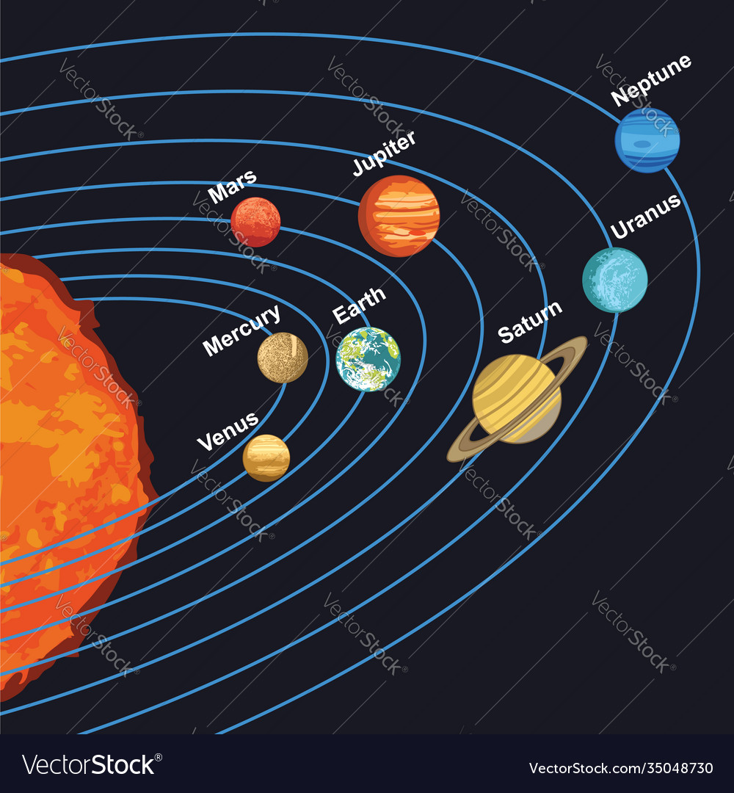

Slide 19
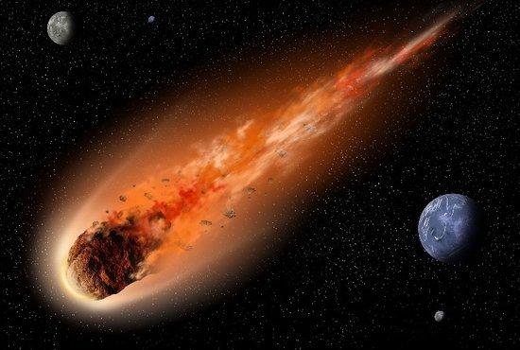
Meteorites

Slide 20
From current astronomical research, we know that meteorites can carry ice and other compounds, including carbon-based compounds.
Other scientists have even suggested that life might have hitchhiked on comets from other star systems.
However, even if this concept were true, the question of how life began on Earth would then only change to how life began elsewhere in space.

Slide 21
4-Chemical Evolution or
Accidental Origin theory
The idea that long ago complex collections of chemicals formed the first cells.
Life began in the oceans .The earliest life on Earth arose at least 3.5 billion years ago from simple chemicals joining together like “soup” then Complex chemicals evolved into living cells

Slide 22
Miller–Urey experiment
In 1950 ,Two American scientists, Stanley Miller and Harold Urey, designed an experiment to simulate conditions on early Earth and observe for the formation of life.
They combined methane, water, ammonia, and hydrogen into a container in the approximate concentrations theorized to have existed on early Earth.
To simulate lightning, they added an electrical spark.
Days later, they examined the “soup” that formed and discovered the presence of several simple amino acids! Although this experimental design probably did not accurately represent early Earth's percent of gaseous combinations,

Slide 23
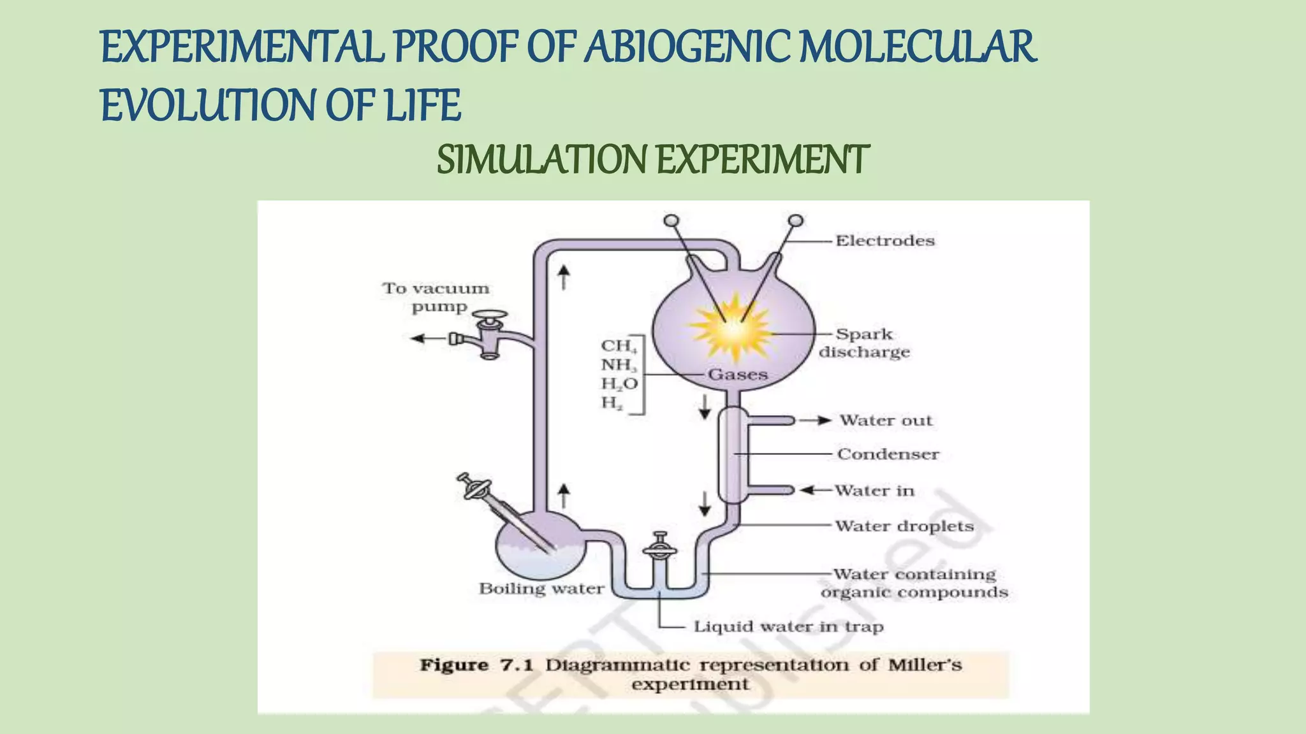
They combined methane, water, ammonia, and hydrogen

Slide 24
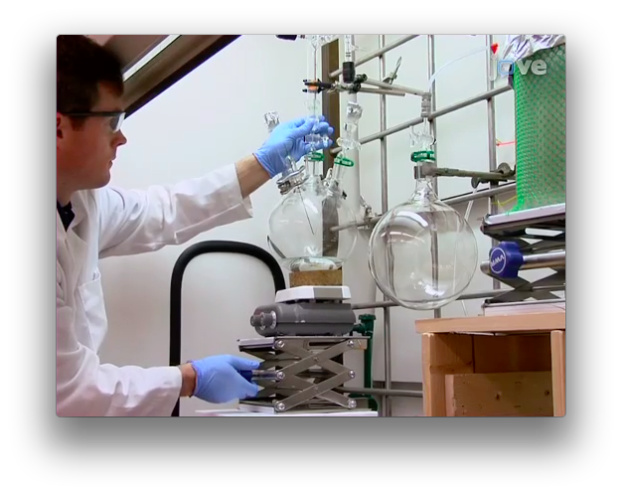
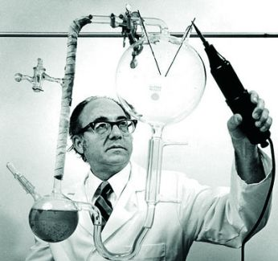
Miller–Urey experiment

Slide 25
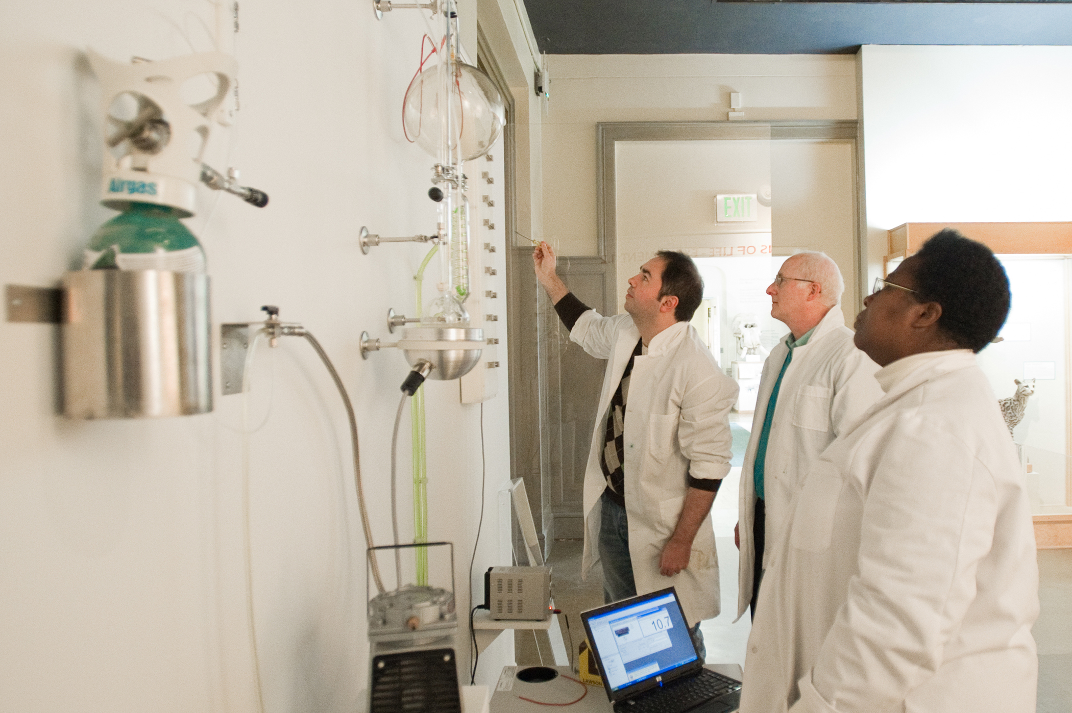

Slide 26
Problems with Miller’s experiment
Miller’s experiment cannot produce enough amino-acids (electrical sparks destroy the amino-acids )
Miller’s (and later) experiment can only create proteins made with up to 30 amino-acids (some proteins have more than 1000 amino-acids )
Proteins made in Miller’s experiment contain both left-handed and right-handed variants of amino-acids (living cells only use left-handed ones)
More over when scientist Change the supposed gazes the result show poising materials like Cyanide and formaldehyde .

Slide 27
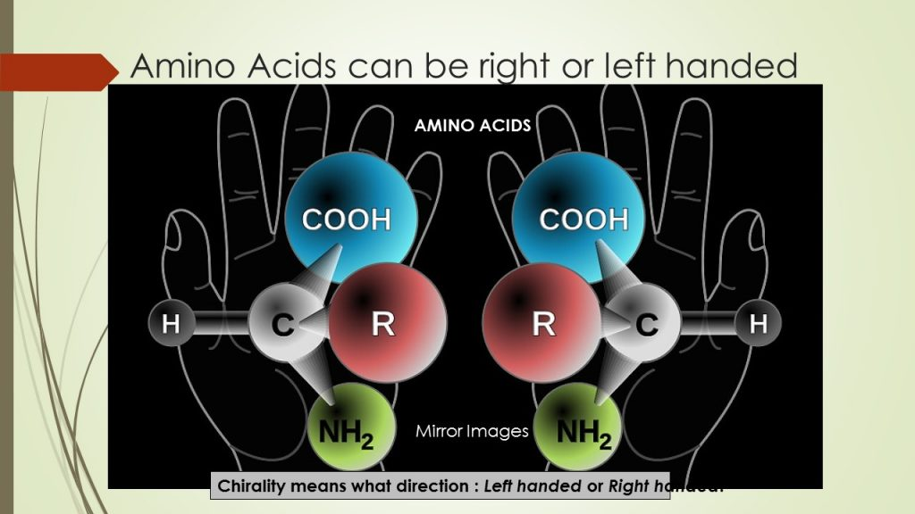

Slide 28
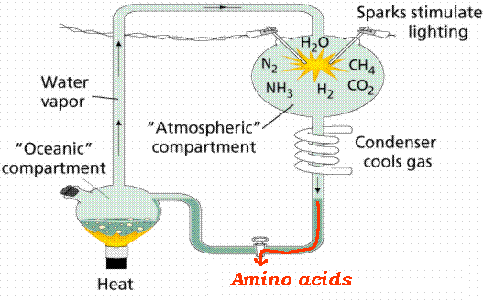
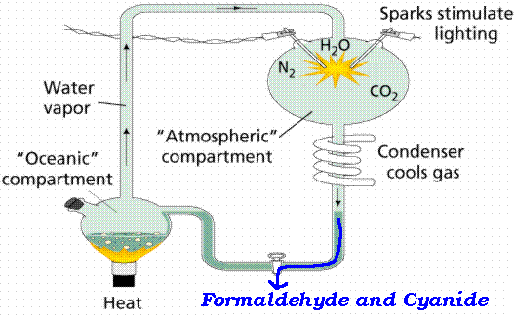
when scientist Change the supposed gazes the result show poising materials like Cyanide and formaldehyde .

Slide 29
Still, Miller's experiment can be shown that the basic building blocks for the large macromolecules can be synthesized in vitro from inorganic compounds.
But No one has yet synthesized a "protocell" using basic components which would have the necessary properties of life so ,We shall never know exactly what happened.

Slide 30
What do scientist say about the origin of life
Evidence suggests that life first evolved around 3.5 billion years ago. (out of the total of 4.6 billion years our Earth has been in existence).
This evidence takes the form of microfossils (fossils too small to be seen without the aid of a microscope) and ancient rock structures in South Africa and Australia called stromatolites.
Stromatolites are produced by microbes (mainly photosynthesizing cyanobacteria) that form thin microbial films which trap mud; over time, layers of these mud/microbe mats can build up into a layered rock structure — the stromatolite.

Slide 31
Stromatolites are still produced by microbes today.
These modern stromatolites are remarkably similar to the ancient stromatolites which provide evidence of some of the earliest life on Earth.
Modern and ancient stromatolites have similar shapes and, when seen in cross section, both show the same fine layering produced by thin bacterial sheets. Microfossils of ancient cyanobacteria can sometimes be identified within these layers.

Slide 32
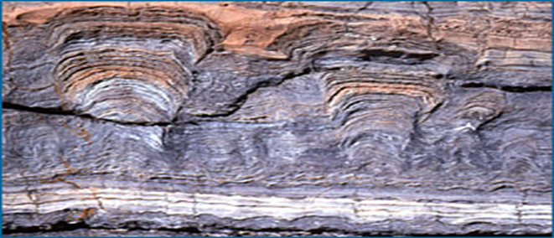
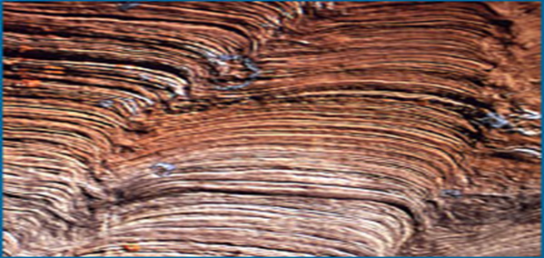
Stromatolites

Slide 33
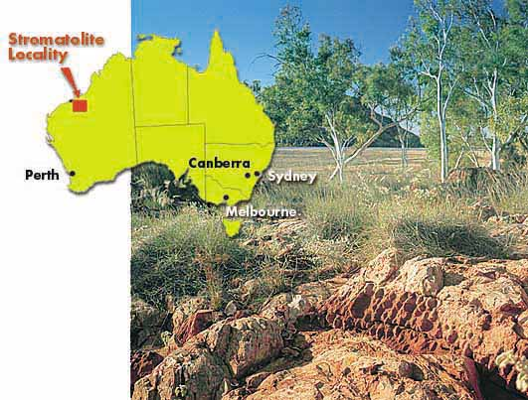
At a site in NW Australia (left), a bed of 3.5 billion year old stromatolite fossils has been discovered

Slide 34
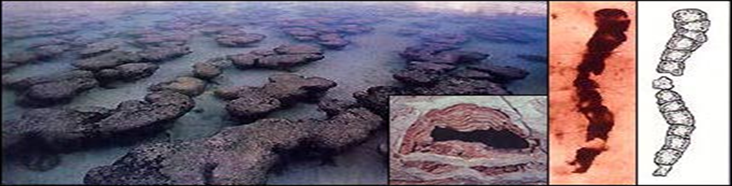
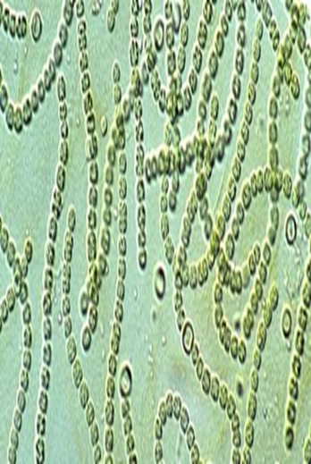
Microfossils of ancient cyanobacteria can sometimes be identified within these layers.

Slide 35
How did life originate?
life almost certainly originated in a
series of small steps in water:
1-Experiments suggest that organic molecules could have been synthesized in the atmosphere of early Earth and rained down into the oceans.

Slide 36
2-Replicating molecules evolved in the form of an RNA self-replicator — an RNA molecule that could copy itself.
Many biologists hypothesize that this step led to an "RNA world" in which RNA did many jobs, storing genetic information, copying itself, and performing basic metabolic functions.

Slide 37
These super-replicators would have become more common — that is, until one of them was accidentally built in a way that allowed it to be a super-super-replicator — and then, that variant would take over.
Through this process of continuous natural selection, small changes in replicating molecules eventually accumulated until a stable, efficient replicating system evolved. are just long chains of simple nucleotides.

Slide 38
3-Replicating molecules became enclosed within a cell membrane.
The evolution of a membrane surrounding the genetic material provided two huge advantages:
the products of the genetic material could be kept close by and the internal environment of this proto-cell could be different than the external environment.
This breakthrough would have given rise to an organism much like a modern bacterium

Slide 39
4-Some cells began to evolve modern metabolic processes and out-competed those with older forms of metabolism.
cells evolved to use different types of molecules for different functions: DNA (which is more stable than RNA) became the genetic material, proteins (which are often more efficient promoters of chemical reactions than RNA) became responsible for basic metabolic reactions in the cell, and RNA was demoted to the role of messenger, carrying information from the DNA to protein-building centers in the cell.
Cells incorporating these innovations would have easily out-competed "old-fashioned" cells with RNA-based metabolisms, hailing the end of the RNA world.

Slide 40
5-Endosymbiosis theory
Endosymbiosis theory , certainly ranks among the most important evolutionary events.
The endosymbiotic theory states that some of the organelles in today's eukaryotic cells were once prokaryotic microbes.
In this theory, the first eukaryotic cell was probably an amoeba-like cell that got nutrients by phagocytosis and contained a nucleus that formed when a piece of the cytoplasmic membrane pinched off around the chromosomes.
Some of these amoeba-like organisms ingested prokaryotic cells that then survived within the organism and developed a symbiotic relationship.
Mitochondria formed when bacteria capable of aerobic respiration were ingested; chloroplasts formed when photosynthetic bacteria were ingested.
They eventually lost their cell wall and much of their DNA because they were not of benefit within the host cell. Mitochondria and chloroplasts cannot grow outside their host cell.

Slide 41
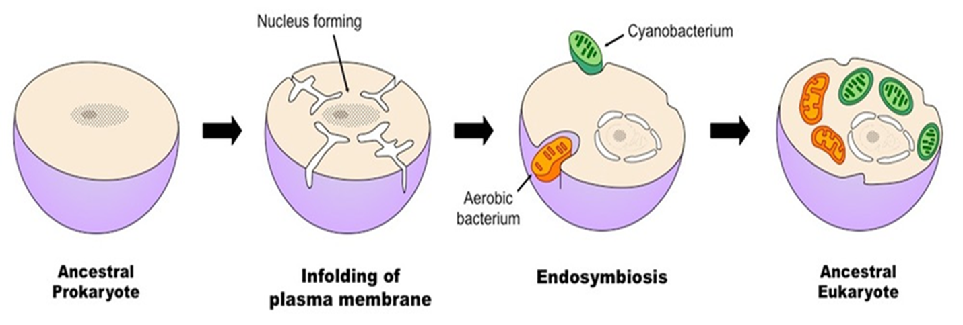
Endosymbiosis theory

Slide 42
6- Multicellularity evolved.
As early as two billion years ago, some cells stopped going their separate ways after replicating and evolved specialized functions. They gave rise to Earth's first lineage of multicellular organisms, such as the 1.2 billion year old fossilized red algae in the photo below.
.

Slide 43



Summary of Evolution of Life
Chemical Evolution
(1 billion years)
Formation
of the
earth’s
early
crust and
atmosphere
Small
organic
molecules
form in
the seas
Large
organic
molecules
(biopolymers)
form in
the seas
First
protocells
form in
the seas
Biological Evolution
(3.7 billion years)
Single-cell
prokaryotes
form in
the seas
Single-cell
eukaryotes
form in
the seas
Variety of
multicellular
organisms
form, first
in the seas
and later
on land

Slide 44
So ,Scientist are still not sure how life originated on Earth.
It could be a heavenly masterpiece, an astronomical anomaly, or a series of mutations and adaptations. There is evidence that favors each theory. Regardless, patterns in similarity appear to link some organisms more closely than others.
But ,It is easy to solve this with a mind behind the universe "super-intelligence or creator is the only good explanation for the origin of life and the complexity of nature."
it seems impossible without one.

Slide 45
Quiz
What gases were believed to be present in the early earth’s atmosphere?
What energy source may have helped create life on earth?
What complex structures did the Miller-Urey apparatus produce?
Has life been recreated in this apparatus?

