Slide 1


Subject : Pedagogical grammar
Instructor : Dr. Saeed
Presenter : Mohammed Raouf
Topic : YES/NO QUESTIONS
Date : 13/12/2020
sunday

Slide 2
OUTLINES
Chapter 11 ( YES\ NO Questions )
> Introduction:
> How to form YES\NO Qestions:
> Invrsions
> With the Be Copula
> With Other Verbs ( Do Verb )
> INTONATION IN YES\NO QUESTIONS
> SHORT ANSWER TO YES\NO QUESTIONS
> The Meaning Of Yes\No Questions
> Negative yes/no questions
> FOCUSED YES/NO QUESTIONS
> STATEMENT-FORM QUESTIONS
> SOME VERSUS ANY
> THE USE OF SHORT ANSWERS
> STATEMENT-FORM YES/NO QUESTIONS
> CONTRACTED VERSUS UNCONTRACTED NEGATIVES IN NEGATIVE QUEST1ONS:
> THE USE OF AREN'T AS A GAP-FILLER
> SOCIAL FUNCTIONS
> IN WRITTEN ACADEMIC TEXTS
> Conclusion
1

Slide 3
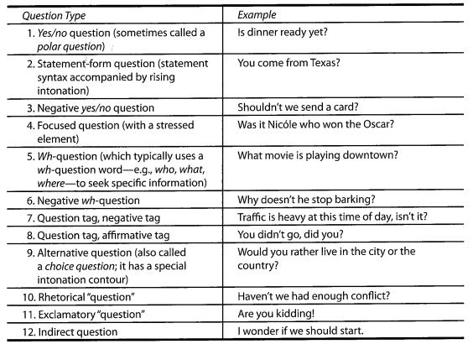
Introduction:
In this chapter, we begin our treatment of questions in English. English speakers have a profusion of questions types available. Here are some of them.
Of course, it is questionable to call all of these questions in the interrogative mood sense of asking someone something. Certainly, there are questions that don’t seek information, and there are statement that do ( de Ruiter, 2012 ).
2

Slide 4

How to form YES\NO Qestions:
Many of the world’s languages form yes\no questions:
Simply by adding rising intonation to declarative statements. English speakers do this too, but the unmarked form of an English yes\no questions requires rising intonation + different word order from a statement, one that inverts the SUBJECT and the OPERATOR ( VERB ).
Only a few other languages beside English use a different word order for yes\no questions such Germany.
In a typological study Ultan ( 1978 ) found that out of 79 various languages families, most languages simply:
Use a distinctive intonation pattern for questions.
Add a special interrogative particle to either the beginning or end of the question. Here is a Chines example from Zhu and Wu ( 2011,p. 634 ):
At an early stage in the history of English, question were made with the use of rising intonation alone. Only much later did inversion come about in question formation. The earliest form of this inversion was with the subject and the main verb. For example:
It took much longer for the rule requiring subject and operator inversion to become standard.
3

Slide 5
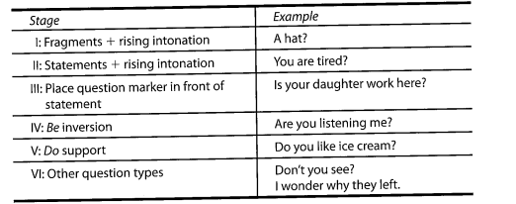
The following is a somewhat modified developmental pattern for untutored learners that we have adopted from Pienemann, Johnston, and Brindley ( 1988 ):
Some of the learners’ challenges with yes\no question:
1. It can generally be said that the inversion is the initial learning challenge.
2. Another challenge observed by Chinese, Zhu and Wu ( 2011 ) is not necessarily the structural differences that cause learners difficulty. But rather the assumption that learners already know how the question function. For instance : a question such as,
Any questions? Can be multifunctional ( Waring, 2012 ).
What is more dubious is the assumption that learner know how to respond to the questions. Replying is not as straightforward as it may seem.
4

Slide 6

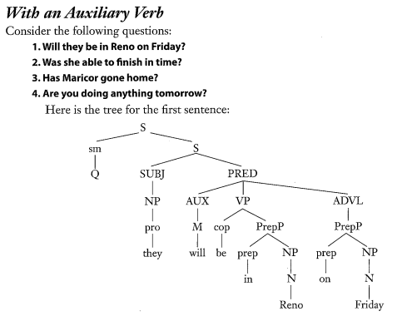
The Form of YES\ NO Questions
Yes\no questions are often defined as questions for which either Yes or No is the expected answer:
Are you going to the party?
Inverting the subject and operator gives rise to the characteristic syntactic form of yes\no questions in English.
SUBJECT-OPERATOR INVERSION
5

Slide 7
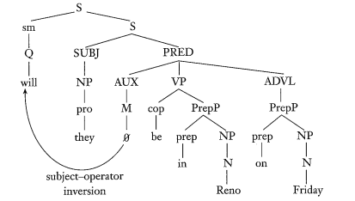
The Q marker is treated as a sentence marker because its scope applies to the whole sentence. Subject-operator inversion inverts the subject with the auxiliary verb will:
6

Slide 8
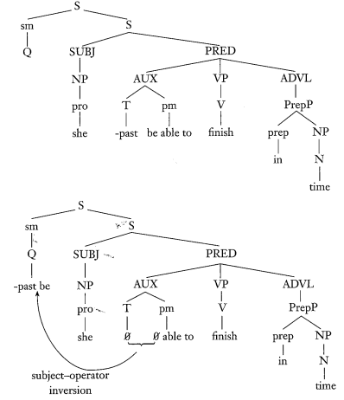
Notice if a sentence had two auxiliary verbs, the operator is only the first auxiliary verb in the auxiliary string that is inverted with the subject. For example:
Will they be gambling in Reno on Friday?
7

Slide 9
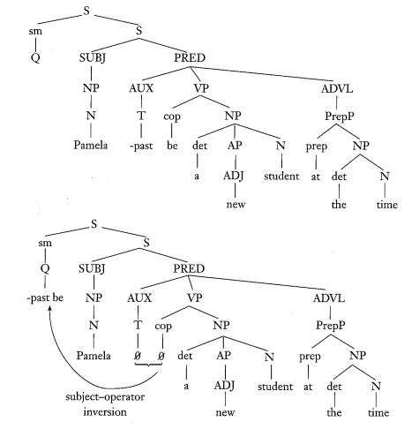
With the Be Copula
As we saw in the previous chapter on negation, the negative particle NOT ( a sentential adverb ) is placed after the first auxiliary verb. In this chapter, we see that it is also the first auxiliary verb that is involved in question formation. Similarly, just as the not follows the be copula verb when no auxiliary verb is present in negative sentences, so does the be copula verb serve as the inverted operator when no auxiliary verb is present in yes\no question formation:
Pamela was a new student at the time.
Was Pamela a new student at the time?
8

Slide 10
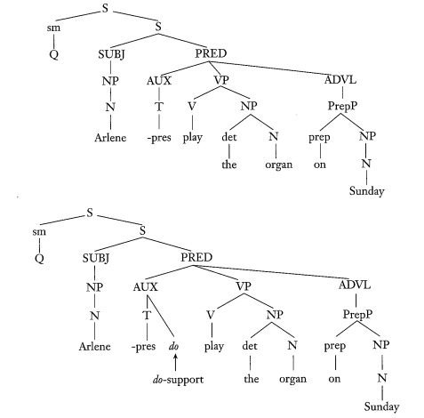
With Other Verbs ( Do Verb )
When a sentence has no auxiliary or be verb, we can’t simply invert the subject and the verb, as we did with the be verb.
Arlene plays the organ on Sunday.
*plays the organ on Sunday?
Such forms were acceptable in historically earlier forms of English. Here we need to insert the Do verb as an operator for the subject.
9

Slide 11
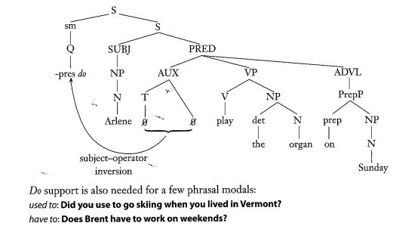
In most cases, however, the first element in phrasal modals is the operator, which inverts with the subject when subject-operator inversion is applied:
10

Slide 12

INTONATION IN YES\NO QUESTIONS
In addition to inverted word order and sometimes the addition of the do operator, English also uses intonation to mark yes\no questions. Intonation in English usually rises on the last stress syllable of the last content word. For example:
Unmarked yes\no question intonation typically rises through the same stressed syllable and then stays high, what is called a “low rise contour” ( Hedberg, Sosa & Gorgulu, to appear ):
While for example, if the questioner expect the answer of the question, the intonation tend to fall.
11

Slide 13

SHORT ANSWER TO YES\NO QUESTIONS
It is unlikely that the response to a yes\no questions will be in the form of a full sentence:
Although these answers are possible, such complete replies may give the listener the impression that the speaker is annoyed by the question.
A more common form of answer, although this too is restricted in its distribution is the short answer:
12

Slide 14

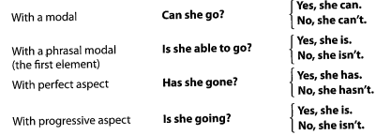
1. If the yes\no question begins with a copula be, as in our example sentence, the short answer is found with the same form of the be verb. ( A ) Note that the be cannot be contracted in an affirmative short answer. ( B ) All affirmative short answers must be followed by at least one other word, or else the full form of the be must be used:
2. When the yes\no question contains an auxiliary verb, the operator is used in short answer:
13

Slide 15


3. If the sentence contains more than one auxiliary verb. Only the first auxiliary verb is taken as the operator:
4. When the do is the operator in the question:
14

Slide 16
The Meaning Of Yes\No Questions
Although not all linguists agree (cf. Bolinger, 1978), most feel that an acceptable paraphrase of ayes/no question might be Is it the case that...? in which the speaker is asking for confirmation or denial of a proposition. Such an analysis implies that yes/no questions are neutral questions-— that is, there is no expectation regarding whether an affirmative or negative reply is likely. Chalker (1984), for example, them "open questions" because the speaker has an opecalls n mind about the answer. However, there are morphosyntactic and/or phonological variations of such open questions, which are influenced by the speaker's expectations. Such is the case with negative yes/no questions.
15

Slide 17
Negative yes/no questions
Negative yes/no questions have a different orientation. In the following contrast,
Is Josh playing soccer this year?
Isn't Josh playing soccer this year?
The first question is neutral with regard to speaker expectations, but the negative question signals that the speaker has reason to believe that something he or she had previously thought was thought might not be so. Because the prior expectation tends to be aligned with the speaker's wishes, Quirk, Greenbaum, Leech, and Svartvik (1985) add that negative questions can express disappointment or annoyance because the speaker's earlier wishes or expectations now seem not to be true any longer:
Aren't we going to the movies? (l thought we had planned to.)
Didn't you say that the test would be next week? (l thought that was what you had announced.)
16

Slide 18


Heritage's (2002) study of news interviews finds that interviewers' negative questions are posed "under the auspices of an ideology of neutrality,"' (p. 143 0), but in reality allow for the interviewer to project an expected answer).Here is an example:
Clinton voices disagreement with Thomas's question, indicating that he interprets it not as a request for information so much as an assertion.
While not all negative questions are posed in an aggressive manner. For example, native speakers of most Asian and West African languages react to a negative yes/no question in a literal manner in their own language—they agree or disagree with its form:
17

Slide 19

Speakers of English, on the other hand, react to negative yes/no questions as if they were affirmative ones; i.e., as if they were disagreeing or agreeing with an implicit assertion
Koshik (2002) showed that teachers' questions do not have to be overtly marked as negative to conference be interpreted with a as student such. For can instance:
Is this the best way to start your paper?
18

Slide 20

FOCUSED YES/NO QUESTIONS
1. Sometimes, however, yes/no questions can be more focused. A proposition may be thought to be true in general, but one of its specific components—subject, verb, object, adverbial—may be still in doubt)The uncertain element is then queried in a focused way. This happens when the speaker has more than one reason of uncertainty to doubt. For example:
19

Slide 21
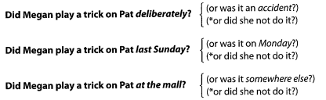
2. When an optional adverbial is present in the question, the adverbial automatically attracts and focuses attention in yes\no questions. For example:
3. Stressing the optional adverbial is natural. While stressing another constituent in the clause is odd. For example
20

Slide 22
STATEMENT-FORM QUESTIONS
Subject-operator inversion does net always take place. In fact, uninverted statement-f0rm questions, marked simply with rising intonation. The speaker who poses the question is anticipating confirmation:
A: I just got back from San Francisco.
B: You had a good time there? ( expecting confirmation)
B's reply with accompanying rising question intonation suggests that B's hunch was that the answer would be "Yes." ad B chosen instead to use the unmarked, neutral' inverted question, we might assume that had no expectation about what A's reply would be:
A: I just got back from San Francisco.
B: Did you have a good time? ( uncertain expectation).
In addition, a negative uninverted question could reflect the fact that new information just been received that runs counter to an earlier expectation:
(Person A returns home early from a shopping trip)
21

Slide 23
Weber (1989) and Williams (1989) both report that uninverted questions are much more common than one might suppose. In her analysis of face-to-face and telephone conversations, Weber found that 41% of the questions were either uninverted, or nonclausal forms, such as the following (Weber, p. 181):
A: I've got so much work that I don't believe it, so I'm just not thinking about that.
B: In school, you mean?
In this nonclausal example, B questions with a prepositional phrase plus the clause tag you mean. Uninverted forms with rising intonation, with and without tags, serve as comprehension checks. addition to comprehension checks, nonclausal questions often function as "next turn repair initiators" (Schegloff, Jefferson, & Sacks, 1977, p. 367). In conversation analysis, repair refers to the efforts of participants to deal with trouble in hearing or understanding:
A: What's the dark green thing?
B: Pardon?
A: What's this?
B: That's Japanese eggplant.
22

Slide 24


One other variation of a statement-form question is an echo question. Which is a type of direct question that repeat part or all of something which someone has just asked. The purpose for using the echo question would simply be to seek confirmation:
If, on the other hand, the pitch of the intonation rises beyond the usual range, then the echo question can express counterexpectation—surprise or disbelief (see VanderBrook & Campbell, 1980):
23

Slide 25

SOME VERSUS ANY
Many ESL/EFL grammar texts say that any is used in questions as well as negatives. Such as:
Do you have any paper I can borrow?
While the weakly stressed some suggests a positive quantity. It is, therefore, used in questions that in some way expect a positive answer, such as with an offer:
(A waiter to a customer in a restaurant)
A: Would you like some dessert? ( to encourage the answer "Yes")
Therefore, we must be cautious about the distribution of some and any, as they can both occur with different question types, depending on the meanings (partly based on Chalker, 1984, p. 15 ):
24

Slide 26
1.THE USE OF SHORT ANSWERS
• One should bear in mind that these form don’t occur frequently as responses to yes\no questions. In Richards (1977), replies to yes\no questions containing auxiliary or verb repetition in written corpus made up less than 20% and less than 10% in spoken English corpus.
• Similarly, in discourse analysis, Winn-Bell Olsen (1980) found that standard short forms were used —.-rather infrequently by English speakers yes/no questions by 8% only in her data (26 out speakers—in of 329 instances).
• Winn-Bell Olsen (1980) discovered that speakers were much more likely to answer questions with a direct "Yes" (or its colloquial variants—e.g., Yup, Yeah, Uh huh) or a direct "No" (or its Variants—e.g., Nah, Nope, Uh uh, Not yet).
• Indirect affirmations, denials, or hedges (e.g., Does it make you uncomfortable to talk about this problem ? I guess maybe it does) accounted for a rather large percentage of the answers.
• Finally, a significant portion of the answers were formulaic sequences of confirmation or denial (e.g., I doubt it). This is most clearly seen in conversations between strangers. Winn Bell Olsen hypothesizes that the more distant the relationship between speakers or the more uncomfortable the situation, the more frequently speakers tend to use standard short-form answers.
25

Slide 27
STATEMENT-FORM YES/NO QUESTIONS
This is related to issues of social familiarity or distance. Using an uninverted question suggests that the person asking the question knows the other person well enough to anticipate the other's answer. Such intimacy often may not exist, and the use of uninverted questions could then appear to be presumptuous:
Worker to supervisor: You're going to the dance?
ESL students have been known to use uninverted questions with their teachers,
You're giving us a quiz on Thursday?
Not realizing that their question can be seen to be presumptuous.
ELLIPTICAL QUESTIONS ( no verb operator )
Informal yes/no questions that occur without an initial operator. They are used with no expectation or no particular expression of emotion:
(Are) You going to the movies?
(Has) She been feeling better?
(Do) You know Fred Callahan?
If YOU is the subject, it can also be deleted in most cases, along with the operator:
(Do you) Wanna study together?
In such questions, the operator and subject are optionally deletable because they are recoverable from Other grammatical and lexical information in the question and from the discourse context.
26

Slide 28
CONTRACTED VERSUS UNCONTRACTED NEGATIVES IN NEGATIVE QUEST1ONS:
English negative yes/no questions, the negative may appear in both Contracted and uncontracted forms. Only the contracted form, however, may appear sentence-initially as part of an operator:
Isn't it appropriate to ask?
Is it not appropriate to ask?
The question with the uncontracted negative after the subject is more formal than its counterpart with a question-initial contracted negative.
In a study, Kontra (1981) has documented the occurrence in contemporary English of uncontracted negative questions such as the following:
27

Slide 29
Is not linguistics a branch of psychology?
Here, the Not appears before the subject in its uncontracted form. While such questions do occasionally occur, we view this type of question as a stylistically formal.
Such a question, Kontra believes, is used when the speaker is inviting the listener to agree with the speaker's assumption.
Another example he cites is the following excerpt from a discussion in the British Parliament (Kontra, 1993, p. 340):
Is not it an outrage that the Minister has not even tried to answer the question? ,
Does not the Minister think that he has a duty to tell people the facts before they vote?
This word order would be unusual in North American English.
28

Slide 30

THE USE OF AREN'T AS A GAP-FILLER
A final note on contracted negative yes/no questions concerns the lexical gap that occurs in the first person singular ( I ). All of the following are acceptable contracted negative questions and short answers:
Isn't he/she/it? He/she/it isn't.
Aren't we/you/they? We/you/they aren't.
However, we cannot contract the verb be and the not in I am not unless we use the nonstandard I ain 't. What speakers of English do in negative yes/no questions (but not in short answers) is to substitute are for am and contract. Thus:
29

Slide 31
SOCIAL FUNCTIONS
Up to now, we have been dealing with questions whose function is primarily to seek new information or to clarify or confirm given or shared information. Yes/no questions can perform a number of other functions of course. Modal forms can be used:
1. In requests for assistance:
Can I get a ride home with you? ( direct request ).
The past-tense form of can softens this a bit:
Could I get a ride home with you? ( less direct).
An even more polite form of request uses an embedded question:
I Wonder if I could get a ride home with you. ( least direct, therefore most polite)
30

Slide 32
2. In making offers or Invitations:
Would you like to sit for a while?
3. They can also be used as directives:
Would you please stand up straight?
4. In making reprimands :
Aren't you a tittle old to be doing that?
5. In making complaints :
Have you ever stayed home all day with a two-year-old?
Clearly, the function of a yes/no question is going to depend on the context and the speaker's intention, That is why Heritage (2002) (see also Raymond, 2003) called questions "a form of social actions”.
31

Slide 33
IN WRITTEN ACADEMIC TEXTS
Of course, it is not just in oral discourse that students will encounter questions. According to Thompson (2001), questions in academic texts assign readers and writers roles.
Hyland (2002) ascribes three functions to questions in textbooks
1. To frame the discourse ( signaIing the issues to be dealt with).
2. To organize the text (explicitly introducing new topics and often using metalanguage such as question or topic).
3. Finally” to set up claims” (stimulating thought and anticipating an affirmation)" (Crawford, 2008, p. 1218).
32

Slide 34
Conclusion
As we have indicated, a challenge for beginning ESL/EFL students is:
1. To learn about inversion in yes/no question.
2. When to use the Do operator.
3. How to respond to some to special yes/no questions.
4. Finally, we should remember that not all yes/no questions are inverted.
33

Slide 35
THANK YOU
( ANY QUESTIONS )

