Slide 1
Pedagogical Grammar
Chapter 10
Negation

Slide 2
Presentation Outline
Introduction
The negation system: Its forms
The word level
The phrase level
The sentence level
A syntactic analysis of sentence-level negation:
With Auxiliary verbs
Not contraction
With the Be Copula
With other main verbs
With Have

Slide 3
The meaning of negation
The scope of negation
A shift in meaning
Some vs Any
Use of the negative system
Social function
No As a Discourse Marker
No versus No
Affixal vs Nonaffixal negation
Contracted vs uncontracted negatives
Negative Equatives
Usage- based negation
Functional negatives
Conclusion

Slide 4
Introduction
Learners first use no, sometimes preceding an entire sentence
Later, they add not to their collections
Following these, they begin to use don’t accurately (as opposed to only correctly in the formula ( I don’t know)
Finally they use other forms of do (i.e., doesn’t and didn’t and other auxiliary verbs and negative adverbs
The first stage of English negation acknowledged by most researchers has been referred to as the No + V or external no stage, where English learners produce utterances such as:
No it go.

Slide 5
Where have utterances such as “no it go” came from ?
English does have a negative particle no, but it is not used in such a way.
Researchers observed that no was the child’s mother’s most frequent negator.
She did not used it in the same way as the child, instead using it to negate nouns (e.g., no books), and gerunds (e.g., no shouting)
After the child heard many of such phrases, the child started creating novel constructions.
This explanation works well for older learners of English as a second language, too, who use the no- structure, e.g., “I no remember”.

Slide 6
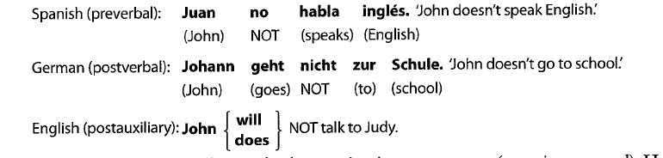
Challenges that EFL/ESL students phased in placing Negative particle
Different languages tend to place their negative particle in different positions in the sentence:

Slide 7
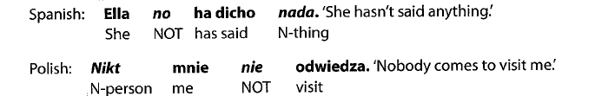
Another challenge was that many languages allow multiple negation in one sentence (Negative concord)
Some languages do not have distinct forms for expressing their equivalents of the English words not and no.
Some have more than two negative particles.
Finally, English usually contracts not in speech and in informal writing , which few other languages do with their negative particle.

Slide 8

The Negation System: Its Forms
The Word Level
At the word level, one can simply use a negative affix in English to convey negativity. The way to make many adjectives and adverbs negative is to add a negative derivational prefix to a word:

Slide 9

The prefixes of negating words such as adjectives and adverbs have come from different languages such as:
Un- is a native English prefix (and the most productive one in English today); in- and it’s allomorphs (different forms of the same morpheme) im-/il-/ir-, come from Latin; dis- comes from Greek; a- from Greek through Latin; and mis- from earlier forms of English and French.
Verbs and other parts of Speech take these prefixes too.
For example, with verbs, dis- combines to make dislike.

Slide 10
Some of the prefixes can have more than one meaning.
Un-, for instance, doesn’t always mean negativity.
For example, in the word unfasten, un- means a reversal of the process denoted by the stem.
We don’t apply the un- prefix to all adjectives.
There are restricted adjectives such as good that turns to bad not *ungood.
And there are other words which we use the more productive prefix with for negation.
For example, disloyal is more common than *unloyal.

Slide 11
When there is more than one prefix possible, to determine which prefix to use with which stem is not always predictable.
When you negating to tend to evaluate pejoratively. We use in-(and its allomorphs), dis-, and (less so) un-.
On the other hand, we use non- and a- prefixes when it’s more objective/descriptive. We can also say that the situation is the way it’s described in its nature, not with your personal evaluation.
For example:
Pejoratively evaluative Descriptive/ Objective
Unprofessional Nonprofessional
Irrational Nonrational

Slide 12
We use prefixes in-, im-, il-, or ir- depending on the phonological consonant if it’s a bilabial (/b/, /p/, /m/).
Example: Possible -> impossible
There is a negative suffix, -less, which can be used to negate nouns by expressing their absence or nonexistence, thus forming adjectives such as hopeless, lifeless and shameless.
Howell (personal communication) has pointed out that there is another suffix, –free, that is used with a more positive connotation (cf. careless versus carefree).

Slide 13
Other formally negative items are:
The negative coordinating conjunction nor- (and + not) and the negative correlative conjunction neither….nor-(not + either).
There are words which have a positive form but a connote negativity such as:
Quantifiers: Little and few
The negative adverb subordinator of conditionals: unless
The negative adverb of time: yet
Intensifiers: too (e.g., too late)
Adverbs of frequency: seldom, rarely, hardly
Also, there are content words that have a negative meaning but that appear positive in form (e.g., fail, forget, lack, and absent).

Slide 14
The Phrase Level
At the phrase Level, no can function as a negative determiner in an NP:
I am surprised that no alternative was proposed.
No plans have been made.
We use no in many idioms.
For example: no way, no problem…
Another common idiomatic pattern that we saw being used by the mother of LI English learner is no+ gerund, which may be used to indicate that something is prohibited – no shouting, no hitting; also common for prohibition are no smoking, no parking- or unexpected, such as no kidding.
Before infinitives (i.e., a sequence of to + verb that follows an inflected verb) not is used to make the phrase negative;
Marge has decided not to pay her income tax this year.
Native Speakers of English split the infinitive with the negative particle, to emphasize the negative action in the phrase.
Marge has decided to not pay her income tax this year.

Slide 15
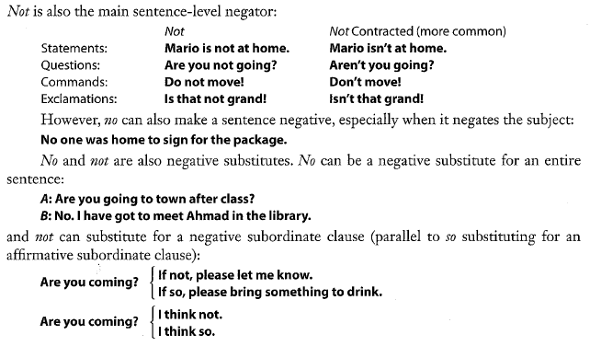
The Sentence Level

Slide 16
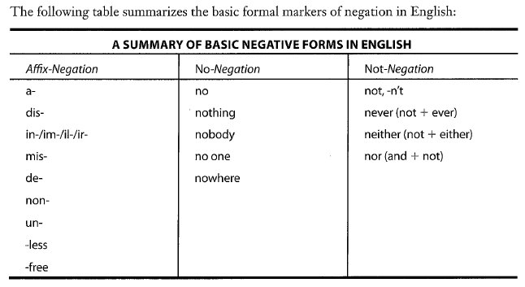
Summary

Slide 17
A Syntactic Analysis of Sentence-Level Negation
In this part, we will only deal with statements.
with auxiliary verbs:
In sentences with auxiliary verbs such as (modals, phrasal modifiers, the perfect have, and the progressive be), we add the particle not after the auxiliary.
For example:
I can swim
I cannot swim
If more than one auxiliary verb is present, the first auxiliary verb is followed by the negative particle.
For example:
Pam has been working hard
Pam has not been working hard

Slide 18
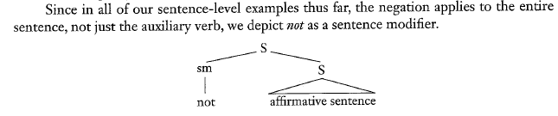
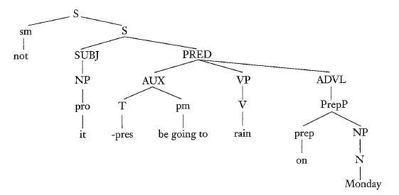
It is not going to rain on Monday.

Slide 19
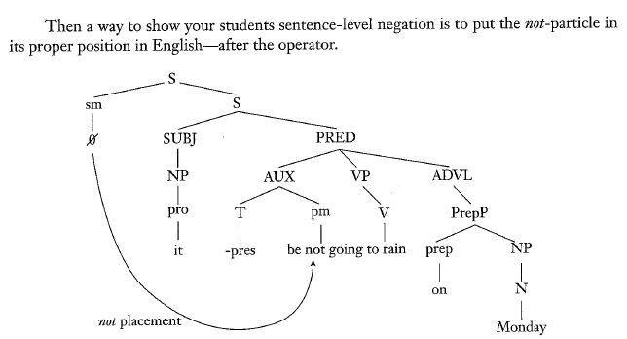

Slide 20
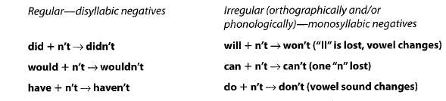
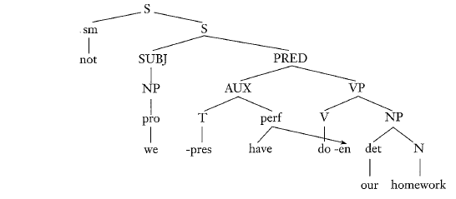
Not Contraction
In many English sentences, the not reduces to –n’t and attaches to the appropriate verb. Many combinations of –n’t with an auxiliary verb are regular, but some are irregular :

Slide 21
With the Be Copula
To make a sentence with the be copula negative, we place the not after the be just as we did with the first or only auxiliary verb.
(a) Brad is a teacher.
(b) Brad is not a teacher.
(c) Brad isn’t a teacher.
There is an exception of the first person singular form of the be verb, am. When we contract am and not, we contract the subject and am instead of am and not.
For example:
I am tired
I am not tired
Contraction:
*I amn’t tired (wrong)
I ain’t tired (non standard)
I’m not tired

Slide 22
With Other Main Verbs
In Elizabethan period, they used to add not particle after the main verb. Such as:
*I go not
In Modern English, when there is no other operator in a negative sentence, we have to add the auxiliary verb do to perform the function of operator. This is called do-support. Such as:
Lana plays the piano
Lana does not play the piano (does with the subject she)
And for contraction, we use the same rule as auxiliary verb contraction. Auxiliary + not
Lana doesn’t play the piano (contraction)

Slide 23
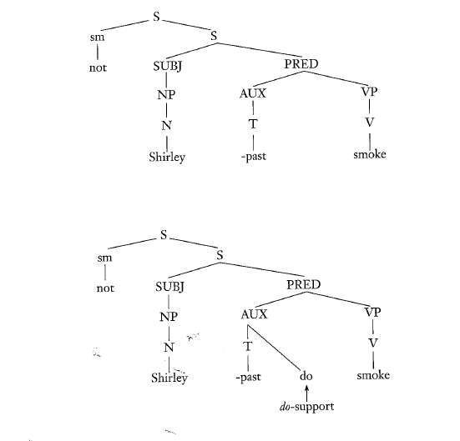
Shirley smoked
Shirley didn’t smoke

Slide 24
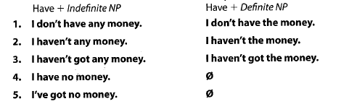
With have
We have five possible negative forms of have/have got followed by an indefinite noun phrase, and three forms followed by a definite noun phrase.

Slide 25
The Meaning of Negation
There is a duality:
First kind, descriptive negation, is used to say how things are not in the world.
Second kind is more discourse oriented.
As for descriptive meaning, logicians would say that there is a symmetry between affirmative and negative propositions:
Affirmative Statement: It is the case that…
Negative Statement: It is not the case that…
The analysis is not as simple as the examples given above, that is because the negative particle can have more than one meaning.
“No pocket.” [there are no pockets] (nonexistence)
“No dirty soap.” [I don’t want…] (rejection)
“No truck.” [This isn’t a truck] (denial)

Slide 26
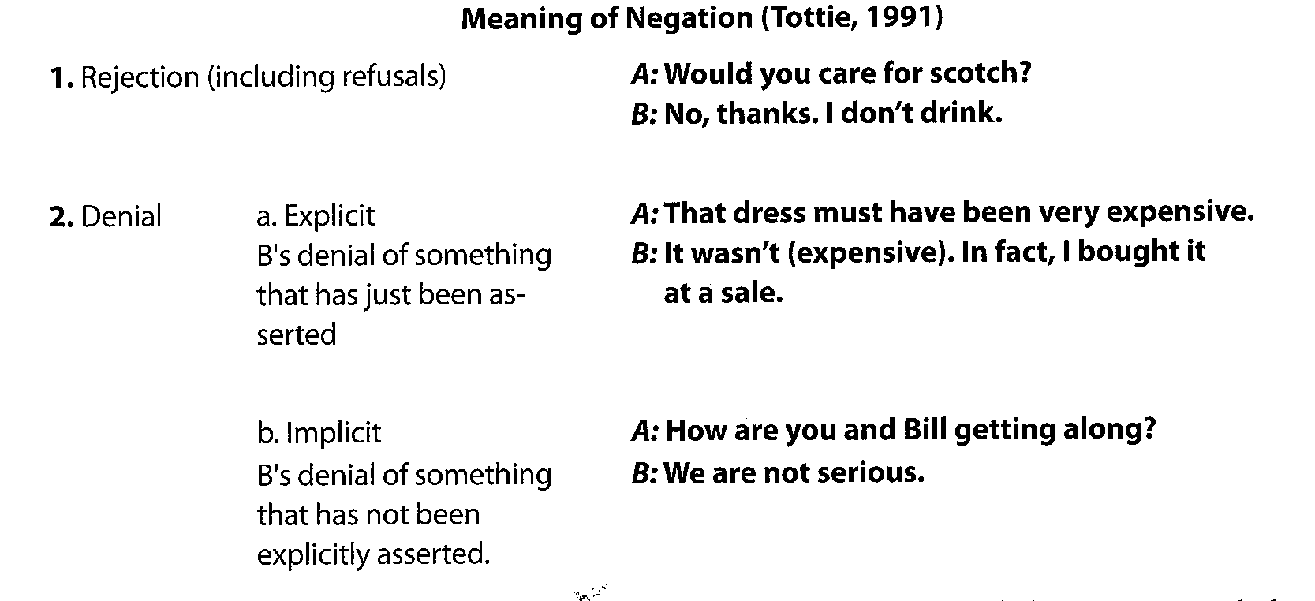
There are two main meanings of negating in English according to the linguist Tottie (1991); rejection and denial, with denial being either explicit or implicit.

Slide 27
Another category is mentioned by Tottie and she calls it “support” , in which listeners signals that the information that the speakers are giving them is received.
Example:
A: My job isn’t easy.
B: No.

Slide 28
The Scope of Negation
What is negated in a sentence is everything that comes after the negative particle until the end of the clause.
Consider the following sentences:
Note: the subject of English sentence is outside the scope of sentential negation, but it can be negated by the determiner no.
*Not anyone was planning to come.
No one was planning to come.

Slide 29
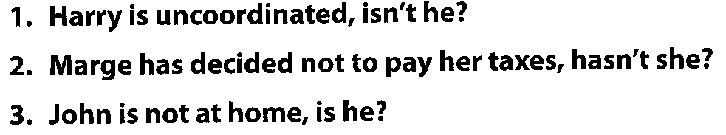
As we have mentioned previously that negation can occur in three levels; word level, phrase level and sentence level.
Harry is uncoordinated. (word negation)
Marge has decided not to pay her taxes. (phrase negation)
John is not at home. (sentence negation)
Here, we can demonstrate that only the third sentence has negation that is sentential in scope by adding a tag question to each.

Slide 30
Note:
While no is only a determiner, its negation is sentential.
No one came to fix the plumbing problem, did they?
The same is applied to not
They never answered, did they?
--------
The Standard English doesn’t permit double negation.
I didn’t buy no books. (nonstandard)
It isn’t possible to have two negatives that are sentential in scope, but it is possible to have a word with a phrasal negative or a phrasal or word negative with a sentential negative.
I have friends who decided not to have TV in the house, or who restrict it very strictly. But I do this for a living! I’m not going to not have a TV, and besides, I like TV!

Slide 31
A Shift in Meaning
Must and Have to meaning
In affirmative, must and have to convey obligation:
We must be on time.
We have to be on time.
In the negative, the meaning of must shifts:
We mustn’t be at school on time. (it’s prohibited that we arrive before 9:00)
We don’t have to be at school on time. (no obligation)
When we have affixal and nonaffixal negation:
I dislike lima beans. = I don’t like lima beans.
However, semantic nonequivalence occurs when there is an adverbial intensifier:
This is totally untrue. ≠ This is not totally true.

Slide 32
Semantic nonequivalence also occurs between sentential negation and negation in prepositional phrase:
My aerobics class isn’t continuing for any clear reason.≠ My aerobics class is continuing for no clear reason.
Another semantic nonequivalence is before “non-pejorative” nouns:
He’s not a doctor ≠ He’s no doctor.
Ambiguity arises with the interaction of not- with quantifiers, especially all:
All the guests didn’t drink wine.

Slide 33
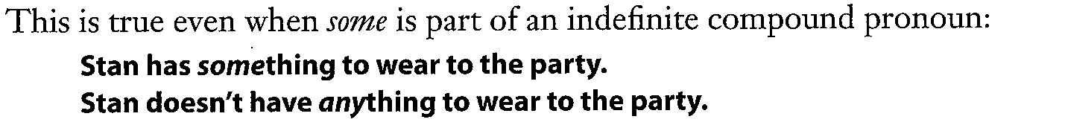
Finally, there is semantic nonequivalence between positive comparatives and negative equatives with negative polarity adjectives:
Samantha is older than Emily. (positive comparative)
Samantha is not as young as Emily. (negative equatives)
----------------------------------------------
Some Versus Any
Negative particle, some in an affirmative sentence changes to any in a negative one:
Laura bought some cheese.
Laura didn’t buy any cheese.

Slide 34
Advanced-level students should know that some and any have two main meanings; one of them is suitable for negation, and the other occurs in a negative sentence when a meaning of identity is mentioned:
I don’t eat some foods – lima beans, for example.
In a negative sentence, some is stressed. While in an positive sentence, any is stressed.
I don’t eat some foods.
Anyone can do that.

Slide 35
Use of the Negative System
Social Functions:
Negatives are used more to respond than to initiate.
In social interaction, negative can be a contrary , denying speech act.
Although some people might expect that the negative, being the new information, would receive prominent stress and pitch. In fact, the stress is reduced.
It has been mentioned that one of the meanings of negation is refusal. Although, it does not follow that all refusals have to be in negative forms.
Example:
Don’t make me mad; keep your money with you. (refusing someone’s offer to pay for you)

Slide 36
Negatives can be used to soften other speech acts in the presence of a perceived social status gap:
Won’t you come in? (come in)
I don’t suppose you’ve had the chance yet. (have you had the chance yet?)
No As a Discourse Marker
discourse markers connect pieces of text at the discourse level as well as connecting discourse to the extra linguistic context.
No has several functions as a discourse marker:
Topic-shift: “I blame her but no um so that’s how I kind of got involved.”
Misunderstanding-management: “No, this is useful, you know, don’t worry.”
Turn-negotiation: “No, go ahead.”

Slide 37
Not versus NO
I don’t have any time to help this weekend.
I have no time to help this weekend.
What is the difference between them in the sentences above?
The main difference is found in spoken and written samples.
The proportions of not-negation and no-negation were almost exactly reversed in speech and writing
The results of the examination of the conversations in the London-Lund Corpus and of written prose in the Lancaster-Oslo/Bergen Corpus were:
The proportion of not-negation in speech was 66% and no-negation was 34%.
In writing, the proportion of not-negation was 37% and no negation was 63%.

Slide 38
The reason to this is the fact that no-negation precedes not-negation. This is due to the fact that written language was found before spoken language. No-negation is more conservative and formal.
Affixal Versus Nonaffixal Negation:
Affixal negation was far more common in writing than in speech.
The reason is that in writing writers have more time to combine and superimpose ideas and can mold their thoughts into a more integrated discourse.
On the other hand, in speech, there is a greater pressure imposed on speakers. They tend to produce utterances where one idea follows another in a fragmented discourse.
The situation is impossible.
The situation is not possible.
It’s not easy to handle this.
This is unbearable.

Slide 39
Contracted Versus Uncontracted Negatives:
Not is uncontracted when is semantically focused. Such as when there is a disagreement in a debate.
However, with a disagreement in a normal social interaction, the not is contracted because to do otherwise is “face-threatening” and dispreferred.
In later research, it was known that the auxiliary contraction occurs in informal situations. The research also showed other differences such as; regional and dialect differences.
Also not contraction occurs readily in interrogatives and imperatives.

Slide 40
Negative Equatives:
It is considered that we use negative equatives more than comparatives when the adjective has negative polarity.
For example the adjective “dumb”
The adjective “dumb” is very rude in the comparative, whereas its positive polarity counterpart in a negative equative is considered more indirect and less rude:
Moe is dumber than Curly.
Moe is not as intelligent as Curly.

Slide 41
Usage-Based Negation:
Not that has a denying function; i.e., it “instructs the addressees to reject a possible inference of what we said before…”
The usage-based view is that speakers encounter and learn frequently occurring patterns, which they subsequently draw on to make meaning appropriate to context of use, and that these patterns constitute their grammar.
The pedagogical point of this discussion is that there are lexicogrammatical patterns that students will encounter, and some students will want or need to learn to use them.

Slide 42
Functional Negatives:
We conclude that by pointing out that just as words need not be marked affixally in order to convey negativity, so, too, can positive statements and questions have negative meaning, depending on the discourse context:
Joe: Did you ace the final, Ray?
Ray: Are you kidding? I’m lucky I passed!
Although that the question and statement in Ray’s response are formally positive, they function as negative.

Slide 43
Conclusion
In this chapter, we have been introduced to the negation system in English.
Beginning-level students will need to practice the forms of negation – both the syntax and the patterns in a meaningful way.
Issues concerning the use of negation will arise for intermediate and advanced-level English students.

Slide 44
Thank you for listening ☺
Presented by: Hateen F. Ramadhan

